Slide 1

Welcome

Slide 2

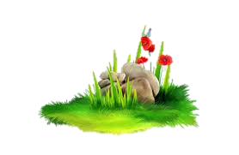
Nahidal Arjin
Class:Five
Subject:English
Unit:19
Title: It was a Great day
Lesson:Last……..tents.
Lesson: 21
Time:45 minutes
Date:25/10/2021
Assistant Teacher
Boddipur Govt. Primary School
Satkhira Sadar, Satkhira

Slide 3
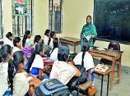
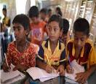

Good morning, students.
Good morning, Teacher.
How are you students?
Fine, thank you teacher.

Slide 4
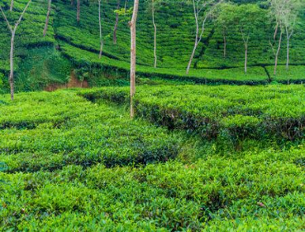
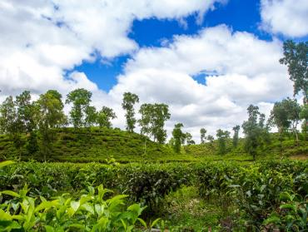
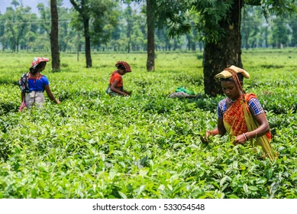
Look at the picture and say about it.
Srimangal with an area of 450 km can be called the tea capital of Bangladesh. The spectacular beauty of some of the tea gardens here continues to attract tourists. The miles and miles of tea gardens here look like a green carpet on a hillside. The best quality tea in the country is produced here.
Have you ever been to a tea garden?
How was your experience?
yes

Slide 5

Lesson Declaration
It was a great day !

Slide 6

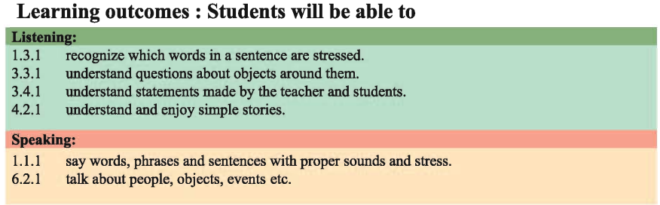

Learning Outcomes

Slide 7

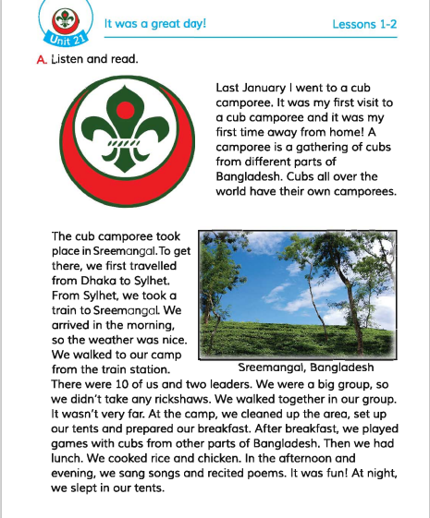
Open page at 82

Slide 8
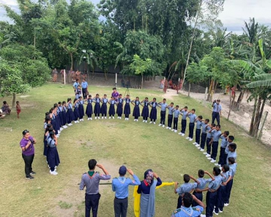
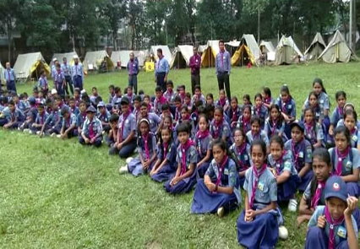
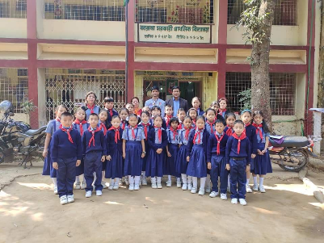
Look at the picture and say about it.
What is cub scouts?
The cub scouts, is a voluntary non-political educational movement for young people.

Slide 9

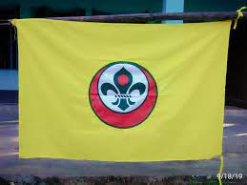
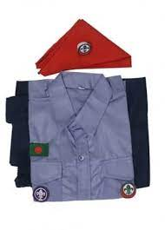
Look at the picture and say about it.
What is it?
Logo of Scouts
Flag of Scouts
Dress of Scouts

Slide 10
Let’s watch a video
Click the video below:
What do you see in the video?

Slide 11
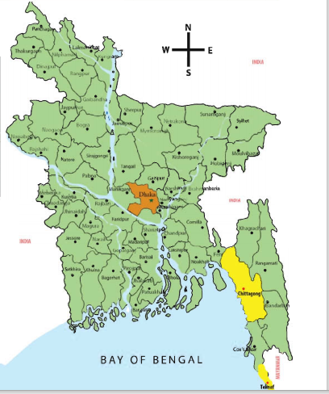
Look at the pisture
Map of Bangladesh
What is it?
Dhaka
Sylhet
Sreemangal
We first travelled from Dhaka to Sylhet. From Sylhet, we went to Sreemangal by train.

Slide 12
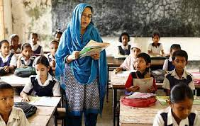
Teacher’s reading

Slide 13

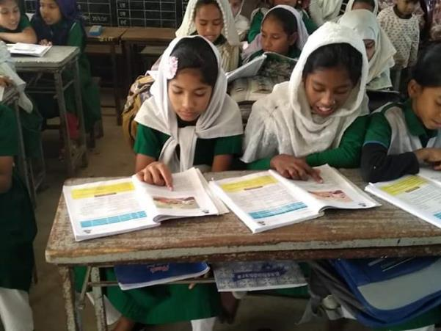
Silent reading

Slide 14
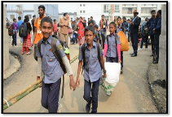
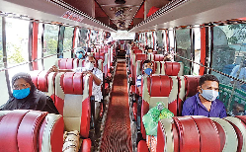
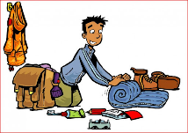
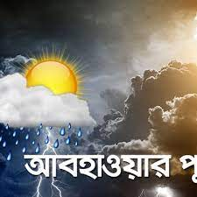
NEW WORD
a camporee is a gathering of cubs
Camporee
Travel
Visit
Prepare
Ready
Climate
Weather

Slide 15
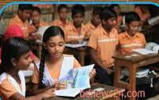
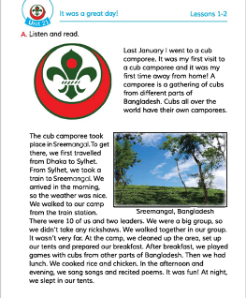
Pair Work
Read the Text
Open your book page at 82

Slide 16


Individual work
Fill in the blank with correct word
Sylhet
camporee
nice
1. I went to a cub ………….
We first trevelled Dhaka to………..
The weather was …………… .

Slide 17

Group Work
Match the answer
Write only the right answer.
1.When did the speaker go to a cub camporee?
✓
(a) Last may
(b) Last march
(c) Last december
(d) Last january
2. When did they reach?
✓
(a) In the evening
(c) At noon
(b) In the morning
(d) At night
3. What did they do at first ?
✓
(a) Walking
(b) Cooking
(c) Firing
(d) Cleaning
4.The team was
✓
(a) 10 members
(b) 9 members
(c) 8 members
(d) 11 members

Slide 18

Evaluation
Answer the following question.
1.What is a cub camporee?
2.Where did the camporee take place?
3.How did they go to Sreemongle from Sylhet?

Slide 19


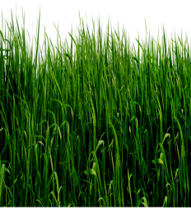
Home Work
Write a short composition on “Visit to the memorable place” in at least five sentences.

Slide 20
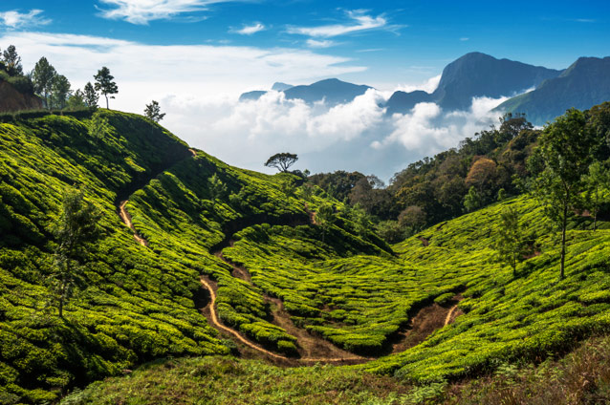
Thank you to all

