Slide 1
Welcome To My English Class

Slide 2
TEACHER INTRODUCING
Montosh Bhoumik
Assistant Teacher
Uttar Baranti Govt Primary School
Moulvibazar Sadar.

Slide 3
LESSON INTRODUCING
Class:Four.
Subject:English For Today
Time:40 Minite
Unit-29, Lesson:4-6

Slide 4
Learning Outcomes
Students will be able to
Listening:
3.4.1-understand statements made by the teacher and students.
Speaking:
1.1.1-say words, phrases and sentences with proper sounds, stress and intonation.
Reading:
1.4.1-reads words, phrases and sentences in the text.

Slide 5
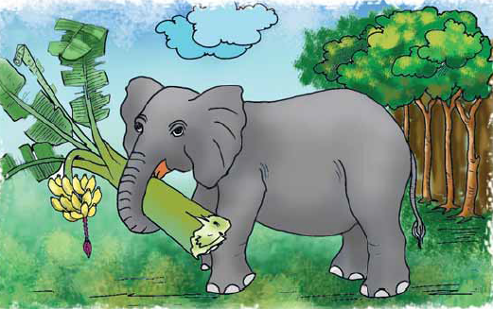
Look at the picture
This is elephant.
What about the picture?

Slide 6
TITLE DECLARATION
Animals. (A. Read)

Slide 7
Presentation

Slide 8
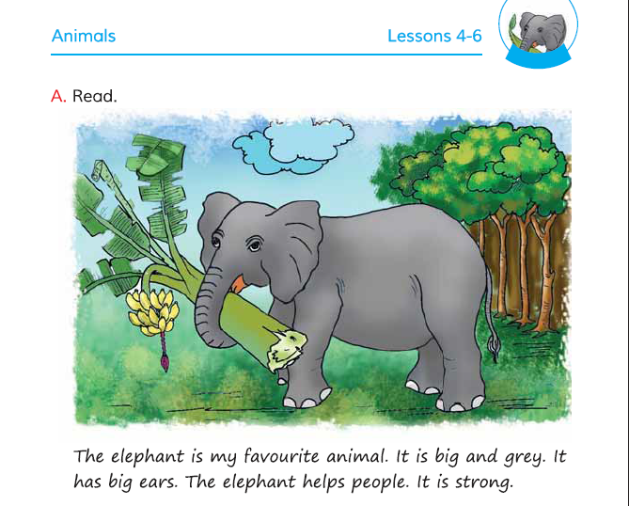
Open your English book at page 59

Slide 9
Teacher’s loud reading and discuss the lesson

Slide 10
The elephant is my favourite animals.

Slide 11
It is big and grey.

Slide 12
It has big ears.

Slide 13
The elephant helps people.

Slide 14
It is strong.

Slide 15
Word Meaning
Favourite
প্রিয়
Strong
শক্তিশালী
Grey
ধূসর

Slide 16
CHAIND DRELL
1
2
3
4
5
Student-1: Read the passage of 1st line.
Student-2: Read the passage of 2nd line.
Student-3: Read the passage of 3rd line. And so on.
And the teacher monitor the whole class.

Slide 17
Group
GROUP WORK
Read the passage in Group.

Slide 18
PAIR WORK
Read the passage in pair.

Slide 19
Task
Write five sentence about your favourite animal.

Slide 20
Thank you

Slide 21
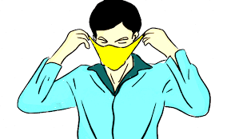
Take care and be safe.
Use mask regularly.

