Slide 1
Welcome

Slide 2
Let's listen to a song….

Slide 3
INTRODUCTION
Mohammad Ruhul Amin Shapan
Assistant Teacher
Ghagotia Govt. Primary School
Tahirpur, Sunamganj.

Slide 4
INTRODUCTION of LESSON
Class :One
Subject :English
Unit :09, Numbers
Lesson :1-3
Date :
Part of Lesson:
C, Count, trace and write.

Slide 5
Learning outcomes:
By the end of the lesson students will be able to……
Reading:
2.1.1- Recognize and read cardinal numbers up to 10.
Writing:
2.1.1- Write cardinal numbers up to 10 in figures.

Slide 6
Write 1, 2, 3, and 4 with your hands in the air
1
2
3
4

Slide 7
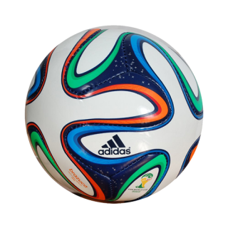
How many balls are there?
1

Slide 8
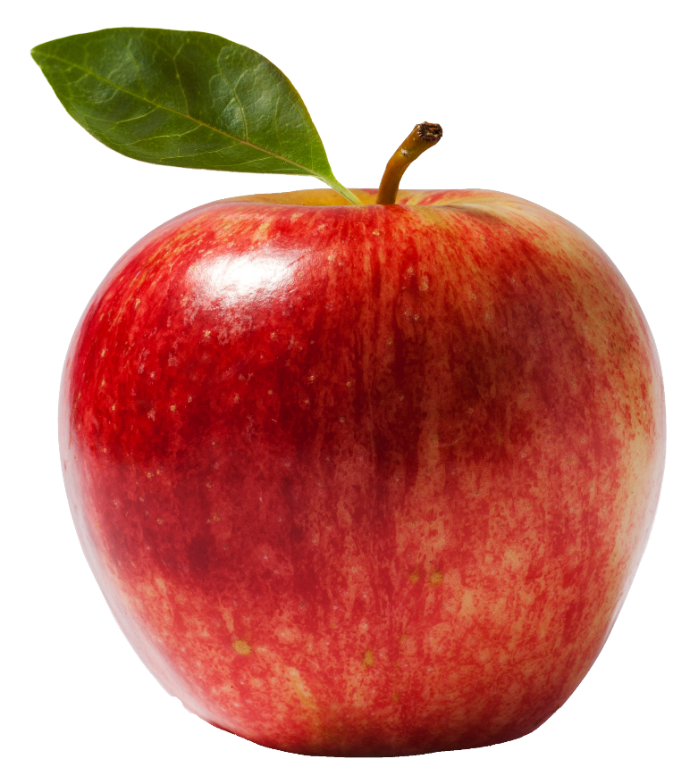
How many apples are there?
2

Slide 9
3
How many caps are there?

Slide 10
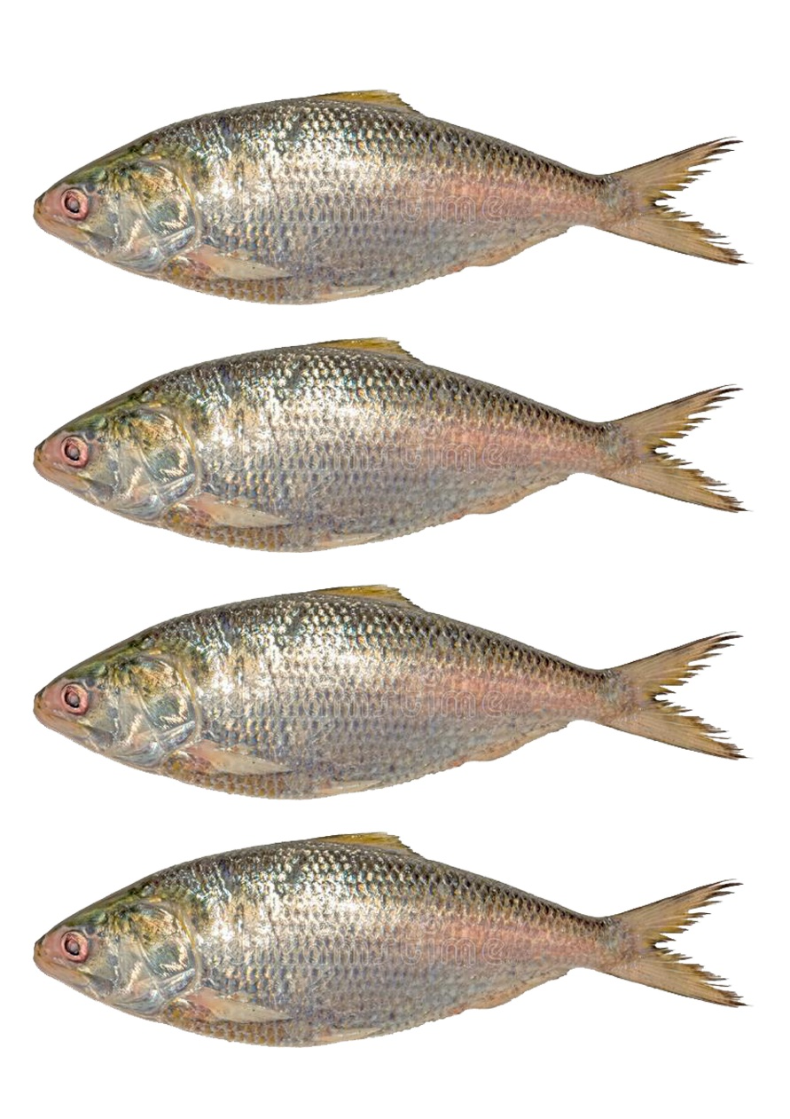
How many fishes are there?
4

Slide 11
Open your book at page 18

Slide 12
4
What is this
How many caps are there?

Slide 13
What is this
3
How many balls are there?

Slide 14
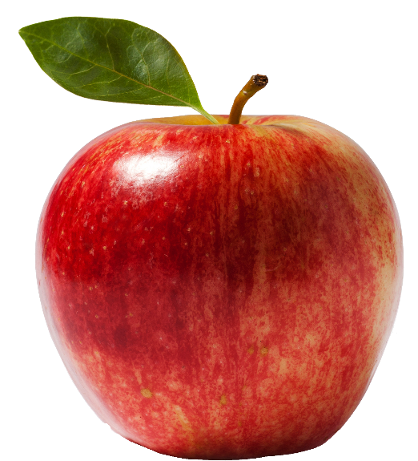
4
What is this
How many apples are there?

Slide 15
1
What is this
How many dogs are there?

Slide 16
2
What is this
How many cats are there?

Slide 17
4
What is this
How many eggs are there?

Slide 18
Write 1, 2, 3, and 4 on your notebook
1
2
3
4

Slide 19
Group work
Match correctly
1
4
3
2

Slide 20
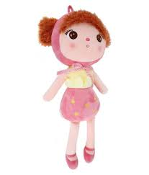
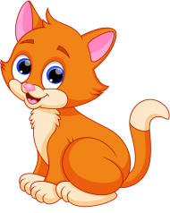
Evaluation
Count and write the numbers
4
2
1
3

Slide 21
Thank You

