Slide 1
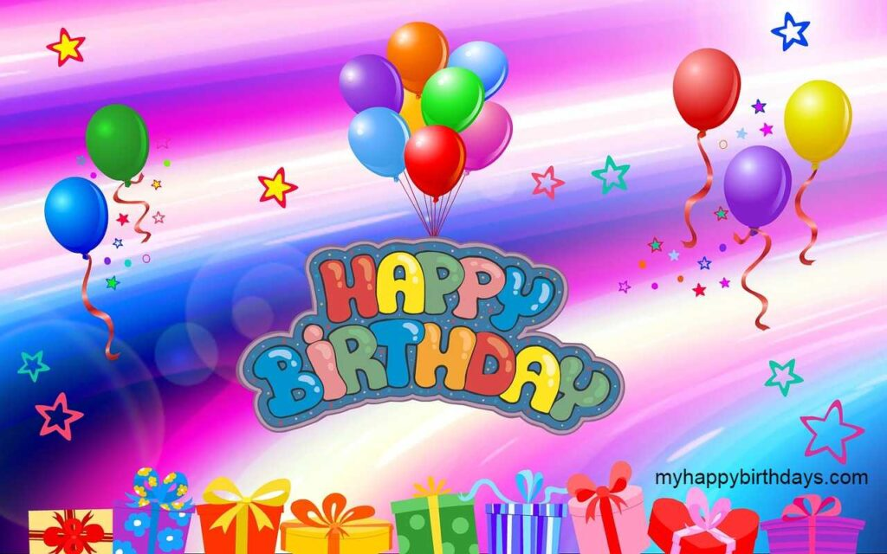
WELCOME
To
Our Multimedia Class
‡nv‡mb
ICT4E †Rjv A¨v¤^v‡mWi

Slide 2
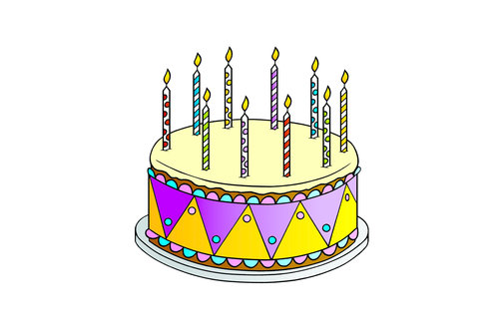

Slide 3
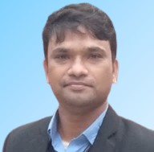
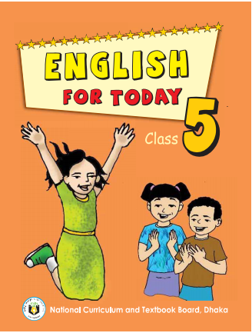
Md. Hossain Ali
Assistant Teacher
Purbo Payradanga GPS
Nageswari, Kurigram.
Email-nkbhossain@gmail.com
Class : Five
Sub : English For Today
Unit : 15
Time : 40 Minutes

Slide 4
Let’s watch the video and think what our lesson might be today?
Notes:
এছাড়া পাঠসংশ্লিষ্ট ভিডিও প্রদর্শন করে শিক্ষার্থীদের কাছ থেকে আজকের পাঠ শিরোনাম বের করতে পারি।

Slide 5
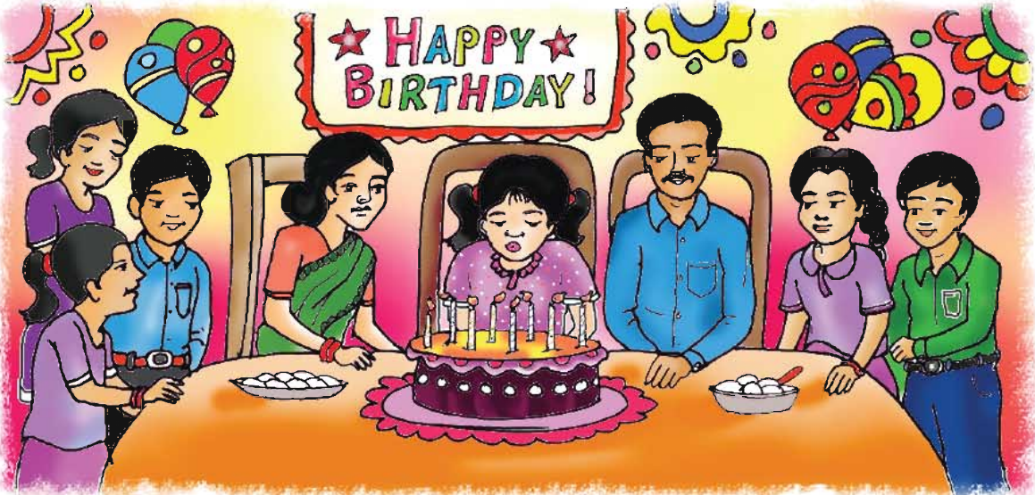
Today we will read
Happy Birthday!
Notes:
পাঠ শিরোনাম ও কবির নাম কয়েকবার উচ্চারণ করব এবং শিক্ষার্থীদের বলতে বলব। পাঠ শিরোনাম তাদের খাতায় লিখতে বলব।

Slide 6
By the end of the lesson students will be able to…
3.4.1- understand statement made by the teacher
and students.
1.1.1- say words, phrases and sentences with proper
sound and stress.
1.5.1- read words, phrases and sentences in the text
with proper pronunciation, stress and
intonation.

Slide 7
Let’s see the picture and think about it.
What can you see in the picture?
What is happening in the picture?
Notes:
এছাড়া পাঠসংশ্লিষ্ট ভিডিও প্রদর্শন করে শিক্ষার্থীদের কাছ থেকে আজকের পাঠ শিরোনাম বের করতে পারি।

Slide 8
Let’s see the picture and think about it.
Who are there in the picture?
What is written top of the picture?
Notes:
এছাড়া পাঠসংশ্লিষ্ট ভিডিও প্রদর্শন করে শিক্ষার্থীদের কাছ থেকে আজকের পাঠ শিরোনাম বের করতে পারি।

Slide 9
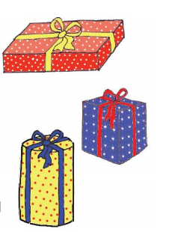
Now let’s see the picture and think about it.
What do these packets look like?
What do we with these packets?
When do we present these to others?
Notes:
এছাড়া পাঠসংশ্লিষ্ট ভিডিও প্রদর্শন করে শিক্ষার্থীদের কাছ থেকে আজকের পাঠ শিরোনাম বের করতে পারি।

Slide 10
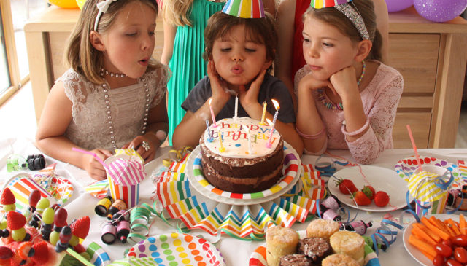
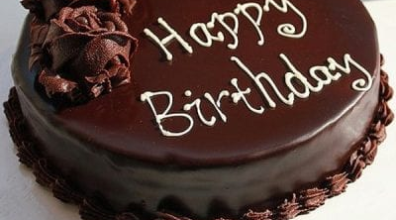
Let’s know some new words
This is the day when a person was born.
Birthday
Birthday is special day for everyone.
A type of soft sweet food made from mixture of flour, sugar, eggs etc.
Cake
People celebrate birthday with cake.

Slide 11
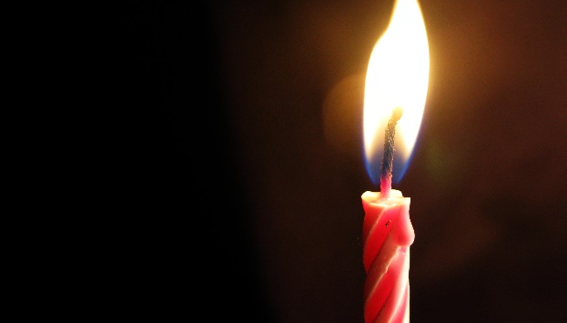
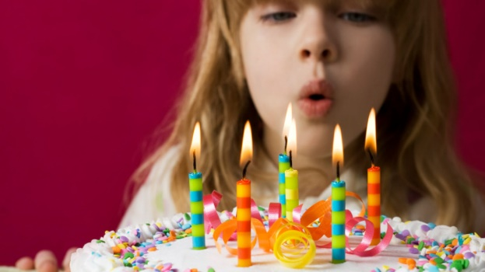
Let’s know some new words
A block of wax with a central wick which lit to produce light.
Candle
Birthday is special day for everyone.
Be extinguished by an air current.
Blow out
People celebrate birthday with cake.

Slide 12
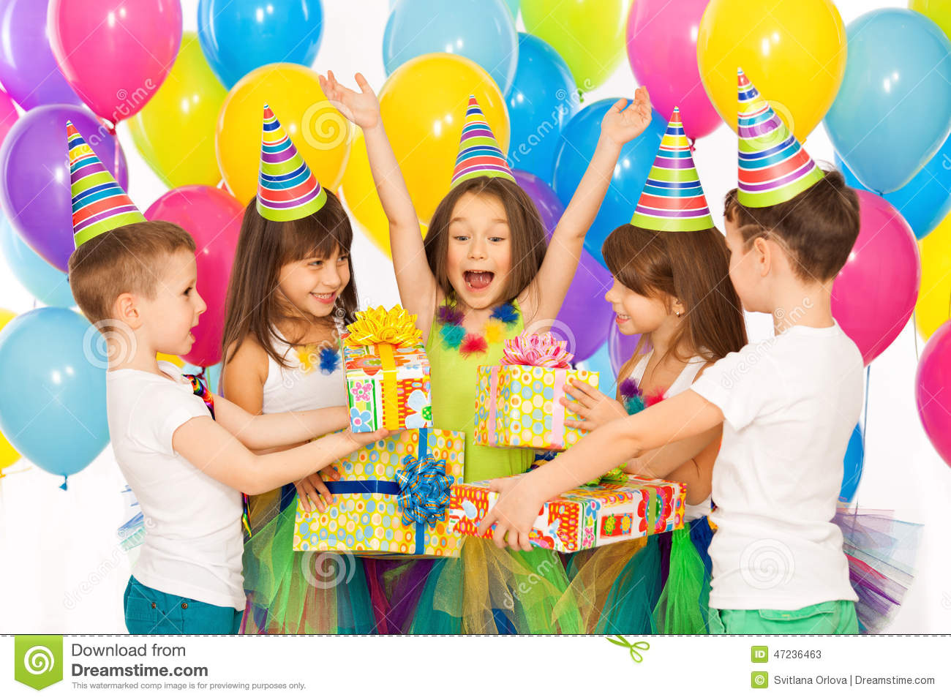
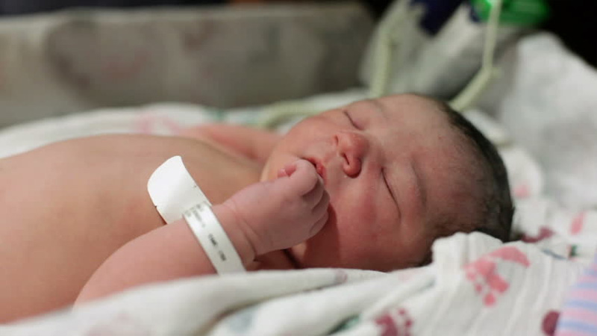
Look at the picture and read with me.
A person birthday is special day. This is the date when the person was born.

Slide 13
Look at the picture and read with me.
People around the word celebrate birthday in different ways. In many countries, people celebrate with cake. There are candles on the cake. There is one candle for each year of the person’s life.

Slide 14
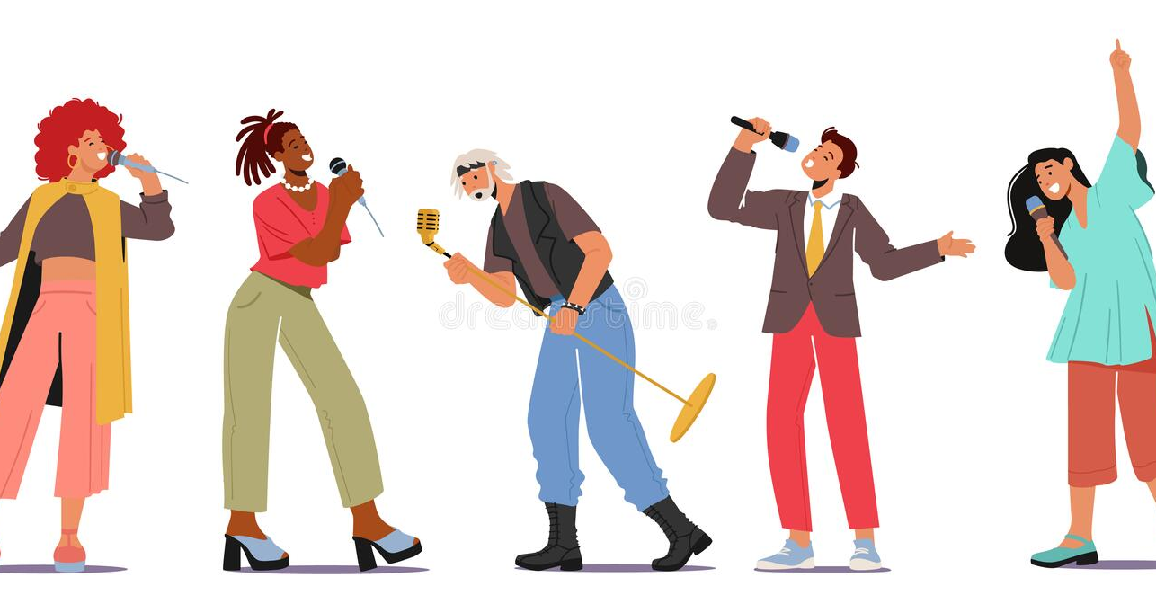
Look at the picture and read with me.
People sing a song for the person. At the end of the song, the person blows out the candles.

Slide 15
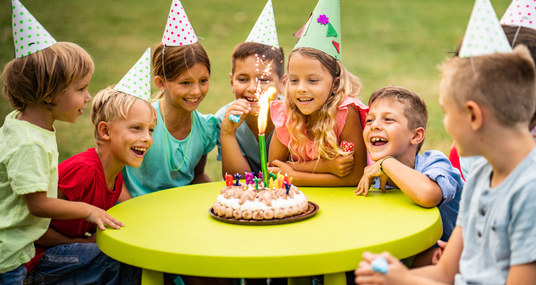
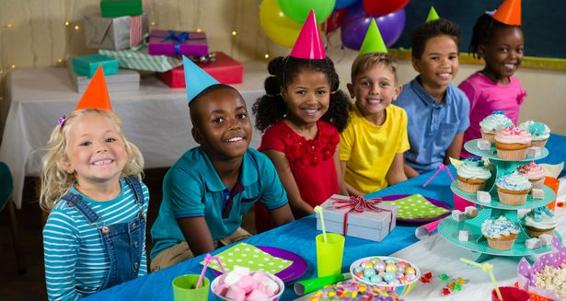
Look at the picture and read with me.
In some countries, there is often a party for a child’s birthday. The child friend’s come to the home.

Slide 16
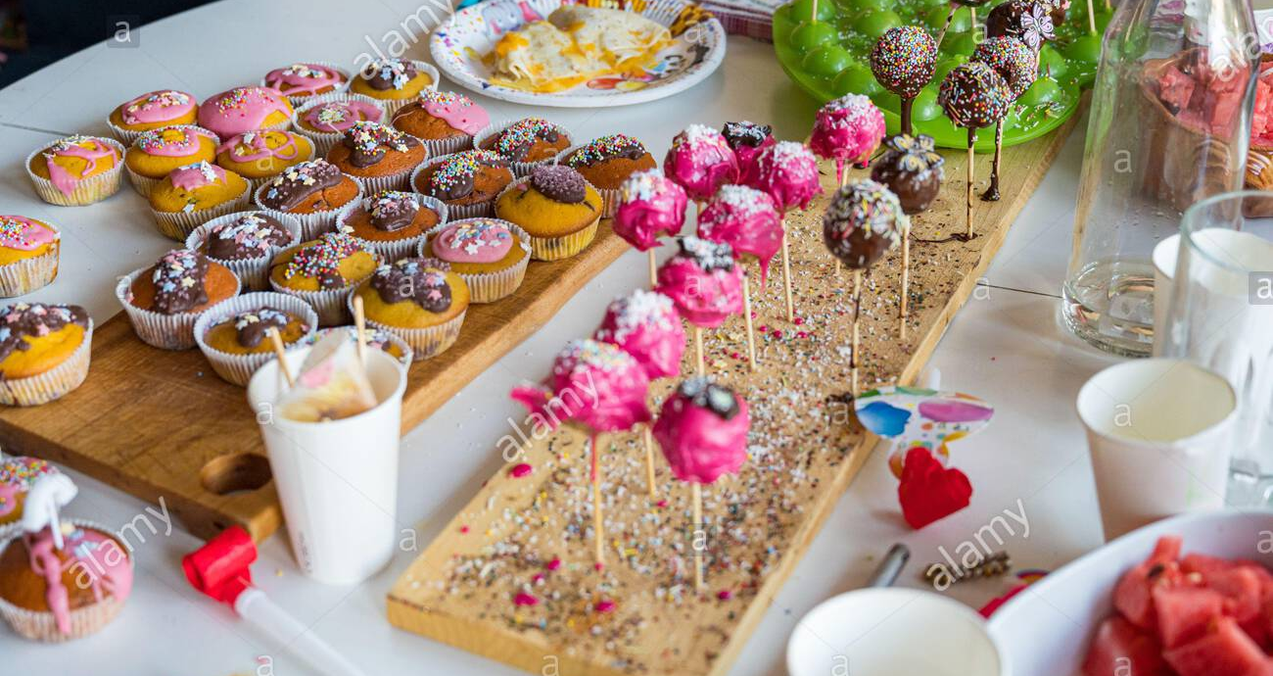
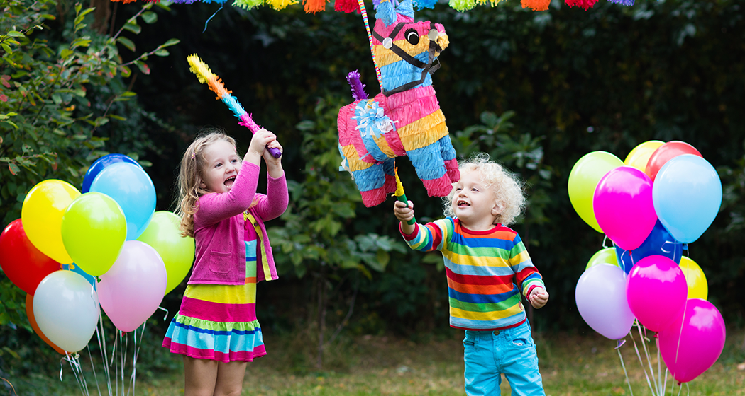
Look at the picture and read with me.
There is special food, like sweets. The children pay games and sing.

Slide 17
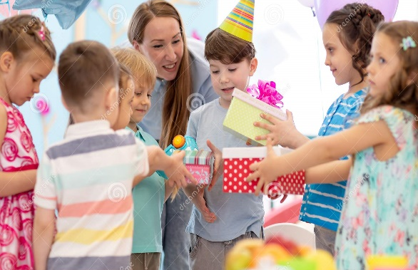
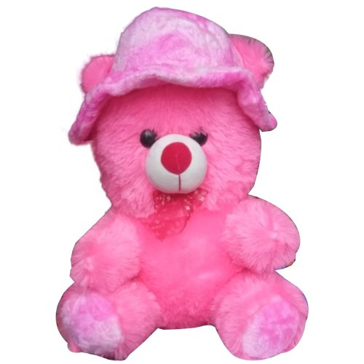
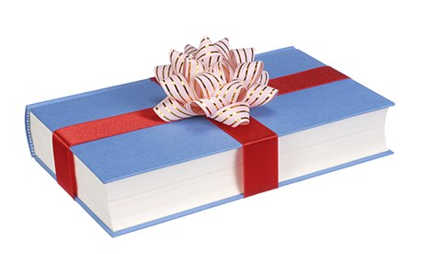
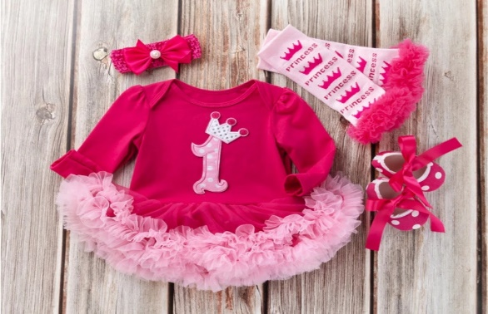
Look at the picture and read with me.
The friends often bring a birthday gift for the child. The gifts are wrapped in colourful paper. The gift may be a toy, a book or some clothes.

Slide 18
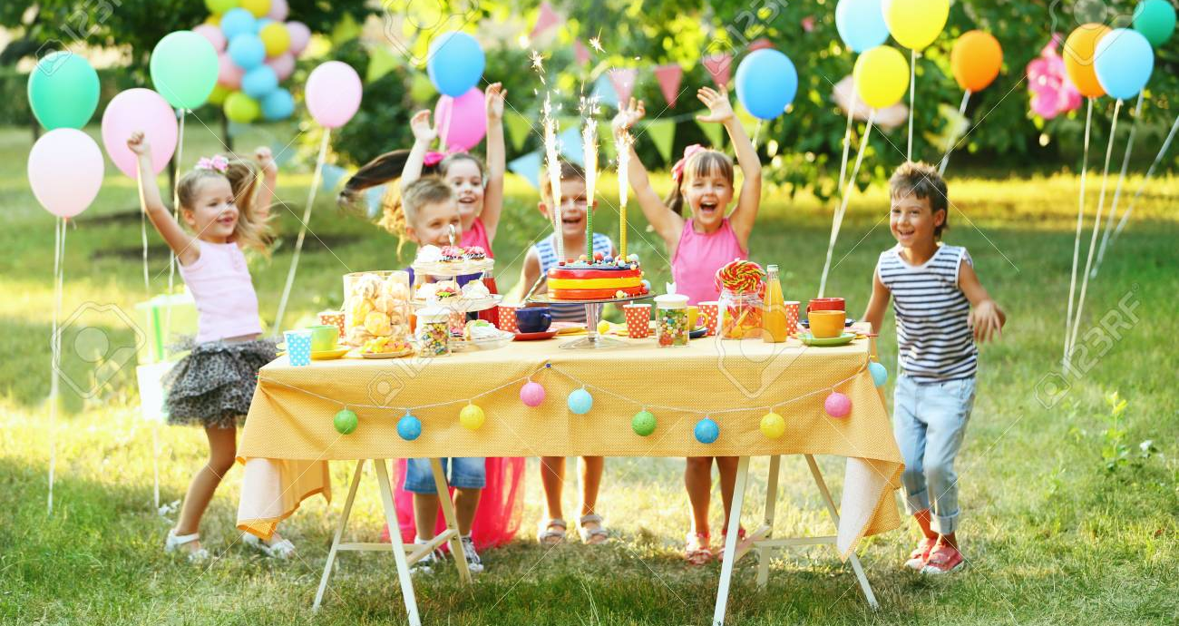
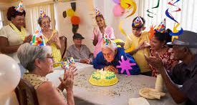
Look at the picture and read with me.
In some countries, the friends don’t bring gifts. The most important thing is to enjoy the day and spend time with friends and family.

Slide 19
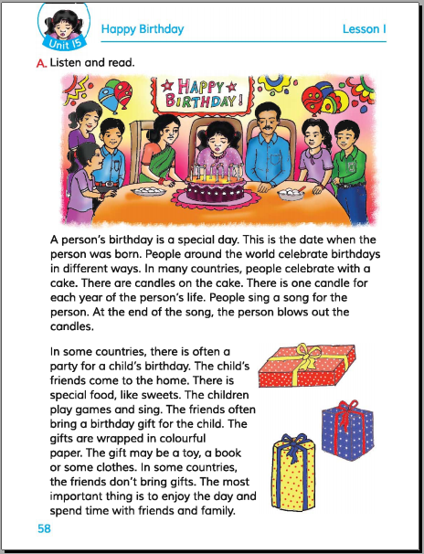
Read the text (IW)

Slide 20
Students silent reading (WCW)
A person birthday is special day. This is the date when the person was born. People around the word celebrate birthday in different ways. In many countries, people celebrate with cake. There are candles on the cake. There is one candle for each year of the person’s life. People sing a song for the person. At the end of the song, the person blows out the candles.
In some countries, there is often a party for a child’s birthday. The child friend’s come to the home. There is special food, like sweets. The children pay games and sing. The friends often bring a birthday gift for the child. The gifts are wrapped in colourful paper. The gift may be a toy, a book or some clothes.
In some countries, the friends don’t bring gifts. The most important thing is to enjoy the day and spend time with friends and family.

Slide 21
Answer the following questions (GW)
Ques: 1. Do people in the word celebrate
birthday in the same way?
Ans: No, People around the word celebrate
birthday in different ways.
Ques: 2. How many candles are put on the
cake and why?
Ans: There are one candles for each year of
the person’s life.

Slide 22
Evaluation (WCW)
Read the text loudly…

Slide 23
Write five sentences about birthday.

Slide 24
One day One word
Special is a thing that is designed for a particular occasion or purposes.
Special
বিশেষ
A person birthday is a special day.

Slide 25
GOOD BYE

