Slide 2
Introduction
Mohmmad Nasir Uddin
Assistant Teacher
Rakhalgonj Bazar Govt. Primary School, Dakshin Surma ,Sylhet .

Slide 3
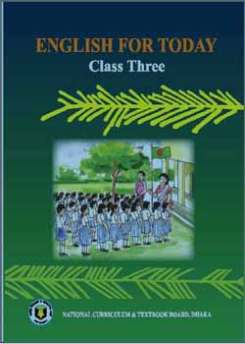
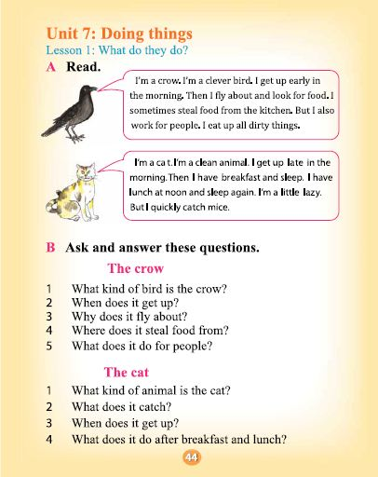
Lesson Introducton
Class : Three
Subject : English
Unit 23 : What do they do?
Page : 46-47
Time : 40 minutes

Slide 4
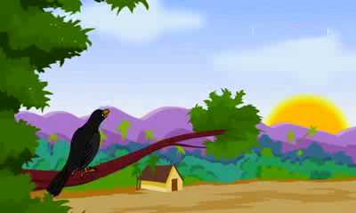
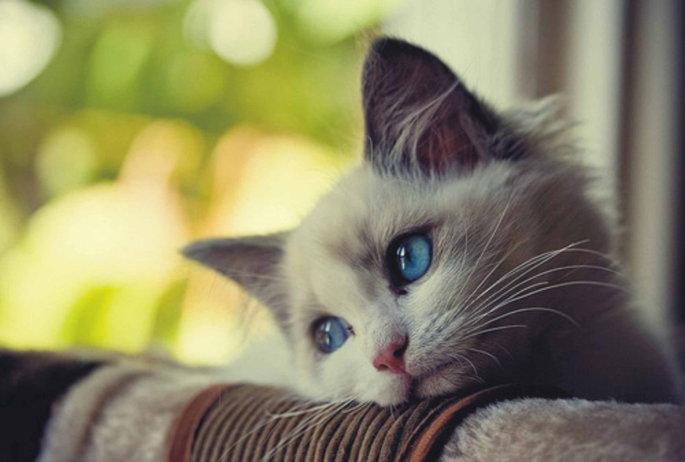
Today’s Lesson
What do they do?

Slide 5
Learning Outcomes
Students will be able to-
1. Read words, phases and sentences in the text with proper punctuation, stress and intonation
2. Ask and answer Wh question .
3. Say what others are doing.

Slide 6
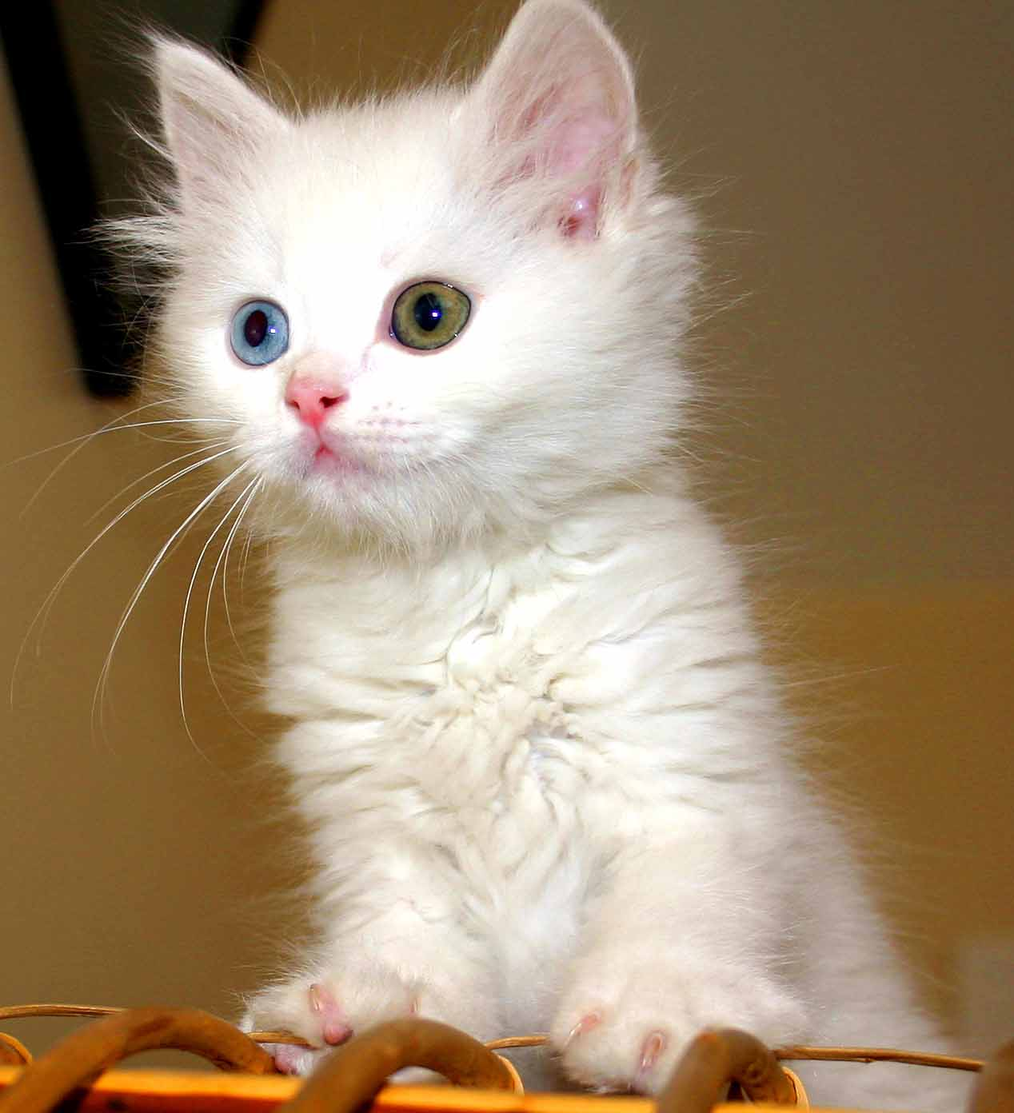
Look , Listen and Read
I’m a cat.

Slide 7
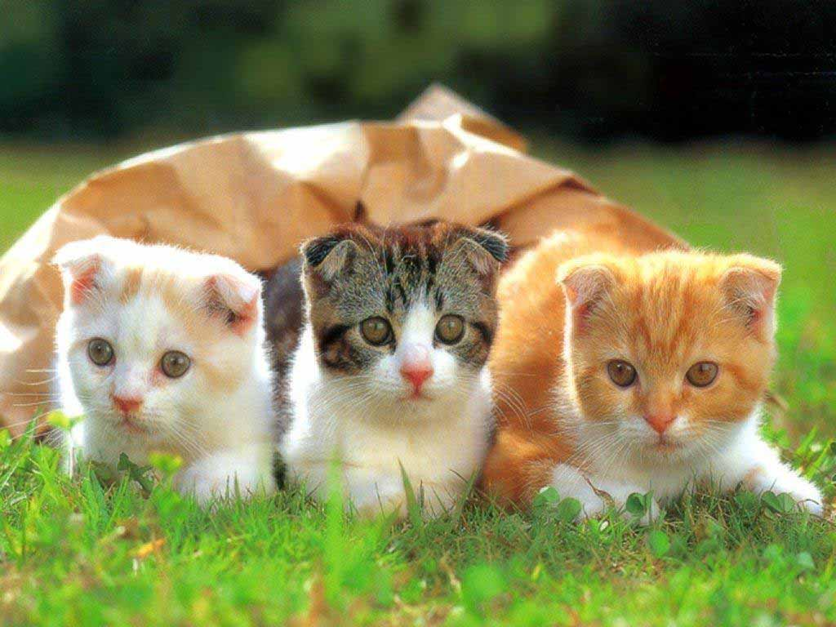
Look , Listen and Read
I’m a clean animal.

Slide 8
Look , Listen and Read
I get up late in the morning.

Slide 9
Look , Listen and Read
Then I have breakfast and sleep.

Slide 10
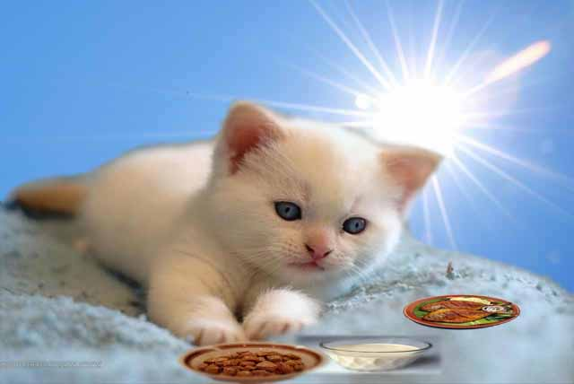
Look , Listen and Read
I have lunch at noon and sleep again.

Slide 11
Look , Listen and Read
I’m a little lazy.

Slide 12
Look , Listen and Read
But I quickly catch mice.

Slide 13
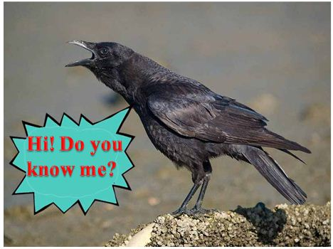
Look , Listen and Read
I’m a crow.

Slide 14
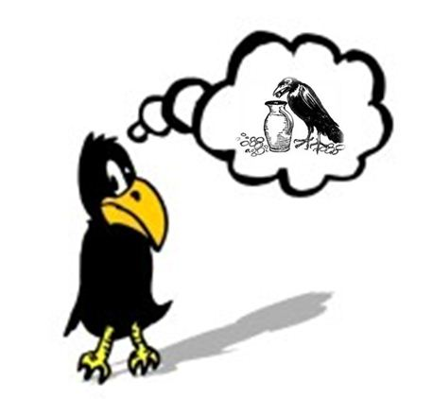
Look , Listen and Read
I’m a clever bird.

Slide 15
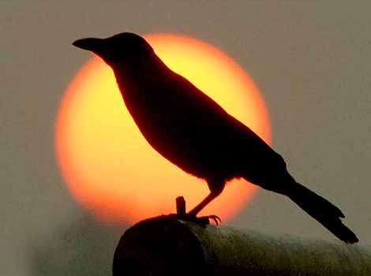
Look , Listen and Read
I get up early in the morning.

Slide 16
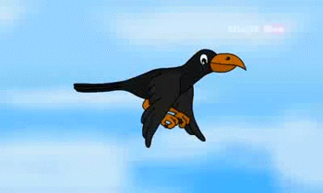
Look , Listen and Read
Then I fly about and look for food.

Slide 17
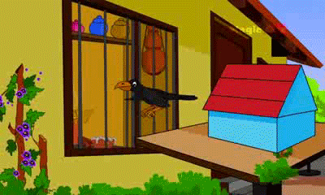
Look , Listen and Read
I sometimes steal food from the kitchen.

Slide 18
Look , Listen and Read
But I also work for people.

Slide 19
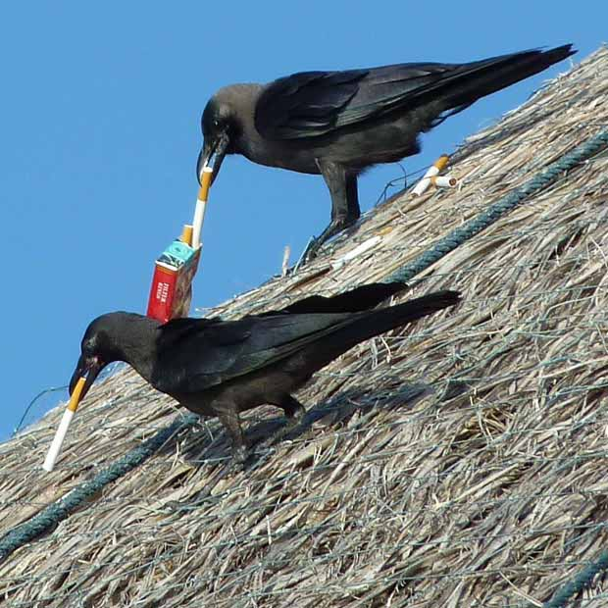
Look , Listen and Read
I eat up all dirty things.

Slide 20
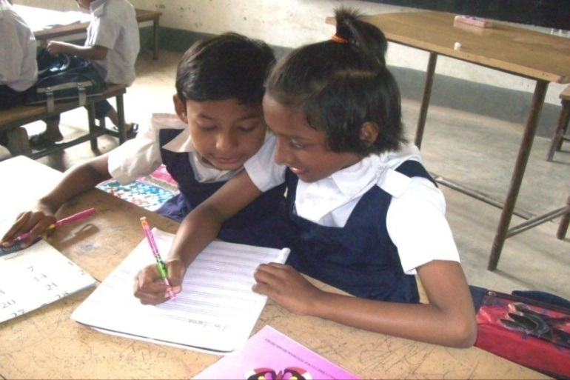
Match the word in A with their opposites in B
A | B
Clever | Active
Clean | Slowly
Late | Foolish
Lazy | Dirty
Quickly | Early

Slide 21
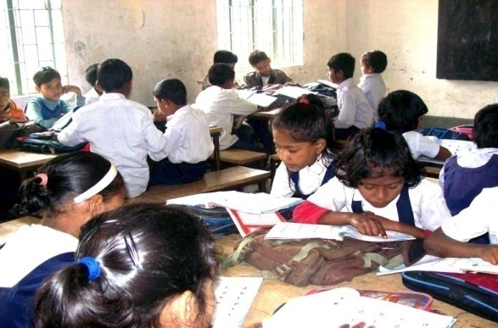
Open your EFT book (page no:46)
Ask and answer the questions.
What kind of animal is the cat?
What does it catch?
When does it get up?
Where does it do after breakfast and lunch?

Slide 22
Evaluation
Answer the Questions
1. What kind of the bird is the crow?
2.When does it get up?
3.Why does it fly about ?
4.Where does it steal food from?
5. What does it do for people?

Slide 23
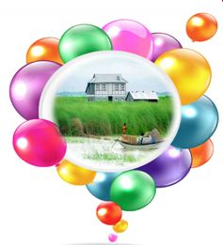
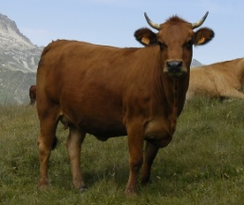
Home Work
Write a short paragraph about ‘The cow’. Answer the questions in your paragraph. Use the clue words in the brackets.
1.What kind of animal is the cow?(gentle) 2.Where does it live?(near our house/ in the cow-shed) 3. What does it eat? (grass, straw etc) 4. What does it do for people?(draws cart, ploughs land, gives milk)

Slide 24
Closing of the Class
Stay
Fine
Thanks

