Slide 1
Welcome

Slide 2
Teacher’s introduce:
Md. Fazlul Hoque
Senior teacher in English
Baniachong senior fazil madrasah
Baniachong – Habigonj.
Lesson introduced:
Class : viii
Subject : English.
Unit : Five
Lesson : One.

Slide 3
Aims and objects:
At the end of this lesson the students will be able to say…
What was shakhe Mujibur Rahman in student life?
2. What was Muhammad Ali Jinnah?
Make paragraph on Shakhe Mujibur Rahman?
Lesson declaration with previous test.
Now look at the picture and answer the following questipns.

Slide 4
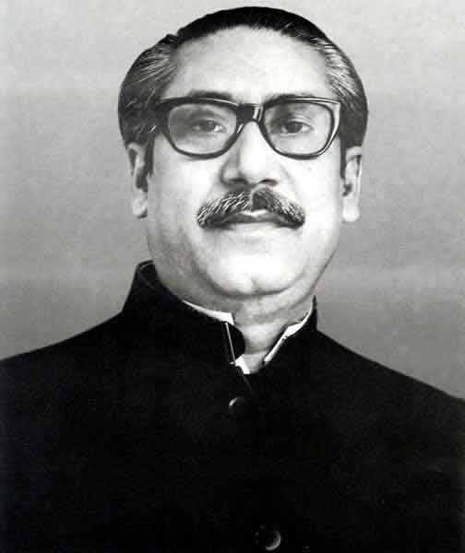
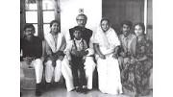

Slide 5
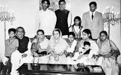

Slide 7
Q: What have you see in the picture ?
A: ……….
Ok thanks. These are the image of Bango Bondu’s family.
Today’s lesson is Bango Bondu Shakhe Mujibur Rahman.

Slide 8
Word meaning.
Significent - তাতপর্য পুর্ন
Language — ভাষা
Movement — আআন্দোলন।
Against — বিরুদ্ধে।
Again — আবার
Announcement — ঘোষণা।
Strikers —আআন্দোলন কারি।
State — রাষ্ট্র ।
Awareness -

Slide 9
Lesson 1 : Bangabandhu and the Language Movement
Seikh Mujibur Rahman was one of the few student leaders played a significant role in turing the language movement into a mass movement. As a student leader,he was the central figure in organizing mass gatherings, rallies and strikes for raising awareness Against the discriminatory language policy of Pakistan. The language movement started when the Govorner GENERAL of Pakistan, Muhammad Ali Jinnah, declared ❝Urdu and only Urdu shall be the state language of Pakistan ❞on 19 March 1948 at the racecourse Madian While addressing a public gathering. He again uttered the same on 24 March 1948 at the University of Dhaka durning his Convocation speech. The students instantly protested against this announcement vehemently.

Slide 10
Answer the question bellow :
a. What was shake mujibur rahman in student kife?
b. What was said by Muhammad Ali kinna?
What stetp should be taken by us to develop our mother languafge?

Slide 11
Home work
Write a paragraph on food and shelter.

Slide 12
Thank you all

