Slide 1
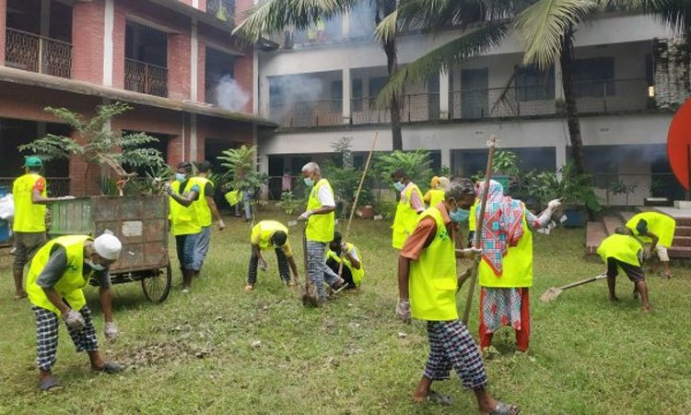

Slide 3
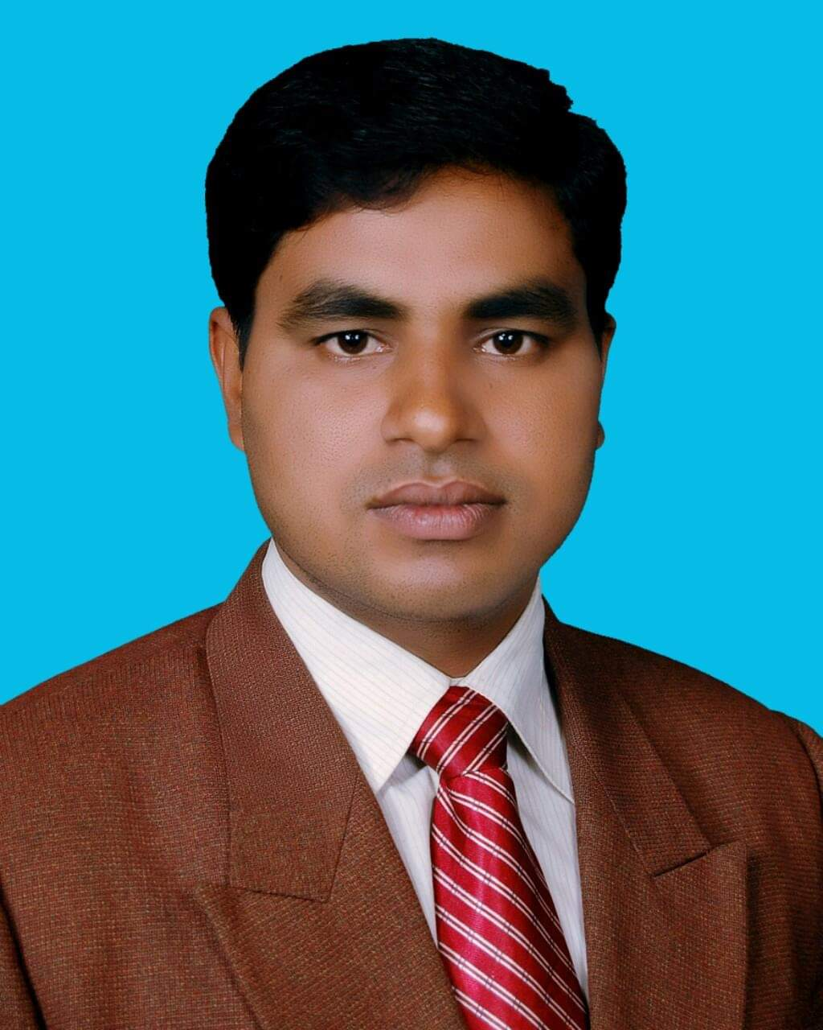
Identity
Md. Noor –E- Alam Siddiki
Asstt. Teacher
Nageswari Keramatia M.L High School.
Mobile- 01716962418
Email- nooralam.na35@gmail.com
Unit -2, Lesson 2

Slide 4
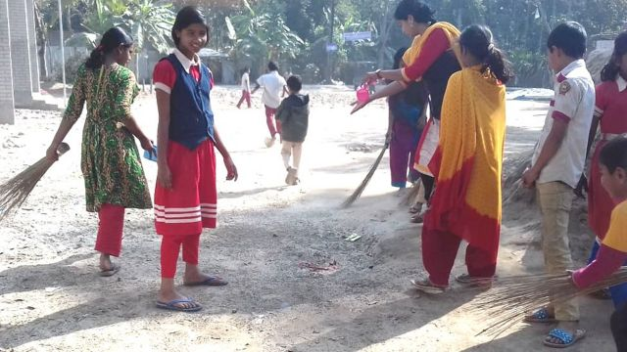
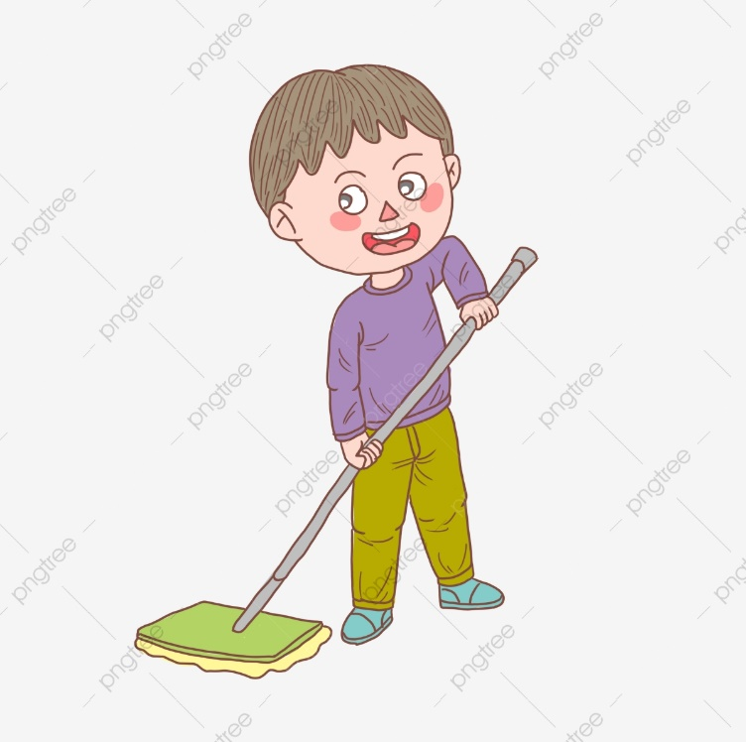
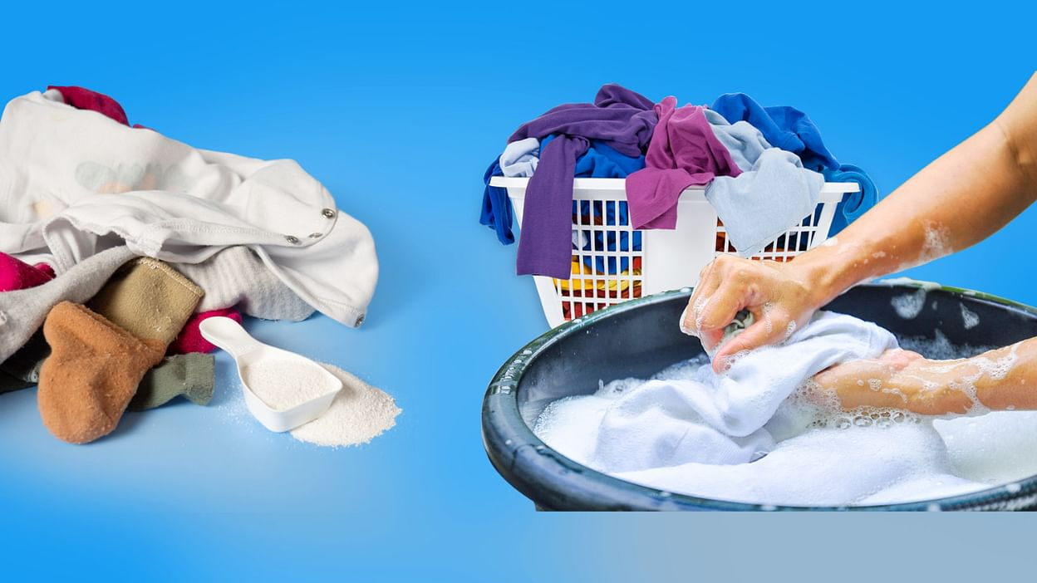
What can you see in the pictures below?
Sweeping field
Mobbing floor
Washing clothes
These activities are part of hygiene.

Slide 5
Today’s class title is
Hygiene
Unit 3, Lesson 3

Slide 6
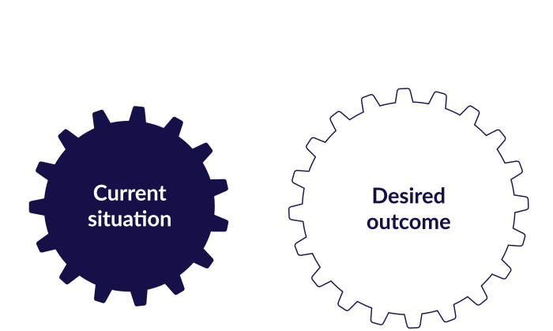
After studied the lesson , students will be able to …
answer questions.
develop reading skill .
identify right or wrong information.
complete sentences.
develop writing skill.

Slide 7
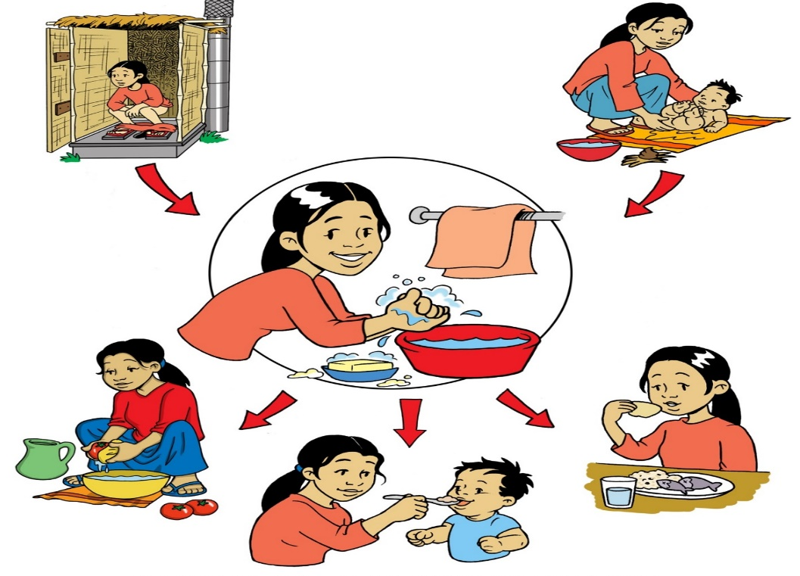
Let’s know some new words.
Hygiene
conditions or practices conducive to maintaining health and preventing disease, especially through cleanliness.
The word ‘hygiene’ means the practice of keeping ourselves clean.

Slide 8
Godliness
the quality of being devoutly religious; piety.
Hygiene is thought to be next to godliness.

Slide 9
Achieve
successfully bring about or reach (a desired objective or result) by effort, skill, or courage.
We can not achieve anything without industry.

Slide 10
spiritually
in a way that relates to or affects the human spirit or soul as opposed to material or physical things.
We can not achieve anything spiritually if we are unclean in our soul.

Slide 11
Soul
the spiritual principle embodied in human beings.
Electricity is the soul of any electrical device.

Slide 12
Read the question first.
1. What can be a hotbed of germs?
2. How many times should we brush?
3. What kind of water should we drink?
Then read the text and answer the questions.

Slide 13
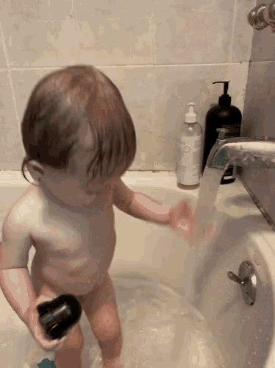
We must keep our body clean. We should have a bath everyday and wash our hair regularly. This will keep the body and hair free from dirt and bacteria.

Slide 14
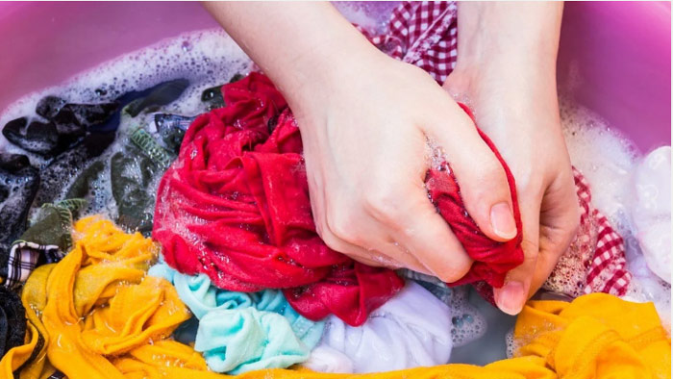
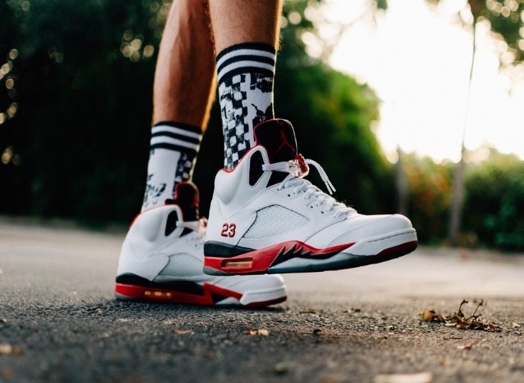
We should wash our cloth regularly. Dirty clothes give off bad smell.
We should wear socks and shoes when we go out to protect our feet from dust and germs.

Slide 15
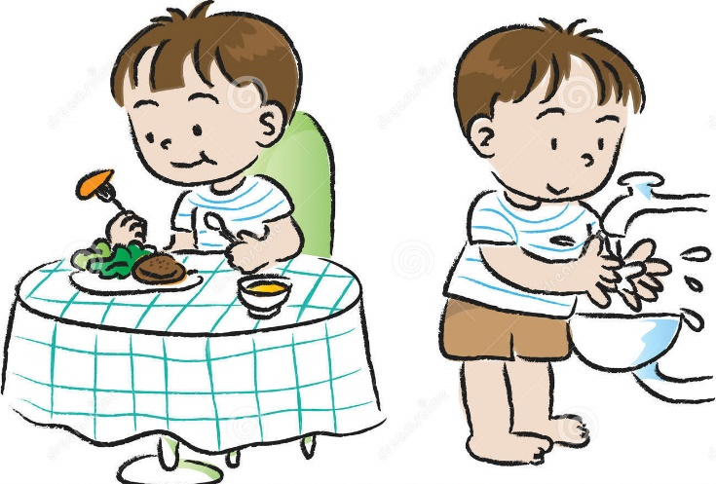
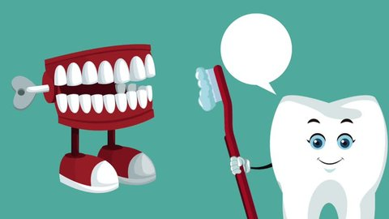
We must wash our hands before taking meals and after using toilet.
We should brush our teeth twice a day after breakfast and supper.

Slide 16
Individual work
B. True or False. If false give the correct information.

Slide 17
Match your answer
1. The information is true.
2. The information is false.
The correct information- Cleanliness is very important for good health.
3. The information is false.
The correct information – We need to wear soaks and shoes to protect our foot.

Slide 18
4. The information is false.
The correct information- We need to brush our teeth after meals.
5. The information is true.
6. The information is true .

Slide 19
Pair work
C Complete the sentences.

Slide 20
Match your answer
1. If we are healthy, we_______________.
can enjoy our life
2. We must be clean so that______________________
we can lead a healthy life
3. You must exercise to _______________.
keep your body fit
4. Nobody likes an _____________.
unclean person
will be able to
5. If we obey the laws of hygiene, we ____________
_______________________.
lead a happy and healthy life

Slide 21
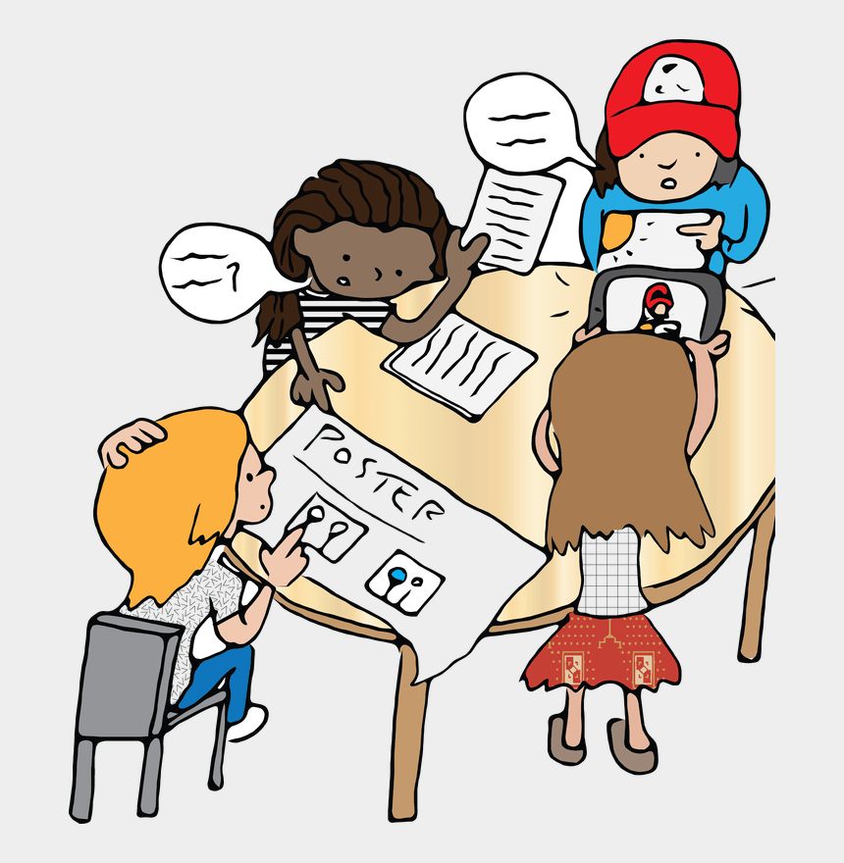
Group work
D. Make a list of five things that you do daily to maintain personal hygiene . Share with other groups and make a poster to display it to the class.

Slide 22
Evaluation
What does hygiene mean?

Slide 23
Thank you.

