Slide 1


WELCOME TO MULTIMEDIA CLASS
Good morning

Slide 2

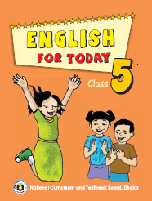
Class: Five
English For Today
Lesson unit: 15
Lesson: (L-1) Happy Birthday. Page – 58

Slide 3
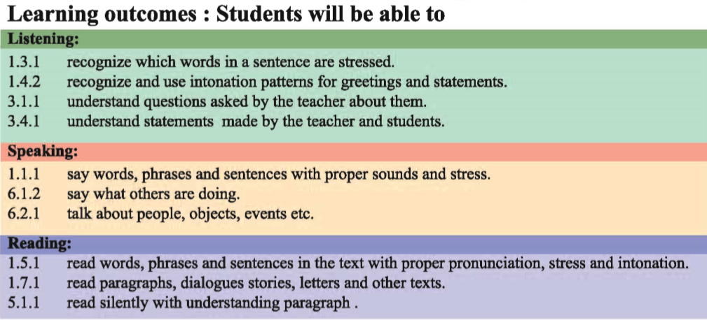

Slide 4
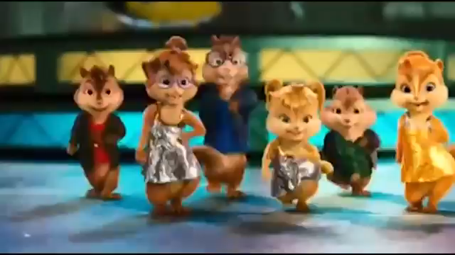
Let’s enjoy a Birthday song

Slide 5
Let’s see and listen a vedio.
https://youtu.be/UTetxq-kSc8

Slide 6
Do you understand what may be our today’s lesson.
Today’s lesson is
Happy Birthday
Lesson: 1
Part: A person’s……..and family.

Slide 7
Open page at 58
of your EFT.

Slide 8
What are they doing?
Who are there in the picture?
What is written on the top of the picture?
How many candles can you see on the cake?
What can you see in the picture?
What is happening in the picture?

Slide 9
Look at the piture and answer the questions
What do these packets look like?
What do we do with these packets?
When do we present these to others?

Slide 10
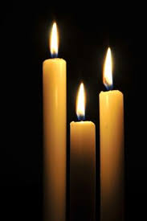
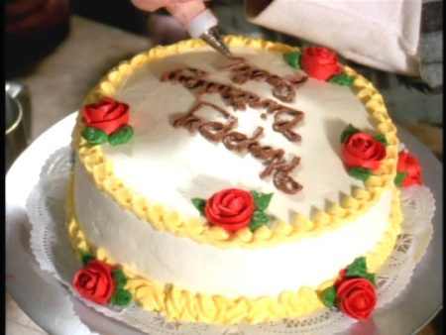
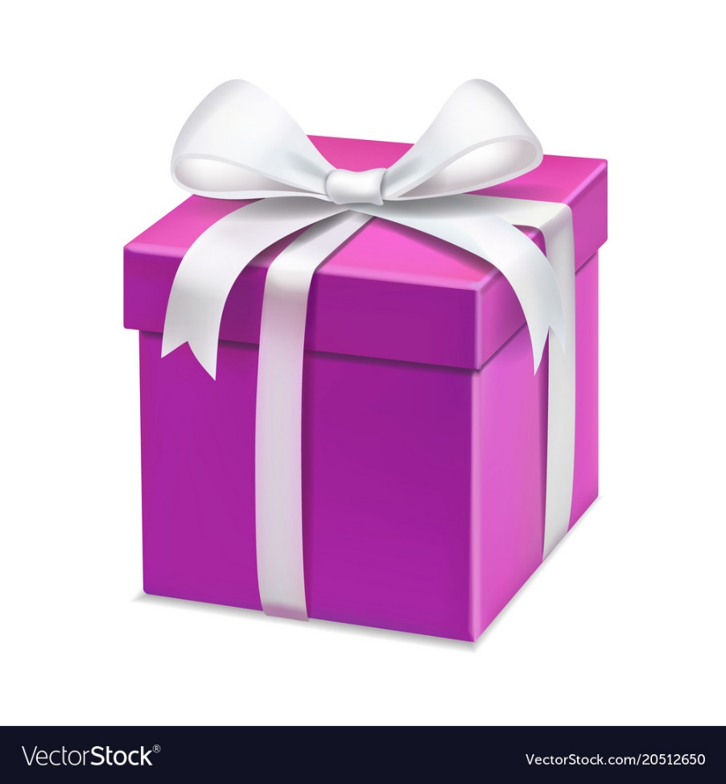
Let’s see some pictures
Candle
Cake
Gift

Slide 11
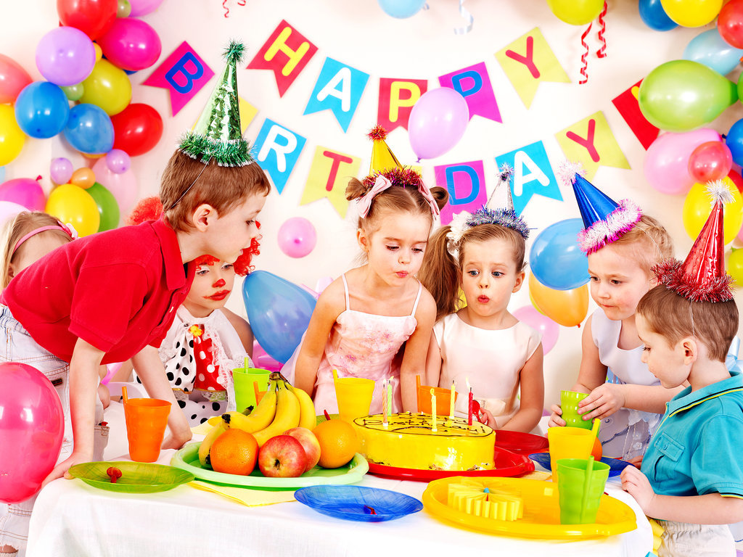

Slide 12
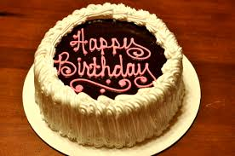
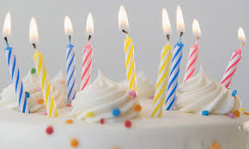
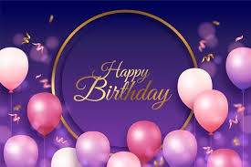
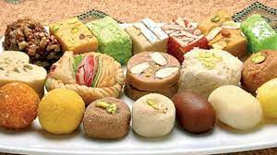
What things do we need to celebrate birthday?
Cake
Candle
Balloons
Sweet

Slide 13
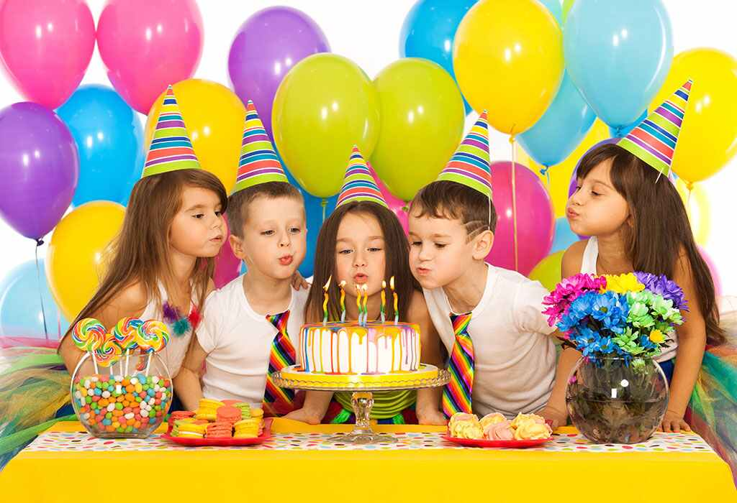
1.Do people around the world celebrate birthday in the same way ?
People around the world celebrate birthdays in different ways.

Slide 14
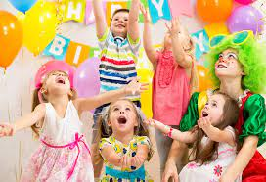
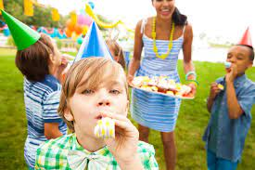
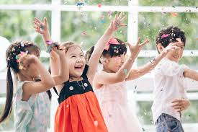
What do the children do on a birthday celebration?
The children play games and sing.

Slide 15
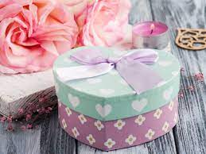
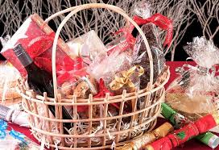
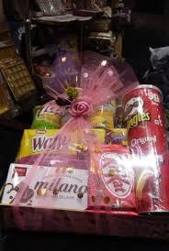
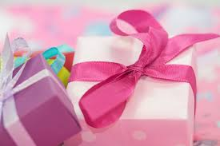
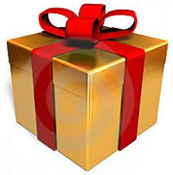
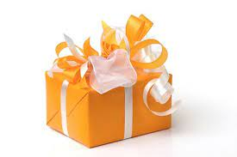
What do the friends bring on a birthday celebration?
The friends often bring a birthday gift.

Slide 16
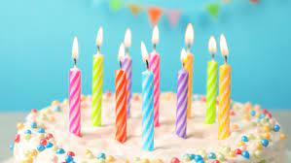
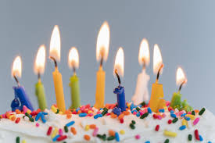
How many candles are used for the each year on a birth day celebration?
There is one candle for each year of a person’s life.

Slide 17
New Words
Birthday -
জন্মদিন
When a child born
Gift
উপহার
Presentation
Enjoy
উপভোগ করা
Pleasure
Candle
মোমবাতি
Wax light
Celebrate
উদযাপন করা
Observe
Observe

Slide 18
Teacher’s reading.

Slide 19
Students’ silent reading
A person’s birthday is a special day . This is the date when the person was born . People around the world celebrate birthdays in different ways . In many countries , people celebrate with a cake . There is one candle for each year of the person’s life . People sing a song for the person . At the end of the song , the person blows out the candles .

Slide 20
In some countries , there is often a party for a child’s birthday . The child’s friends come to the home . There is special food , like sweets . The children play games and sing . The friends often bring a birthday gift for the child .The gifts are wrapped in colourful paper . The gift may be a toy , a book or some clothes . In some countries , the friends don’t bring gifts . The most important thing is to enjoy the day and spend time with friends and family .

Slide 21
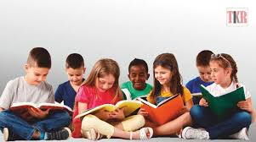
Group work
1.Do people around the world celebrate birthday in the same way ?
2.How do people celebrate birthday in most of the country ?
3.What do people bring to a birthday party ?

Slide 22
Evaluation
1.What do the children do on a birthday?
2.What types of gifts are given on a birthday ?
3.What is birthday?
4.What is the most important thing on a birthday?
5.Who bring gifts for a child on its birthday?

Slide 23

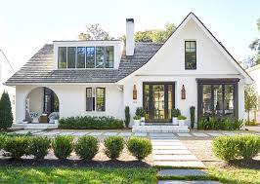
Write five sentences about “Your Birthday Party”

Slide 24
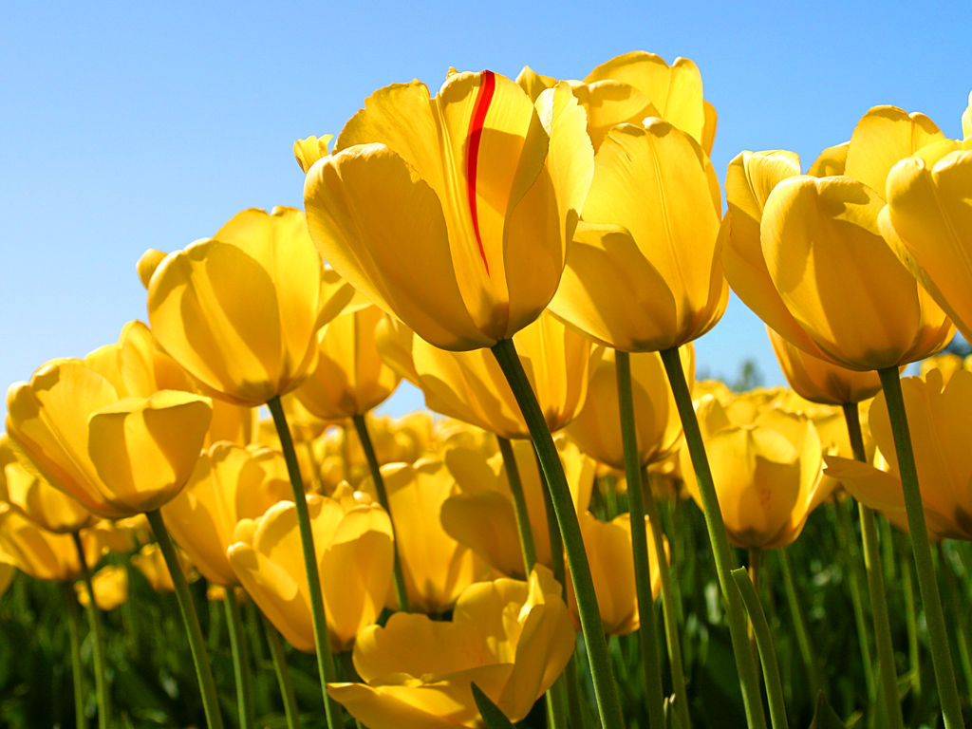
ধন্যবাদ

