Slide 2
Teachers identity
মোসাঃসামসুন নাহার,
মোসাঃসামসুন নাহার,
Mst. Samsun Nahar
Assistant teacher
Rudronagar Government Primary School
Damurhuda , Chuadanga

Slide 3
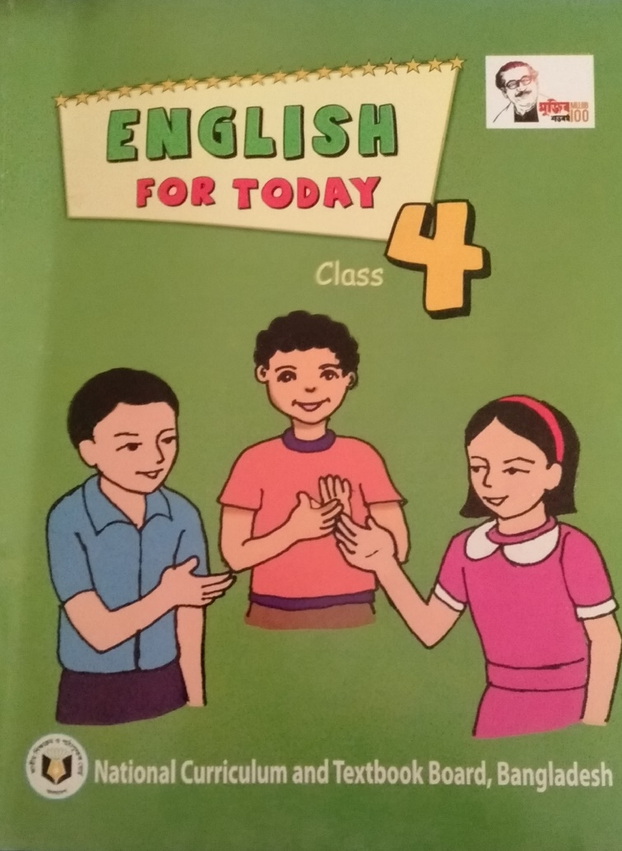
Introduction of the lesson
Class: Four
Unit:3
Lesson Tittle:Family
Today’s Lesson:1-2
Learning activities-A,B

Slide 4
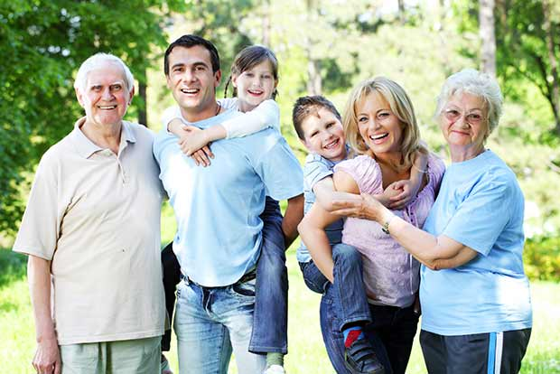
What can you see in the picture:

Slide 5
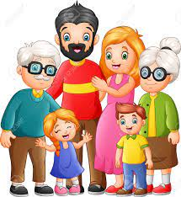
today’s lesson is
Family

Slide 6
Learning Outcomes
Students will be able to :
3.1.1 Understand simple questions and statements about
them.
3.2.1 understand questions about family and friends.
3.1.2 ask and answer Yes/No questions
5.1.1 read silently with understanding paragraphs, stories and other texts.
10.2.1 write a short composition about oneself, friends, family and other familiar topics.

Slide 7
New words
Family Household

Slide 8
New words
Primary Elementary.

Slide 9
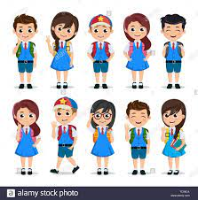
New words
Students Learner

Slide 10
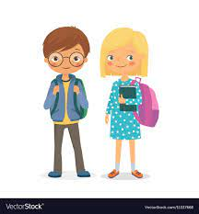
Look at the picture and read the text
Farzana and Jamil are from Kustia

Slide 11
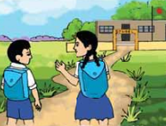
Look at the picture and read the text
They go to Chachua Primary School. Farzana is nine years old. She is in class 4.

Slide 12
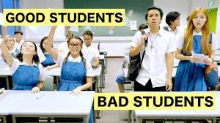
Jamil is seven years old. He is in class 2.They like school and they are good students.

Slide 13
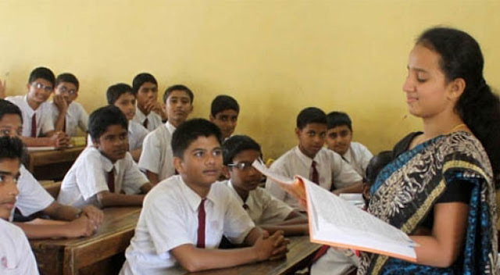
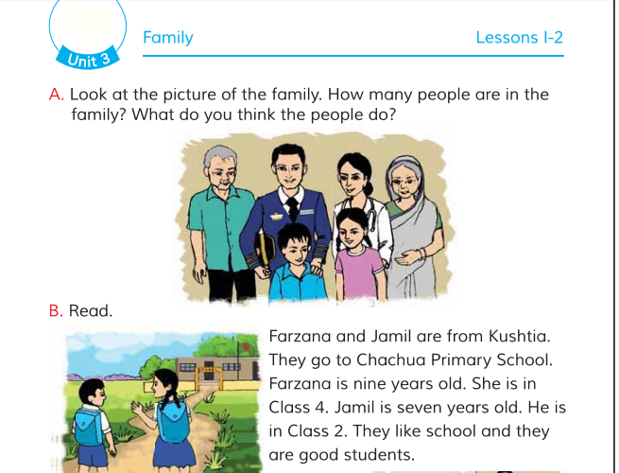
Teacher’s Reading

Slide 14
Silent Reading
Open your book page at
6

Slide 15
Pair work
````
Read the text in pair.one will read other will listen.

Slide 16
Group work
Write true/ false.
Farzana and Jamil are from Bogura . False.
Jamil is nine years old . False.
Farzana is seven years old. False
They go to chachua primary school. True
They are good students. True

Slide 17
Evaluation
Answers the following questions.
1.Where do Farjana and jamil live?
2.How old is Farzana ?
3.How old is jamil ?

Slide 18
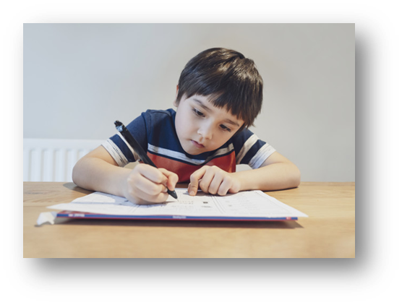
HomeTask
Write 5 Sentences about” Your family”.

