Slide 2
Identity
Sabina Yeasmin
Lecturer in English
Baridhara Nazmul Ulum Alim Madrasah
Badda, Dhaka

Slide 3
Class : Alim /HSC
Subject : English 1st Paper

Slide 4
Let’s enjoy the video
Fetching...
https://www.youtube.com/watch?v=ZsQfqlkayJ4

Slide 5
Let’s watch some images attentively

Slide 6
Can you guess what’s the today’s topic by watching the video & these images?
Part-1
Exactly today’s topic is-
Unit:1, Lesson: 2 Nelson Mandela, from Apartheid Fighter to President

Slide 7
Learning outcome
At the end of the lesson, students will be able to-
Increase vocabulary
1
2
Achieve the reading skill.
Answer the questions easily.
3
Fill in the blanks without clues spontaneously.
4

Slide 8
The text on Mandela is written by Andrew Quinn and Jon Herskovitz
Jon Herskovitz
Andrew Quinn

Slide 9
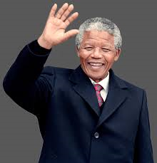
Let’s Introduce with Nelson Mandela
Name:Rolihlahla Mandela
Born: 18 July,1918
Clan: Madiba
Surname: Nelson
Edu: BA &LLB, SA

Slide 10
Lets Introduce him
Involved politics In 1942
Joined Congress in 1944
Nobel Preace Prize in 1993
President in 1994
Died in 2013

Slide 11
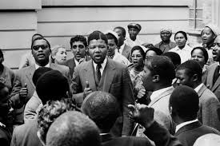
Vocabulary
Guided
Mean: Indicate the way someone
Syn: Conducted, Driven
Ant: Unguided
Ex: Nelson Mandela guided South Africa.

Slide 12
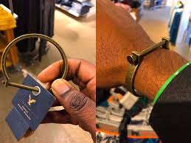
Vocabulary
shackles
Mean: A situation that restrains someone
Syn: Chain/restrictions
Ant: freedom
Nelson Mandela broke down the shackles of apartheid.

Slide 13
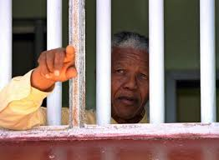
Vocabulary
Imprisoned
Mean: Kept in prison
Syn: Jailed, caged, detained
Ant: freed
Ex: Nelson Mandela was imprisoned nearly 27 years.

Slide 14
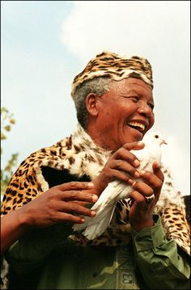
Vocabulary
Emancipation
Mean: The process of giving people social or political freedom
Syn: Liberation, release
Ant: Repression, deprivation
Ex: He worked for the emancipation of South Africa’s black people.

Slide 15
Now read the text.
Reuters
15 December 2013
JOHANNESBURG (Reuters)- Nelson Mandela guided South Africa from the shackles of apartheid to a multi – racial democracy, as an icon of peace and reconciliation who came to embody the struggle for justice around the world.

Slide 16
Imprisoned for nearly three decades for his fight against white minority rule, Mandela never lost his resolve to fight for his people’s emancipation. He was determined to bring down apartheid while avoiding a civil war. His prestige and charisma helped him win the support of the world.

Slide 17
“I hate race discrimination most intensely and in all its manifestations. I have fought it all during my life; I will fight it now, and will do so until the end of my days,”

Slide 18
Mandela said in his acceptance speech on becoming South Africa’s first black president in 1994, “The time for the healing of the wound has come. The moment to bridge the chasms has divide us has come”.
“We have at last achieved our political emancipation”.

Slide 19
Individual work
Fill in the blanks
Nelson Mandela was one of the greatest leaders of the world. (a) his life, he fought against racism. He was (b) with capital(c) in historic Revonia (d) case. The trial took (e) in 1963. This great leader had to (f) 30 years’ imprisonment.
Throughout
charged
offences
Trial
place
undergo

Slide 20
Individual work
Fill in the blanks
A serious (g) broke out in the state when he was behind the bar. However, the South African white leaders realized the truth to bring an (h) to the malpractice.Then Nelson Mandela was released and after (i)
the problem was at last solved and South Africa enjoyed true(j)
uprising
end
negotiation
democracy

Slide 21
Pair work
Discuss about Nelson Mandela’s Political life.

Slide 22
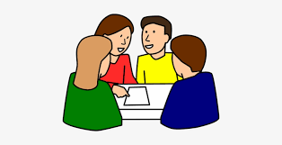
Choose the correct answer from the alternatives
Group work
1. What is the meaning of the word ‘chasm’?
(a).cleft (b). top (c). hatred (d). border
2. What does the word ‘apartheid’ mean?
(a).apart (b).distance (c).discrimination (d). dialogue
3. What is the synonym of the word ‘icon’ ?
(a) portrait (b) image (c) symbol (d) idol
4. What does the word ‘Shackles’ mean?
(a) restraints (b) sick (c) stigma (d) spur
5.The word ‘healing’ refers to-
(a) curing (b) heating (c) shooting (d) ailing
√
√
√
√
√

Slide 23
Evaluation
Answer the questions
1.Who was Nelson Mandela? What did he do for the blacks of South Africa?
2.What did Mandela say in his acceptance speech?
3.Why is Nelson Mandela famous?
4. How did he want to bring down apartheid?
5.What did Mandela dream his life?

Slide 24
Home work
Write a short paragraph on ‘Nelson Mandela’.

Slide 25
Thank you so much
For watching

