Slide 2
gG
PRESENTED
BY
Md. Mamunur Rashid
Assistant Teacher
Rajbari Model Govt. Primary school
Manikchari, Khagrachari.
mamunurrashid642@gmail.com

Slide 3
LESSON INTRODUCTION
ENGLISH FOR TODAY
CLASS:FIVE
UNIT:10
MY HOME DISTRICT
LESSON UNIT:
MY HOME DISTRICT………THROUGH THE TOWN.

Slide 4
LEARNING OUTCOMES
Listening:
1.3.1 recognize which words in a sentence are stressed.
3.3.1 understand questions about objects around them.
Speaking:
1.1.2 say sentences with proper intonation.
Reading:
1.6.1 recognize and read statements ,commands , greeting and answer.
Writing:
8.1.1 make sentences using words and phrases given in the textbook.

Slide 5
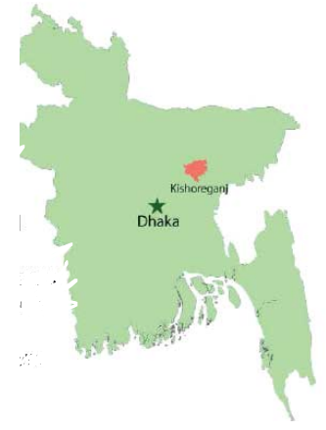
Look at the picture
Dear student’s think and try to say , which district’s famous places are mentioned in the map/picture.
Yes , you are correct .Kishoregonj district . Thank you all .Our today’s lesson is….

Slide 6
Our Today’s Lesson
My Home District
Subtitle :
My home district…………….….. through the town.

Slide 7
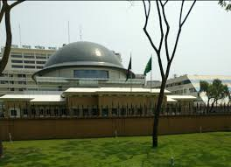
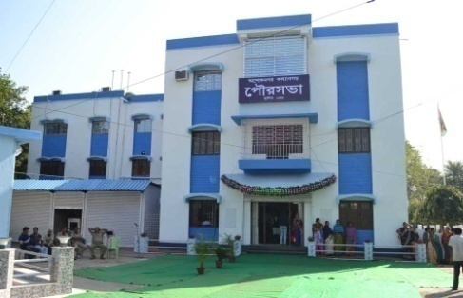
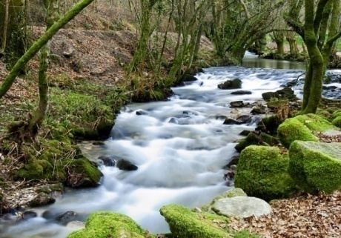
NEW WORDS WITH MEANING
to have the main offices of an orqanization in a particular place.
Headquartar
Municpality
a city or town with its own local government.
Landlord
a person who owns a vast of land area.
Flow
to move in one direction.

Slide 8
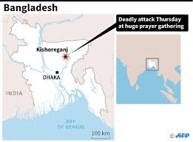
Look at the map
Kishoreganj is about 145 kilometres from Dhaka. My home district is Kishoreganj . It is about 145 kilometres from Dhaka . It is a district headquarter.

Slide 9
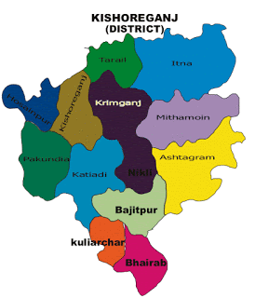
Let us know some information about Kishoreganj .
It is a district headquarter . The district has 8 Municipality, 13 Upzilas,108 Unions,1745 Villages.
Kishoreganj

Slide 10
Do you know him ?

Slide 11
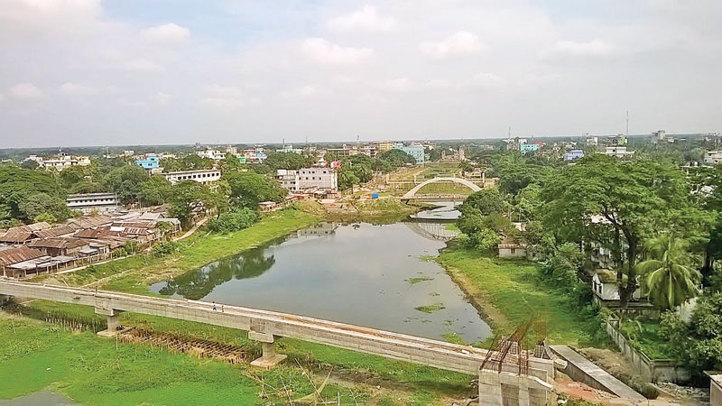
The area of Kishoreganj is 10 square kilometres . The river Narasunda flows through the town.
Narasunda river

Slide 12
TEACHERS READING
Dear student’s open your book at page 38.Say after me.

Slide 14
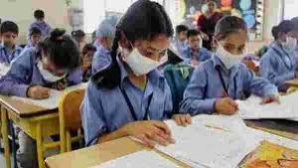
STUDENT’S SILENT READING
Dear student’s read the text silently.
Dear student’s open your English book at page number 38 read and point out with your finger.

Slide 15
STUDENT’S LOUD READING
Dear student’s read the text loudly.

Slide 16
PAIR WORK
Write ‘True’ for correct statement or ‘False’ for incorrect statement.
a)Kishoregonj is about 108 kilometers from Dhaka.
b)The name of the Kishorgonj come from an old landlord.
c)The area of Kishorgonj is 10 square kilometres.
d)The river Narasunda flows outside the town.
e)There are 8 upozilas in Kishoregonj district.
false
True
True
false
false

Slide 17
GROUP WORK
Answer to the following questions.
a) How many villages are there in Kishoreganj district?
b) How does the name ‘Kishoreganj’ come from?
c) What is the area of Kishoreganj?
d) What flows through the Kishoregonj?

Slide 18
EVALUATION
Write a short composition about your home district answering the following questions.
a) What is the name of your home district?
b) How many upazilas , unions , municipalits and villages are there in your home district?
c) How does your district name come from?
d) What is the area of your home district?
e) Are there any river that flow through your home district?

Slide 19
HOME WORK
Make list of important places and personalities in Kishoreganj.

Slide 20
Goodbye

