Slide 1
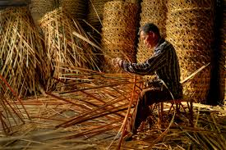
Kanan Roy , Assistant teacher , Dakshin Chand Pur -1 Govt Primary School

Slide 2
Wellcome

Slide 3
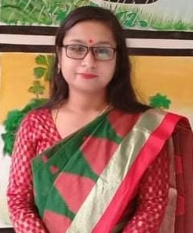
Presented By
Kanan Roy
Assistant teacher
Dakshin Chand Pur -1 Govt Primary School
Harirampur , Manikganj
E -mail : kananroy6@gmail.com

Slide 4
TODAY’S LESSON
Class : 4
Subject : English
Unit : 23
Lesson : 1-3
Activity : BC

Slide 5
Learning outcomes
By the end of the lesson students will be able to
Read silently with understanding paragraphs , stories and other text materials .
Reading
5.1.1
Use capital letters for sentence beginnings.
6.1.1
Writing
Use capital letters for proper nouns .
6.1.2

Slide 6
Look carefully
1 . I’m Shanta.
2 . He is good student .
3 . This is very nice .
4 . Her name is Keya .
5 . I like mango juice .
Sentence always start with capital letter .
We use full stop at the of the statements .

Slide 7
Look carefully
1. Karim is good boy .
2. Shihab lives in Dhaka .
3. We may go to our village home in Lalmonirhata .
4. There are Rina , Rohan and Nila .
Name of people and places also start with a capital letter .

Slide 8
Look carefully
1. The first name of the year is January .
2. The last name of the year is Deacember .
3. The first day of the week is Saturday .
4. The last day of the week is Friday .
Name of day’s and months also start with a capital letter .

Slide 9
Let’s Practice
Add capital letters and full stops to the paragraph
1. manik is six years old he has a sister her name is mina she is five years old manik and mina live in sylhet with their parents
1. Manik is six years old .He has a sister. Her name is Mina . She is five years old . Manik and Mina live in Sylhet with their parents .

Slide 10
Home work
Add capital letters and full stops .
1 . her name is mina
2 . march is the third month of the year
3 . they are going to cox-bazar
4. his favourite subject is bangla
5. i like mango juice

Slide 11
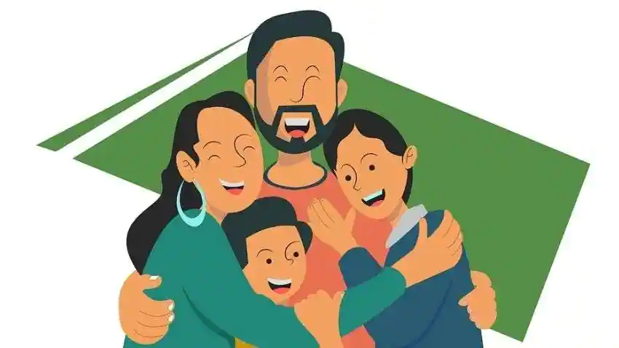
One day one day
Parents
Father - Mother
পিতা -মাতা
I love my parents very much .

Slide 12
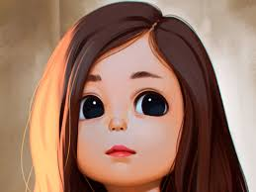
Thanks for all

