Slide 1
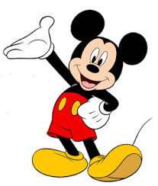
Welcome to our today’s class

Slide 2
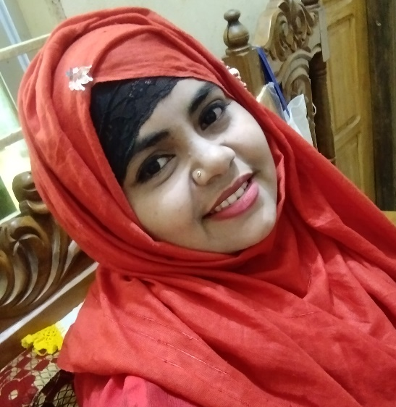
Teachers identity
Farhana parvin jui
Assistant teacher
Char veduriya-1 g.p.s.
Bhola sadar.

Slide 3
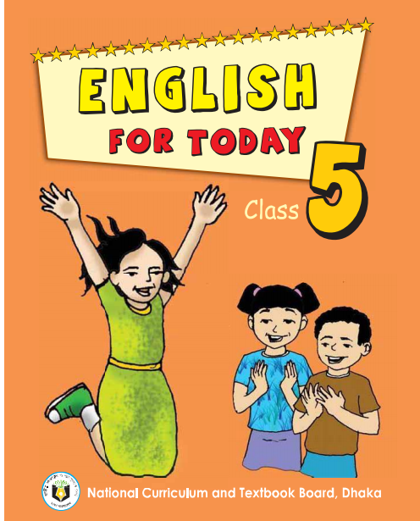
LESSON INTRODUCTION
Sub: English
Class: Five
Lesson:Unit-ten
Topic:
Time:40 minutes

Slide 4
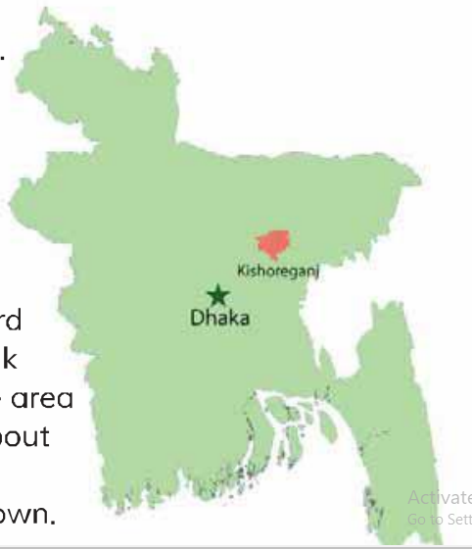
What do you see in the picture?

Slide 5
Today our lesson is
My home district,part:2

Slide 6
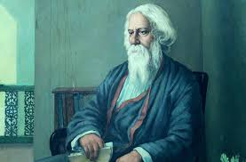
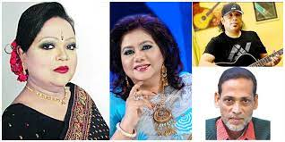
Word meaning
A person who writes poems.
কবি
Poet
Known about by many people.
Famous
বিখ্যাত

Slide 7
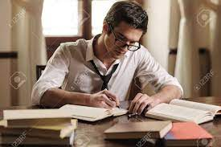
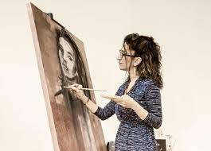
Word meaning
Writer
Who has written a particular text
লেখক
Painter
চিত্রশিল্পী
Who paints pictures

Slide 8
LET’S PLAY A BINGO GAME
New words
poet
famous
writer
painter

Slide 10
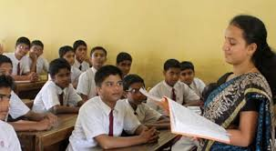
Teacher’s loud reading

Slide 11
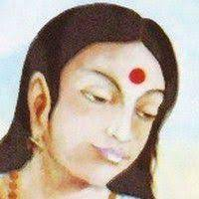
Kishorgang is also the home district of some famous people.candrabati,the first women poet of bangla letareture,was born here.

Slide 12
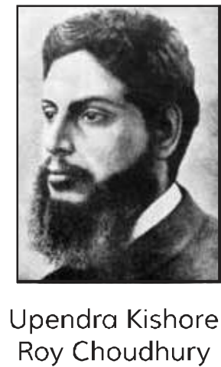
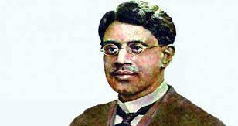
Two writers of children’s literature,Upendrakishore Roy Chowdhury and Sukumar Roy are also from here.

Slide 13
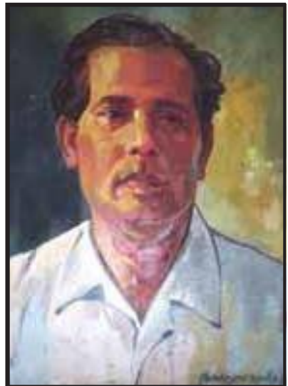
The great painter Zainul Abedin comes from Kishoreganj,too.

Slide 14
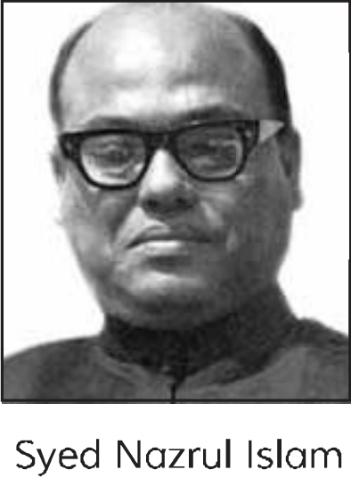
Syed Nazrul Islam,the first acting president of Bangladesh,is also from here.

Slide 15
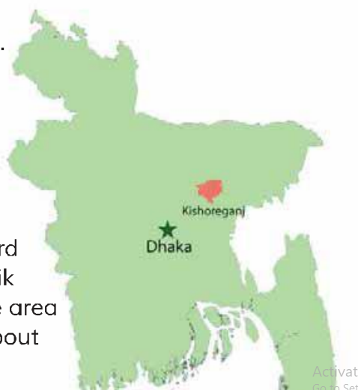
I love my home district!

Slide 16
Pair work
Answer the questions.
1.What’s the name of Mamusn’s home district?
2.How far is it from Dhaka?
3.How did it get its name?
4.What is the name of the river in the town?
5.What are two things you can see in the town?
6.Who are two famous people from his town?

Slide 17
Group work
Make a list of the important places in Kishoreganj.Which place do you think is the most interesting?Why?

Slide 18
Have you read about Kishoreganj?
Yes,I have.There are many important places here.
Which place do you think is the most interesting?
Can you mention the name of them?
But I think,The most interesting place is the Fort of Isha-khan because he was one of the twelve landlords of Bengal.
They are Solakia EidGround,Govt.Guraudayal collage,pagla mosque,Fort of Isha-kha,Shah Muhammad Mosque,Shiva temple of Chandrabati etc.

Slide 19
Home work
Write at list 5 sentence about ‘The importance places of Kishoreganj’.

