Slide 1
Welcome everybody

Slide 2
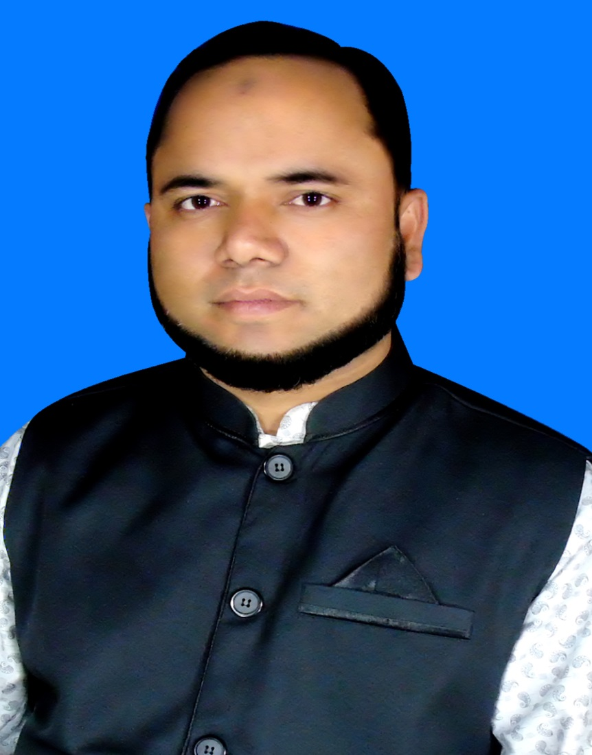
Teacher`s identity
Md.Zakir Hossain Molla
(M.B.S,B.Ed)
Assistant Teacher(Social Science)
Baneswardi High School,
Nagarkanda,Faridpur.
Mobile No:01621401412

Slide 3
Lesson introduction
Class: Nine & Ten
Subject:English-1
Unit: 10
Lesson:04
Date:15-08-2021

Slide 4
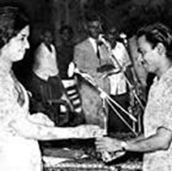
Warm up
Look at the picture. He is a great son of our country.
T:Who is he ?
Ss:He is Zahir Raihan.
T: What do you know about him ?
Ss:He was one of the most talented film makers in Bangladesh.

Slide 5
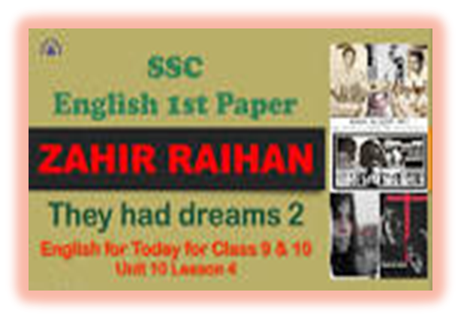
Lesson declaration

Slide 6
Learning out comes
After completing the lesson , student will be able to :
*Read the passage with meaning
*tell some information about the passage.
*Participate in conversations and discussion
*Take and give interviews
*Complete a grid
* write a paragraph

Slide 7
Reading Test
T: Let’s go find out some important information about Zahir Raihan .
Zahir Raihan
could not see his dream come true.
Was missing since 30 December 1971.
Participated in
Liberation war
was a famous film maker
His best documentary’s name’Stop Genocide’
made a movie based on language movement named’Jibon Theke Neya’

Slide 8
Individual work
T:Use appropriate information from the text above to complete the grid.
Participated in | Famous as | Best documentary | Movie based on language movement | Missing since | His dream
Zahir Raihan
Liberation war | film maker | Stop Genocide’ | ’Jibon Theke Neya’ | 30 December 1971. | came true.

Slide 9
Pairs Task
T: Work in pairs.Discuss.
1 Why Zahir Raihan is considered a freedom fighter though he was a film maker?
2. How does the title of the lesson fit the story of Zahir Raihan ?
Minni: Simmi ,can you tell me why Zahir Raihan is considered a freedom fighter though he was a film maker?
Simmi: Because he joined the Liberation war in 1971.Besides, he donoted money in the ‘Freedom fighters’ Trust and his documentary ‘Stop Genocide’ created world sentiment in favour of our liberation .
Minni: How does the title of the lesson fit the story of Zahir Raihan ?
Simmi: Yes, the title of the lesson fits the story. The title is ‘They had dreams’
Similiarly the story is about Zahir Raihan’s dream for a democratic society that will ensure freedom of speech and will.
Minni: Thank you, Simmi.
Simmi: Thank you.You are welcome.

Slide 10
Group Work
T: Meet a freedom fighter in your locality . Interview him/her.
Abir:Assalamu alaikum, Mr. Abdul Hakim,We have come to know about your
experience as a freedom fighter in our Liberation War .We will you ask
some questions.May we start now .
Abdul Hakim :Yes.
Abir:In which area did you fight ?
Abdul Hakim: I fought in the border area of Joypurhat District .
Abir: Where did you take training from?
Abdul Hakim: I took training from Indian army in Deradun training academy.
Abir: Can you tell us any exprienceb of your s in liberation war ?
Abdul Hakim: On December 14,1971,Pakistani army attacked our village. They killed many people.I was the team leader of freedom fighters.We occupied Pak
Army’s camp.We killed their major. Thus we could make our village free from the enemies.
Maruf: Could you fulfill your dream by achieving the independence of the country ?
Abdul Hakim : Not at all ! There are many problems in our country. Yet ,I believe that one day our present generation will take the responsibility of this nation and they will take a change in this country.
Rupa: Thank you Mr.Abdul Hakim for giving us your valuable time.
Abdul Hakim :May Allah bless you.

Slide 11
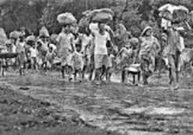
Home Work
Write a Paragraph on ‘Freedom fighter Abdul Hakim’

Slide 12
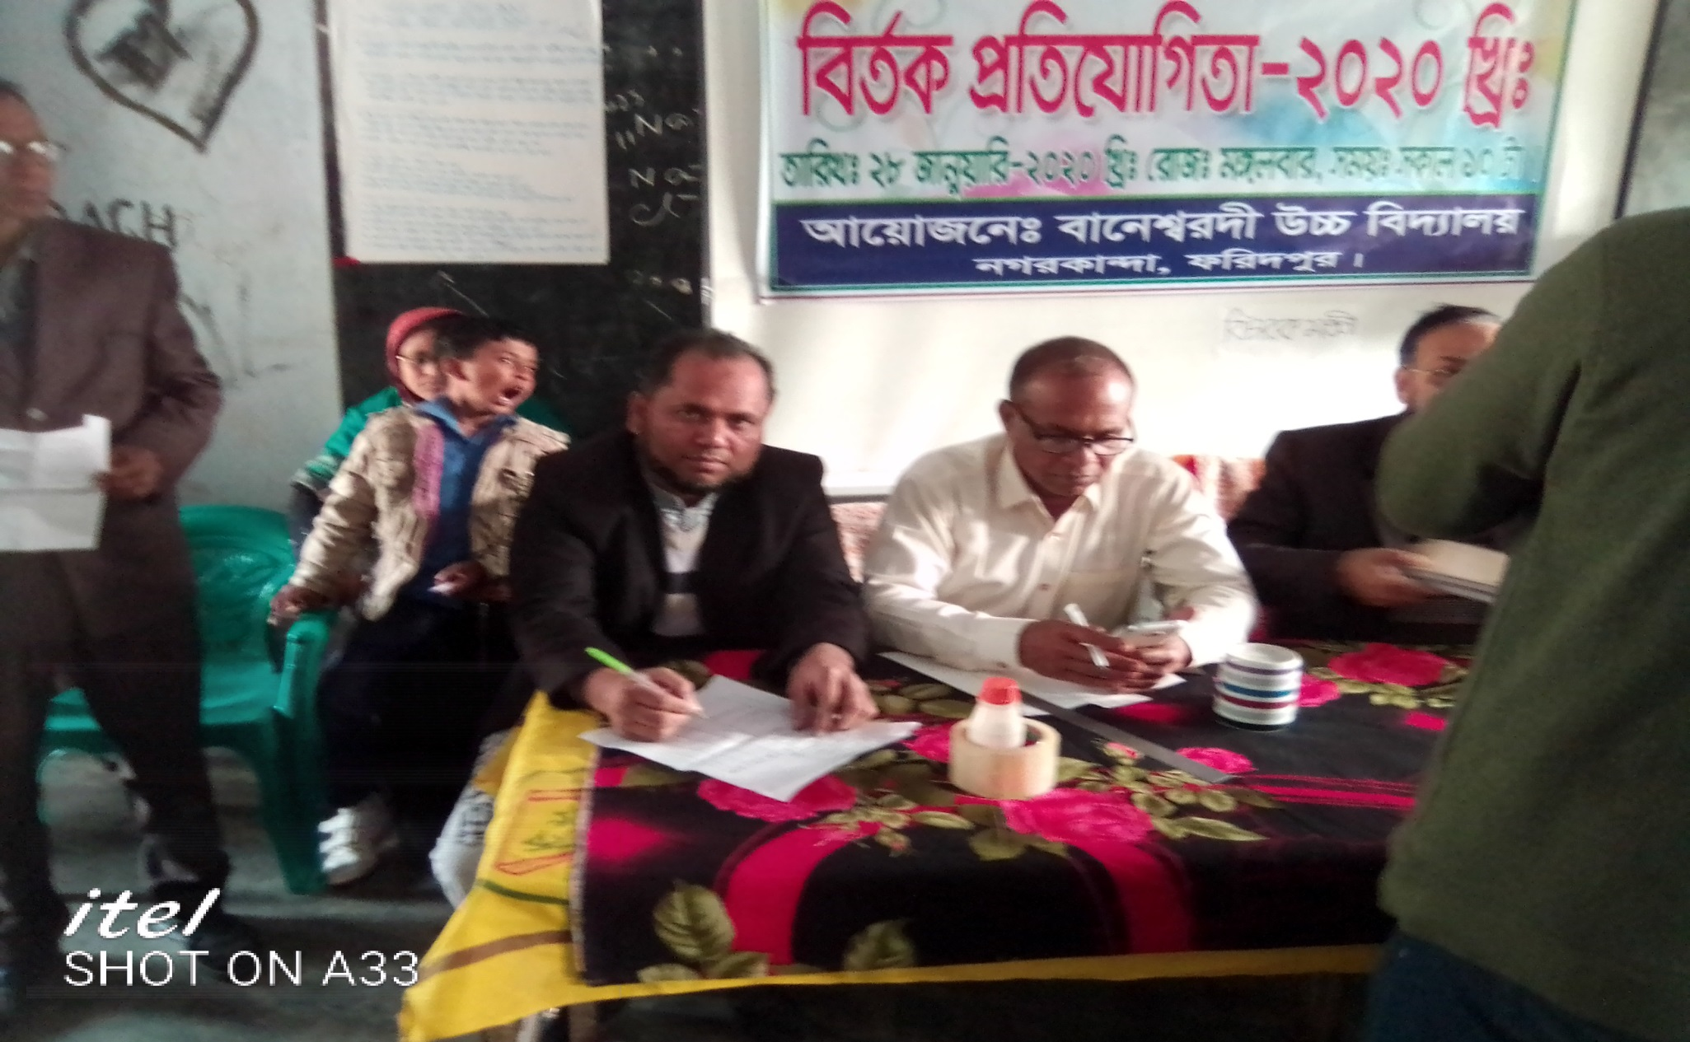
Good bye

