Slide 1
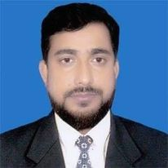
Welcome to my new class

Slide 2
Introduction
About myself
About my class
MD. ARIFUL ISLAM
LECTURER IN ENGLISH
SHAYESTAGANJ KAMIL MADRASAH
SHAYESTAGANJ, HABIGANJ
CON: 01711957590
EMAIL: arif046980@gmail.com
CLASS: TWELVE
SUB: ENGLISH 1ST PAPEWR
PERIOD: 1ST
SS NUMBER:50
TIME 50 MINUTES
DATE: 26/082021
TOPIC: UNIT-2
LESSON: 04

Slide 3
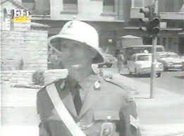
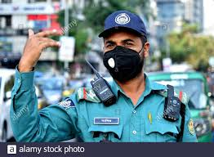
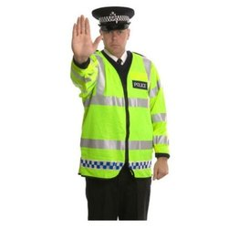
LOOK AT THE PICTURES TELL ABOUT THEM

Slide 4
Yes all of you are right
This is the very picture of traffic polic. So our today’s topic is My Brother Is A Traffic Police Man

Slide 5
Our lesson
Unit Two: Traffic Education
Lesson 4 From Filippos Fylaktos' Film"My Brother, the Traffic Policeman"

Slide 6
LESSON OUTCOMES
AFTER COMPLETING THE THE LESSON THE STUDENTS WILL BE ABLE TO:
Tell about a film on traffic police.
Ask and answer simple question.
Make paragraph on traffic police

Slide 7
Warm up activity:
Imagine yourself as a traffic policeman. You have just finished your shift
directing traffic near a school from morning till noon. Talk to a small group
for 5 minutes about your experience.

Slide 8
Let us read the passage first
The persona of a traffic policeman has always been a curious one. It has often found important space and close treatment in literature and other arts. Besides the many poems about this fascinating character, there is at least one movie where the central character is a traffic policeman. In 1963, Greek film maker Filippos Fylaktos made this film named My Brother, the Traffic Policeman. It featured a slightly manic traffic policeman,

Slide 9
Read silently
Antonis Pikrocholos, who is utterly devoted to service and duty, and applies the traffic code with unyielding severity. Tickets rain down upon law-breakers in particular taxi-drivers and especially Lampros, who happens to be in love with Pikrocholos’ sister, Fofo. In his turn, the traffic policeman is in love with a businessman’s daughter, Kiki, who is afraid to reveal her feelings to her father. Besides, Antonis has given lots of traffic tickets to a bus belonging to her fatherÕs company. For all these reasons, the road to marriage for both couples is long and strewn with obstacles, but the outcome is a happy one for everyone involved.

Slide 10
Individual Work
3. Guess the meanings of the following words from the context:
a. persona
b. curious
c. fascinating
d. manic
e. devoted
f. obstacles

Slide 11
Pair Work
4. Answer the following questions:
a. What does Ôgiving ticketsÕ mean in the context?
b. What idea of the central character have you formed?
c. What is meant by 'the road to marriageÕ?
d. In which language was the movie probably made?
e. How does the movie end?

Slide 12
Evaluation
Find the meaning of the word Ômanic.Õ What is the root word for manic? Describe in 5 sentences how a manic traffic policeman would behave in real life.

Slide 13
Homework
Go to Google and find out more about the film and write a 200 words paragraph based on your search. If possible, watch the film on the You Tube.

Slide 14
Thank you all

