Slide 1
WELCOME MY STUDENTS

Slide 2
TEACHER IDENTITY
MST. KOHINOOR AKTER BANU
ASSISTANT HEAD MASTER
ALAMPUR SECONDARY GIRLS SCHOOL
KUSHTIA SADAR KUSHTIA
MOBILE NO- 01716494605

Slide 3
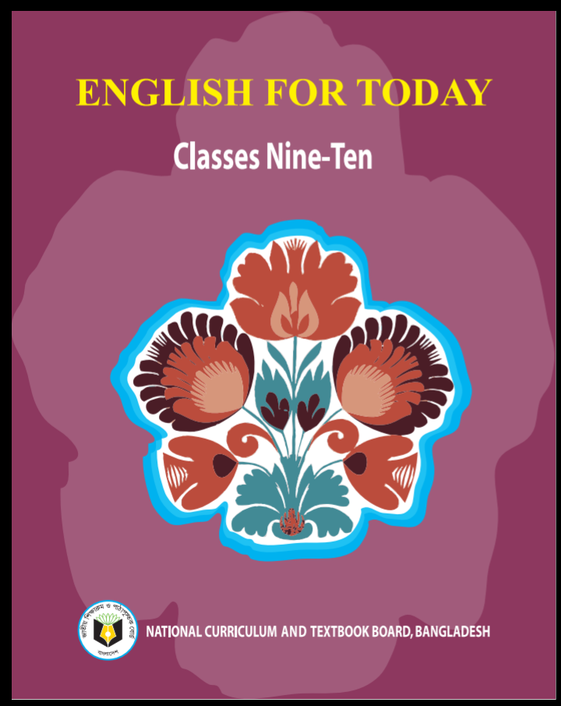
English 1st paper
Class:- Nine
Unit- seven (People who stand out)
Lesson- One (Zainul Abedin, the great artist)

Slide 4
Learning Outcomes-
1. Read and demonstrate the understanding texts through silent reading
2. ask and answer questions
3. Listen to an audio text for specific information

Slide 5
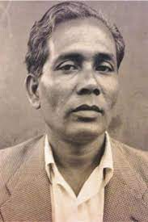
-Do you know this person? why is he famous?
Ans: He is Zainul Abedin. He is a great artist.

Slide 6
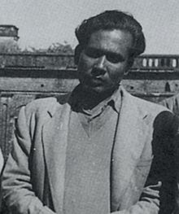
Shilpacharya
Zainul Abedin
জয়নুল আবেদিন

Slide 7
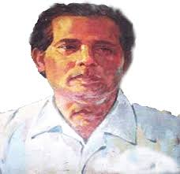
-Can you name some of his world famous sketches?
Ans: The Struggle is one of his world famous paintings. His other world famous sketches are Rebel Cow, Nobanno, study of a crow, Two Faces and Famine paintings.

Slide 8
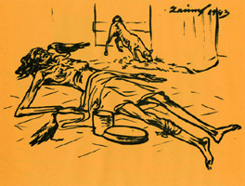
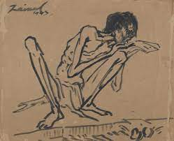
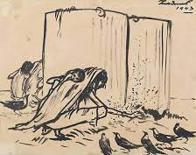
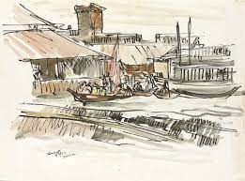
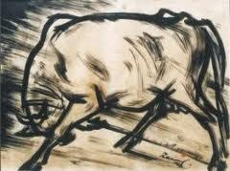
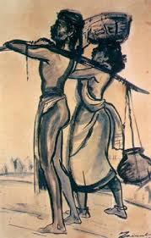
Some works of art by Zainul Abedin

Slide 9
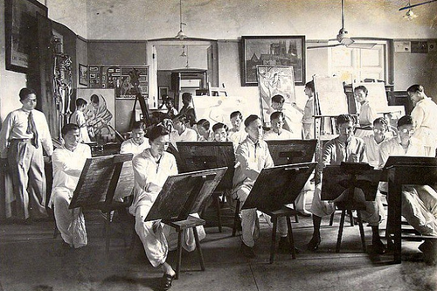
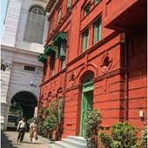
He depicted these extremely shocking pictures with human compassion. He made his own ink by burning charcoal and used cheap ordinary packing paper for sketching. Using the ink and applying the brush where necessary, he produced the drawings and sketches which later became iconic images of human suffering.
Zainul developed a knack for drawing and painting when he was a high school student. After completing high school, he took admission in the Government School of Art, Calcutta (now Kolkata).
Government School of Art, Calcutta

Slide 10
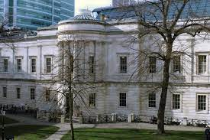
He graduated with the first position in first class in 1938. He was appointed a teacher of the Art School while he was still a student there. He also attended the Slade School of Arts, London during 1951-52.
Slade School of Arts, London
Zainul Abedin is considered the founding father of Bangladeshi art. He was an artist of outstanding talent and earned international reputation. For his artistic and visionary qualities, he is referred to as Shilpacharya meaning 'great teacher of art' in Bangladesh. He was the first Principal of the first art school in Dhaka in East Pakistan (now Bangladesh). He organized the Nabanna (harvest) exhibition in 1969. The exhibition included a 65 feet long scroll portraying the rural East Pakistan in phases from abundance to poverty.

Slide 11
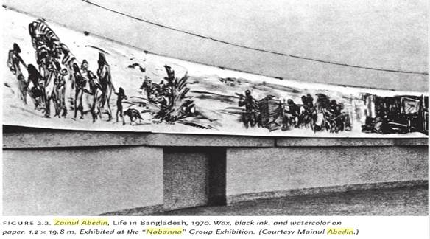
This intensified the already heightened non-cooperation movement against the Pakistan regime. The exhibition was symbolic of the Bangalec artists' protest and a milestone in our struggle for cultural and political freedom. ZainuTs dynamic style of work is evident in a 30 feet long scroll painting called Manpura, which was done to commemorate the death of hundreds and thousands of people in the devastating cyclone of 1970.

Slide 12
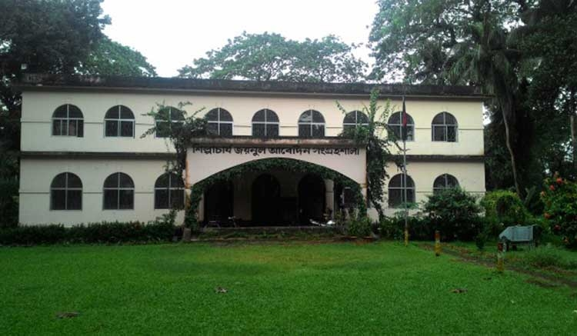
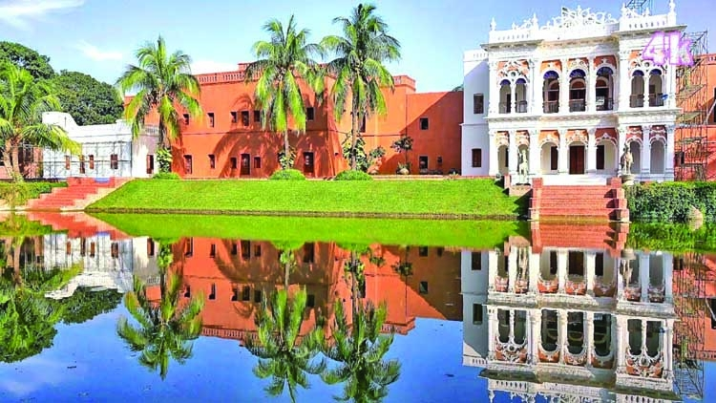
He designed the pages of the Constitution of the Bangladesh. He founded the Folk Art Museum at Sonargaon, and also Zainul Abedin Shangrahasala, a gallery of his own works in Mymensingh in 1975.
Folk Art Museum at Sonargaon
Zainul Abedin Shangrahasala

Slide 13
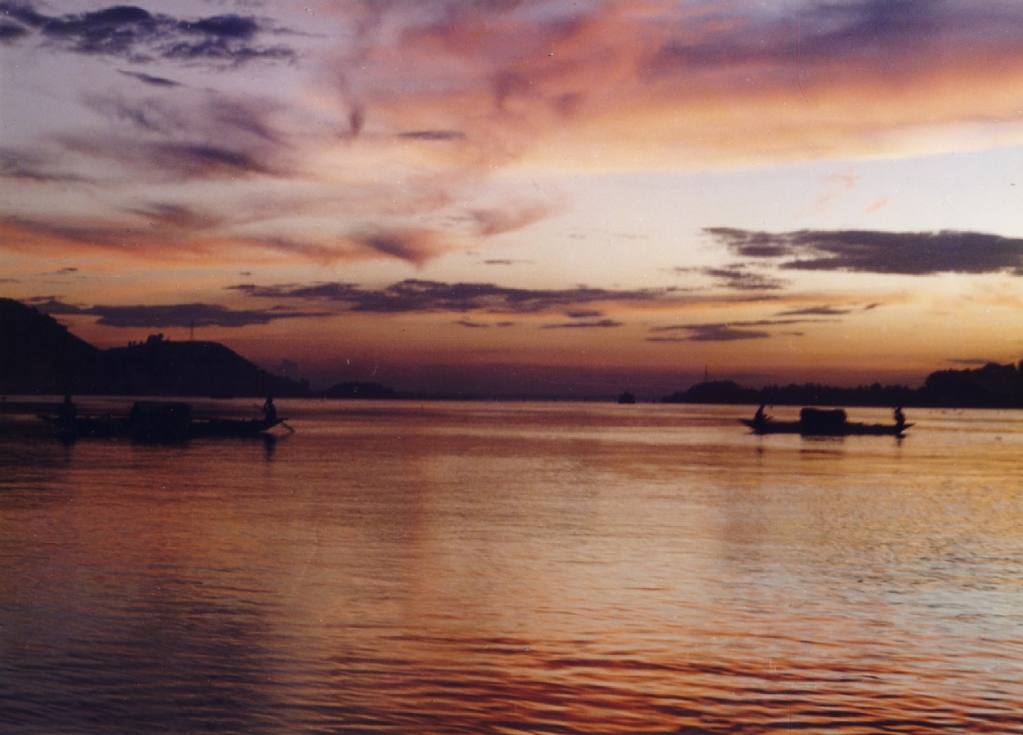
The river Brahmaputra played a vital role in his paintings and was a source of inspiration all through his career. Much of his childhood was spent near the scenic river Brahmaputra. A series of water colours that Zainul did as his tribute to the river earned him the Governor's Gold Medal in an all-India exhibition in 1938. This was the first time that he came into spotlight and this award gave him the confidence to create his own visual style.
Brahmaputra

Slide 14
Word & Meaning
Word
Colonial
Characteristic
Dissatisfaction
Deprivation
Starvation
Depict
Knack
Meaning
ঔপনিবেশিক
বৈশিষ্ট্যময়
অসন্তুষ্টি
বঞ্চনা
খাদ্যাভাব
চিত্রিত করা
নৈপুণ্য

Slide 15
Evaluation
Choose the best answer-
1. Which one is not appropriate for Zainul Abedin?
✔
a. Master of art, | b. A sculptor,
c. A great teacher, | d. A painter
2. The river Brahmaputra – Zainul Abedin much.
a. pleased, | b. satisfied,
c. heightened, | d. encouraged.
✔
3. Where was Zainul Abedin born?
a. Sonargaon, | b. Dhaka,
c. kishoregonj, | d. Mymensingh.
✔

Slide 16
4. What is the synonym of the word ‘exhibition’ in line.13?
a. display, | b. performance
c. fair, | d. advertisement.
✔
5. Zainul Abedin was honored with the title ‘Shilpacharya’ for this_
a. eccentricity, | B . Outstanding academic performance,
c. Poetic genius, | d. Artistic and visionary qualities.
✔
6. The antonym of the word ‘famine’ in line no.3 is__.
a. wealth, | b. abundance,
c. justice, | d. happiness.
✔

Slide 17
Answer the following questions
1. What were the themes of his famous sketches?
Ans: ‘Famine Sketches’ are the famous paintings of Zainul Abedin. The themes of those sketches were the helplessness, deprivation, starvation, and sufferings of the poor.
2. Why is he called humanitarian artist?
Ans: In his ‘Famine Sketches’ Zainul Abedin drew the helplessness, deprivation, starvation and miseries of the poor people. Therefore, he is called a humanitarian artist.
3. Where did he spend much of his childhood?
Ans: He spend much of his childhood near the scenic banks of the Brahmaputra River.

Slide 18
4. Where did Zainul Abedin join as a teacher after his graduation?
Ans: Zainul Abedin joined the government school of art as a teacher after his graduation.
5. Why is he called the founding father of Bangladeshi modern art?
Ans: He is called the founding father of Bangladeshi modern art, because he introduced new style of painting to Bangladesh art, established modern Art in Bangladesh with his extraordinary talent and presented it before the world.

Slide 19
Thank You my All Students

