Slide 2
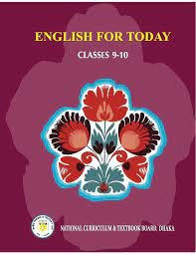
Identity
Md . Tauhid mia
Teacher of
P .G darussalam Dakhil Madrasah
Kalmakanda , Netrokona
CLASS: Nine-Ten
Subject: English for today

Slide 3
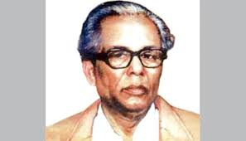
Let`s see a picture

Slide 4
OUR TO DAY`S TOPIC IS -
Zainul Abedin , The Great Artist

Slide 5
Learning outcome
After we have studied this lesson ,we will be able to …..
Ask and answer question
Read and understand text through silent reading
Write a dialouge

Slide 6
Flag belongs to which country?
Bangladesh
bangladesh is focused here as Zainul abedin was born in this country

Slide 7
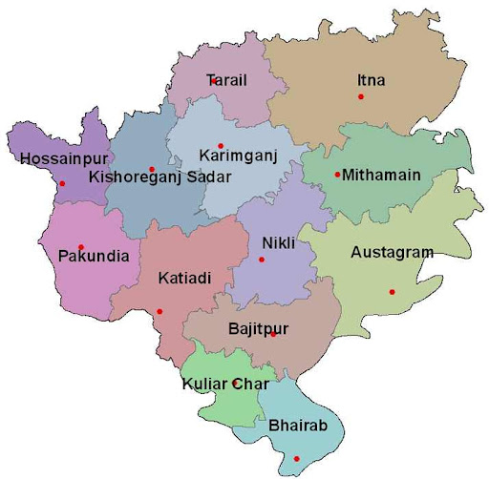

Slide 8
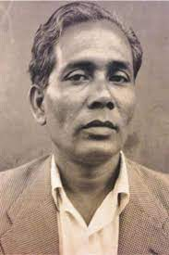
Born
29 December 1914
Place
Kishoregonj
Died
28 May 1976
Zainul Abedin

Slide 9
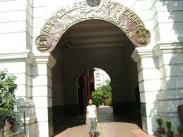
Education
Government school of Art in Calcutta
The Government College of Art and Craft in Kolkata, India

Slide 10
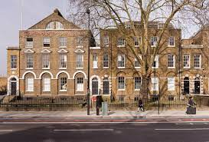
Art school , London

Slide 11
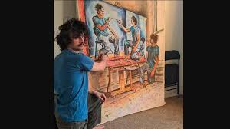
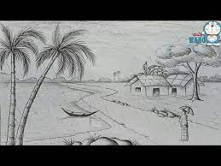
Known for
Painting
Drawing

Slide 12
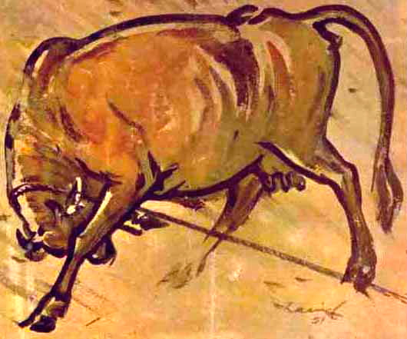
Notable Work
Rebel Cow
The picture shows the extreme effort for freedom

Slide 13
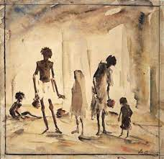
Famine Painting -

Slide 14
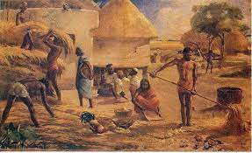
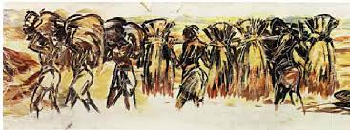
Nobanno

Slide 15
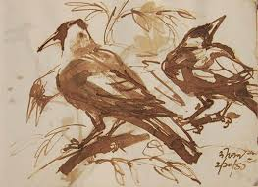
Study of a Crow; Two faces.

Slide 17
East Pakistan
East Pakistan was the eastern provincial wing of Pakistan between 1947 and 1971,

Slide 18
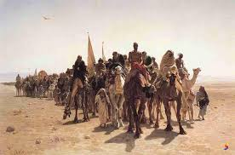
pioneer
Leader, Ambassador, promoter
Zainul Abedin was the pioneer of modern Art

Slide 19
visionary
Dremer, sharp
Zainul abedin was a visionary leader

Slide 20
Let`s have tour from the text
Dear Learners open your book at page 92 and read silently

Slide 21
A. Read the passage carefully and answer the questions
Zainul Abedin (29 December 1914 – 28 May 1976) was a Bangladeshi painter born in Kishoregonj, East Bengal, British India (now Bangladesh). He became well known in 1944 through his series of paintings depicting some of the great famines in Bengal during its British colonial period. After the Partition of Indian subcontinent he moved to East Pakistan (now Bangladesh). In 1948, he helped to establish the Institute of Arts and Crafts (now Faculty of Fine Arts) at University of Dhaka.The Indian Express has described him as a legendary Bangladeshi painter. Like many of his contemporaries, his paintings on the Bengal famine of 1943 are viewed as his most characteristic works.

Slide 22
His homeland honored him with given the title “Shilpacharya” (Bengali: “Great teacher of the arts" for his artistic and visionary attributes. He was the pioneer of the modern art movement that took place in Bangladesh and was rightly considered by Syed Manzoorul Islam as the founding father of Bangladeshi modern arts, soon after Bangladesh earned the status of an independent republic.

Slide 23
. Answer the questions from the passage above
• Who was Zainul Abedin?
• Why is he famous?
• What are his well known sketches?
• Why he is called shilpacharya?

Slide 24
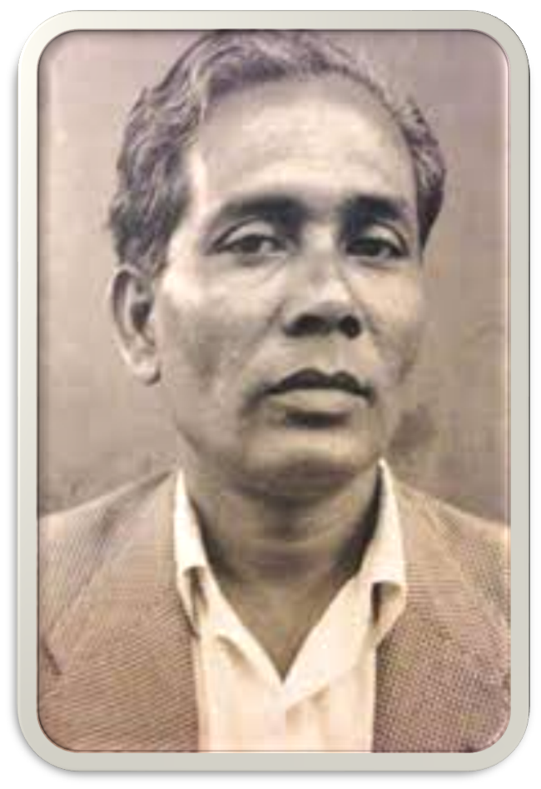
C . Look at the picture and talk about his in pairs .
Take the help of the question given below.
How old is he?why do you think so?
What is his famous work?
What is he wearing?

Slide 25
HOME WORK.
Write a dialouge about life and activities of zainul abedin

Slide 26
Thank you so much

