Slide 2

Welcome to my class

Slide 3

Exchange greetings with students
T: Good morning/afternoon students.
SS:Good morning/afternoon teacher.
Notes:
How are you today? Fine thank you . বলতে উৎসাহিত করব।

Slide 4
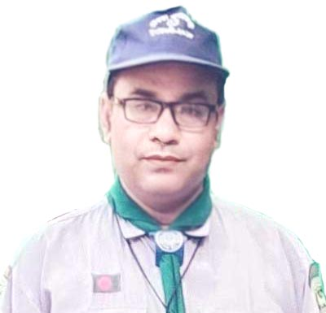
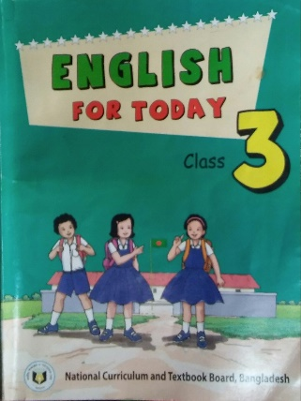

Introduction
Mohammad Arman Ali
Assistant teacher
Teota Govt. primary school.
Shibaloy, Manikgonj.
Mobile no- 01712466188
E-mail- armanali6188@gmail.com
English For Today
Class: three
Unit: 26 What are they doing?
Lesson: 3-5 ( A )

Slide 5
Class: 3 English
Learning outcomes
Students will be able to-
Listening: 3.1.1- understand statements.
Speaking:
6.1.1 – say What the speaker is doing.
6.1.2 – say What others are doing.

Slide 6
Let’s listen and sing the song.

Slide 7

Open your book at page 53

Slide 8
Listen the audio.
Notes:
I will ask the students to listen the audio more than once .

Slide 9
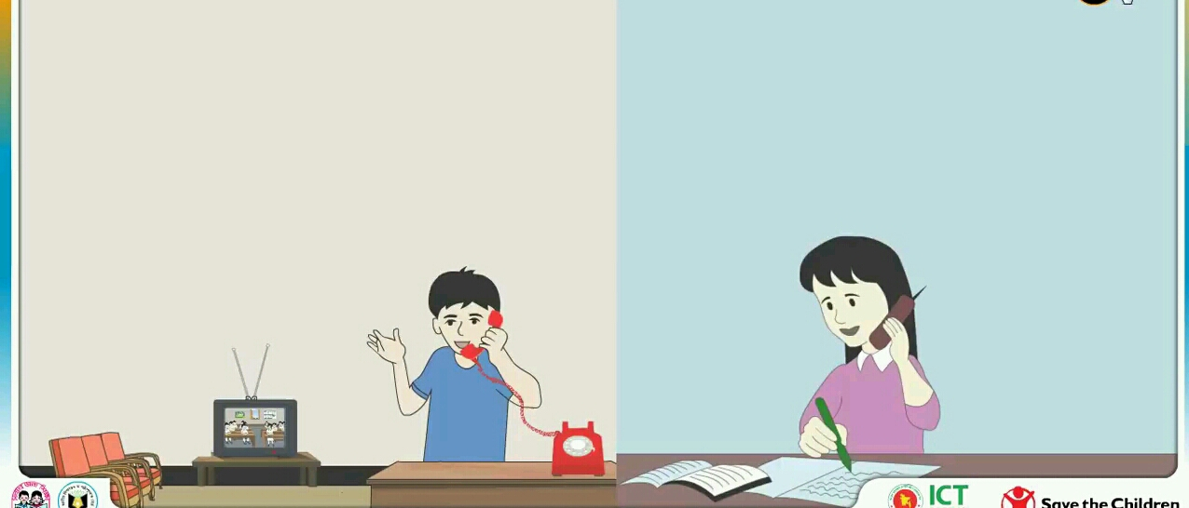
Let’s see the pictures.
Notes:
I will ask the students to describe the situation, scenery etc. and I will ask who and what are they doing.

Slide 10
What are they doing?
Notes:
I will encourage SS to say that they are talking over telephone.

Slide 11
What are you doing?
I’m doing homework.

Slide 12
What are you doing?
I’m watching TV.
Notes:
I will try to understand SS that while doing any work, we add ing with the word. কারো কাছে যদি জানতে চাই সে কী করছে, তাহলে আমরা প্রশ্ন করি ,What are you doing?

Slide 13
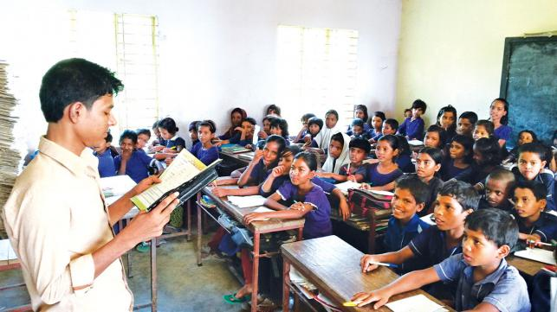
Teacher’s reading
Notes:
At first I will read 3/4 times and SS listen to me. After then, SS will say with me.

Slide 14
I will call two students in front ( one boy and one girl) and ask them to play a role in the conversation.
I’m reading.
What are you doing?

Slide 15
I will call other two students in front ( one boy and one girl) and ask them to play a role in the conversation.
I’m writing.
What are you doing?
Notes:
In this way, I will ask different different students to play a role. At first, first student ask ,second student answer.after then,second student ask , first student answer.

Slide 16
Pair work
Notes:
Sitting in their respective seats, SS ask and answer I will evaluate them through observation. I will move in the class and help if necessary. At last I will want to know what they have learnt today.

Slide 17


