Slide 1
W
E
L
O
E
C
M

Slide 2
Teacher’s Identity
Md Jahid Hossen Khan
Headteacher
Rajihar Government Primary School .
Agailjhara , Barishal .
Mobile: 01623309794

Slide 3
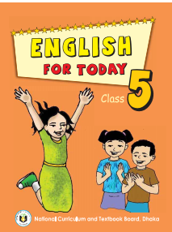
Class: Five
Subject: English

Slide 4
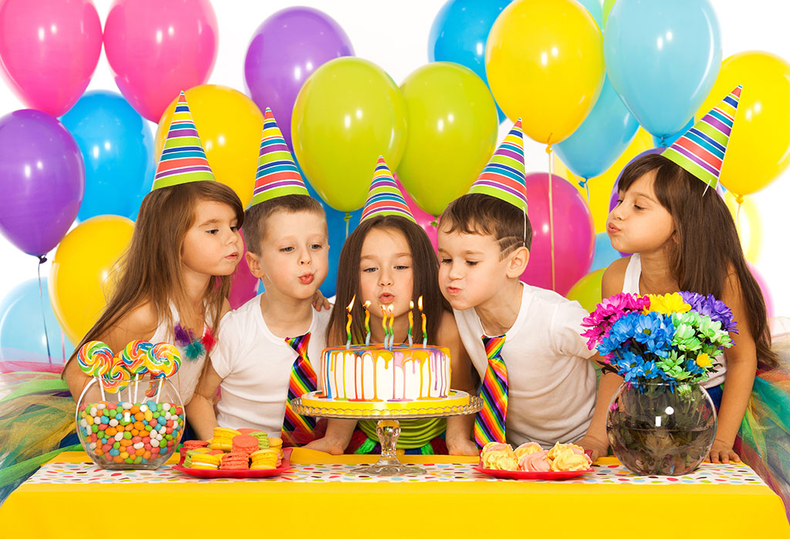
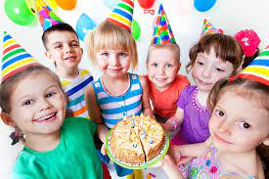
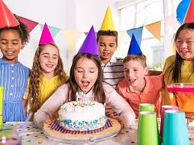
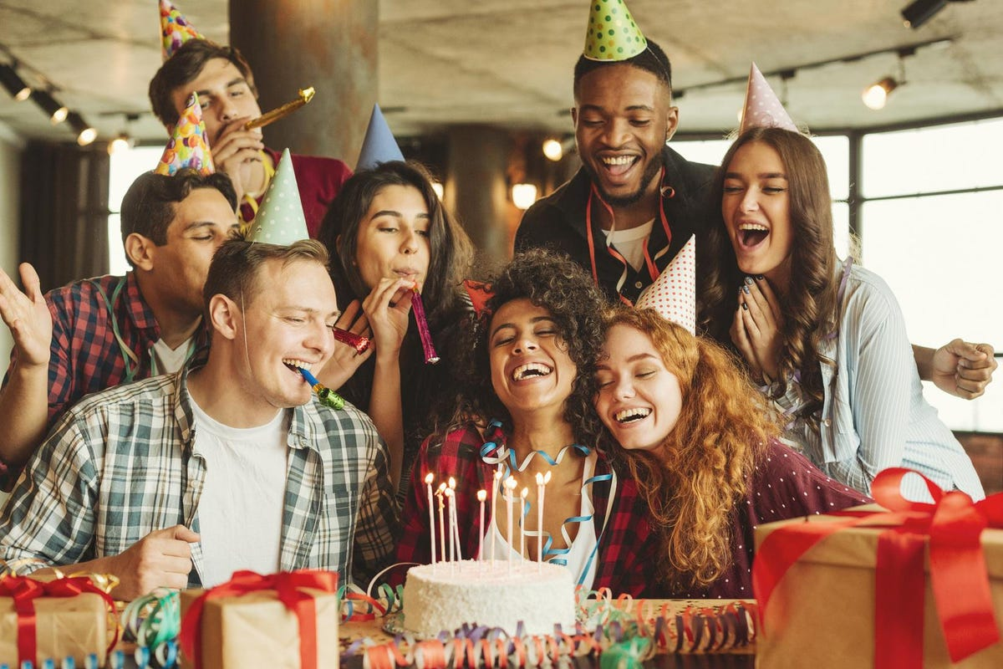
Let’s see the pictures.
What are the pictures about?

Slide 5
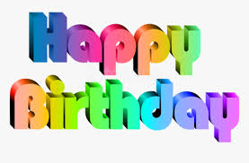
Today’s Topic
Unit: 15
Lesson: 1
Activity: A

Slide 6
1.3.1
recognize which words in a sentence are stressed.
1.4.2
recognize and use intonation patterns for greetings and statements .
3.1.1
understand questions asked by the teacher about them .
Listening:
3.4.1
understand statements made by the teacher and students.
1.1.1
say words , phrases and sentences with proper sounds and stressed.
Speaking:
6.1.2
say what others are doing.
6.2.1
talk about people , objects, events etc.
1.5.1
red words , phrases and sentences in the text with proper pronunciation, stress and intonation.
Reading:
1.7.1
read paragraphs , dialogues, stories, letters and other texts.
5.1.1
Read silently with understanding paragraph.

Slide 7
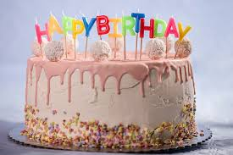
Let’s know some new words.
This is the date when the person was born.
Birthday
A type of food which is made of flour , sugar and salt etc.
Cake

Slide 8
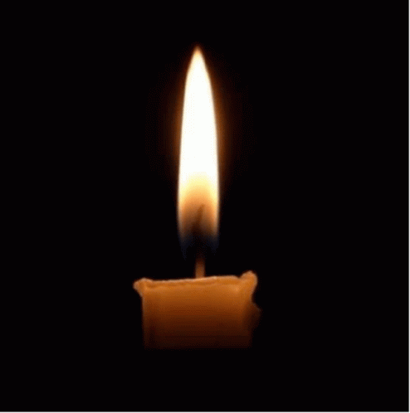
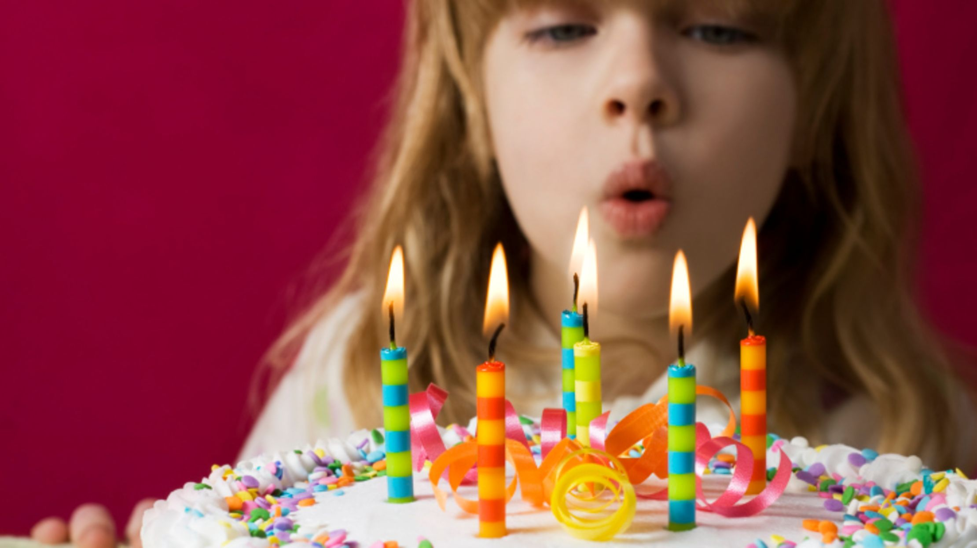
A stick of wax with a string going through it that you burn to produce light.
Candle
Blow out
To extinguish by air.
Children
The little boys and girls.

Slide 9
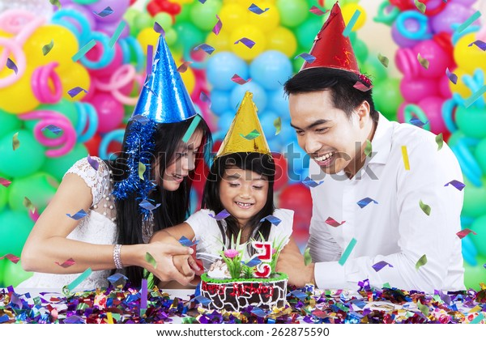
Teacher’s Model Reading.
A person’s birthday is a special day .

Slide 10
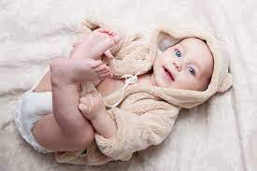
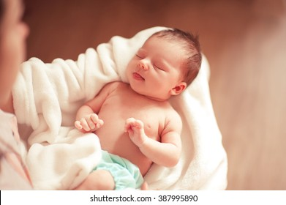
This is the date when the person was born .

Slide 11
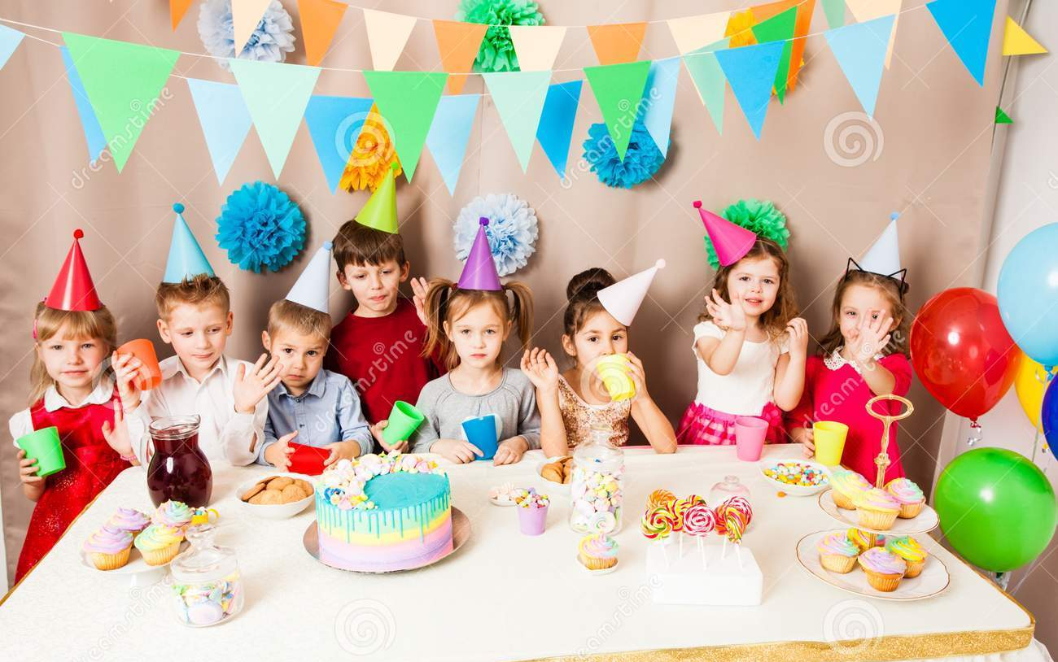
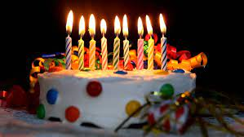
People around the world celebrate birthdays in different ways . In many countries , people celebrate with a cake. There is one candle for each year of the persons life .

Slide 12
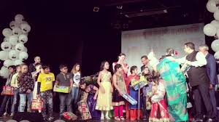
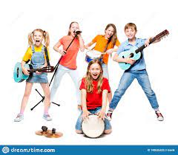
People sing a song for the person.

Slide 13
At the end of the songs , the person blows out the candles .

Slide 14
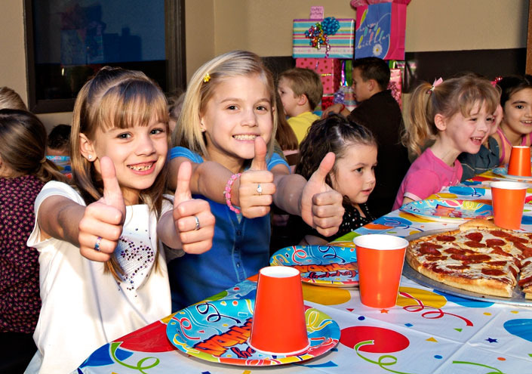
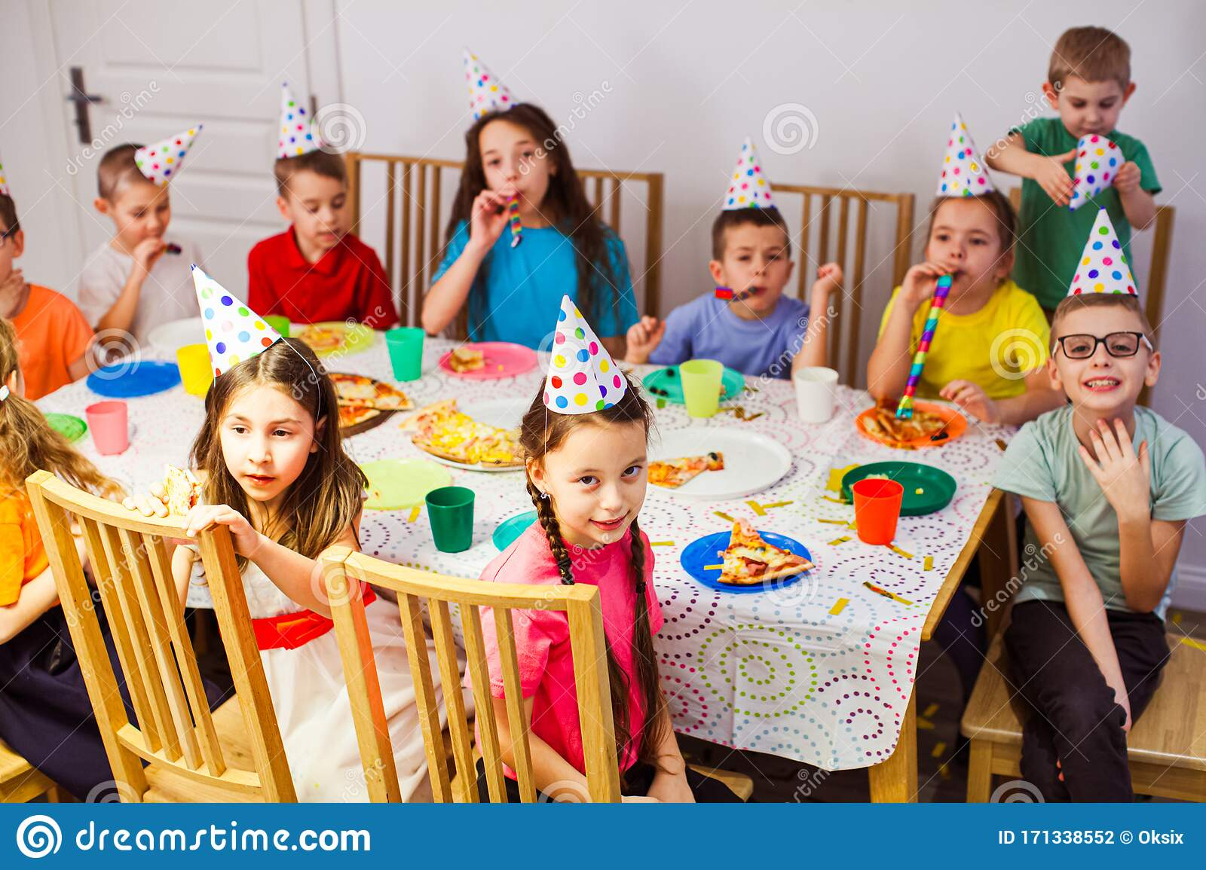
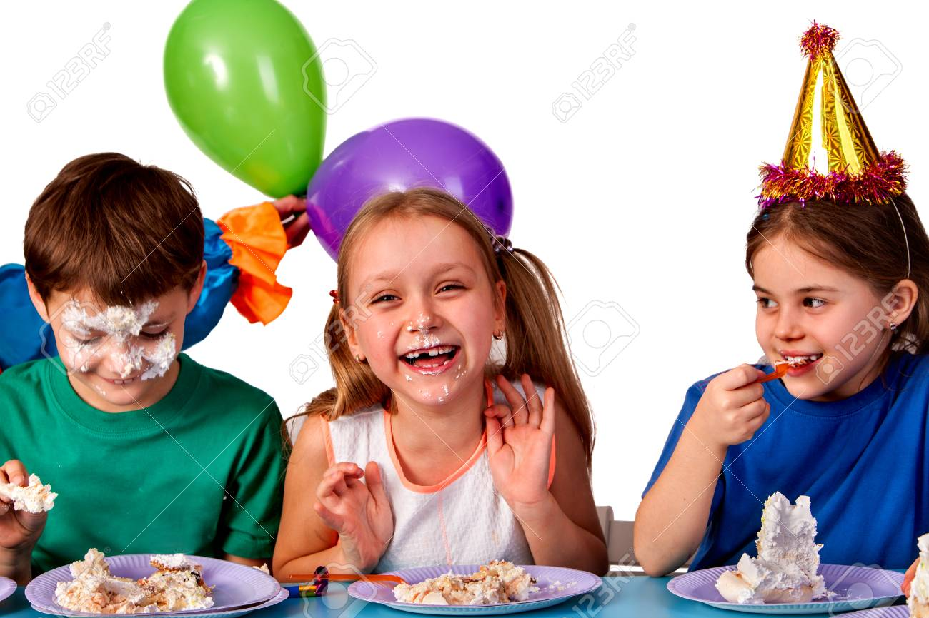
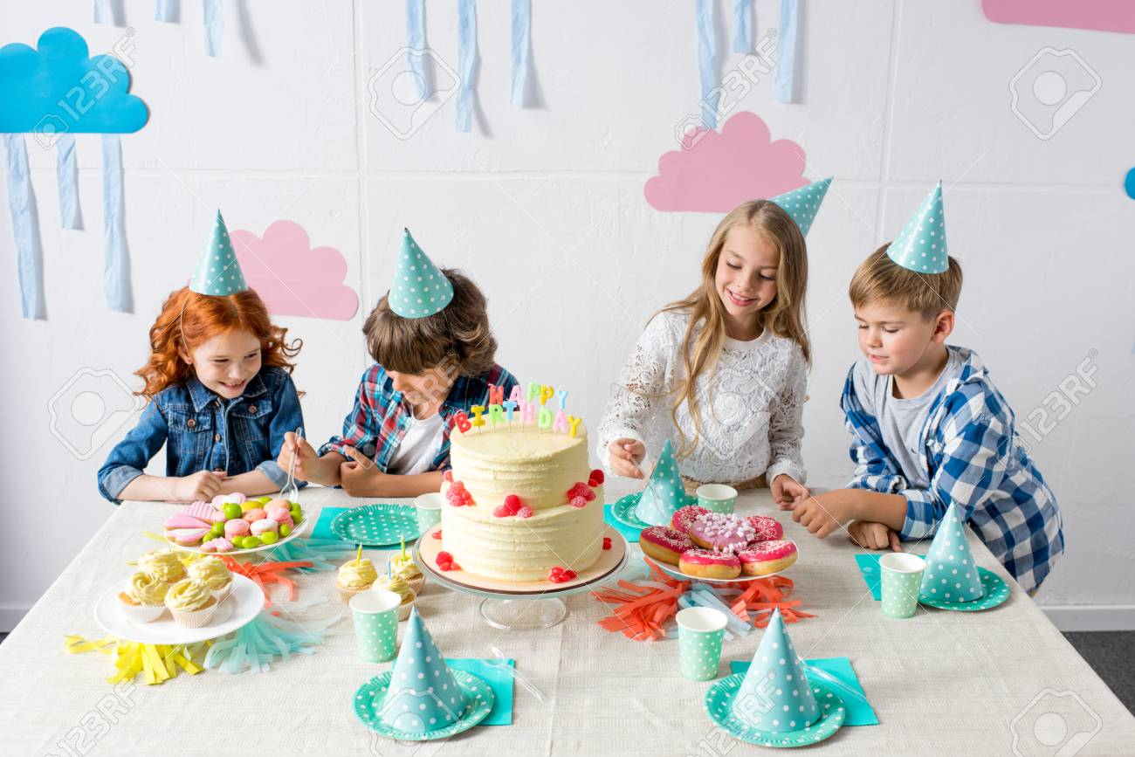
In some countries, there is often a party for a child’s birthday. The child’s friends come to the home .There is special food, like sweets .

Slide 15
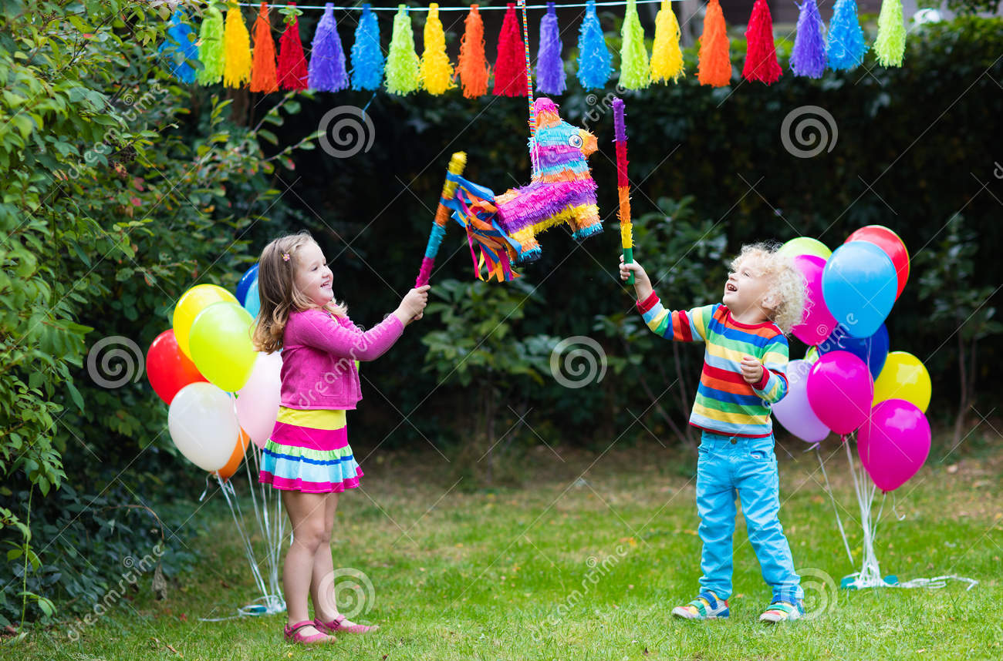
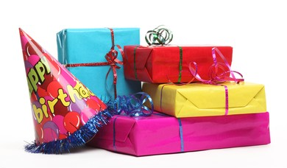
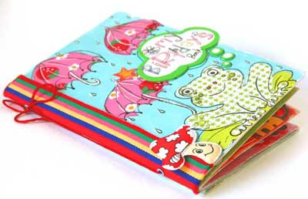
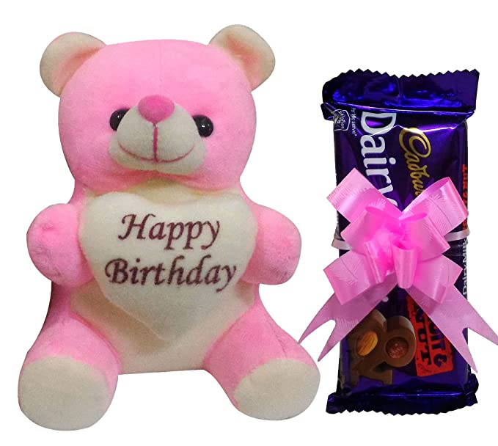
The children play games and sing . The friends often bring a birthday gift for the child. The gifts are wrapped in colourful paper . The gift may be a toy , a book or some clothes .

Slide 16
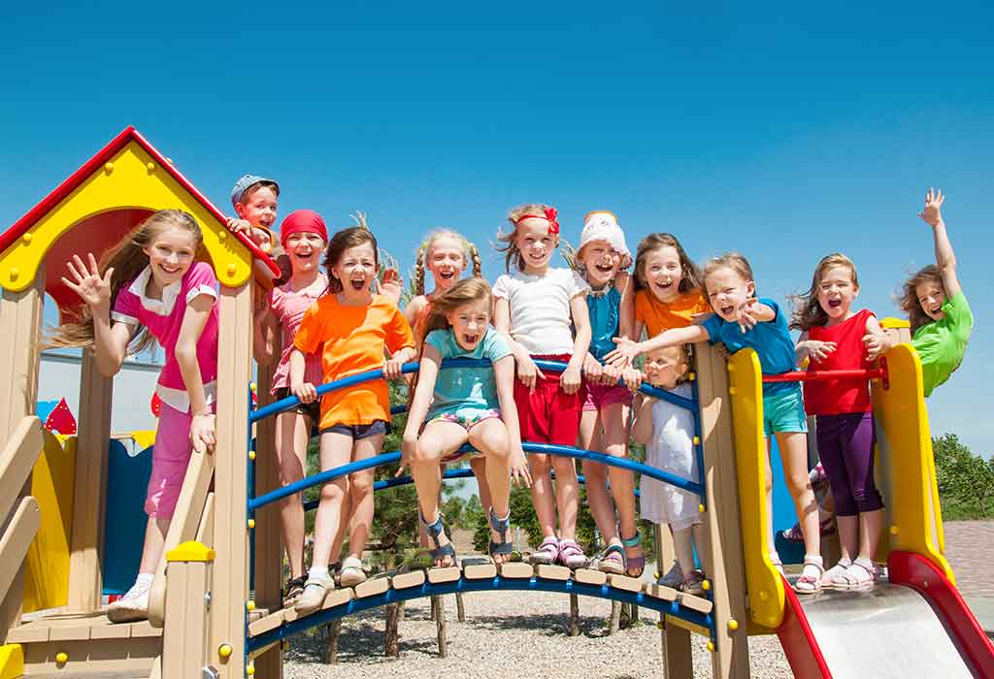
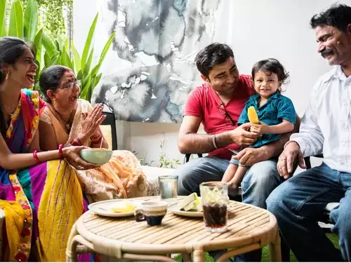
In some countries, the friends don’t bring gifts .The most important thing is to enjoy the day and spend time with friends and family .

Slide 17
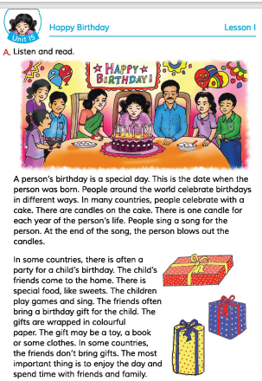
Let’s introduce with the book
Open your book at page 58

Slide 18
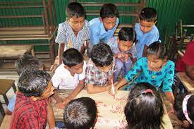
Group work
Read the text

Slide 19
Silent reading
Whole class work
A person’s birthday is a special day . This is the date when the person was born . People around the world celebrate birthdays in different ways . In many countries , people celebrate with a cake. There is one candle for each year of the persons life . People sing a song for the person. At the end of the songs , the person blows out the candles .
In some countries, there is often a party for a child’s birthday. The child’s friends come to the home .There is special food, like sweets . The children play games and sing . The friends often bring a birthday gift for the child. The gifts are wrapped in colourful paper . The gift may be a toy , a book or some clothes . In some countries, the friends don’t bring gifts .The most important thing is to enjoy the day and spend time with friends and family.

Slide 20
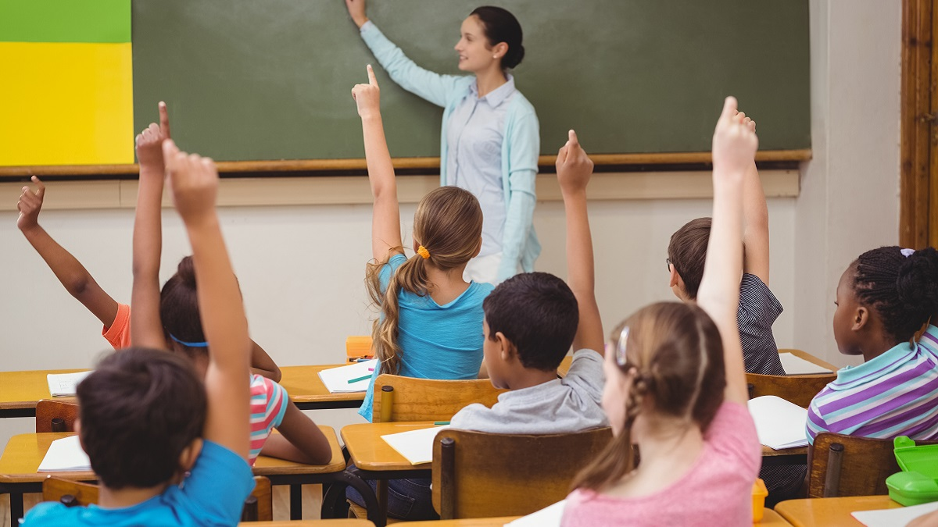
Evaluation
Whole class work
Read the text

Slide 21
Ask and Answer
What is birthday ?
Ans: Birthday is the day when the person was born .
b.How do people celebrate birthday ?
Ans: People around the world celebrate birthday in different ways.
c.What do the children do on birthday ?
Ans: The children play games and sing on birthday .
d. Why do people arrange birthday party ?
Ans: People arrange birthday party to celebrate their child’s birthday .
e. What may be the birthday gift ?
Ans: The birthday gift may be a toy , a book or some clothes .

Slide 22
Home Work
Practise reading the text.

