Slide 2
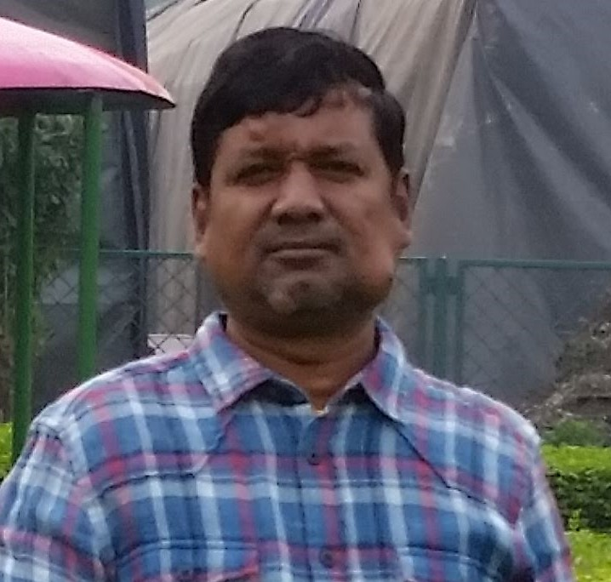
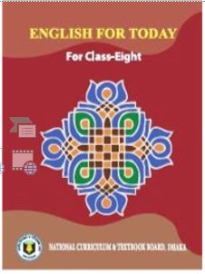
Shah Mohammad Lutful Haider
Assistant Teacher
LUTFUNNESA BALIKA BIDDANIKETON
PAGLA, GAFARGAON
Class- 8
Unit-7, lesson-3
Time: 50 minutes

Slide 3
Let’s watch the video.
https://www.youtube.com/watch?v=EIEzYQTHo4k

Slide 4
Can you tell about the video?
What can you see in it?

Slide 5
River Gypsies in Bangladesh-1

Slide 6
Learning outcomes
By the end of the lesson, students will be able to…
read and understand the text through reading
learn the meaning of new words
ask and answer questions
write a short paragraph

Slide 7
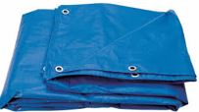
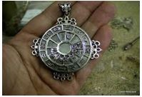
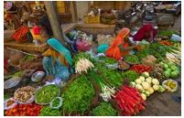
New words
tarpaulin
A heavy water proof sheet
talisman
A magical thing that is remedy for cure
sell
vend

Slide 8
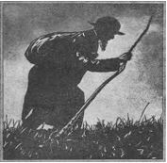
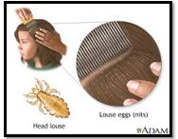
wander
He is wandering.
roam
Blood sucker
that lives in head
lice

Slide 9
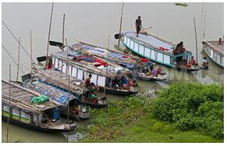
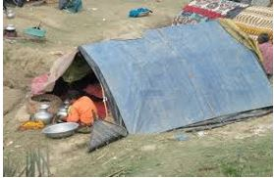
May to December, they stay in small country.
In winter,stay in tent on river banks.
They are known as
Bedey

Slide 10
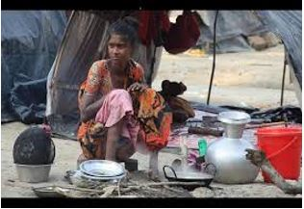
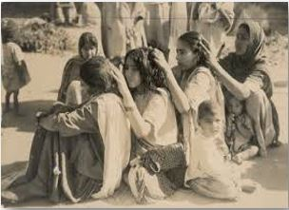
busy with cooking in open air.
idling away in picking off lice.

Slide 11
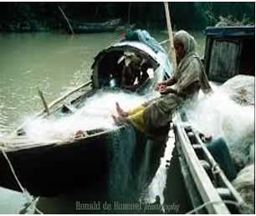
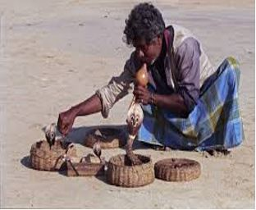
Earning sources
Busy with fishing
Snake charming

Slide 12
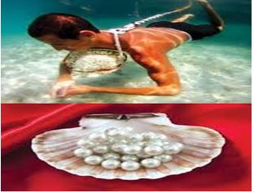
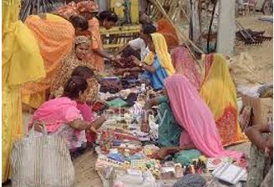
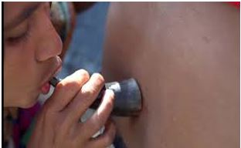
Collecting pearls
Selling cosmetics
Sucking blood to heal pain.

Slide 13
profession
Selling
talisman
Catching
fish
Snake charming
To heal pain

Slide 14
Pair work
Talk about the earning sources of the river gypsies.

Slide 15
Individual work
Fill in the gaps with appropriate words.
Known
River gypsies are (a) ______ as bedey. The have their own (b) _______ and culture. They live (c) _____ groups and do not have any(d) ________. They live a nomadic life, travelling (e) ________ one place to another.
lifestyle
in
Land
from

Slide 16
Evaluation
Who are river gypsies?
How do they live?
What do river gypsies do in winter?
What do river gypsy men do for a living?
What do river gypsy women do for a living?

Slide 17
Homework
Have you seen any gypsy /bedey/snake charmer or any other person selling things from door to door in your area?
Write your experience about any one of them in ten sentences.

