Slide 1
Welcome to our
English class

Slide 2
Presented by:
MD.AZIZUR RAHMAN
Assistant Teacher
Kandigoan Govt. Primary School.
Kamalgonj,Moulvibazar .

Slide 3
Class: Five
Subject: English
Unit: 11
Today`s Lesson: Lessons: 4-5

Slide 4
Learning Outcome
Students will be able to -
Listening:
4.2.1 understand and enjoy simple stories.
Speaking:
1.1.1 say words, phrases and sentences with proper sounds and stress.
Reading:
1.5.1 read words, phrases and sentences in the text with proper pronunciation, stress and intonation .

Slide 5
What do you see in the picture?
Behind is a preposition
A girl is behind the tree.
behind

Slide 6
Lesson declaration
‘Where’s the library’
U:11, L: 4-5
Page: 44

Slide 7
What is preposition?
pre = পূর্বে , position = অবস্থান
অর্থাৎ Preposition হলো সেই সকল শব্দ বা word যারা কোন শব্দের পূর্বে বসে পূর্ববর্তী word এবং Head word এর মধ্যে সম্পর্ক স্থাপন করে।
A preposition is a word used to link nouns, pronouns, or phrases to other words within a sentence.

Slide 8
Let`s know the meaning of some preposition
Behind
In front of
পিছনে
সামনে

Slide 9
Let`s know the meaning of some preoposition
Next to
Outside
পাশে
বাহিরে

Slide 10
Let`s know the meaning of some preoposition
Opposite
After
বিপরীত
পরে

Slide 11
Open your book at page 44

Slide 12
Try to answer the questions
I W
behind
in front of
next to
opposite
outside

Slide 13
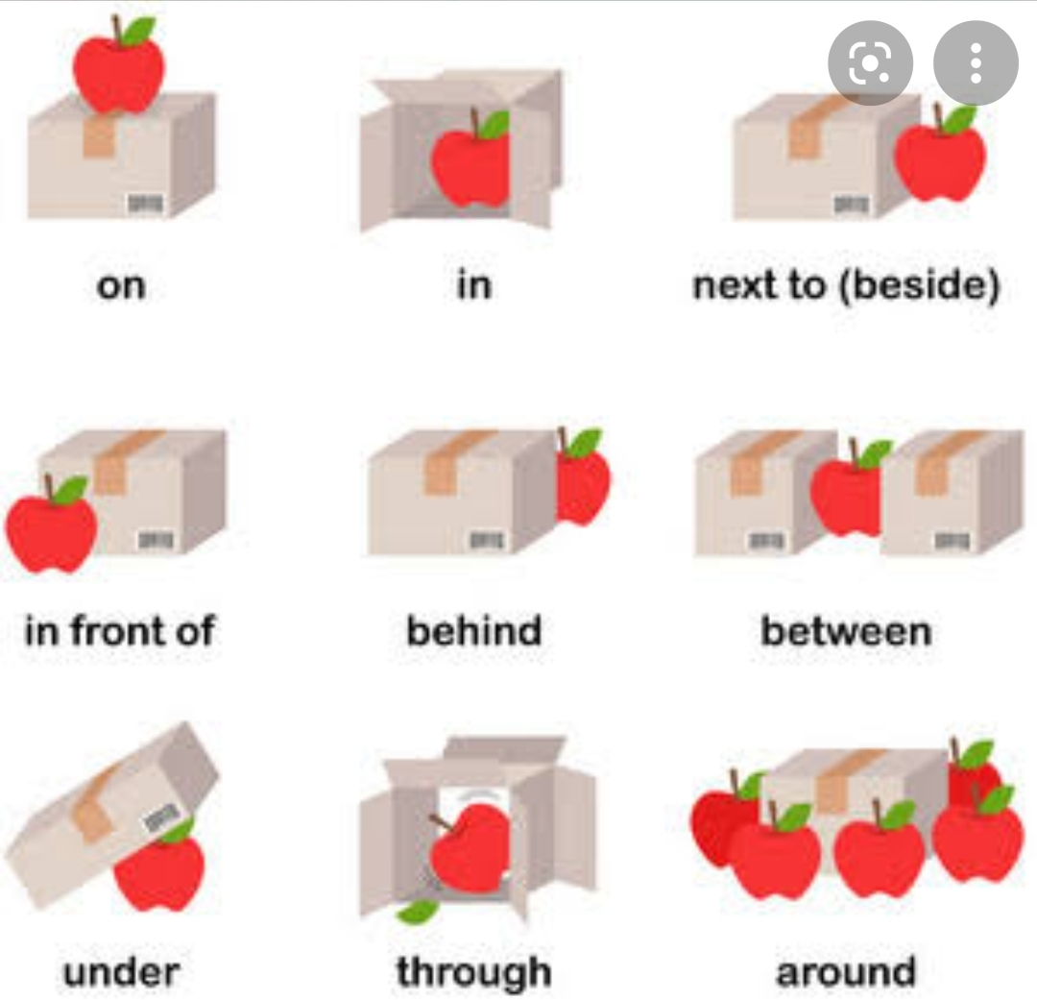
Let’s see some places of preposition

Slide 14
Let’s try to answer
G W
Behind
In front of
Next to
Above
Between
Below
In
On

Slide 15
Let’s practise again

Slide 16
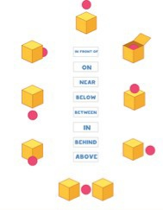
Evaluation
Above
8
Behind
In
1
7
Write the
Appropriate
preposition
Below
On
2
6
In front of
Near
5
3
Between
4

Slide 17
One day one word
Above
উপরে

Slide 18
Home work
Write at least 10 sentences
using preposition

Slide 19
Thanks to all.
See you in the next class

