Slide 1
WELCOME EVERYONE

Slide 2
Presented by:
Md.Shakhawat Hossain
Assistant Teacher
Borogangni Govt.Primary School
Alamdanga,Chuadanga.

Slide 3
Lesson Identity
Subject :English
Class:Four
Unit:15
Sagar and his family
Lesson:1-3
Page:30

Slide 4
Learning outcomes -
Listening
1.1.1 recognise sound differences in the context of words
1.2.1 recognise which syllable in a word is stressed
1.3.1 recognize which words in a sentence are stressed.
3.2.1 understand question about family and friends of students .
3.4.1 understand sentence made by the teacher and students.
Speaking
1.1.1Say words,phrases and sentenceS with proper sound and stress.
6.2.1 talk about people, object and event etc.
Reading
1.4.1 read words,phrases and sentences in the text
1.5.1 read words,phrases and sentences in the text with proper pronunciation, stress and intonation.
1.7.1 read paragraphs, duologues,stories,letters and other texts.
5.1.1 read silently with understanding paragraphS, stories and others text materials.

Slide 5
Good morning students!
How are you?
I’m fine thank you.

Slide 6
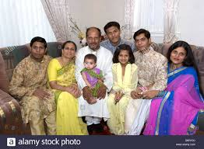
What do you see in this picture ?
This is a family

Slide 7
Today’s lesson
Sagar and his family

Slide 8
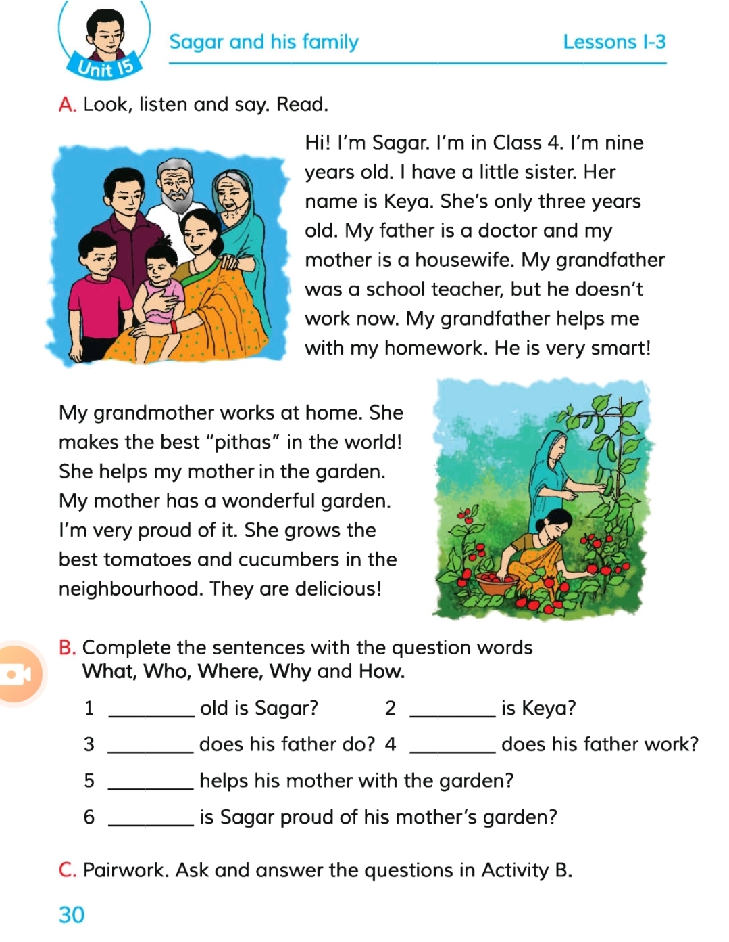
Let’s open at page 30 and look at the pictures.What do you see?What are they doing?
Yes, you are rights.First one is sagar’s family. And in the second one his grandmother helping his mother in the garden.

Slide 9
Now just keep listening
Hi! I’m Sagar.I’m in Class 4. I’m nine years old.I have a little sister.Her name is Keya.My father is a doctor and my mother is a housewife.My grandfather was a school teacher, but he doesn’t work now.My grandfather helps me with my homework.He is very smart!
My grandmother works at home.She makes the best “pithas” in the world! She helps my mother in the garden.My mother has a wonderful garden.I’m very proud of it.She grows the best tomatoes and cucumbers in the neighbourhood.They are delicious.

Slide 10
Now work in pair and read the passage again.

Slide 11
Now I’ll ask you some questions about sagar’s family and you’ll answer them shortly

Slide 12
Say the answer shortly
1. How old is Sagar?
Ans.Nine years old.
2.Which class does he read in?
Ans.In Class 4.
3.Who helps him with his homework?
Ans.His grandfather.
4.Who makes the best “pithas”?
Ans.His grandmother

Slide 13
Home work
Find out the new words from the text and make at least one sentence for each.

Slide 14
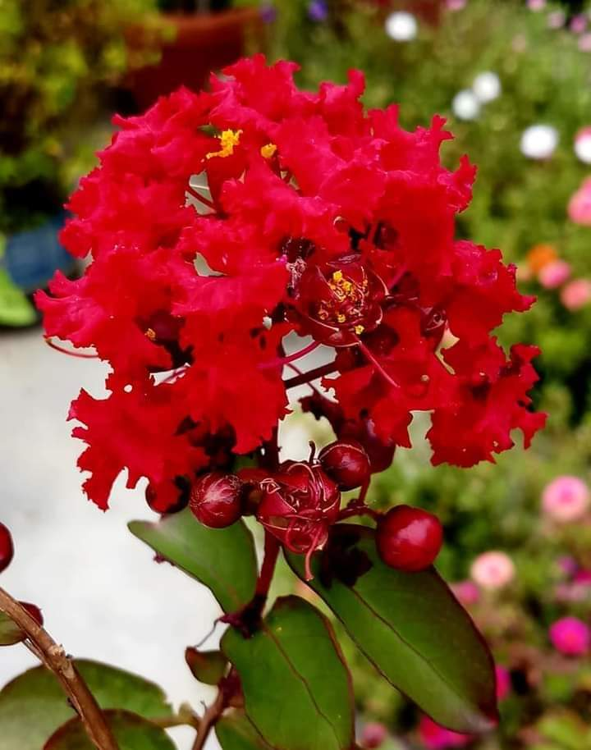
Thank you all

