Slide 1
Welcome

Slide 2
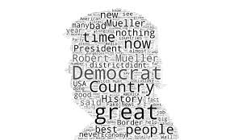
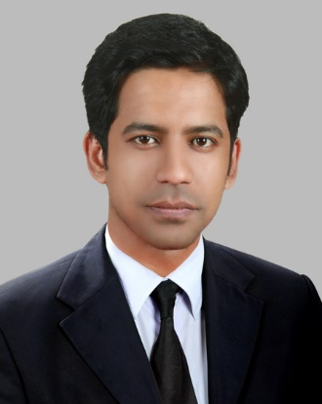
Introduction
Rajan Shaha
Assistant Teacher in English
Ispahani Public School & College
Cumilla Cantonment

Slide 3
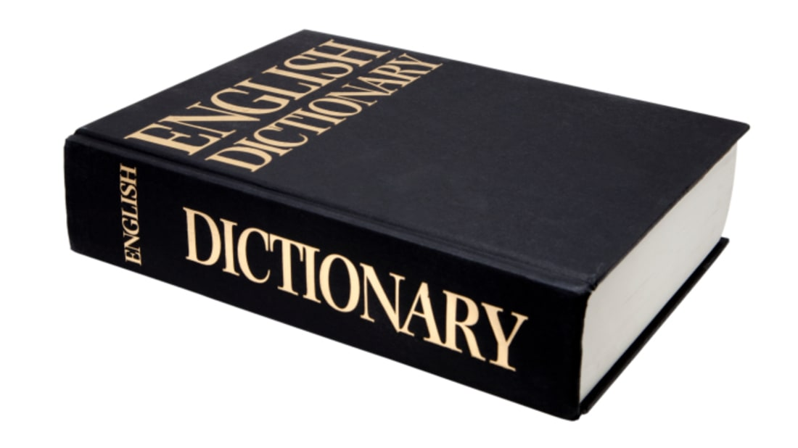
Do you know how to look up a word in a dictionary?

Slide 4
Our today’s topic is about searching a word in a dictionary. And it is …
Find your
Unit-2, Lesson-1

Slide 5
Learning outcomes
After completing this lesson students will be able to …
look up words in a dictionary.
read and understand the table of content pages.

Slide 6
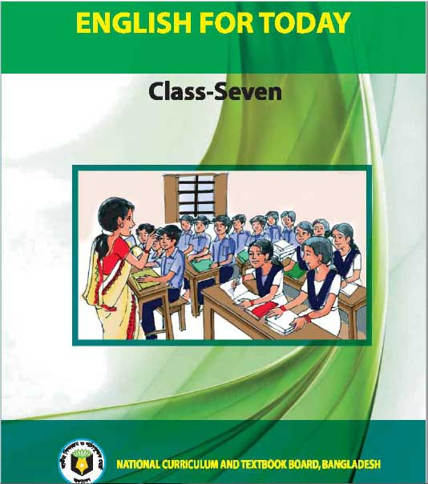
Let’s read the text.

Slide 7
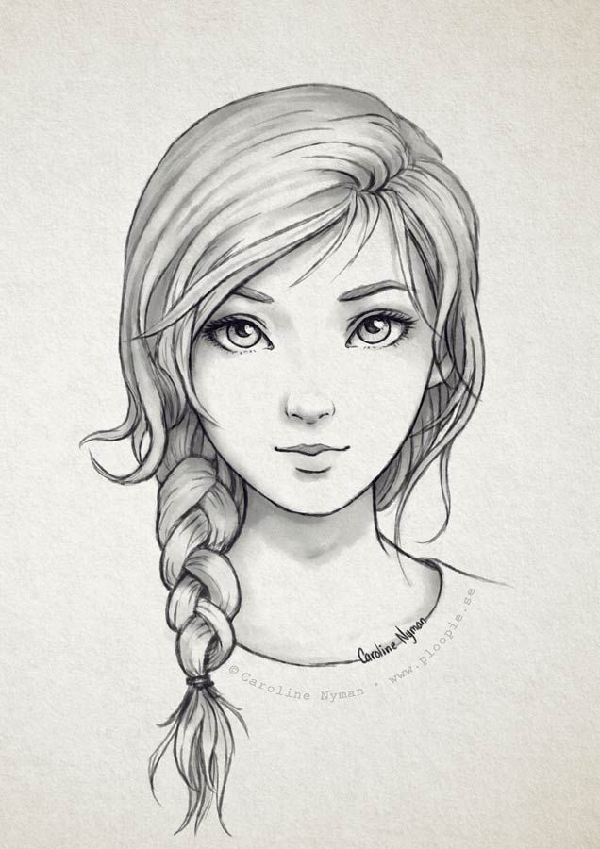
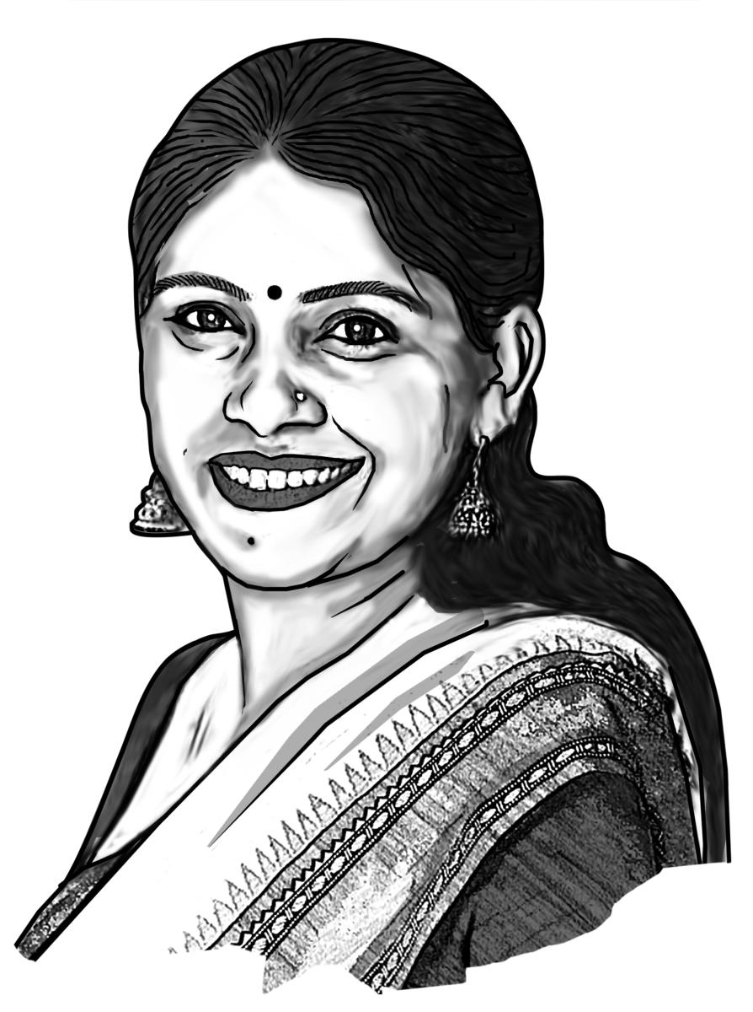
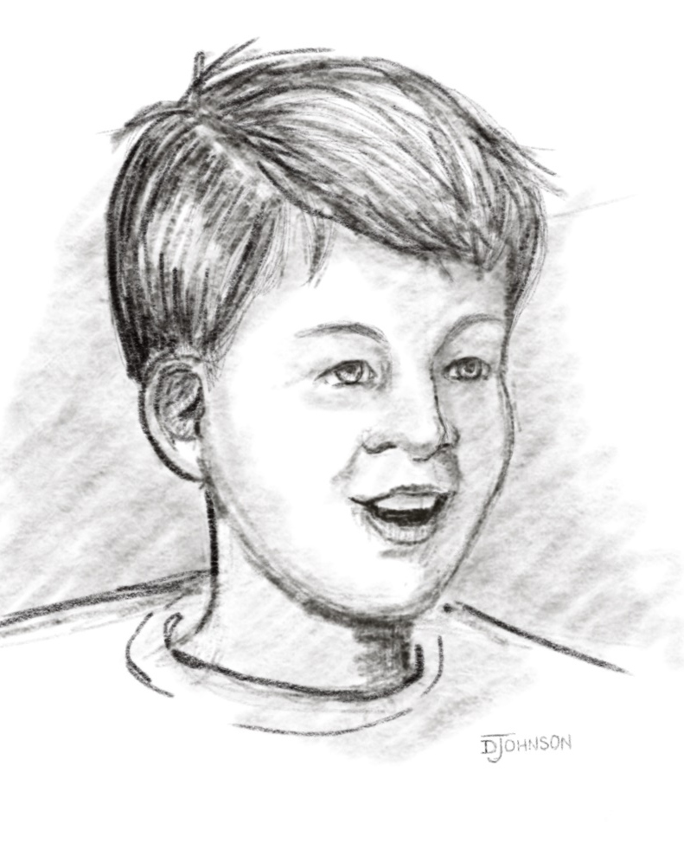
Let’s listen to a dialogue
Rupa
Ananda
Teacher

Slide 8
A. Read the dialogue.
Teacher : Students, do you have a dictionary?
Rupa : Yes, miss, I have one.
Ananda : I have one too.
Teacher : Do you know how to look up a word in a dictionary?
Rupa : Not really. It often takes a long time to find the meaning of a word in a dictionary.
Teacher : How about you, Ananda?
Ananda : Same with me. I often get confused. So many words, so many signs, ooh!
Teacher : It’s because you haven’t learned how to look up a word quickly in a dictionary.
Rupa, Ananda : How can we do it, teacher?
Teacher : Ok, let’s start with a page from a dictionary.

Slide 9
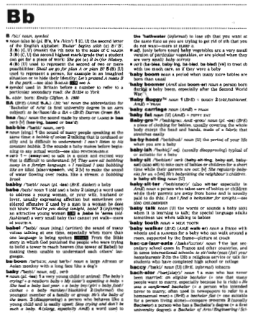
D. Look at a dictionary page.

Slide 10
Make a list of letters/words in bold. Answer the following questions.
a. What do you see at the top left corner of the dictionary page?
a. What is the first letter and word in the left hand corner?
Answer: The letter B.
Answer: B, BA, baa, babble, babby, babe, babel, baboon, baby.

Slide 11
D. Read the text about how the dictionary page has been written.
The teacher asks the class, “Have you noticed that the words in bold are written one after another? Ok. Do you find any rule or system or order in arranging these words?”
“Yes, teacher, The page starts with a single letter B and slowly words come below this letter,” Rupa said.
“Thank you, Rupa. You’ve got it! Let me write B and some of the words from this page on the board. Then I’ll show you how they are written one after another like in the alphabet. Look at the board and ask me if it is clear or not. OK?”

Slide 12
E. Arrange the following words in alphabetic order.
bet | bat | bag | book | bait | batch
bag | bait | bat | batch | bet | book

Slide 13
F. Look at the dictionary page again. Discuss in groups and find out the following information about BA, baby, bachelor.
meaning of words (i.e definition)
spelling
examples of use/example sentence
grammatical information (parts of speech, irregular verbs and plurals, countable and uncountable nouns)
formal/informal
abbreviations
i.e. is the abbreviation for the Latin phrase id est, meaning “that is.” This abbreviation is used when you want to specify something mentioned previously; it can be used interchangeably with “specifically” or “namely.” Here are some examples: “Only one city, i.e., London, has hosted the Summer Olympics three times.”

Slide 14
Solution
BA
Meaning: A university degree
Spelling: biːˈeɪ
Part of speech- Noun
Example: He obtained B.A. degree from the Open University.
Baby
Meaning: A very young child who has not yet begun to walk or talk.
Spelling: ˈbeɪ.bi
Part of speech- Noun
Example: The baby is crying.

Slide 15
Solution
Bachelor
Meaning: A man who has never married.
Spelling: ˈbætʃ.əl.ər
Part of speech- Noun
Example: He remained a bachelor until he was well into his 40s.

Slide 16
That’s all for today.

