Slide 1
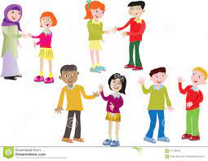
কামরুন্নাহার
Welcome to English class

Slide 2
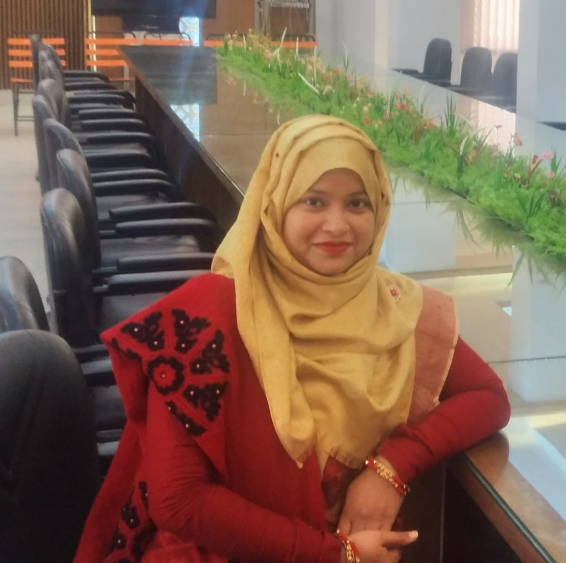
কামরুন্নাহার
This is Kamrunnaher
Assistant Teacher of
Sreerampur purbapara government primary school
Raipura – Narsingdi
ICT District Ambasador Narsingdi

Slide 3
কামরুন্নাহার
Class : Four
Subject : English
Unit : 1. About me
Lesson : (1-3) A

Slide 4
কামরুন্নাহার
Learning outcomes -
Students will be able to……………………..
Listening:
1.1.1 recognize sound differences in the context of words.
3.1.1 understand questions asked by the teacher about students.
3.4.1 understand statements made by the teacher and students.
Speaking:
1.1.1 repeat after the teacher and say words, phrases and sentences with proper sounds, stress and intonation.
2.1.2 make simple introduction or self introduction.

Slide 5
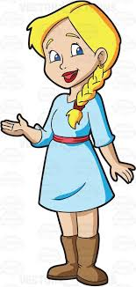
কামরুন্নাহার
Let ‘s sing a song together
Hello !
Hi!

Slide 6
কামরুন্নাহার
What are they doing ?
They are talking .

Slide 7
কামরুন্নাহার
Today we will learn -

Slide 8
কামরুন্নাহার
What is this ?
This is our
” ENGLISH
FOR TODAY”
Text Book

Slide 9
কামরুন্নাহার
Hello , dear students
I am your English teacher.
My name is Kamrunnaher
Now it’s your turn. What about you ?

Slide 10
কামরুন্নাহার
Look at the picture and say about you

Slide 11
কামরুন্নাহার
কামরুন্নাহার
Look at the picture and say about you

Slide 12
কামরুন্নাহার
Look at the picture and say about you

Slide 13
কামরুন্নাহার
Individual work
Give your information.
Hello, I'm.....
I'm in class........
Hi! I'm......
I'm from.......
Hello! I'm.......
I'm...... years old.

Slide 14
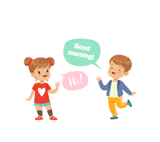
কামরুন্নাহার
Pair work
Now practice by pair
Hello, I'm.....
I'm in class........
I'm from.......
I'm...... years old.

Slide 15
কামরুন্নাহার
Open your English book at page no 2 and read

Slide 16
কামরুন্নাহার
How can we give introduce about me?
Hello/ Hi!
Name
Age
Occupation
Class
Name of school

Slide 17
কামরুন্নাহার
Group work
Give answer one by one
1.What is your name ?
2.How old are you ?
3.What do you do ?
4.What class are you in ?
5.Which school do you go to ?

Slide 18
কামরুন্নাহার
Evalution
Say 5 sentences about you.

Slide 19
কামরুন্নাহার
Thank you, that’s all for today
See you tomorrow.

Slide 20
কামরুন্নাহার
Home work
You will say 5 sentences about you with your parent

