Slide 2
Welcome to English Class

Slide 3
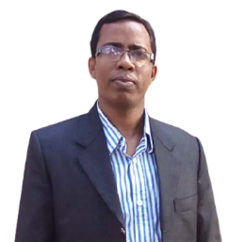
Md.Abdur Razzak
Assistant Teacher (English)
Shatgram Akota High School
Baniachang,Habigang
District Ambasadder,Habigang
Mobile Number:01731181479
Class:Eight
Subject: English For Today
Unit:Three
Lesson:Four

Slide 4
Watch the vedio and answer the following questions.
What did you see in the vedio?
What is it called?

Slide 5
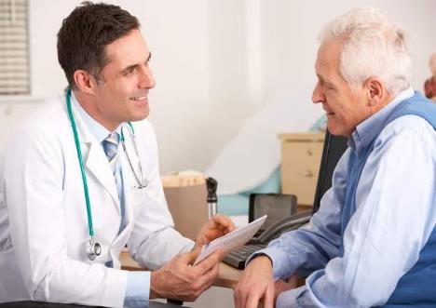

Slide 6
Learning outcomes
By the end of the lesson, the students will be able to-

Slide 7
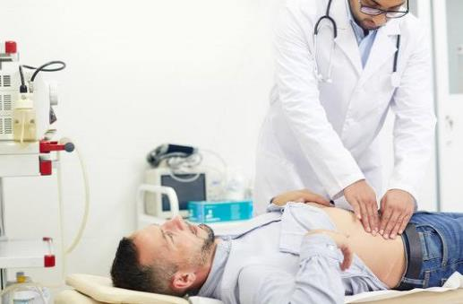
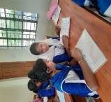
A.Talk about the picture and answer the following questions.
00
3
1
2
Pair Work
Time:Three minutes
1. Who is the man lying on the examination table?
2. Who is examining the patient?

Slide 8
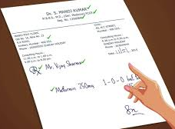
Let us introduce with some key words.
Prescribe
To tell somebody to take a particular medicine or have a particular treatment
The doctor prescribed me some medicine.

Slide 9
Clinic
an establishment or hospital department where outpatients are given medical treatment or advice
He was admitted in a clinic.

Slide 10
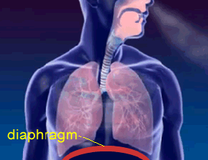
Breathing
Breathing
the process of taking air into and expelling it from the lungs.
His breathing was shallow.

Slide 11
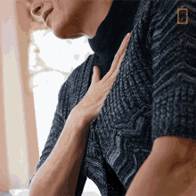
Chest pain
Pain in chest
The man feels chest pain.

Slide 12
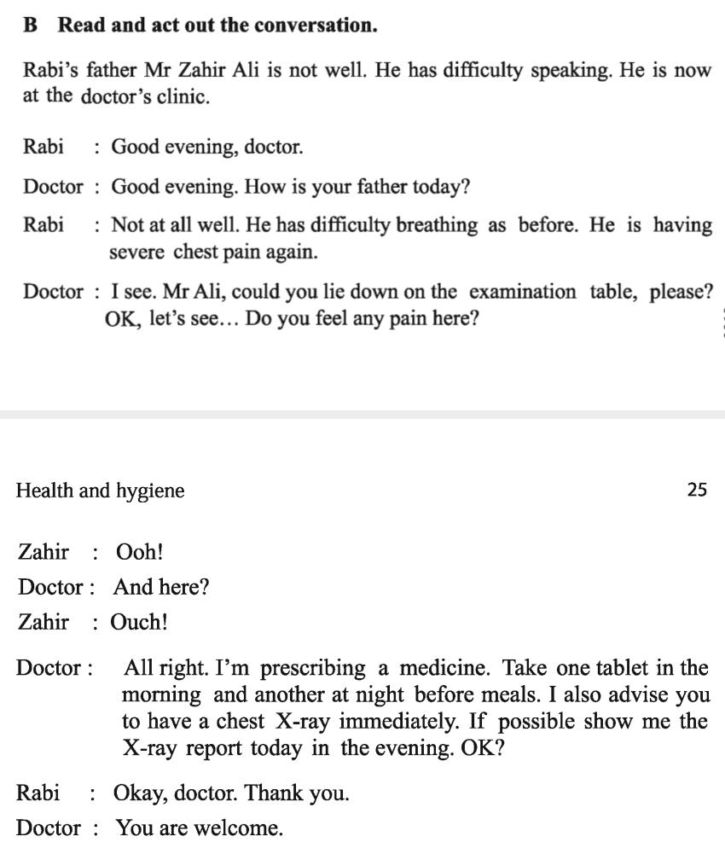
B. Read and act out the conversation.

Slide 13
Doctor: I see. Mr. Ali, could you lie down on the table, please? OK, let’s see....Do you feel any pain here?
Rabi: Okey, doctor. Thank you.
Rabi: Good evening,Doctor.
Doctor: Any here?
Zahir: Ouch!
Doctor: How is your father today?
Zahir: Ooh!
Doctor: All right. I’m prescribing a medicine. Take one tablet in the morning and another at night before meals. I also advice you to have a chest X-ray immediately. If possible show me the X-ray report today in the evening. OK?
Rabi: Not at all well. He has difficulty breathing as before. He is having severe chest pain again.
Doctor: You are welcome.

Slide 14
C.Read the text in B silently and answer the following questions in pair.
1.Who are talking in the dialogue?
2.Where does the dialogue take place?
Pair Work
3.What are Zahir Ali's problems?
5
9
00
2
10
3
6
4
8
1
7
4.Why can't Zahir Ali tell the doctor about his problems?
Time:Ten minutes
5.What does the doctor prescribe him?

Slide 15
D.Ask and answer the questions.
1. Did you have any stomach pain or leg injury anytime before?
2. When was it?
4
5
2
3
1
0
Pair Work
3. Where did you go to get well?
Time:05 minutes

Slide 16
E. Suppose,you visited a doctor for fever. Make an imaginary dialogue between you and the doctor.Then,act it out in pairs.
Pair Work
5
9
00
2
10
3
6
4
8
1
7
Time:Ten minutes

Slide 17
Doctor: How have you got it?
Doctor: Good evening. How are you?
Doctor: I see. Do you have a bad cough?
Doctor: Ok. I am prescribing a medicine. Take one tablet after your meals three times a day.
Doctor: You are welcome.
Myself: Not so well.I have got a bad cold.
Myself: Yesterday, I was coming from school. At the time, it began to rain and I got drenched.
Myself: Good evening,doctor.
Myself: Ok,doctor. Thank you.
Myself:Yes, doctor.

Slide 18
HOME WORK
Suppose,you visited a doctor for stomach pain.Make an imaginary dialogue between you and the doctor.

Slide 19
Wishing the best luck for everybody.

