Slide 1
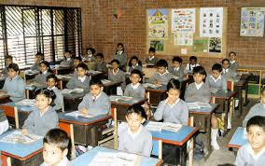
Welcome
My dear students.

Slide 2
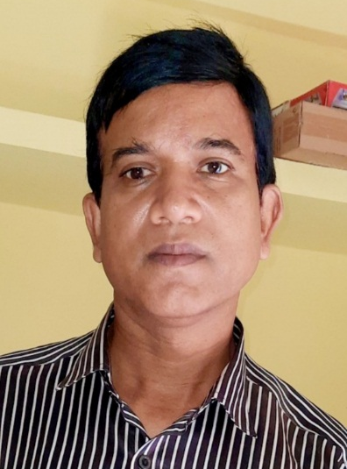
Teachers’ Information
Mohammad Harunur Rashid
M.S.S; M.Ed.
Assistant Teacher(ICT).
West Guzra Muniria Darussunnah Alim Madrasah.
Noapara, Raozan, Chittagong.
Mob. No:01818466820
Email:harunur152@gmail.com

Slide 3
Class Room Information
Class : Eight
Subject : English For Today
Unit : Seven,
Lesson : 3, page:74
Total Time : 45minutes

Slide 4
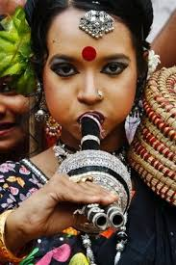
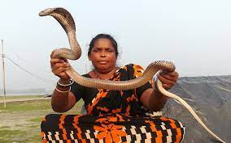
1.What do you see in the picture?
2.What do they?
They catch snake and show snake play
3.What call them?
River gipsies

Slide 5
Today’s Lesson
River gypsies in Bangladesh(1)
Unit Seven, Leson 3
Page Number:74

Slide 6
By ending of the lesson,
students will be able to
1.Read and understand a passage.
2.Ask and answer the questions.
3.Choose the correct answer.
4. Fill in the gaps.

Slide 7
Before starting our class, lets enjoy a video

Slide 8
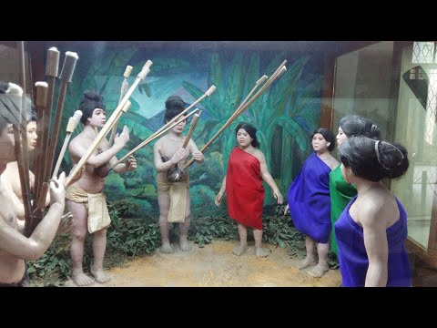
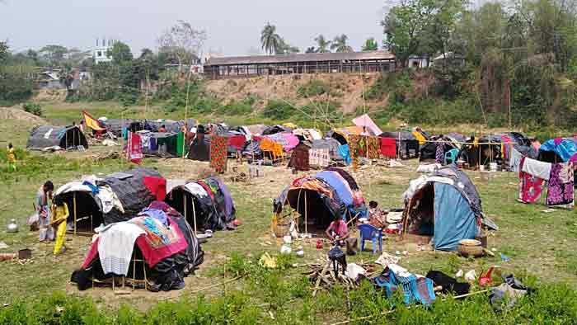
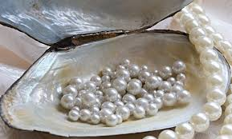
Lets know the meaning of key words of this lessons .
Originated from the traits of their common heredity and cultural traditions
1.ethnic
2. gypsy
nomad
3.pearls
a valueable stone

Slide 9
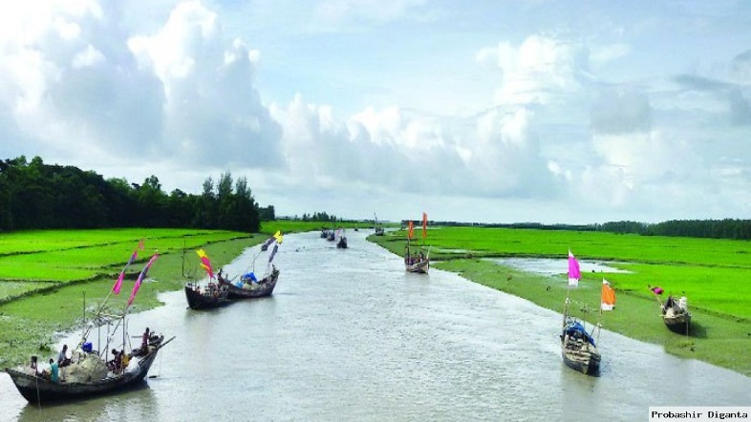
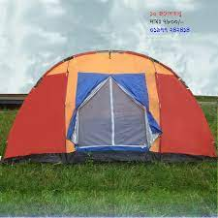
journey trip
4 roam.
a large piece of heavy waterproof cloth
5. tarpaulin
6. tents
camps

Slide 10
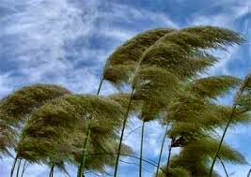
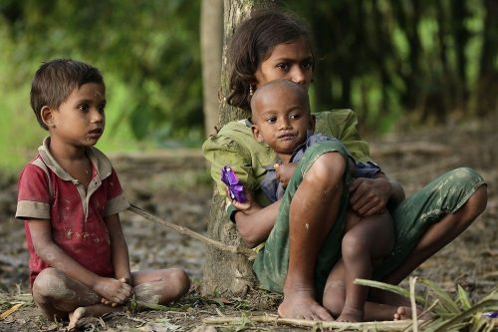
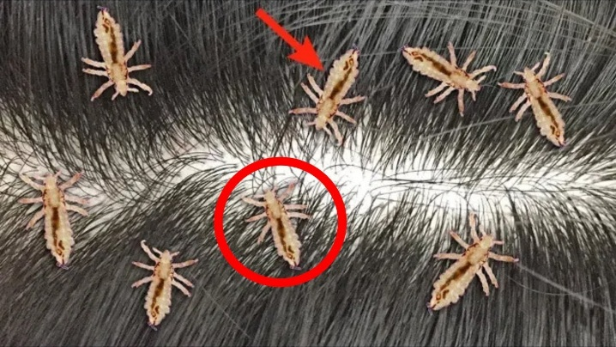
7. monsoon
seasonal wind
8. Toddlers
babies
9. lice
Crum,Gad bee

Slide 11
Read the story
silently and try to understand.
River gypsies are an ethnic group in Bangladesh. They are known as bedey to local people. The gypsies have their own lifestyle and culture. They live in groups and do not own any land. Therefore, they live a nomadic life, travelling from one place to another. These people roam across our rivers and waters from May to December in small country boats.

Slide 12
These boats are their houses and these people are a part of our waters. In winter, many water bodies dry up. At that time they return to the mainland and live in make-shift tarpaulin tents on open river banks. You can see their men relaxing in the tents. Toddlers play with dogs or other pets in the dust. Women often idle away time by hair doing, picking off lice in twos or threes sitting in a row.
v

Slide 13
Thoughout the monsoon, they remain busy with fishing. They also dive for natural pearls in waters. Sometimes, they camp for a couple of weeks. Men catch snakes and entertain people with snake charming and sell herbal cures. Women go from door to door to sell bangles, cosmetics and other things. They also try to heal pains of old people often by sucking out blood from their body. Many villagers be lieve in the magical power of the gipsies.They can make an evil spirit leave someone’s body by magic or special powers.
v

Slide 14
Now, write the answers of the following questions.
1.Who are river gypsies?
2.How are their lifestyle and cilture?
3.What do you mean by nomadic life?
4.When do river gypsies roam across our rivers and waters?

Slide 15
Match your answers
1. Who are river gypsies?
Answer: River gypsies are those people who live a nomadic life travelling from one place to another place.
2. How are their lifestyle and cilture?
Answer: They live in groups and earn their livelihood by fishing snake charming and sell herbal cures. They have ethnic culture

Slide 16
3. What do you mean by nomadic life?
Answer:By nomadie life, I mean that it is a kind of life travelling from one place to another
4. When do river gypsies roam across our rivers and waters?
Answer:River gipsies roam across our rivers and waters from May to December.

Slide 17
1. Choose the correct answer .
(a)The term ‘nomadic’ refers to a person who---
i. Lives in one’s own house ii. Lives in a rented house
iii.Lives permanently at a place. iv.travels from place to place.
Correct answer: i. iv.travels from place to place.
.
(b)In the passage, the word ‘fishing’is ---?
i. a noun ii.an adjective iii. an adverb iv.a verb
Correct answer: i. a noun

Slide 18
(c) ‘Ethnic group’ refers to a group of people having a ---- identity.
i.racial ii.tribal iii.regional iv.political
Correct answer: i.racial
(d)Snake charming is a popular ---in our rural areas.
entertain ii.entertained iii. entertainment
iv.entertaining.
Correct answer:iii. entertainment
.

Slide 19
(e)According to the passage, river gypsies are also recognized as----’
i.Bangladeshi ii.Ama iii. Bedey iv.Tribal.
Correct answer: iii. Bedey
(f)Toddlers play with dogs or other pets in the dust. Here ‘toddlers’ refer to---
i. The offspring of river gypsies ii.The river gypsies
iii.The Bedeys iv.Lice
Correct answer: i.The offspring of river gypsies

Slide 20
(g)River gypsies are nomadic people. Because---?
(i)they have no permanent settlement
(ii)They lack education
(iii) they have no place in the society
(iv)all of thes
Correct answer: (i)they have no permanent settlement

Slide 21
Home work:
Home work:
3. Read the following text and fill in the gaps with appropriate words to make it a meaningful one.
River gypsies are an ethnic group in Bangladesh. They are known as (a)--- to local people. The gypsies have their own lifestyle and (b)---. They live in groups and do not own any land. Therefore, they live a (c ) --- life, travelling from one place to another. These people roam across our (d )--- and waters from May to December in small country boats. These boats are their houses and these people are a part of our (e )---.

