Slide 1
WELCOME
Numbers
14,15,16

Slide 2
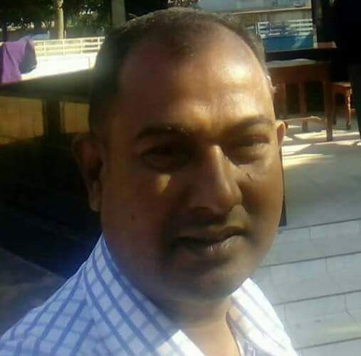
TEACHERS IDENTITY
Md Faruk Hossain
Assistant Teacher
Belowa Adi. Govt. Primary School
Ghoraghat, Dinajpur.

Slide 3
LESSON IDENTITY
ENGLISH FOR TODAY
Class-2
Lesson. Numbers
Lesson unit. 1o (1-3 A)
Time.4o minutes

Slide 4
Learning Outcomes
Students will be able to ---
count and say numbers (14,15,16)

Slide 5
Let’s enjoy a video

Slide 6
Numbers
14,15,16

Slide 7
Let’s say the numbers that we learned
1
2
3
4
5
6
7
8
9
10
11
12
13

Slide 8
Open your book at page 20

Slide 9
Let’s Count and say the number
1
4

Slide 10
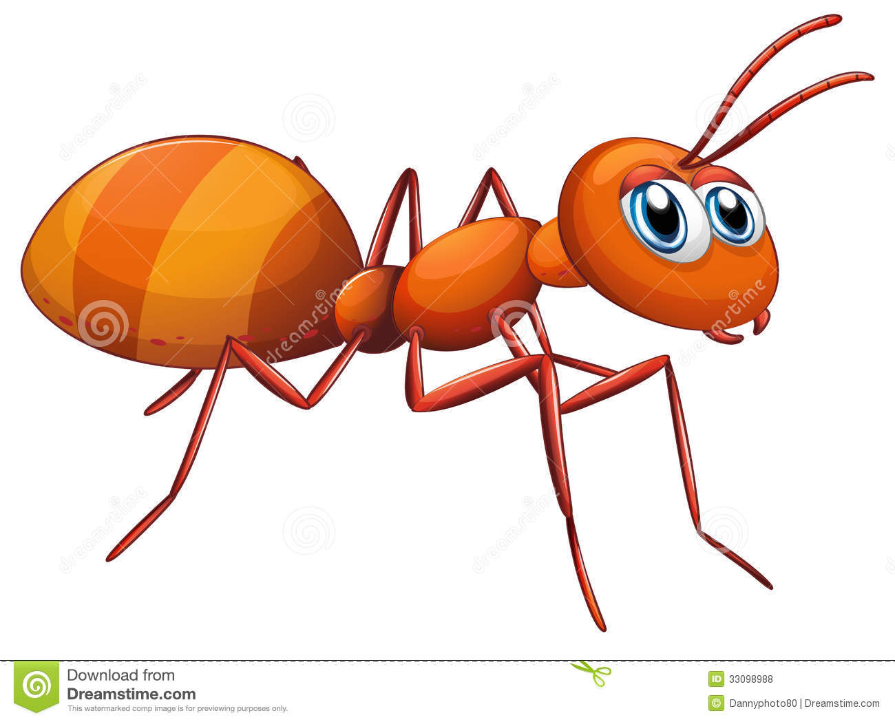
Let’s Count and say the number
1
5

Slide 11
Let’s Count and say the number
1
6

Slide 12
1
4
Listen and say

Slide 13
1
5
Listen and say

Slide 14
1
6
Listen and say

Slide 15
IW
Say the numbers 14,15 and 16

Slide 16
Group Work
Count the members of your group and say the number.

Slide 17
Home Work
Draw 16 pictures/shapes and colour them.

Slide 18
Thank you

