Slide 1
W
E
L
C
O
M
E

Slide 2
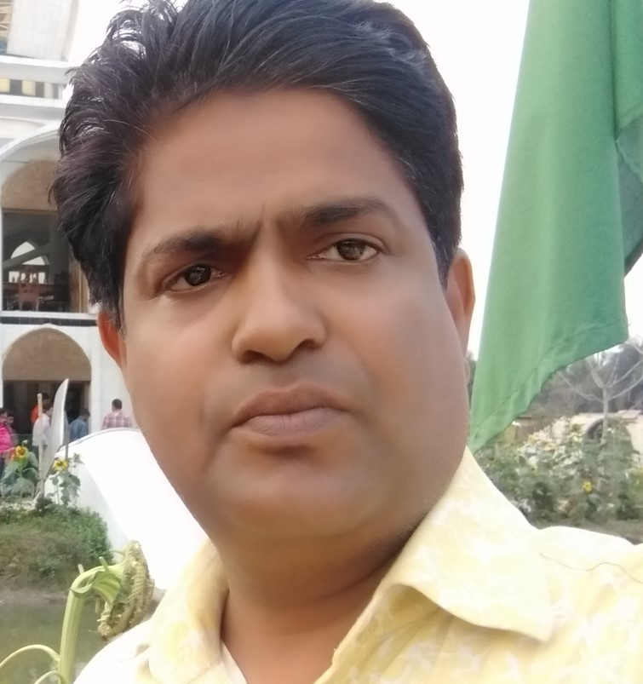
Teacher’s Identity
Md Jahid Hossen Khan
Headteacher
Rajihar Government Primary School .
Agailjhara , Barishal .
Mobile: 01623309704

Slide 3
Class: Five
Subject: English

Slide 4
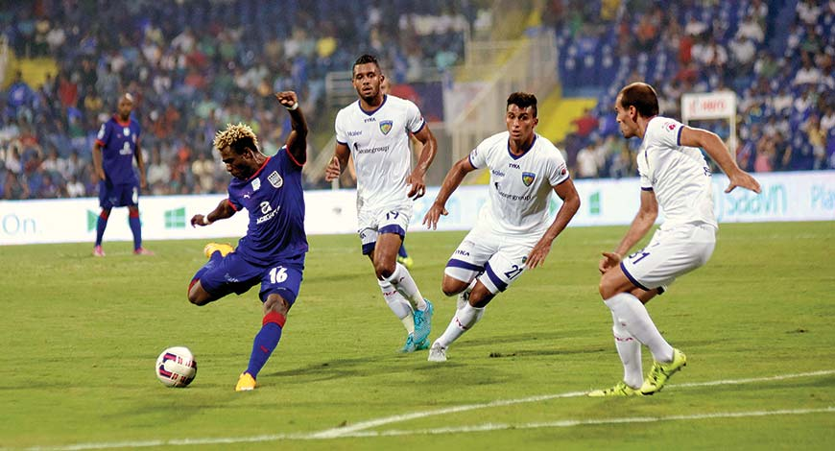
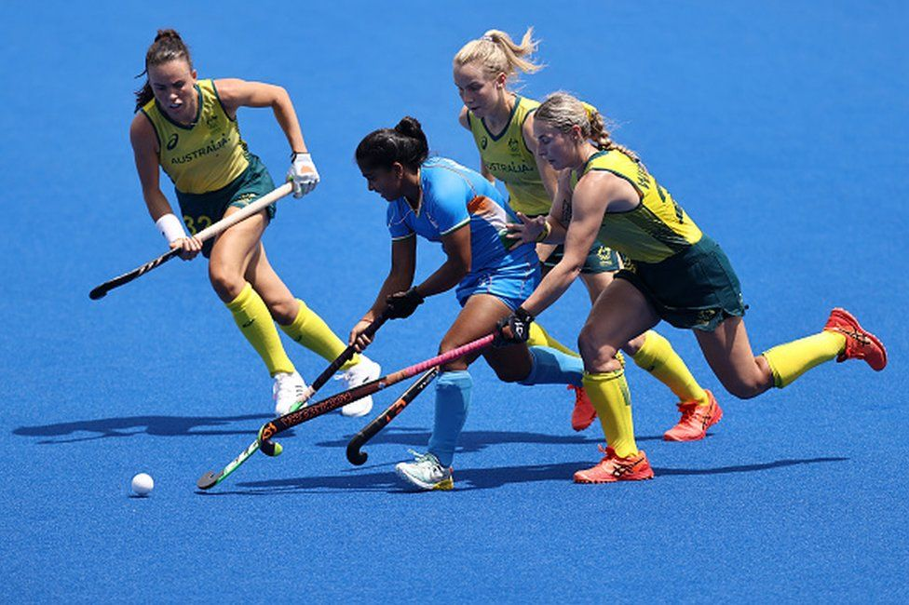
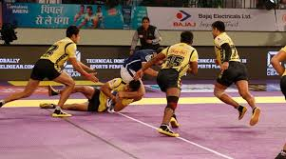
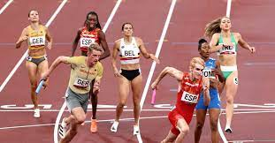
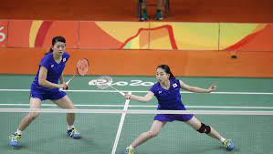
Let’s see the pictures.
What are the pictures about?

Slide 5
Today’s Topic
Topic: Sport
Activity: A ,B&C
Unit: 17
Lesson: 1-2

Slide 6
1.2.1
recognize which syllable in a word stressed
1.3.1
recognize which words in a sentence are stressed
Listening:
1.4.1
recognize and use information patterns for yes/no wh questions
3.2.1
understand questions about family and friends of student
3.4.1
understand statements made by the teacher and students
1.1.1
say words , phrases and sentences with proper sounds and stress.
Speaking:
3.1.2
ask and answer Yes/No questions .
6.2.1
talk about people ,objects events etc.
8.1.1
take part in conversations on appropriate topic.

Slide 7
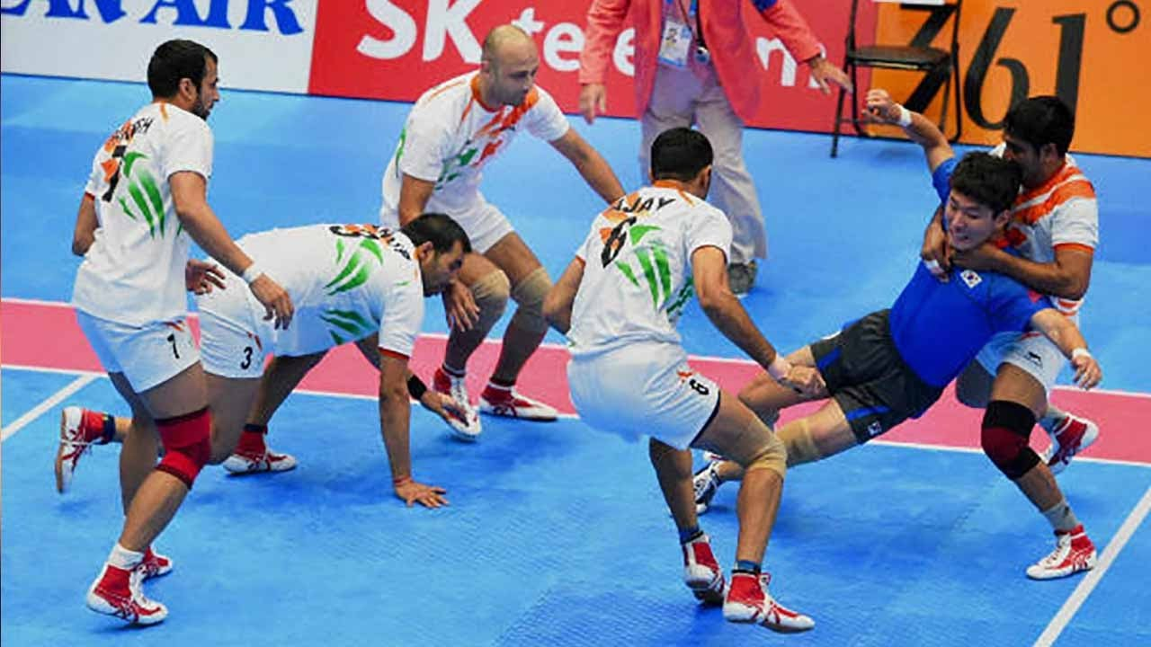
What is the name of the game ?
kabadi

Slide 8
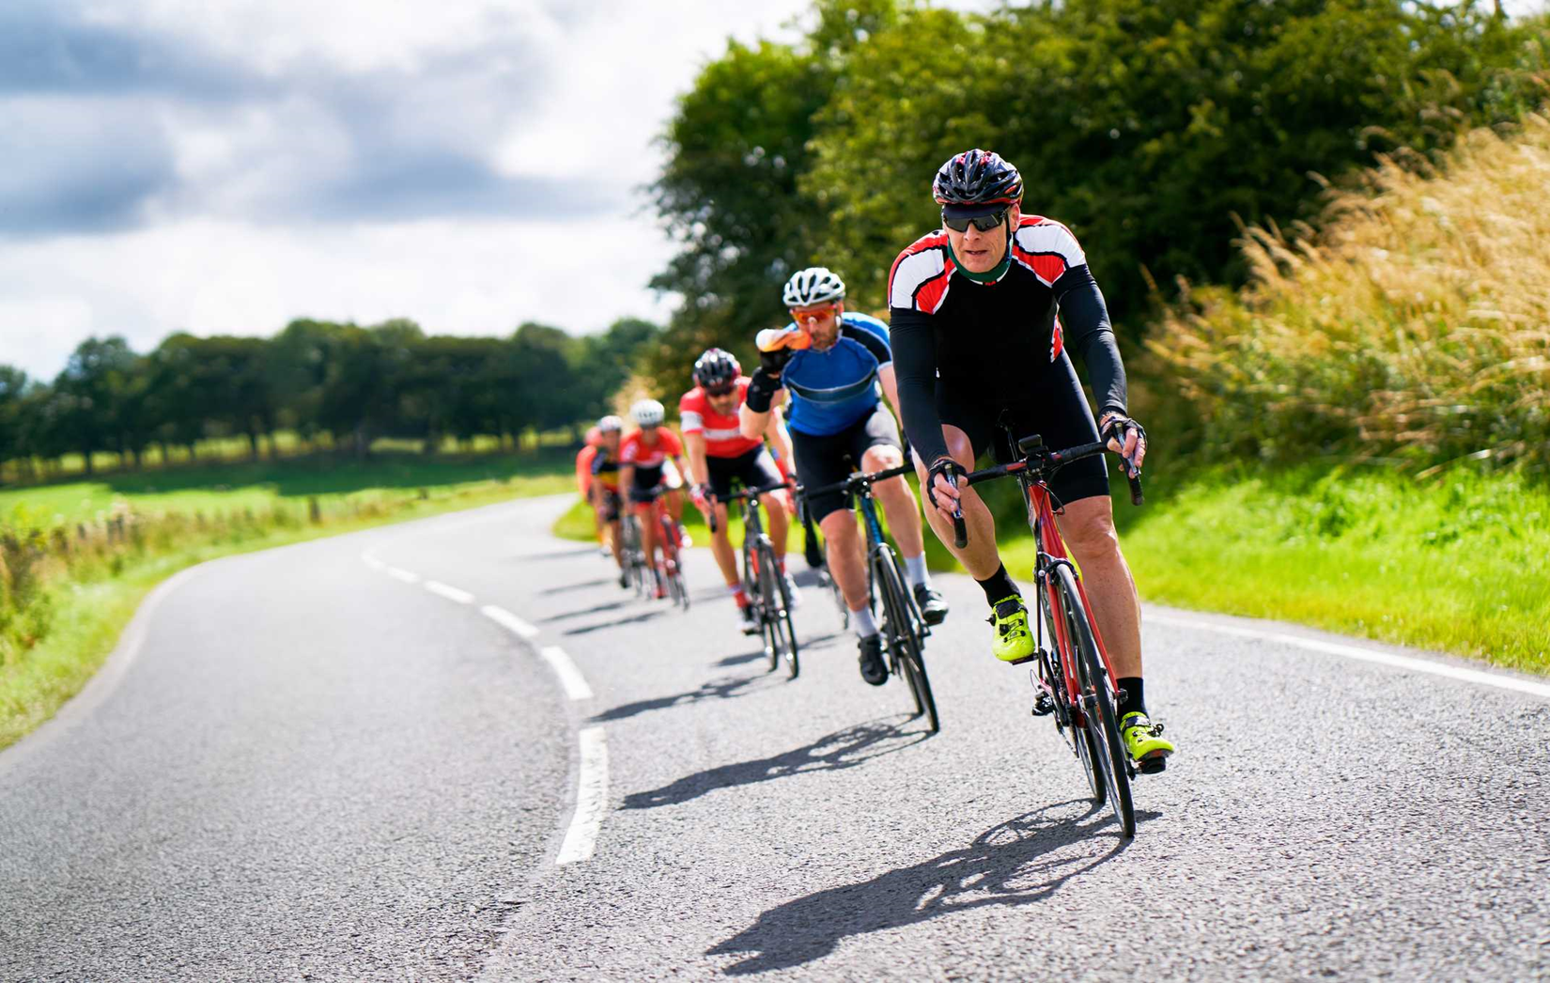
What is the name of the game ?
cycling

Slide 9
What is the name of the game ?
cricket

Slide 10
What is the name of the game ?
badminton

Slide 11
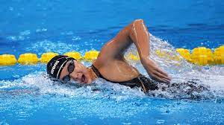
What is the name of the game ?
swimming

Slide 12
What is the name of the game ?
football

Slide 13
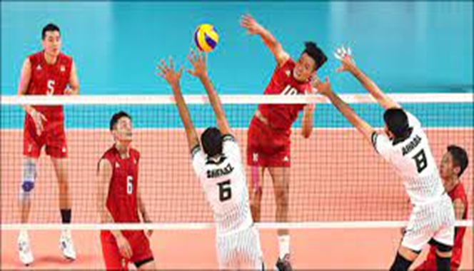
What is the name of the game ?
volleyball

Slide 14
What is the name of the game ?
weightlifting

Slide 15
Let’s pronounce some words
sport
kabadii
cricket
badminton
football
weight-lifting
volleyball
Swim-ming
cycling

Slide 16
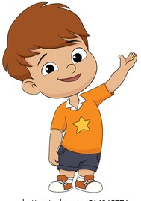
Anousha: I love badminton.I play with my family on weekends. I also go swimming and a cycling a lot
Baichong: Do you play or do any sports?
Role play
Baichong: I play cricket and I do weightlifting.
Anousha: Weightlifting ! Are you strong?

Slide 17
Baichong: Not very , but I want to get stronger. My brother is very strong .
Anousha: My brother is strong , too . He plays kabaddi and volleyball . He’s good at sports .
Baichong: I’d like to try kabadi . I’d also like to learn how to play volleyball .
Baichong: I love football too, but not as much as cricket . That’s my favorite sport .
Anousha: Volleyball is exciting , but I like playing football more

Slide 18
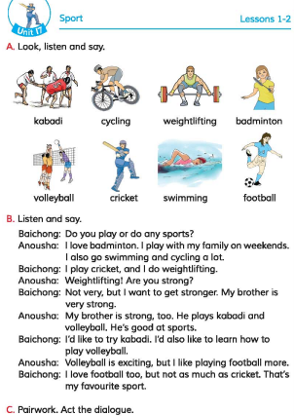
Keeping touch with the book
Open your book at page 66

Slide 19
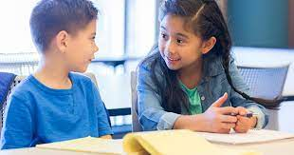
Pair work
Role play

Slide 20
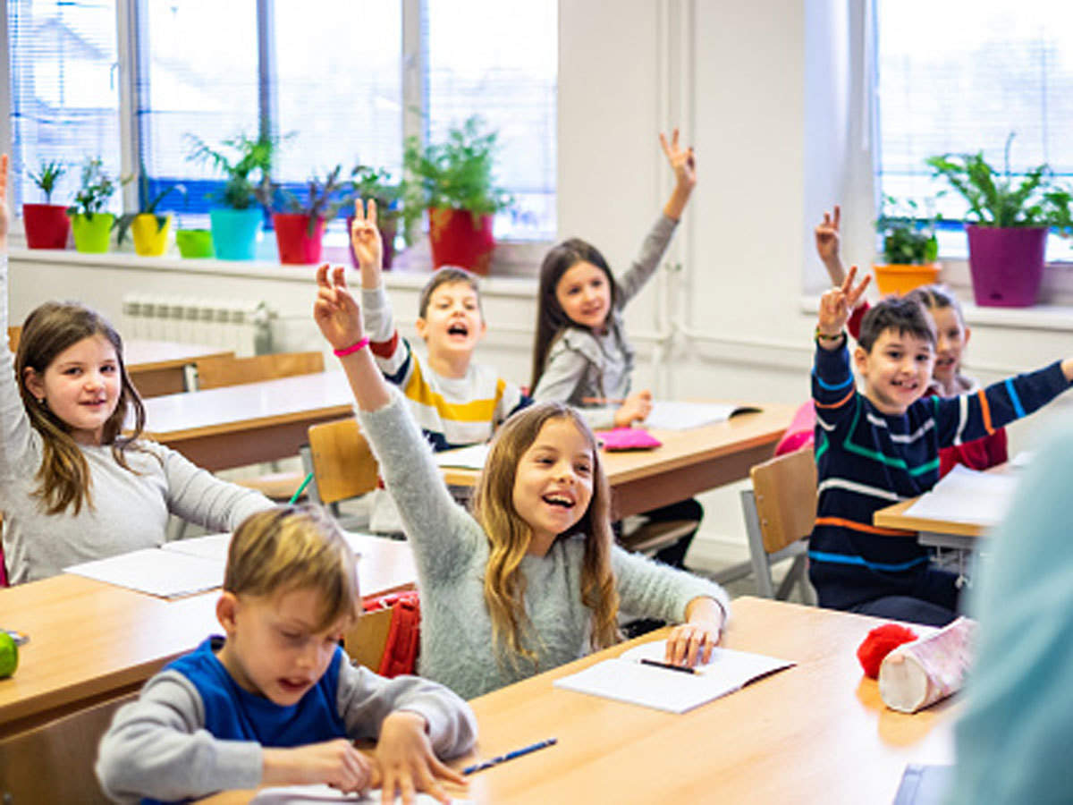
Evaluation
Ask and answer
Q1. Who loves badminton ?
Ans: Anousha loves badminton .
Q2: What is Baichong’s favorite sport ?
Ans: Baichong’s favorite sport is cricket .
Q3: Who likes to go swimming ?
Ans: Anoushsa likes to go swimming .
Q4: What does someone need for weightlifting ?
Ans: Someone needs to be stronger for weightlifting ,
Q5: What do Baichong and Anousha like to do ?
Ans: Baichong and Anousha likes games and sports .

Slide 21
Home Work
Practise speaking the name of the games and sports.

