Slide 1
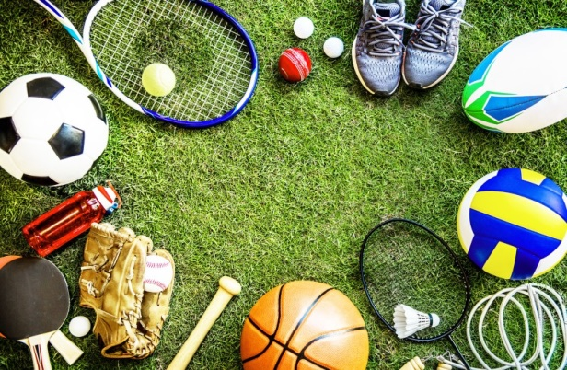
Welcome to my multimedia class

Slide 2
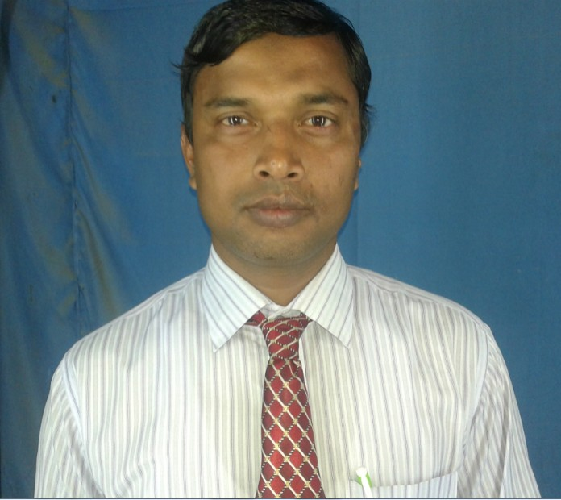
Introduction
Md. Faruq Hossain
Assistant teacher
Anandabash Govt. primary school.
Mujibnagar, Meherpur.
Mobile no- 01717406029
E-mail- faruqbd01@gmail.com
Class: Five
Subject: English
Caption of the lesson: Sport.
Today`s Lesson: Lesson 5-6

Slide 3
Let`s watch a video clip.
What did you watch?
https://www.youtube.com/watch?v=v3m_DlYSJOA&t=61s&ab_channel=SporDelisiHD
Sport

Slide 4
Today`s lesson
Lesson 5-6

Slide 5
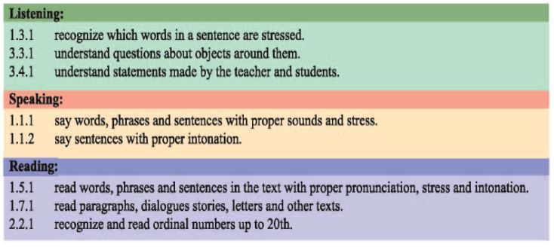
LEARNING OUTCOMES
Students will be able to-------

Slide 6
Think about the picture.
What is it?
National flag of Bangladesh.

Slide 7
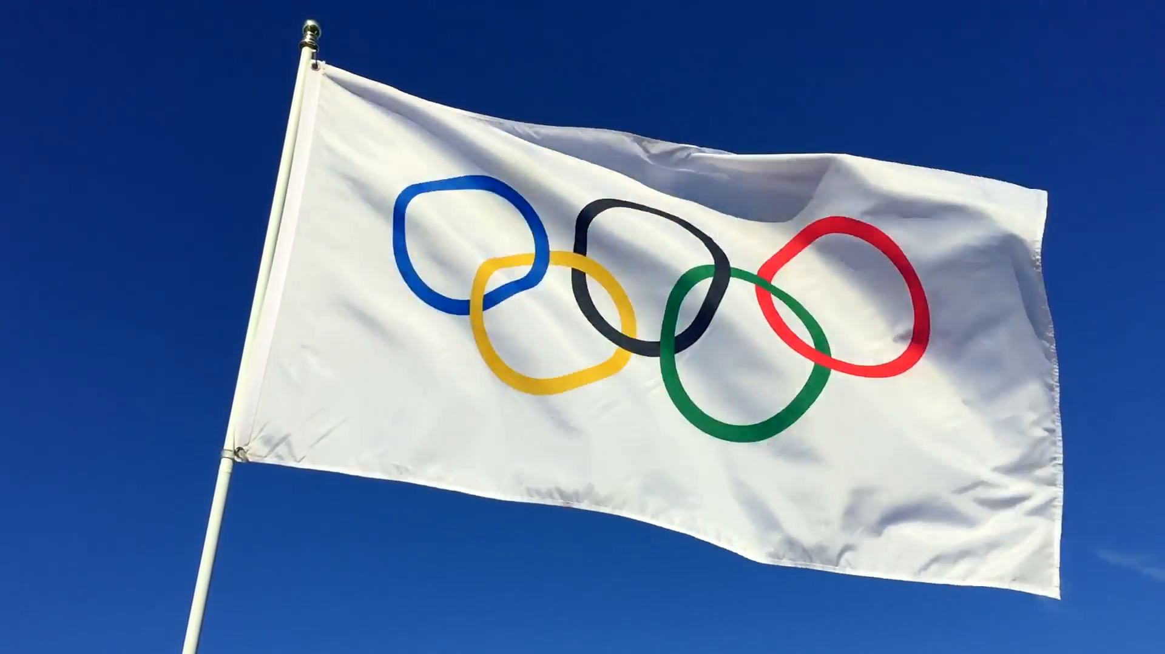
Think about the picture.
What is it?
* The Olympic games is the biggest sports competition in the world.
* There are five rings in Olympic flag.
Olympic Games flag.

Slide 8
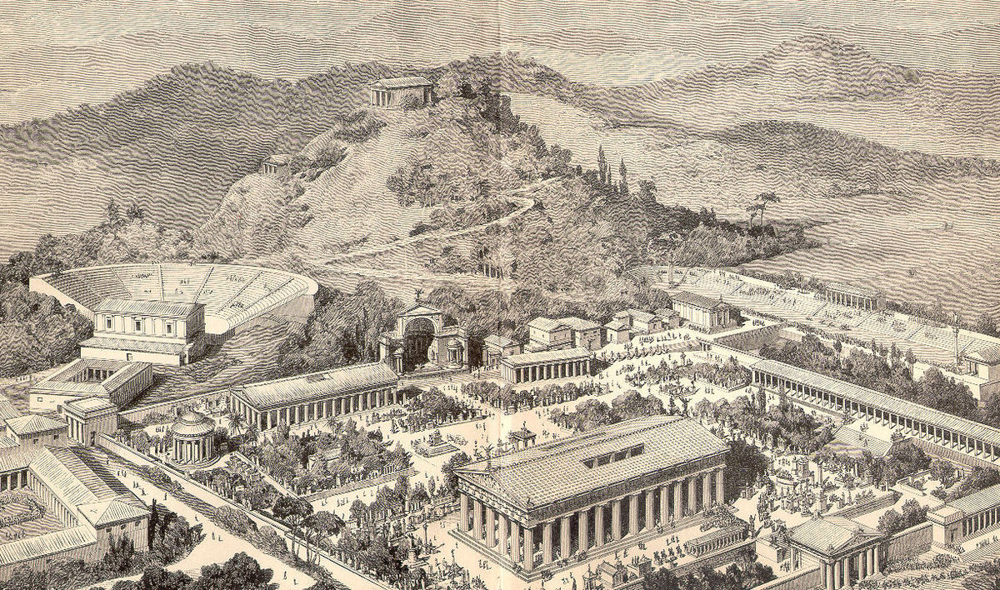
Think about the picture.
The first Olympic games were held in Greece almost 3000 years ago.

Slide 9
Group work
Answer the following questions.
Group- A: When was the first Olympics?
Group- B: How many rings of a Olympics flag?
Ans: Almost 3000 years ago.
Ans: Five rings.

Slide 10
Let`s watch a video clip.
What did you watch?
https://www.youtube.com/watch?v=zUHaUNpCn0o&ab_channel=TimesofIndia
The Modern Olympic Games

Slide 11
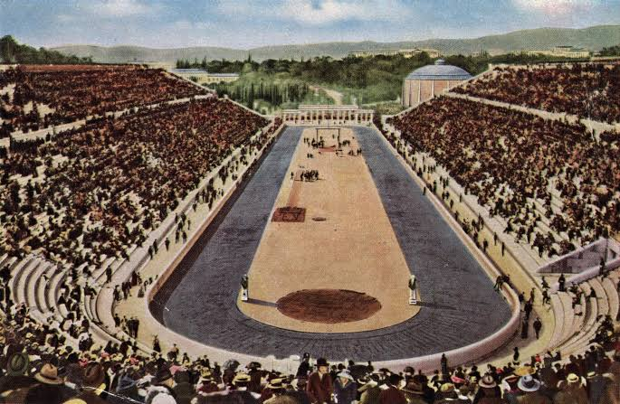
Think about the picture.
The modern Olympic Games started in 1896

Slide 12
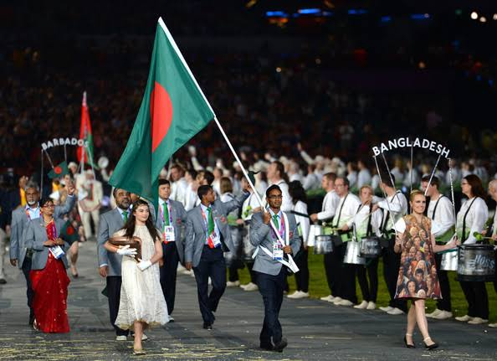
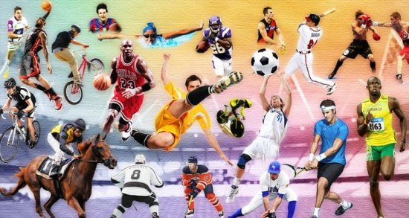
Think about the picture.
More than 200 nations send a total of about 13000 athletes to compete in more than 30 different sports.

Slide 13
Pair work
Answer the following questions.
1. When did the modern Olympic Games begin?
2. How many athletes compete in the Olympics?
Ans: In the year 1896.
Ans: About 13000 athletes.

Slide 14
Open your english book at the page no-68.

Slide 15
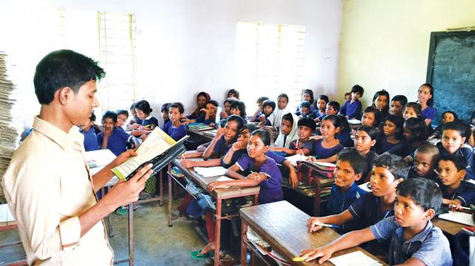
Loud reading

Slide 16
Some word meanings
Biggest
Competition
Held
Host
Athlete
Compete
Modern
বৃহত্তম
প্রতিযোগিতা
অনুষ্ঠিত হওয়া
স্বাগতিক
ক্রীড়াবিদ
প্রতিযোগিতা করা
আধুনিক

Slide 17
EVALUATION
Write “T” for correct statement or “F” for false statement.
1. The Olympics are held every three years.
2. The first Olympic games were held in Greece.
B. Answer the following questions.
1. How many countries compete in the Olympics?
2. How often are the Olympics held?
F
T
Ans: More than 200 countries.
Ans: Every four years.

Slide 18
Home work
Write a short composition about “Olympic Games”
in 5 sentences.

