Slide 1
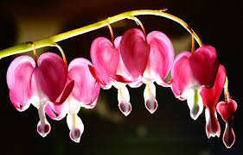
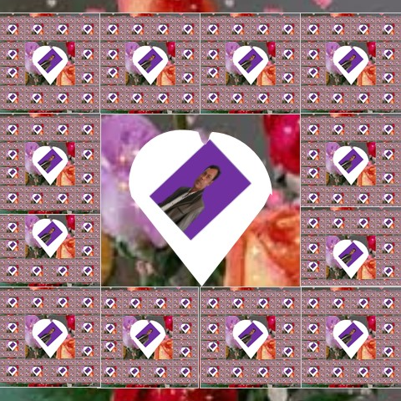
Welcome to the lesson

Slide 2
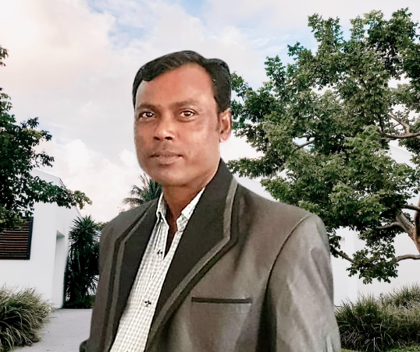
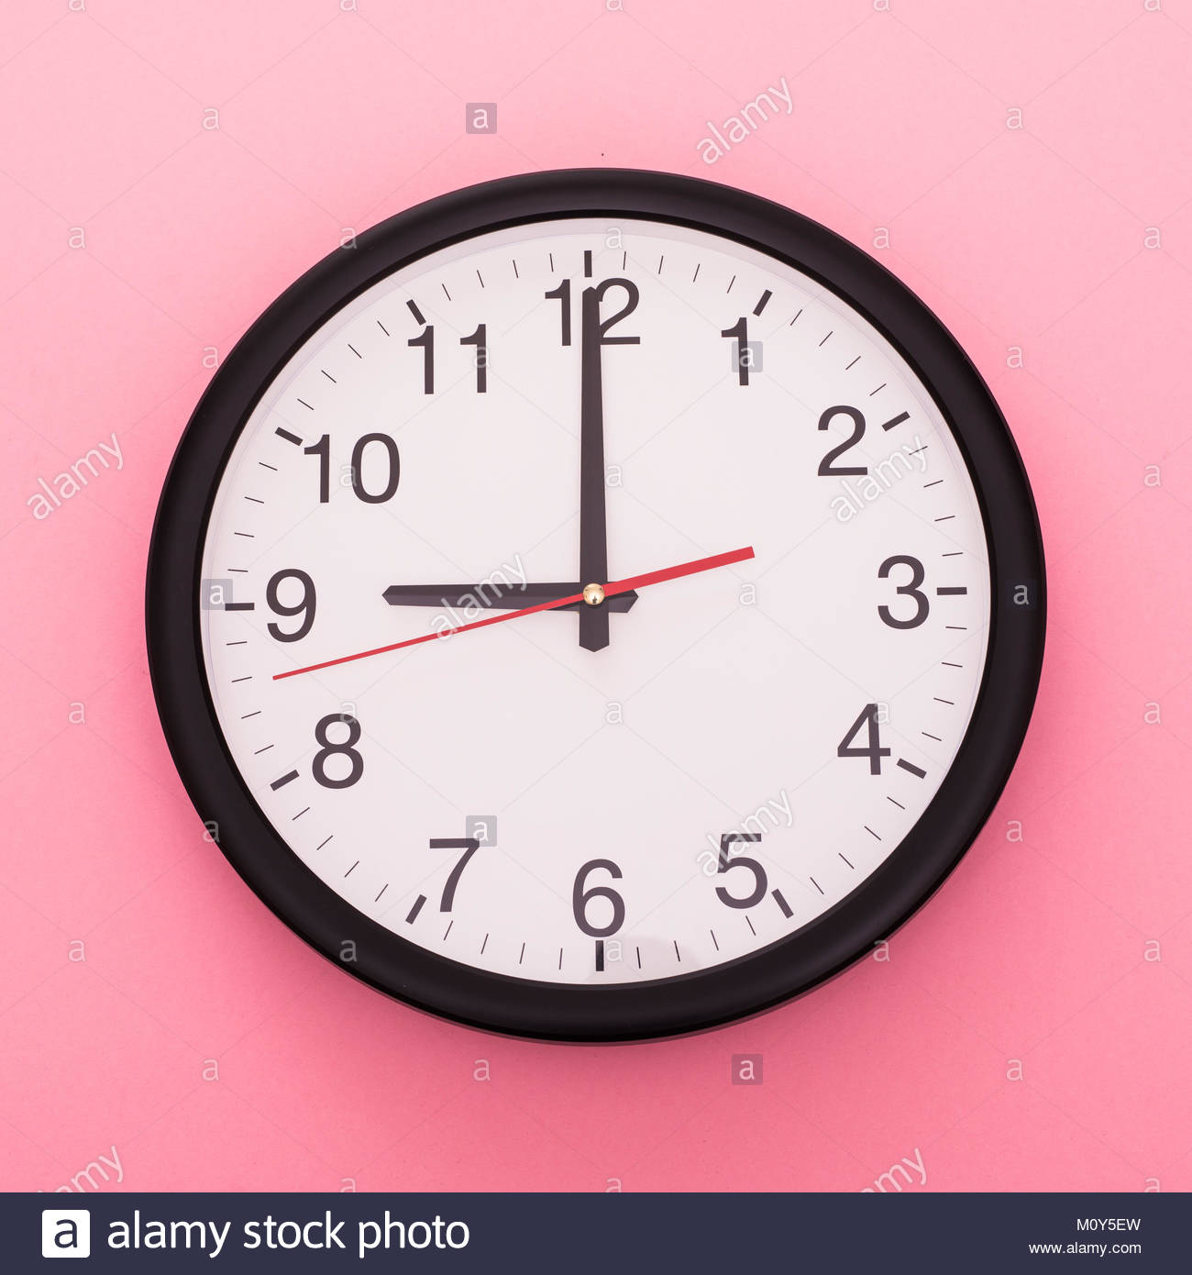
Identity
Name :Ramjan ali
Assistant teacher
Majer gaon gov primary school
Companigonj, Sylhet
Mobail no :01724354399.
Class :five
Subject:English
Unit :13
Lesson :one
Time 45 minite
Date:

Slide 3
Learning outcomes :
students will be able to
1.3.1 recognize which words in a sentence are stressed.
4.3.1 understand and enjoy simple poems.
4.1.1 To recite poems
5.1.1 To tell the time (hours and minutes and mention a.m/p.m half past, quarter past, quarter to etc

Slide 4
Lets go now a video

Slide 5
Today we are going to read
Telling the time.

Slide 6
One Day One Word
Our todays one word is
Word
Bangla Meaning
Sentences
Go back to your home.
Go back
ফিরে যাও

Slide 7
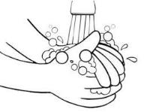
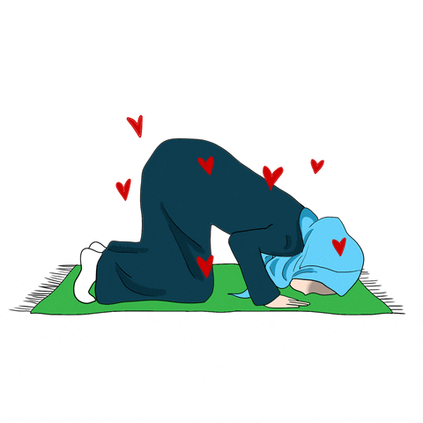
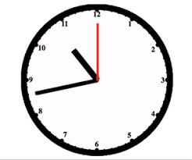
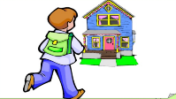
Now, we will disscuss about some new words and try to say word meaniag
Wash
To make something clean using water
ধৌত করা
Words which you say to god
Pray
প্রার্থনা
Clock
Tells time
ঘড়ি
Return
ফিরে যাওয়া
Go back

Slide 8
What is this?
This is a clock?

Slide 9
Let’s introduce with a clock
Clock
12
11
1
Minute hand
10
2
9
3
Hour hand
8
4
7
5
6
Digit

Slide 10
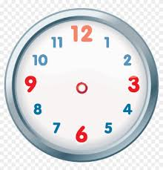
Now, we try to tell the time…..
5 Hours
5 o’clock
0 Minute
7 Hours
7 o’clock
0 Minute

Slide 11
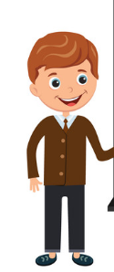
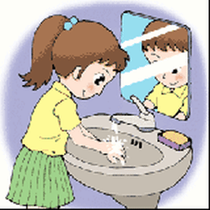
Now tell me, what is the time and what are they doing?
and
Wash yourself
It’s 5 o’clock
Pray

Slide 12
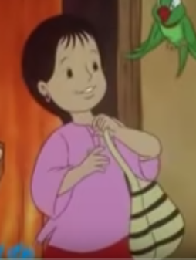
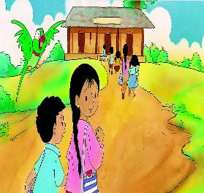
and
It’s 9 o’clock
Take your bag
Go to school

Slide 13
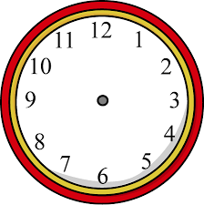
Pair work
Rose
Belly
Lilly
What time is it? Mention your work to do.
What time is it? Mention your work to do.
What time is it? Mention your work to do.

Slide 14
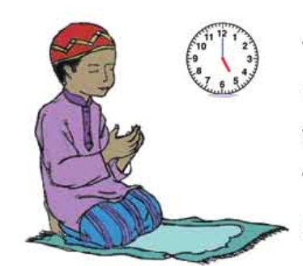
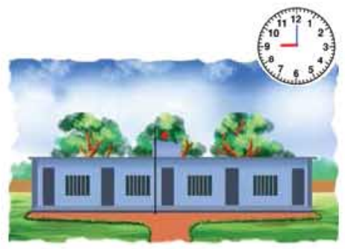
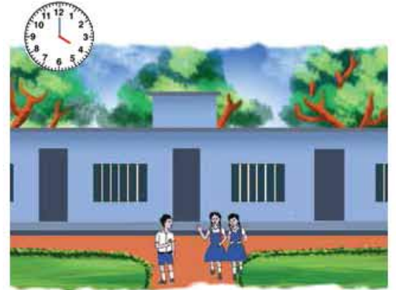
Look at the pictures attentively and answer the questions.
1.What time is it
now?
Ans: It’s 5 o’clock.
1.What time is it
now?
Ans: It’s 9 o’clock.
1.What time is it
now?
Ans: It’s 9 o’clock.

Slide 15
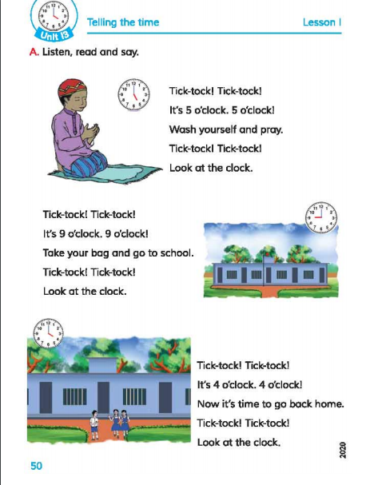
Now Open your book at page no 50, unit:13, lesson:1.
Let's read the lesson.

Slide 16
Group work
1.How long is your school day?
Ans: It’s 6 hour.
2.How is your walk to school?
Ans: It's 15 minute.
3.How long is your summer holiday?
Ans: It’s 15 days.

Slide 17
Evaluation
Rearrange the lines with correct order.
Wash yourself and pray.
Tick-tock! Tick-tock!
Tick-tock! Tick-tock!
Look at the clock.
It's 5 o'clock. 5 o'clock!

Slide 18
Task
Write five sentences about your days activities time.

Slide 19
Thank you and goodbye

