Slide 1
Now we will sing a song
Good
morning

Slide 2
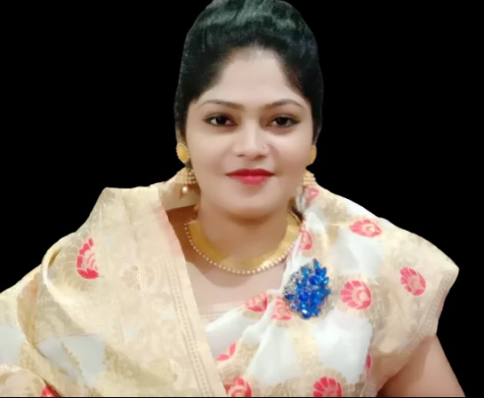
Introduction
Hafiza Khanam. Assistant teacher.
99 No. Nilokhi G.P.S.
Gopalganj Sadar,
Gopalganj.
khanamhafiza@gmail.com
Class: One
Subject: English
Alphabet. Lesson:4-6,
Unite : 9. Page : 19

Slide 3
Lets see the video

Slide 4
Lesson Declaration
g
G
Alphabet(Gg)

Slide 5
Learning outcome
Students will be able to-
1.1.1 to become familiar with English sounds by listen to
common English word.
1.1.2 to say simple words.
1.2.1 to recognize and read the alphabet both small and
capital (non-cursive) letters.
3.1.2 write words using non-cursive small letters.

Slide 6
Look, listen and say
G
g
goat

Slide 7
g
goat
Small letter

Slide 8
Look, listen and say. Trace in the air.
G
G

Slide 9
Look, listen and say. Trace in the air.
g
g

Slide 10
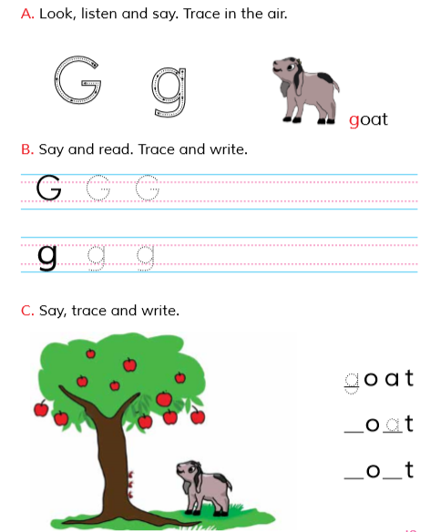
Open at page 19

Slide 11
WCW
Loud reading by the teacher
G
goat
goat
g

Slide 12
Say and read. Trace and write.
WCW
G
G
G
g
g
g

Slide 13
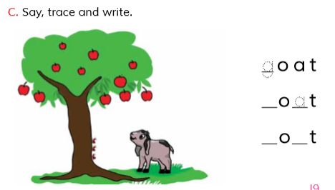
Individual work
Say, trace and write.

Slide 14
Evaluation
Write noncursive small letter “ ”.
g

Slide 15
Look and say. Write.
Evaluation
Look at the picture and fill in the gaps:
Goat

Slide 16
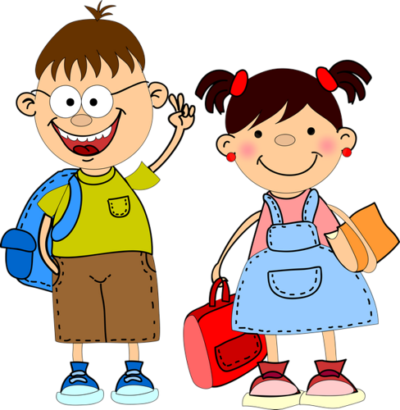
Good
bye

