Slide 1
Wellcome

Slide 2
Teachers Identity
Name-Lakshmi Puti Chakma
Assistant Teacher
Ananda Nagar GPS
Khagrachari Sadar

Slide 3
Lesson Identity
Sub-English
Class-1
Unit-5
Lessons-(1-3)
Activity -A

Slide 4
Learning outcomes
Students will be able to-
1.1.1 become familiar with English sounds by listening to common English words.
1.1.1 repeat after the teacher simple words and phrashes.
1.1.2 say simple words and phrashes.

Slide 5
Lets enjoy an audio

Slide 6
Lesson Declaration
Our todays lesson is “Commands”

Slide 7
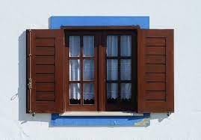
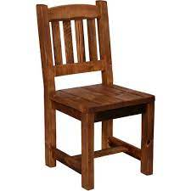
Look at the pictures
Window
Door
Chair
Floor

Slide 8
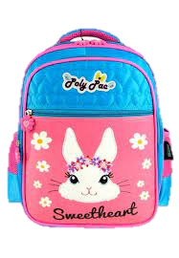
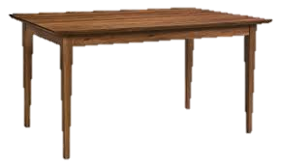
Look at the pictures
Table
Book
Pencil
Bag

Slide 9
Listen to this audio . Repeat after the audio and point to the book.

Slide 10
Practice the name of the pictures
GW
Window
Chair
Door
Floor

Slide 11
Practice the name of the pictures
GW
Table
Pencil
Book
Bag

Slide 12
IW
Table
Pencil
Window
Practice the name of the pictures
Book
Floor
Bag
Chair
Door

Slide 13
IW
Match the names with pictures
Window
Book
Chair
Bag

Slide 14
Open your books at page -10

