Slide 1
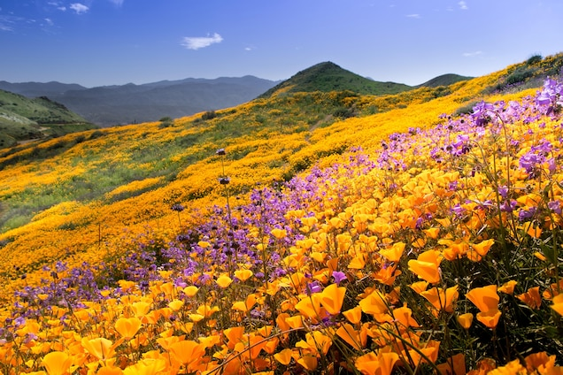
Welcome
Subject: English First Paper
Class: Ten
Unite - Three

Slide 2
Teacher’s Introduction
Mst.Kohinoor Akter Banu.
Assistant Headmaster
Alampur Secondary Girls School.
Kushtia Sadar, Kushtia
Mobile no - 01716494605

Slide 3
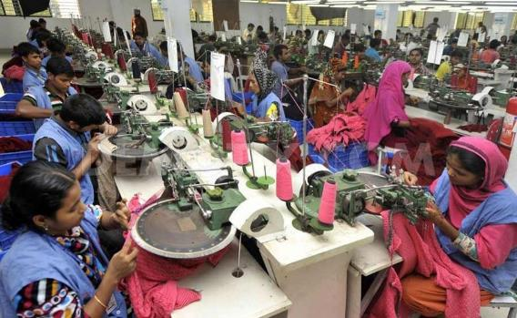
Look at the Pictures!
Who are they ? What are they doing?

Slide 4
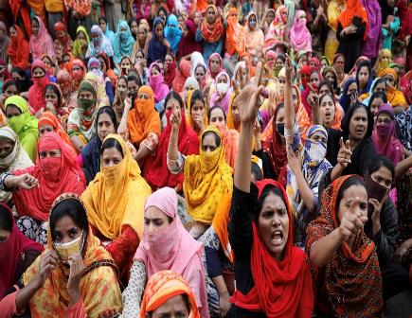
Look at the Pictures!
Why are they on the street?
What do they want?

Slide 5
Today’s Lesson
Unit: 03: Events and Festivals
Lesson: 02
Reference Book: English For Today

Slide 6
Learning Outcomes
At the end of this lesson, students will be able to –
tell about May Day
apply some key words from the text
describe the historical background of May Day
analyse the need of Labour Organisations
write a narrative story (third person’s point of view)

Slide 7
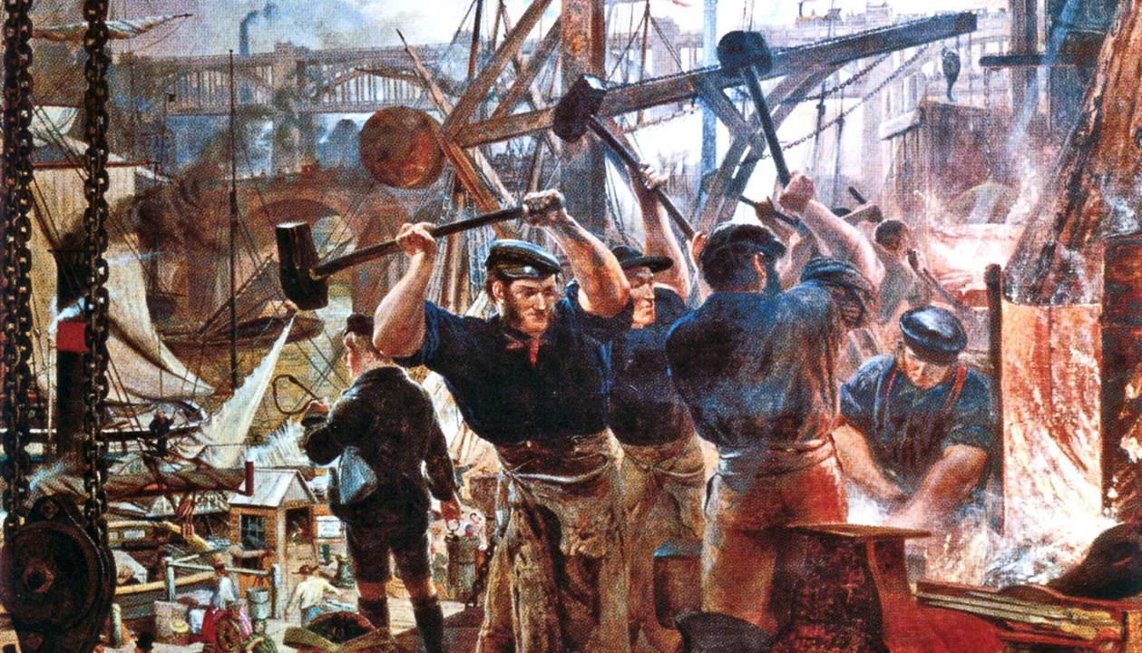
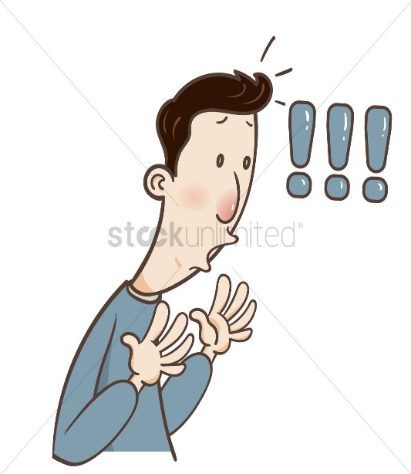
History of May Day
14 or more hours work day!
Manual Work
The Industrial Revolution

Slide 8
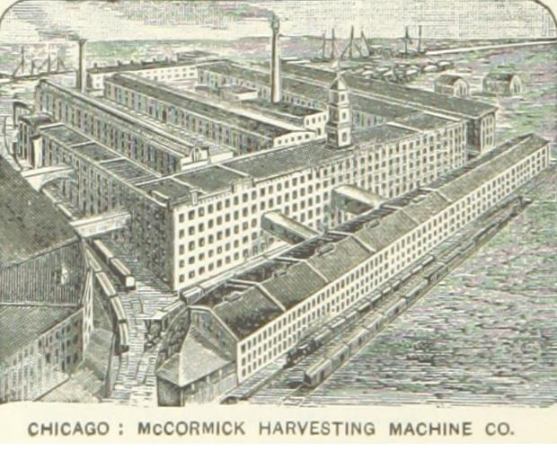
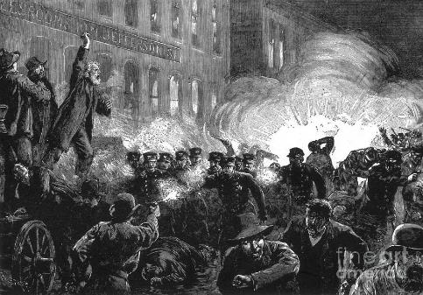
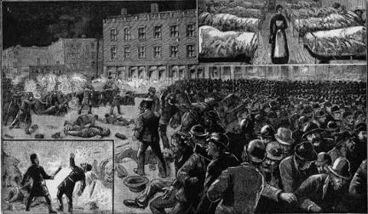
May 1, 1886
McCromic Harvest
Machine Company
Labour Leaders’ Speeches
Rally, Strike and the Wounded

Slide 9
Key Vocabularies
Observe = Celebrate
International Workers’ Day is observed all over the world.
Commemorate = Recollect
Every year, we commemorate the sacrifices of our freedom fighters.
Establish =
Set up/found
Our school was established in 1938.
Demand = Claim
They demand their salaries.
Address(V)= Speak to
The leader has already addressed the crowd.

Slide 10
Key Vocabularies
Urge = Suggest strongly
We urge them to attend the seminar.
Strike-breaker = A person who breaks a strike
The strike-breakers attacked on the civilians.
Instantly = Promptly
A police van reached there immediately.
Wounded = Hurt
Many people were wounded in the clash.

Slide 11
Key Vocabularies
Exploit = Abuse
The owner exploits his workers.
Gain = Attain
He gained practical knowledge in the field.
Condition = State
The living condition of the workers is full of struggles.
Injured = Harmed
Some of them were injured.

Slide 12
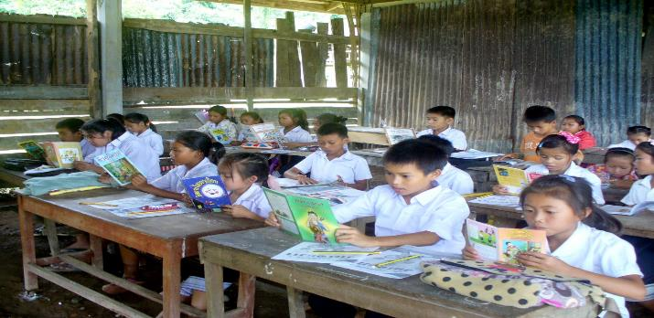
Silent Reading
Students will be instructed to read the text silently.

Slide 13
Individual Work
Go through and write down the answers of the following questions-
What does May Day refer to?
How long did the workers have to work in a day before the May 1 strike?
Why did the workers in Chicago go on strike?
What do you learn from the events of May 1, 1886?

Slide 14
Complete the Story
Text book- Page: 32 Question no: C
Complete the story using the verbs from the box…
add | support | begin | work | hear
send | arrive | tread | do | live

Slide 15
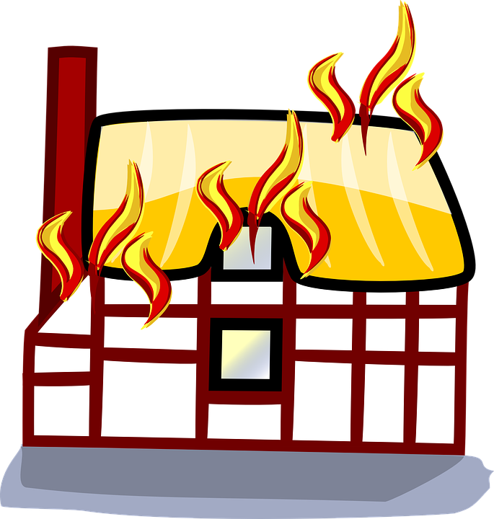
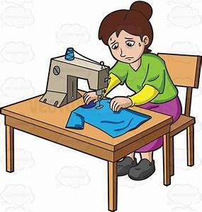
Have You Noticed?
Have a close look at the words and sentences used in the story-
Tania She The workers
…someone shouting “Fire! Fire!”
Who is telling the story?
Tania or Someone else

Slide 16
Homework
Story Writing
Every year, a large number of people move to Dhaka for getting job and earning enough money to support their family. Rokeya is one of those who have already left their home and living in Dhaka. She works in a garment factory at Gazipur in Dhaka…..
Note: Your story should contain at least 200 words. Don’t copy down from the text. Use your own words, phrases and sentences and complete the story. Add dialogues if possible!

Slide 17
ALLTHANKEW

