Slide 2
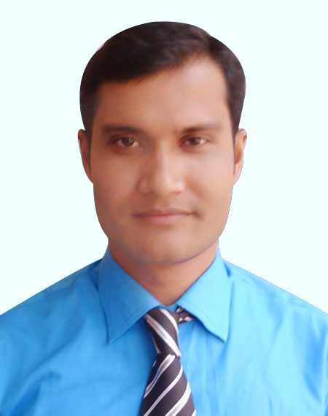
Teachers identity
Lessons identity
Md. Belal Hossan
Assistant teacher
Ceora Government primary school
Class-Three
Subject- English
Unite-39
Lesson 7-9

Slide 3
Good morning, students.
Good morning, teacher.
How are you today?
Fine. and you?
Fine, thank you.

Slide 4
Let’s listen a song

Slide 5
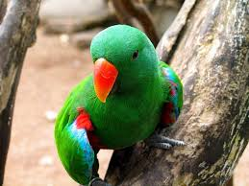
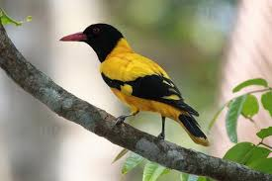
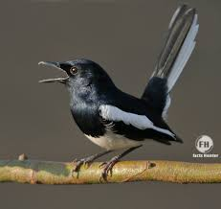
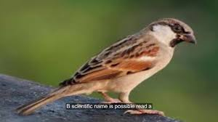
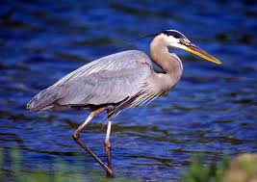
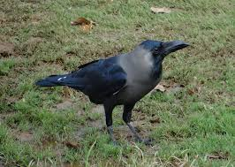
See the following pictures and try to say what is our today’s lesson?
What kind of birds look here?
Many kinds of birds look here.
Which bird is common of our country?
The crow is very common bird in our country.

Slide 6
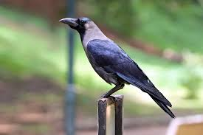
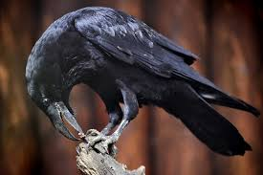
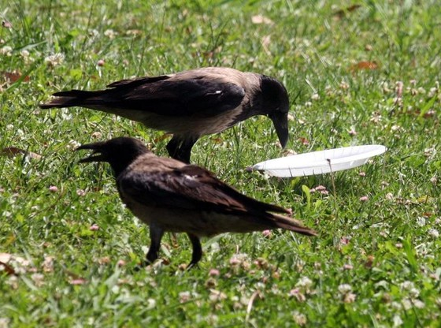
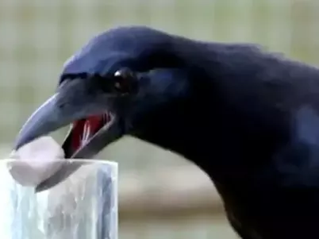
What do you see in the picture?

Slide 7
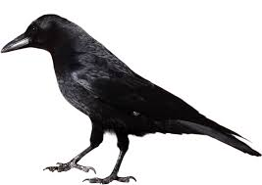
Today’s our lesson is
The crow

Slide 8
Learning outcomes
students will be able---
Listening: 4.3.1 enjoys and understand stories.
Speaking: 1.1.4 say words and sentences with proper sounds and stress.
Reading: 5.1.3 read texts.

Slide 9
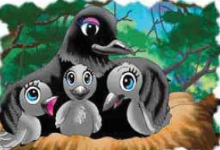
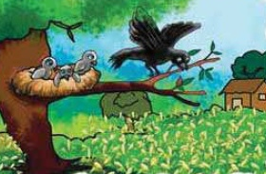
My dear students-
Can you say, about our previous lesson?
From our previous lesson, we know the mother crow and young crow.
.

Slide 10
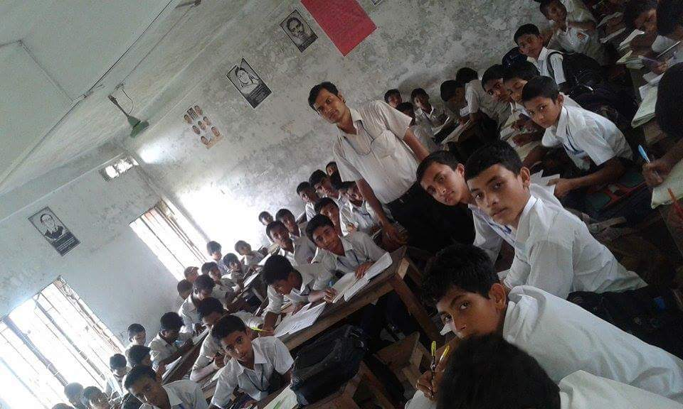
Teacher’s loud reading
Open your EFT book at page 79.

Slide 11
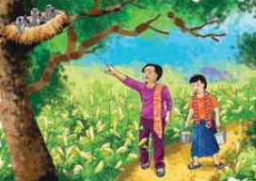
The next morning young crows see the farmer again. There is another man with him. The man sees the nest.

Slide 12
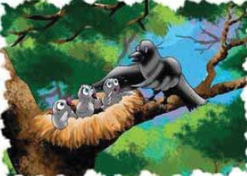
Mother crow comes back. The young crows say to their mother, “Is it time to leave now?” Mother crow says, “No. It’s not time yet!”

Slide 13
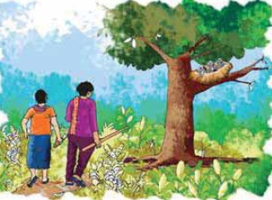
The next day. The young crows see the farmer and the man again. The man has a stick.

Slide 14
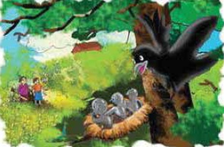
Mother crow comes back. She sees the farmer and the man with the stick.

Slide 15
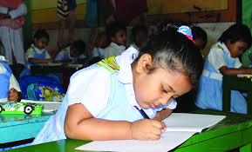
Individual work
Say the words and with proper sound and stress:
Again, Yet, Stick, Farmer, Another.

Slide 16
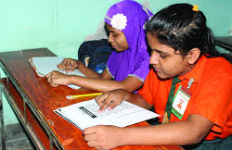
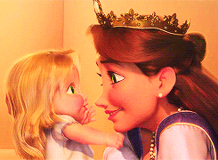
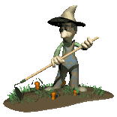
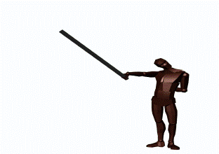
Pair work
Let’s find out new words and meaning them.
m
Mother
Parent
Farmer
Cultivator
Stick
Rod

Slide 17
Group work
All groups work in same.
1. How many people do the crows see?
2. How many days are there is the story?
Group -1
1. How many people do the crows see?
2. How many days are there is the story?
Group -2
1. How many people do the crows see?
2. How many days are there is the story?
Group -3

Slide 18
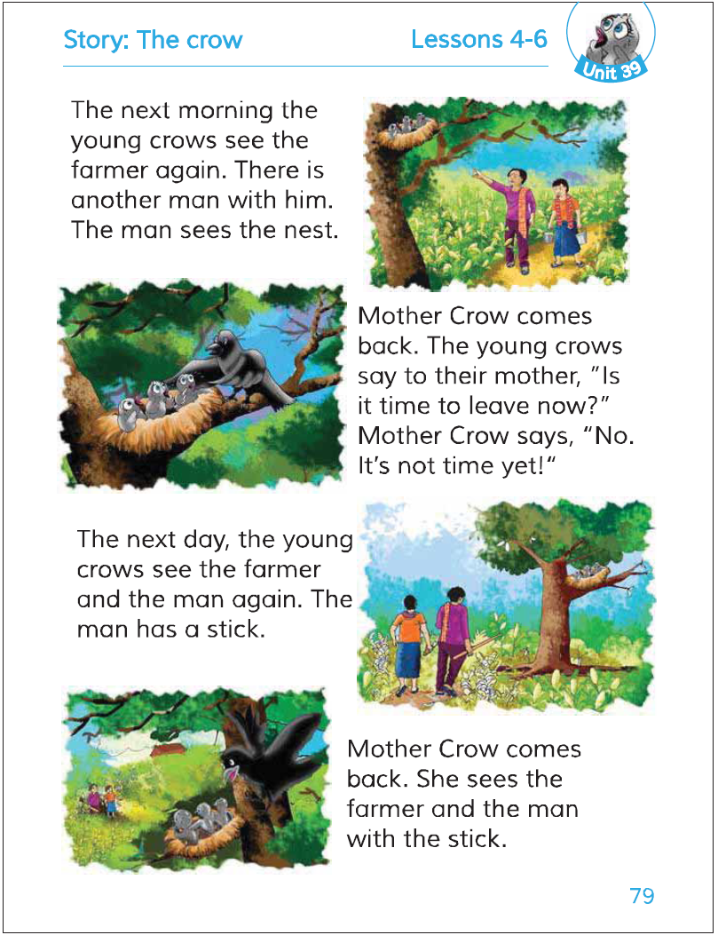
Student’s reading in pair.

Slide 19
Checking learning

Slide 20
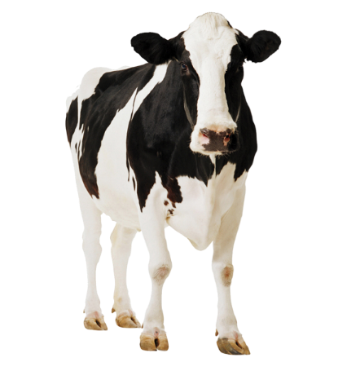
Checking learning
cow
I’m a cow /goat.
I live in a stream/ shed.
shed
I get up early / late.
I am a slow / quick animal.
early
slow

Slide 21
Fill in the blanks:
1. The man sees the .
nest
2. Mother comes back.
crow
3. The man has a .
stick
Matching
4. The young crows see the .
farmer
5. There is with him.
another man

Slide 22
Right answer
Wrong answer
What is the man see?
B. The house
A. The hut
✓
D. The room
C. The nest

Slide 23
Home work
Write five sentences about the crow.

Slide 24
Thanks

