Slide 1
Welcome to English class

Slide 2
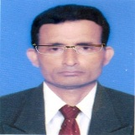
Identity
Manik Chandra Majumder
Senior Teacher
Gazirhat High School
Senbag, Noakhali.
Mobile No: 01717155169
Email: manikmajumder01@gmail.com
Class : Eight-Ten
Subject : English 2nd paper
Time : 50 Minutes
Date : 00/00/2021

Slide 3
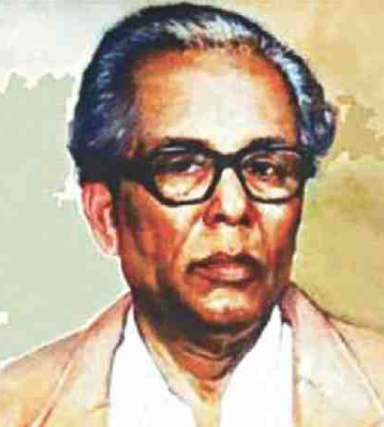
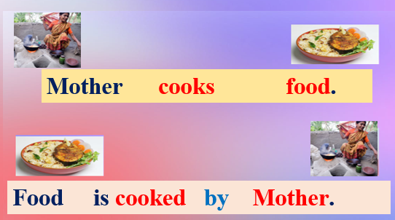
Look at the pictures and read the sentences.
Now observe the pictures and parts of the sentence.
Zainul Abedin drew these pictures.
Zainul Abedin
drew
these pictures.
Subject
Verb
Object

Slide 4
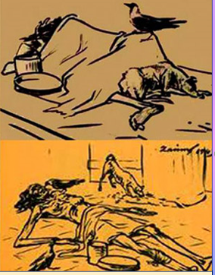
These pictures
were drawn by
Zainul Abedin
Subject becomes object and object becomes subject

Slide 5
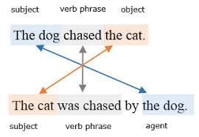
Generally three types of sentences can be changed from Active to Passive:
1.Assertive Sentence
2. Interrogative Sentence
3. Imperative Sentence

Slide 6
Let’s watch a Video

Slide 7
Our today’s Lesson is -----

Slide 8
Learning outcomes
After the end of the lesson, students will be
able to…
tell the definition of voices,
tell the kinds of voices,
describe some rules of changing voices,
change the voices.

Slide 9
Definition of Voice
Voice: is the way of expressing verbs which describes whether the subject does the work or it has been done by the subject. There are two types of voice--Active & Passive voice.
Active Voice: Subject does the work by himself
actively (e.g., "The dog bit the postman.").
Passive Voice: Subject does not do the work by himself actively rather the object’s work is done by the Subject (e.g., "The postman was bitten by the dog.
Verb must be transitive as active verb

Slide 11
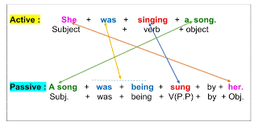
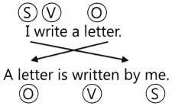
Look at the pictures and read the sentences.

Slide 12
Subject becomes object and object becomes subject.
Subject | Object
I | me
We | us
You | your
He | him
She | her
They | them
Who | whom
Rules of changing Active to Passive voice
Preposition ‘by’ is used before object
Verb always becomes past participle form with the help of Auxiliary verb according to Person, Number and Tense forms.

Slide 13
1. Assertive Sentence
Present Indefinite Tense-
Active: Sub. + V1 +obj.
Passive: (Sub. +am/is/are+V3+by+obj)
1. Active: He draws a picture.
Passive: A picture is drawn by him.
2. Active: Fishermen catch fishes.
Passive: Fishes are caught by fishermen.
3. Active: The cow gives us milk.
Passive: We are given milk by the cow.
or: Milk is given us by the cow.

Slide 14
Past Indefinite Tense-
Active: Sub. + V2 +obj.
Passive: (Sub.+ was/were+v3+by+obj.)
1. Active: Mother cooked rice.
Passive: Rice was cooked by mother.
2. Active: The boy made a kite.
Passive: A kite was made by the boy.
3. Active: Rina opened the door.
Passive: The door was opened by Rina.

Slide 15
Present Continuous Tense-
Active :Sub.+ am/is/are+ Verb+ing +obj.
Passive : (Sub.+ am/is/are+being+V3+by+obj)
Active: They are eating mangoes.
Passive: Mangoes are being eaten by them.
Active: I am reading a novel.
Passive: A novel is being read by me.
Active: Kamal is drawing a map.
Passive: A map is being drawn by Kamal.

Slide 16
Past Continuous Tense
Active :Sub.+ was/were+ Verb+ing +obj.
Passive : (Sub. + was/were+being+V3+by+obj)
Active: They were eating mangoes.
Passive: Mangoes were being eaten by them.
Active: I was reading a novel.
Passive: A novel was being read by me.
Active: Kamal was drawing a map.
Passive: A map was being drawn by Kamal.

Slide 17
Present Perfect Tense-
Active: Sub. + have/ has +V3 +obj.
Passive: (Sub. +have/has+been+V3+by+obj)
1. Active: He has drawn a picture.
Passive: A picture has been drawn by him.
2. Active: Fishermen have caught fishes.
Passive: Fishes have been caught by fishermen.
3. Active: We have finished the work.
Passive: The work has been finished by us.

Slide 18
Past Perfect Tense---
Active: Sub. + had +V3 +obj.
Passive: (Sub. +had+been+V3+by+obj)
1. Active: He had drawn a picture.
Passive: A picture had been drawn by him.
2. Active: Fishermen had caught fishes.
Passive: Fishes had been caught by fishermen.
3. Active: We had finished the work.
Passive: The work had been finished by them.

Slide 19
Future Indefinite Tense-
Active: Sub. + shall/ will +V1 +obj.
Passive: (Sub.+ shall/will+be+V3+by+obj.)
1. Active: Sumon will help me.
Passive: I shall be helped by Sumon.
Active: They will do their duties.
Passive: Their duties will be done by them.
Active: Monir will do the work.
Passive: The work will be done by Monir.

Slide 20
Future Continuous Tense-
Active: Sub. + shall/ will + be +Verb+ing +obj.
Passive: (Sub.+ shall/will + be+ being+V3+by+obj.)
1. Active: They will be building the house.
Passive: The house will be being built by them.
Active: She will be making cakes.
Passive: Cakes will be being made by her.

Slide 21
Future Perfect Tense-
Active: Sub. + shall/ will + have +V3+obj.
Passive: (Sub.+ shall/will + have +been+ V3+by+obj.)
1. Active: They will have built the house.
Passive: The house will have been built by them.
Active: She will have made the cakes.
Passive: The cakes will have been made by her.

Slide 22
If modal auxiliary verbs add in Active voice- as----
(can/ could/ shall/ should/ will/ would/ may/ might/ must + V1)
Passive: Sub.+ modal auxiliary+be+V3 +by+obj.
1. Active: Sumon can help me.
Passive: I can be helped by Sumon.
Active: They may do their duties.
Passive: Their duties may be done by them.
Active: Monir might do the work.
Passive: The work might be done by Monir.

Slide 23
Sometimes in passive voice we use preposition to, with, at instead of ‘by’ before object.
Example-----
Active: The boy pleases us all.
Passive: We all are pleased with the boy.
Active: Panic seized me.
Passive: I was seized with panic.
Active: I know the boy.
Passive: The boy is known to me.
Active: His behaviour surprised me.
Passive: I was surprised at his behaviour.

Slide 24
If any object is Reflexive pronoun as myself, himself, herself. themselves , ourselves, it will be unchanged---
Example:
1. Active: He killed himself.
Passive: He was killed by himself.
2. Active: The ladies fan themselves.
Passive: The ladies are fanned by themselves.

Slide 25
If any object of Reflexive verb as myself, himself, herself. themselves , ourselves, it will be unchanged in passive voice.
Example:
1. Active: He killed himself.
Passive: He was killed by himself.
2. Active: The ladies fan themselves.
Passive: The ladies are fanned by themselves.

Slide 26
If present participle adds after object in Active voice this present participle will be remained unchanged.
Example:
Active: I saw a ship coming (present participle)to the port.
Passive: A ship was seen coming to the port by me.
Active: I heard him saying (present participle) this.
Passive: He was heard saying this by me.

Slide 27
If Double object/ Retain object adds in Active
Voice. Example:
Active: Mina gave Tareq a dairy. (Two objects)
Passive: A diary was given Tareq (Retain Object) by Mina.
Or Passive: Tareq was given a diary (Retain Object) by Mina.
Active: Mr. Alam teaches us English. (Two objects)
Passive: We are taught English (Retain Object) by Mr. Alam.
Or Passive: English is taught us (Retain Object) by Mr. Alam.

Slide 28
If Factitive verb adds in Active Voice.
The Complement of factitive verbs remains unchanged and Complement refers /any post/position or call name.
Example:
Active: We made him captain. (complement)
Passive: He was made captain by us.
Active: The villagers elected him chairman. (complement)
Passive: He was elected chairman by the villagers.
Active: We appointed him caretaker. (complement)
Passive: He was appointed caretaker by us.

Slide 29
If Active voice is present continuous indicating future
Example:
Active: My father is going to open a bank account.
Passive: A bank account is going to be opened by my father.
Active: Teacher is going to take the class.
Passive: The class is going to be taken by teacher.

Slide 30
2. Interrogative Sentence
To change Active voice of Interrogative Sentence into Passive at first make the Interrogative sentence into Assertive then make it into Passive and finally reform it into Interrogative Sentence .
Example: If the sentence is Yes/ No Interrogative.
Active: Do you know him?
Assertive: You know him.
Passive: He is known to you.
Passive: Is he known to you?

Slide 31
If the Interrogative Sentence start with Wh-Pronoun as Who, Which, What, Where, When, Why, How--------we have to use the same Wh-Pronoun at beginning of the passive voice so that the sentence remains Interrogative . Example----
1. Active: What do you want?
Passive: What is wanted by you?
2. Active: Which book do you want?
Passive: Which book is wanted by you?
3. Active: Who opened the door?
Passive: By Whom was the door opened?
4.Active: Whom are you calling?
Passive: Who is being called by you?

Slide 32
3. Imperative Sentence
To change Active voice of Imperative Sentence into Passive voice ----Follow it this structure
Passive: Let/let not + object+ be + V3.
Active: Do the sum.
Passive: Let the sum be done.
Active: Take care of your health.
Passive: Let your health be taken care of.
Active: Do not laugh at the poor.
Passive: Let not the poor be laughed at.

Slide 33
Group work
Change the voices
His performance satisfied the teacher.
Don’t make a noise.
She will tell us a story.
Anwar was collecting books.
We have made him our captain.
He learns his lesson timely
Is he doing the work?
His behaviour surprised me
I was shocked at his conduct.
I was annoyed with him.
Group Work

Slide 34
Evaluation
Change The following voices:
1.He taught us English.
2. Did the boy catch the bird?
3. Pen through the word.
4. I am often helped by you.
5. Will you write the letter?
6. Cricket is liked by us.
7. He annoyed me.

Slide 35
Change the voice
We nominated him leader.
They have arranged a meeting.
We should love our country.
They are digging a hole.
He was making a kite.
Always speak the truth.
Don’t hate the poor.
Is food being cooked by her?

Slide 36
GOOD BYE

