Slide 2
WELCOME
TO
ONLINE
ENGLISH
CLASS

Slide 3
Teacher’s identity
MD. KHALILUR RAHMAN
ASSISTANT TEACHER
ATGHARIA HIGH SCHOOL
HARIPUR,THAKURGAON.

Slide 4
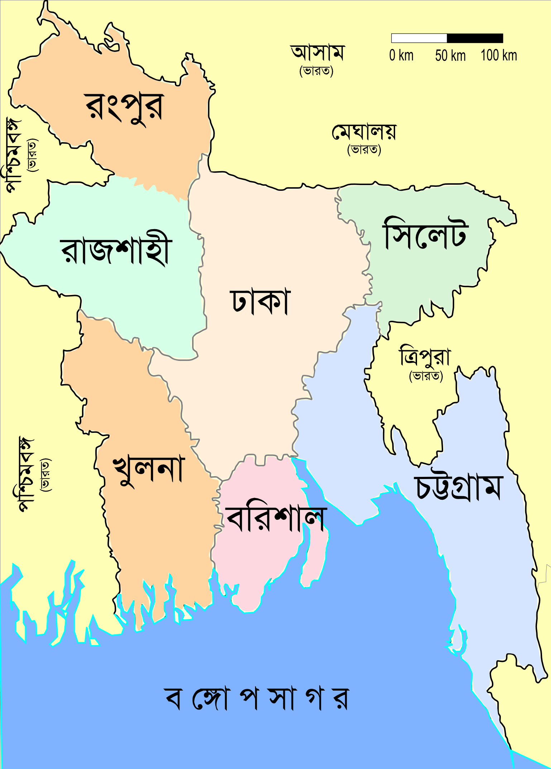
TODAY’S TOPIC: SENTENCE
CLASS:-SIX
Map
Rose
Tree
A Sentence is a group of words making a complete sense.
Example : My brother is student of class Ten
of Atgharia High School.

Slide 5
Learning Outcome
Sentence এর গঠন ও অর্থগত বিষয়ে জানতে পারবে

Slide 6
Classifications of sentences.
According to meaning there five kinds of sentences.
They are : (a) Assertive sentence.
(b) Interrogative sentence.
(c)Imperative sentence .
(d) Optative sentence.
(e) Exclamatory sentence.

Slide 7
According to structure there are three kinds of sentences .
They are 1. Simple sentence.
2 Complex sentence.
3.Compound sentenc

Slide 8
Assertive Sentence
An assertive sentence is a sentence which gives us a statement or a description.
Example: My brother is a student of Class Ten of Atgharia High School.
Assertive
.
Affirmative
Negative

Slide 9
Interrogative Sentence
What is interrogative sentence ?
An interrogative sentence is a sentence which asks any question.
Example : Have you played football?
Where did you go yesterday ?
Structure : (i) W/H + auxiliary verb+Sub+ Extension.
(ii) Auxiliary verb+ sub +p. verb + Extension.

Slide 10
IMPERATIVE SENTENCE
An imperative sentence is a sentence which expresses
any order, request, advice etc,
Structure: i. Principal verb+obj+ Extension.
ii.Do’t/ Never+verb+ obj+ex,
iii. Let +object + verb + EX
iv.Please/ kindly +verb +obj + Ex
Example : Do the work, Let’s go to cinema.

Slide 11
Optative Sentence
An Optative Sentence is a sentence which expresses any pray or wish
Structure :May +sub +verb +Ex.
Example : May you be happy .

Slide 12
Exclamatory Sentence
An Exclamatory Sentence is a sentence which expresses sudden feelings, emotion, joy , sorrow etc.
Structure : i. Interjection! + a sentence
ii. How / what + a / an + adje+
Sub+ verb !
Example : Hurrah ! We have won the game.
What a dangerous thing a little learning is!

Slide 13
Chapter lesson : To know about Sentence .
To identify sentences.
To make more sentences
Home work : Write about twenty sentences

Slide 14
THANK
YOU
ALL

