Slide 1
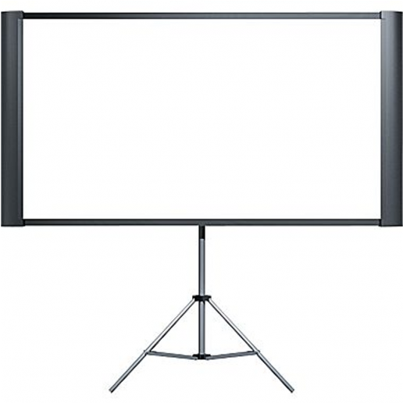
WELL COME TO
MY CLASS

Slide 2
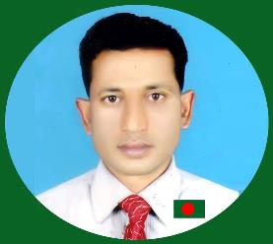
Md Abul Kalam Assistant teacher
Shahapur Govt Primary School
Baniyachong, Habiganj.
01718509171
Class-five
Subject- English
Time: 40 minutes

Slide 3
Let watch a video
Vedio click

Slide 4
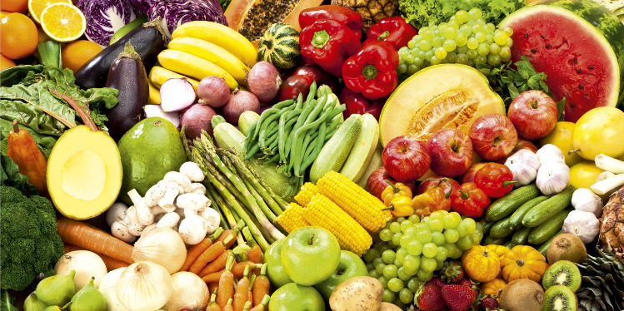
Look at the pictures.
Now, try to say about the following pictures.
If we eat this food, we will be healthy.
Why do we eat this food?

Slide 5
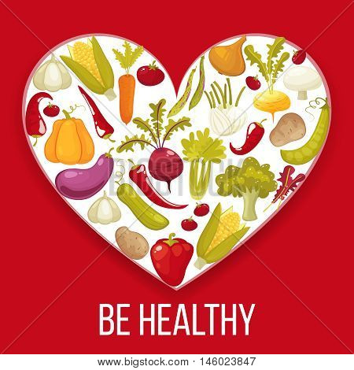
Today’s our lesson is
Unit- 7
Lesson: 1-2
Be healthy

Slide 6
LEARNING OUTCOMES
Students will be able to…
Carry out simple command and instructions.
2. Understand the new words and meaning them.
3. Write answer the simple question.
4. Write short and simple composition.

Slide 7
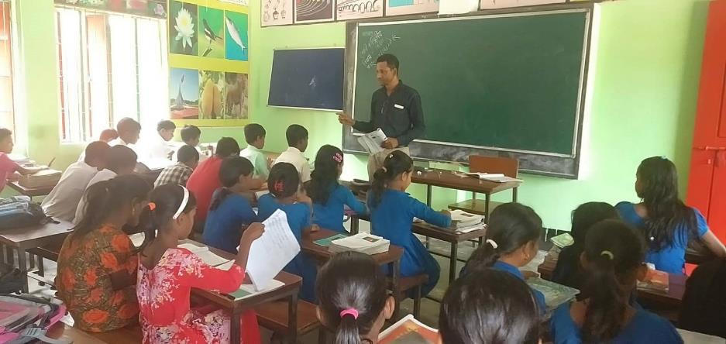
Open you EFT book at page 26.
Teacher’s loud reading and discuss the lesson

Slide 8
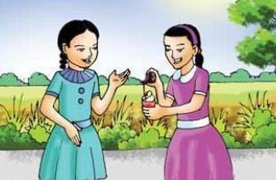
Nasreen
Sima
I am putting some chocolate on my ice-cream. Ice-cream is delicious with chocolate.
What are you doing, Nasreen?

Slide 9
Sima
Nasreen
Well, it looks good, but you shouldn’t eat a lot of chocolate or ice-cream.
Of course! I don’t eat them regularly.

Slide 10
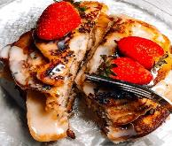
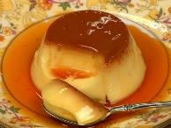
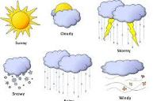
Individual work
Let’s find out the new words and meaning them.
Delicious
Tasty
Placing
Putting
Weather
Climate

Slide 11
Sima
Nasreen
Oh, fruits and vegetables. I love pineapples and bananas. They are my favourites. I eat cucumbers and lettuce a lot, too.
What kind of food do you eat regularly?

Slide 12
Sima
Nasreen
Would you like to try some of my ice-cream with chocolate? We should eat it quickly. It will melt soon in this hot weather.
I eat fruits and vegetables every day. Carrots and tomatoes are my favourites, but I also like strawberries and bananas.
Ok,! Thanks

Slide 13
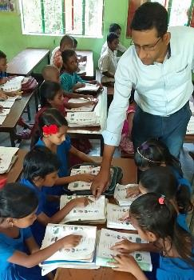
Pair work
Answer the questions:
1. What is Sima’s favourite food?
2. What does Nasreen eat a lot?

Slide 14
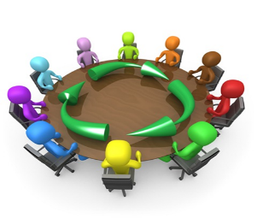
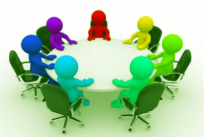
Group work
All groups work is same.
Write a short composition on healthy food at least in five sentences.
Group -1
Group -2
Group -3

Slide 15
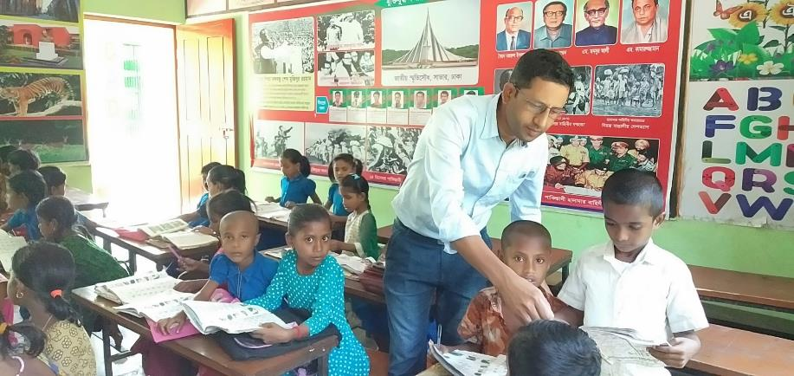
Student’s loud reading help by teacher

Slide 16
Evaluation
Fill in the blanks.
Matching
is putting
a. Nasreen some chocolate on Sima’s ice-cream.
b. It good.
c. It is , too.
d. But none should a lot of chocolate or ice-cream.
e. Sima tells Nasreen not too much chocolate or ice-cream.
looks
delicious
eat
to eat

Slide 17
Home work
Tomorrow you will be write 5 items name of healthy food.

Slide 18
