Slide 1
WELCOME

Slide 2
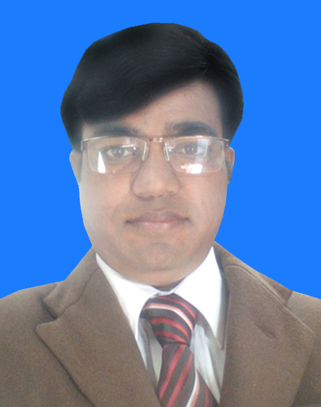
INTRODUCTION
Md. Nazmul Islam.
Assistant Teacher( English)
Bhair hat girls high school.Kaunia , Rangpur.
SUBJECT: English 1st Paper
CLASS: Eight

Slide 3
What can you see in the picture?

Slide 4
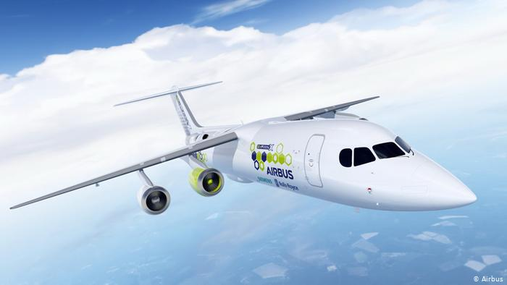
At the airport
Can you guess what is the place?

Slide 5
Topic’s name:
At the airport
Unit One
Lesson 1
Time: 40 min.

Slide 6
OBJECTIVES OF THE LESSON
By the end of the lesson the students will be able to
ask and answer questions.
read and understand text.
write answers to questions.

Slide 7
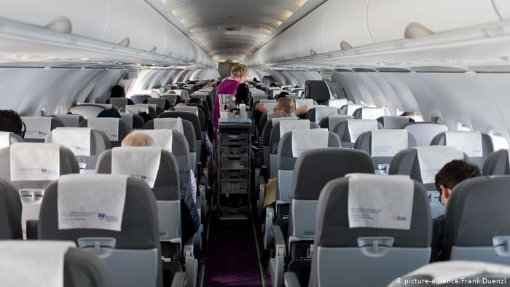
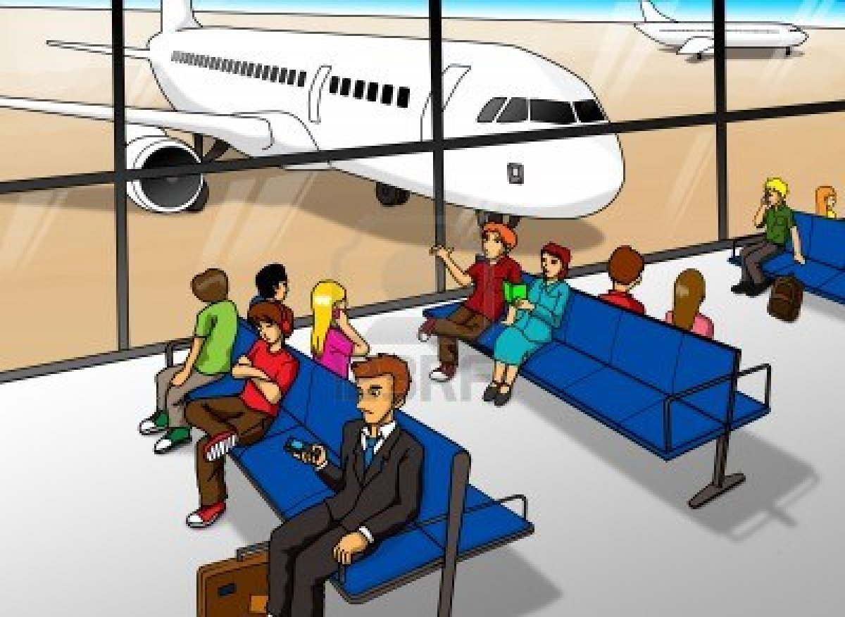
Lounge
Vocabulary
A room for waiting in at an airport
They are waiting in the lounge at the airport.

Slide 8
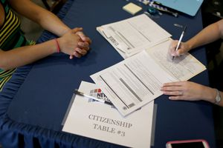
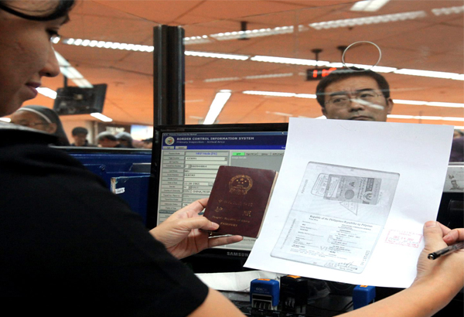
Immigration
An area at an airport, a sea port, etc. at which the passports
documents of people wanting to come into a country are checked.
The man is going through the immigration.

Slide 9
Read the text from the book and write answer of the following questions.
1. Why is Mita excited?
Ans: Mita is excited because this is her first time to board a plane.
2. Why aren’t Mita’s parents going with her?
Ans: Mita’s parents were too busy with their work.
3. What does an immigration officer do at the airport?
Ans: An immigration officer checks passport and stamps it.

Slide 10
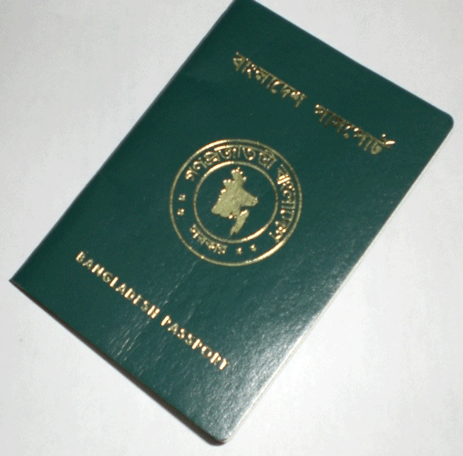
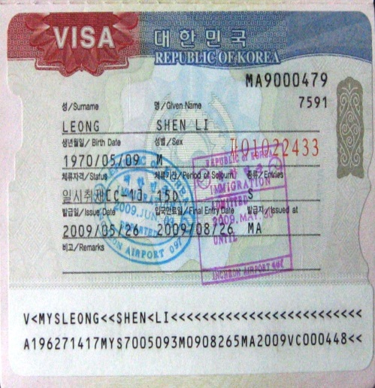
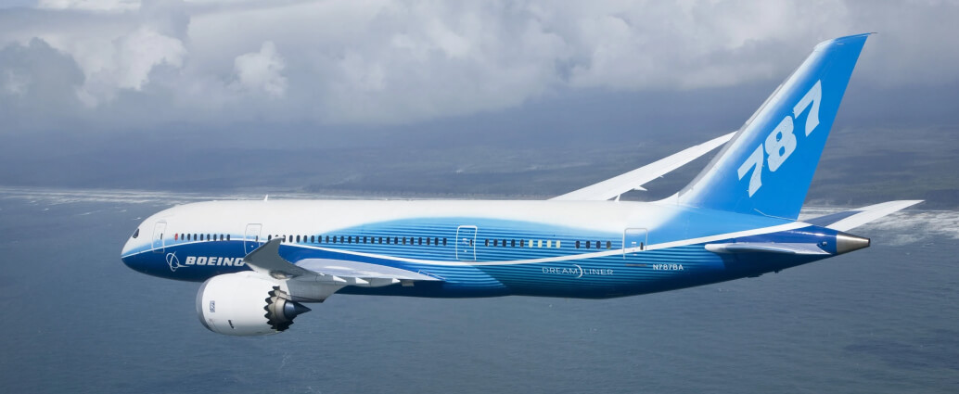
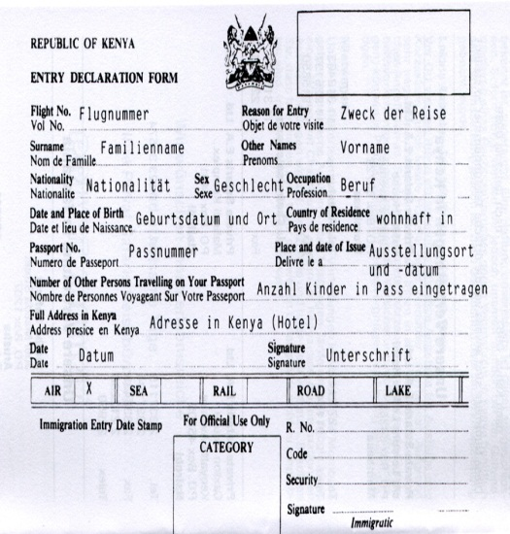
Preparation for going abroad

Slide 11
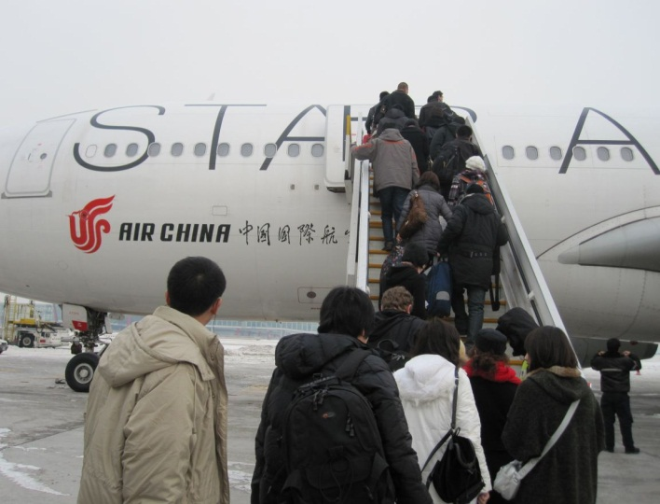
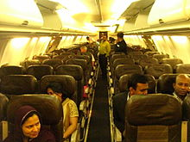
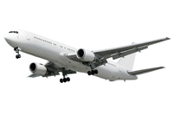
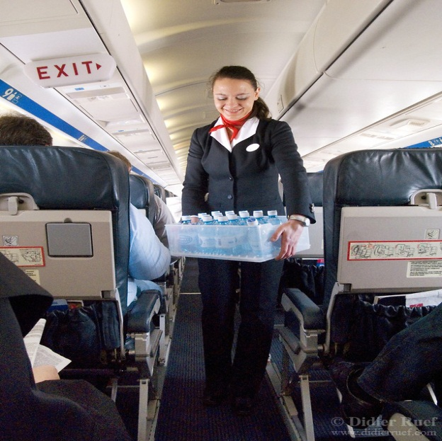
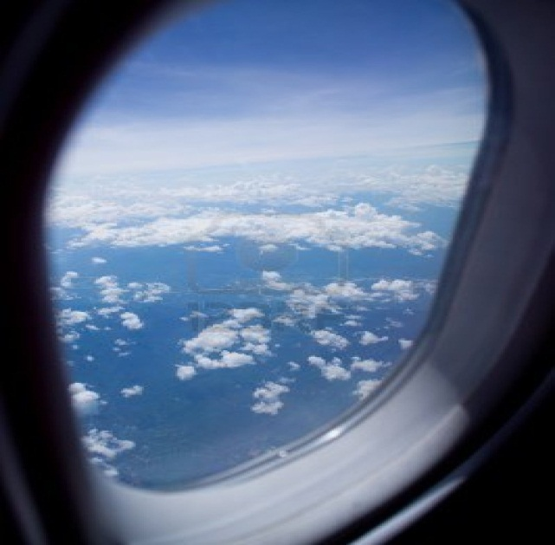
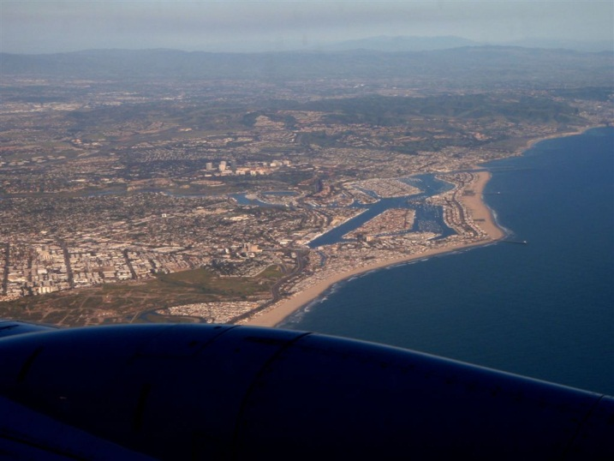
On the way while travelling
Boarding on the plane
Having seat
Plane flying
Air hostess’ service
Exciting view from the window
Notes:
The teacher can only show the slide or ask few questions as this slide is related to the slide no 14 where the students are asked to write a short composition about the preparation before travelling and the experience on the way.

Slide 12
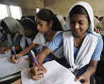
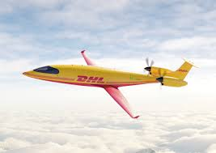
Individual Work
Think you are going to travel to Singapore by a plane.
Now write a short composition about your preparation before travelling and your experience on the way. (10 min.)

Slide 13
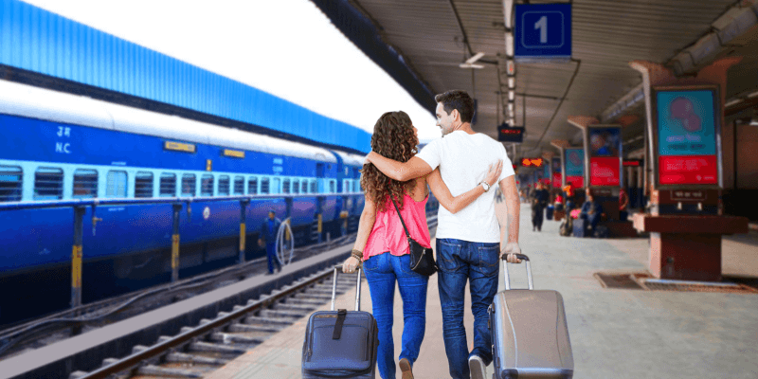
A trip to your grandparents’ house
Journey By A Train
Have A Look

Slide 14
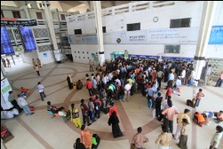
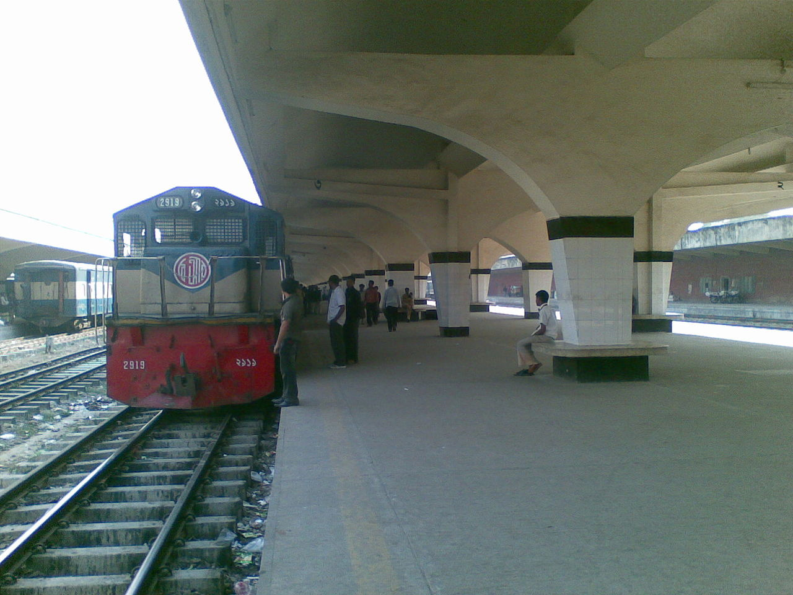

Slide 15
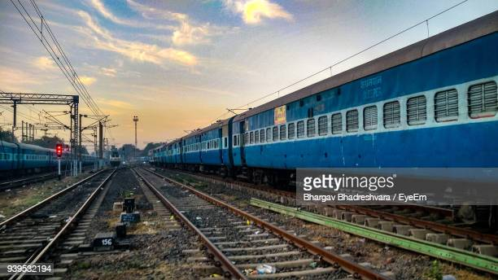

Slide 16
HOME WORK
Think you are going to travel to your grandparents’ house by a train. Now write a short composition about your preparation before travelling and your experience on the way. (Not more than 100 words)

Slide 17
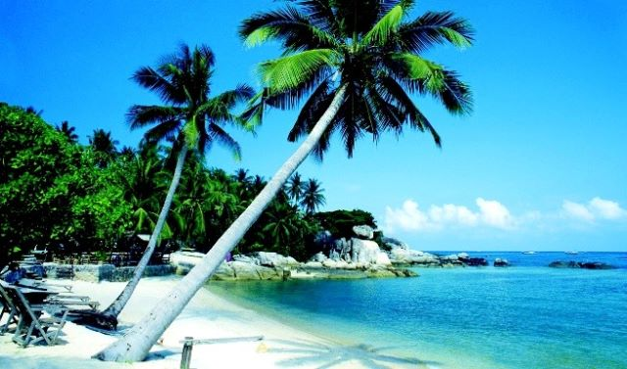
THANK YOU ALL
Dear students, please stay safe and use musk.

