Slide 2
Chowdhury Razu Ahamed
Lecturer
(English)

Slide 3
Learning Outcomes
After the end of the lesson students will be able to --
Know the meaning of new words so that they can realize the passage theme.

Slide 4
Lesson Identity
English
For
Today
11-12
Unit : 03
Lesson : 01
What Is A Dream ?

Slide 8
New Words
&
Their Meaning

Slide 10
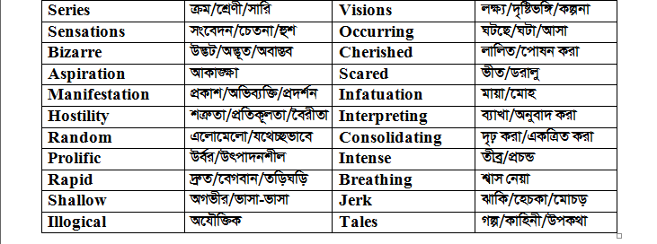

Slide 11
Learn the new words with meaning by heart

