Slide 1
Lutfor Rahman (M,A, M-Ed)
Assistant Teacher,
SB Trainer English, Arts and Crafts and BGS.
Selected Master Trainer in English TMTE Project British Council and DPE.
ICT4E District Ambassador, Dinajpur
Kundarampur, Government Primary school School,
Ghoraghat, Dinajpur.
E-mail: mlutfor81@gmail.com
Welcome To My
TITLE HERE
01
Multimedia
02
TITLE HERE
Class
03
TITLE HERE

Slide 2
Lutfor Rahman (M,A, M-Ed)
Assistant Teacher,
SB Trainer English, Arts and Crafts and BGS.
Selected Master Trainer in English TMTE Project British Council and DPE.
ICT4E District Ambassador, Dinajpur
Kundarampur, Government Primary school School,
Ghoraghat, Dinajpur.
E-mail: mlutfor81@gmail.com

Slide 3
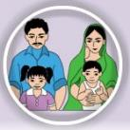
Yes, you are correct. The rhyme is about a family. Thank you all. Today`s lesson is…
Dear students, think and try to say, what about the rhyme.

Slide 4
Dear students, think and try to say, what about the rhyme.
Yes, you are correct. The rhyme is about a family. Thank you all. Today`s lesson is…

Slide 5
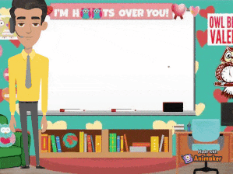
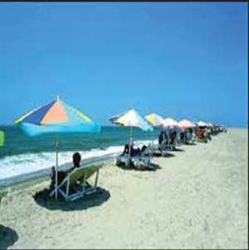

Slide 6
Listening
4.3.1 Enjoy and understand the simple stories.
Speaking
3.1.1 Ask and answer Wh questions.
Reading
5.1.1 Read simple paragraphs.
Writing
10.1.1 Write short and simple paragraphs by answering a set of questions.
I’m Tisha. I’m a student. I’m in Class 3.
There are four people in my family.

Slide 7
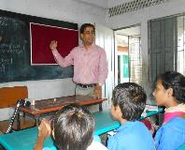
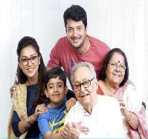
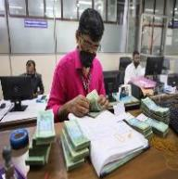
Teacher
Who teaches student.
Where father, mother, brother and sister live together.
Family
Banker
Who works in bank.

Slide 8
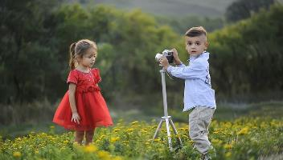
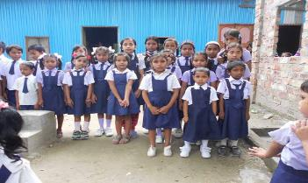
New Words
Little
Short in size
I’m Tisha. I’m a student. I’m in Class 3.
There are four people in my family.
Student
Who reads in school

Slide 9
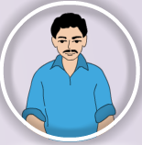
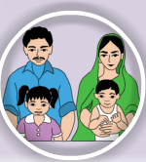
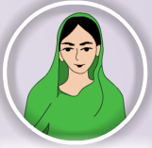
My mother is a teacher.
I’m Tisha. I’m a student. I’m in Class 3.
There are four people in my family.
My father is a banker.

Slide 10
My mother is a teacher.
My brother is two years old.
My father is a banker.

Slide 11
My brother is two years old.
Teacher`s Reading
Dear students,
open your book at page 68. Say after me.

Slide 12
My mother is a teacher.
I’m Tisha. I’m a student. I’m in Class 3.
My father is a banker.
There are four people in my family.
Teacher`s Reading
Dear students,
open your book at page 68. Say after me.
Click the audio icon below

Slide 13
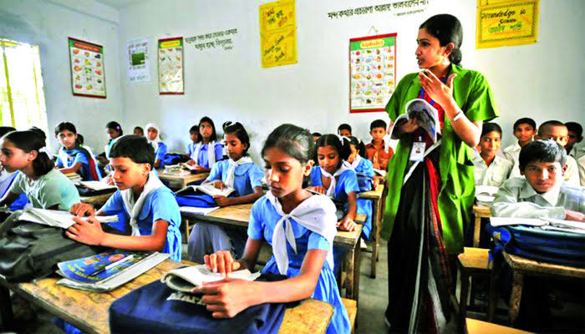
Open your English book at page number 68 read and point out with your finger.
I’m Tisha. I’m a student. I’m in Class 3.
Click the audio icon below
There are four people in my family.
Dear students, read the text silently.
My mother is a teacher.
My father is a banker.
My brother is two years old.

Slide 14
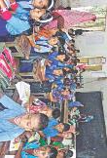
Dear students read the text loudly.
Dear students, read the text silently.
Open your English book at page number 68 read and point out with your finger.

Slide 15
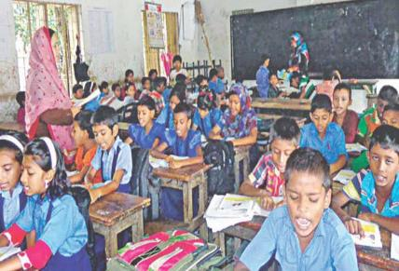
Dear students read the text loudly.
Fill in the blanks.
Tisha is a ………. .
She is …..class 3.
c. There are ……..members in Tisha’s family.
d. Tisha’s mother is a…………
e. Her father is a………….

Slide 16
Student
in
Fill in the blanks.
Tisha is a ………. .
She is …..class 3.
c. There are ……..members in Tisha’s family.
d. Tisha’s mother is a…………
e. Her father is a………….
four
teacher
banker

Slide 17
Re-arrange
1. Tisha/ I’m .
Ans: I’m Tisha.
Ask and answer.
What is the girl’s name? What class is she in?
2. How many people are there in her family?
3. What does her mother do?
4. What does her father do?
5. How old is her brother ?
2. class/ in /3 /I’m .
Ans: I’m in class 3.
3. My/a /is /teacher/mother.
Ans: My mother is a teacher.
4. father/a/is/My/banker.
Ans: My father is a banker.
5. brother/My /is/years /two/old.
Ans: My brother is two years old.

Slide 18
Wh-question
Ask and answer.
What is the girl’s name? What class is she in?
2. How many people are there in her family?
3. What does her mother do?
4. What does her father do?
5. How old is her brother ?
Ans: The girl’s name is Tisha. She is in class 3.
2. There are four people in my family.
1. I’m Tisha.
4. My father is a banker.
3. My mother is a teacher.
Ans: There are four people in her family.
5. My brother is two years old.
Ans: Her mother is a teacher.
Ans: Her father is a banker.
Ans: Her brother is two years old.

Slide 19
Group No-1,3
Ask and answer.
1. What is the girl’s name? What class is she in?
2. How many people are there in her family?
3. What does her mother do?
4. What does her father do?
5. How old is her brother ?
Wh-question
Group No-2,4
Wh-question
1. I’m Tisha.
2. There are four people in my family.
3. My mother is a teacher.
4. My father is a banker.
5. My brother is two years old.
1. I’m Tisha.
Q: What is her name?
2. There are four people in my family.
Q:How many people are there in her family?
3. My mother is a teacher.
Q: What does her mother do?
4. My father is a banker.
Q: What does her father do?
5. My brother is two years old.
Q: How old is her brother ?

Slide 20
Ask and answer.
What is your name?
What class are you in?
3. How many people are in your family?
4. What does your mother do?
5. What does your father do?
Group No-1,3
Ask and answer.
1. What is the girl’s name? What class is she in?
2. How many people are there in her family?
3. What does her mother do?
4. What does her father do?
5. How old is her brother ?
Group No-2,4
Wh-question
1. I’m Tisha.
2. There are four people in my family.
3. My mother is a teacher.
4. My father is a banker.
5. My brother is two years old.

Slide 21
Ask and answer.
What is your name?
What class are you in?
3. How many people are there in your family?
4. What does your mother do?
5. What does your father do?
Write a paragraph About “your family” according to the questions.
What is your name?
What class are you in?
How many people are there in your family?
What does your parents do?
How many brother or sister do you have?

Slide 22
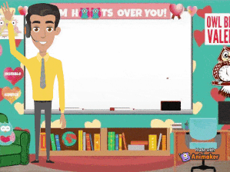
Write a paragraph About “your family” according to the questions.
What is your name?
What class are you in?
How many people are there in your family?
What does your parents do?
How many brother or sister do you have?

