Slide 1
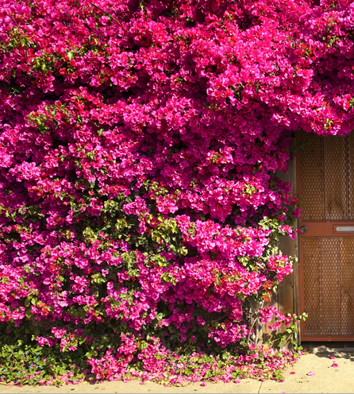
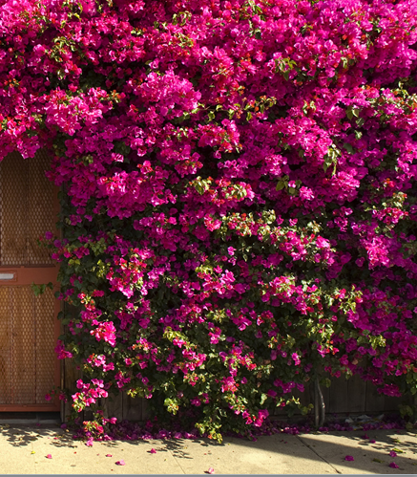
Welcome to my presentation

Slide 2
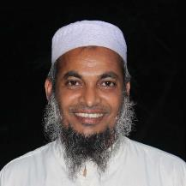
Introduction of the teacher
Dewan Rezaul Hassan
(Assistant Teacher)
Baropakhia Rothindrapara Government Primary School
Delduar, Tangail.
E-mail:drezaulhassan@gmail.com

Slide 3
Lesson Introduction
Class :Two
Subject: English
Lesson’s name : Colours
Unit:16
Lesson:4-6 (A)

Slide 4
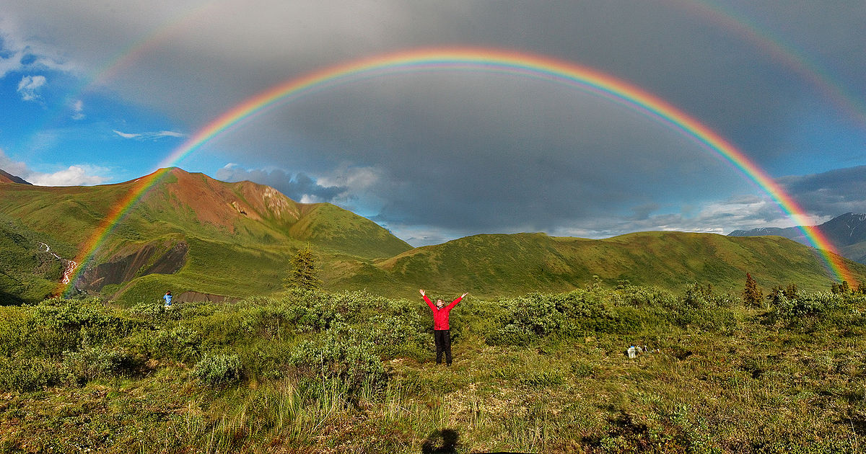
Look at the picture
What is this?
Think and answer me…..
Rainbow.
How many colours are there in Rainbow?
7 Colours

Slide 5
Our Today’s Lesson is-
COLOURS

Slide 6
Learning outcomes:
By the end of the lesson the students will be able to -
1.1.1 Become familiar with English sounds by listening to common English word.
1.1.2 Say simple words and phrases with proper sounds and stress.
1.4.1 Read words and phrases sentences with the help of visual clues
and simple sentences.
3.1.1 Write words and phrases using non-cursive capital letters.

Slide 7
A.Look, listen and say.
What colour is this?
Red

Slide 8
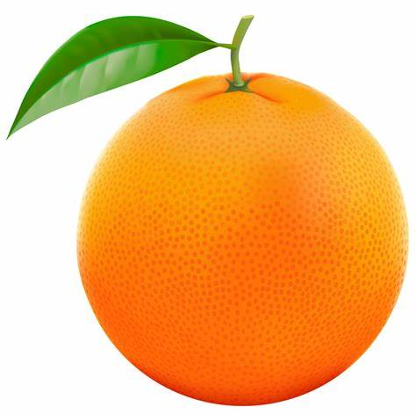
What colour is this?
Orange

Slide 9
What colour is this?
Yellow

Slide 10
What color is this?
Green

Slide 11
What colour is this?
Blue

Slide 12
A.Look, listen and say.
What colour is this?
Indigo

Slide 13
What colour is this?
Violet

Slide 14
Seven colors of Rainbow
Yellow
Indigo
Blue
Colours
Green
Orange
Red
Violet

Slide 15
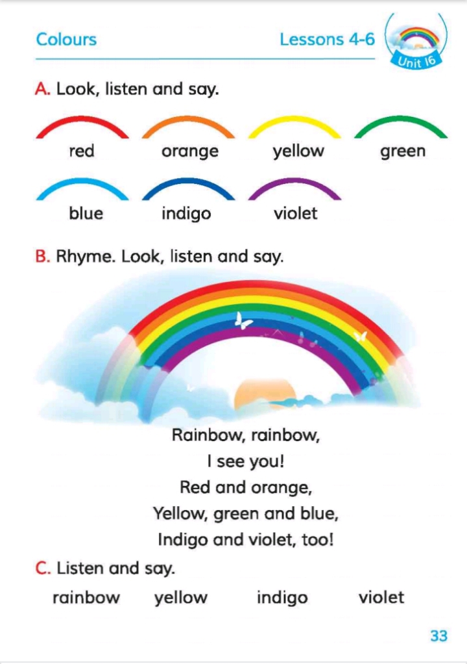
Connect With Textbook
Page number: 44

Slide 16
Individual work
Look, listen and say the name of the colors.
VIOLET
INDIGO
BLUE
GREEN
YELLOW
ORANGE
RED

Slide 17
Pair Work
Match the pictures with the colors’ name.
violet
blue
orange
yellow

Slide 18
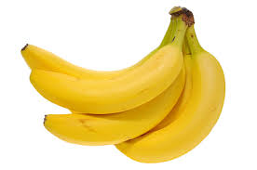
GROUP WORK
Write the color’s name below in the picture.
Group-1
………………………..
……………………….....
……………………….....
Group-2
…………………………
………………………..
………………………..

Slide 19
Learning cheeking
1.How many colors are there in the Rainbow ?
2. Write the name of seven colors.

Slide 20
Draw a picture of Rainbow and color with 7 colors.

Slide 21
Thanks for watching

