Slide 1
Welcome everybody

Slide 2
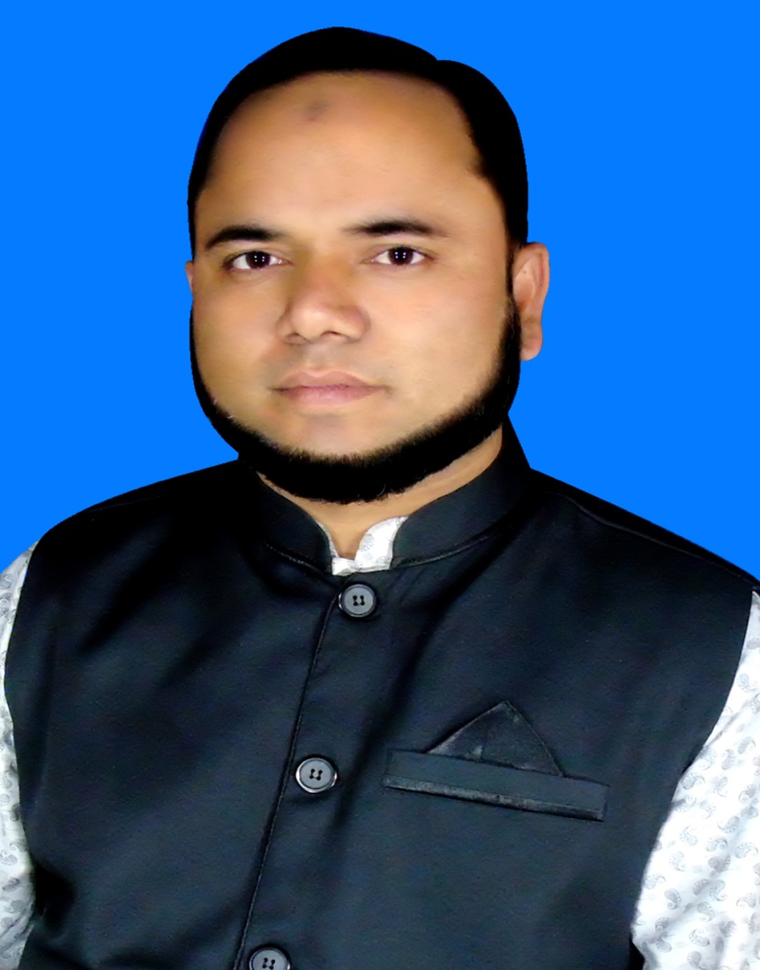
Teacher`s identity
Md.Zakir Hossain Molla
(M.B.S,B.Ed)
Assistant Teacher(Social Science)
Baneswardi High School,
Nagarkanda,Faridpur.
Mobile No:01621401412

Slide 3
Lesson introduction
Class: Nine & Ten
Subject:English-1
Unit: 01
Lesson:01, Part-1)
Date:15-08-2021

Slide 4
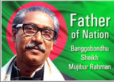
Warm up
T: Do you know the great man?
Ss: Yes,Father of Nation .

Slide 5
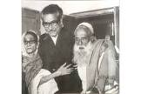
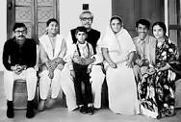
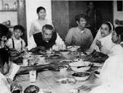
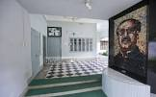
Create mental environment
T: Look at the pictures below and discuss the following questions in pair.
1.Who can you see in the pictures?
2.What do you know about them ?
3. Where were those people during the liberation war ?

Slide 6
Declaration of lesson
So dear learners, we shall discuss about “Bangabandhu’s Family in 1971.”

Slide 7
Learning outcomes
After completing the lesson ,the students will be able to :
#read and understand texes
# narrate incident and events in logical sequence
#participate in conversations,discussions and debates
#tell stories
# solve true or false
# ask and answer the questions

Slide 8
Key words/Vocabulary
Suspect /apprehend = আশঙ্কা করা
barricades = প্রতিবন্ধক /অস্থায়ী প্রতিরোধ ব্যবস্থা
indiscriminately = নির্বিচারে
surround= ঘেরাও করা
at random = এলোপাতাড়ি
at a loss= বিভ্রান্ত / কিংকর্তব্য বিমূড়
agitated = উত্তেজিত
disguise = ছদ্মবেশ
provision = খোরাক, খাবারের ব্যবস্হা
protested= প্রতিবাদ করেছিলো

Slide 9
Key words/Vocabulary
evil deed = মন্দ কাজ
pretending = ভান করছে এমন
niece = ভাতিজি/ ভাইজি
threatened = হুমকি দিয়েছিলো
fled = পালিয়ে গিয়েছিলো
occupational forces = পেশাদারী বাহিনী
cordoning = ঘিরে/ বেষ্টনী দিয়ে
chanting = কোন লাইন বা গান জপছিল এমন
invigorating = বল দায়ক
rescue = উদ্ধার
persisted = জিদ ধরে থাকা

Slide 10
Reading Test(Individual work)
Make a list of five ways how the Pakistan Army tortured Bangabandhu’s family:
1.Bangabandhu was arrested and taken to Pakistan.
2.His family members were kept under house arrest.
3.Their house No.32 in Dhanmondi was shot at random.
4.Their village house was set on fire .
5.They were threatened in various ways.

Slide 11
Individual work
1. False,
Correct Information:- Begum Mujib stayed with her husband Bangabandhu at the night on 25 March, 1971.
2. True.
3. False,
Correct Information:- Some close people stood beside the family of Bangabandhu during Liberation War.
4. True.
5. False,
Correct Information:- After Liberation War was over, Sheikh Jamal returned home in the afternoon while Sheikh Kamal returned home the next day.

Slide 12
Pairs work
Divide into pairs and tell the sufferings of Bangabandhu’s family during Liberation war in your own words.
Answer.They had to flee from one place to another.
Or,They could not move easily.
Or,They were worried about their future.

Slide 13
Group Work
T: Discuss the sufferings of people during the liberation war .
S1:The Pakistan Army set fire to houses
S2: They killed many people
S3:They disrespected women
S4:Many were buried alive
S5:They floated many people in the water
S6:The kept many people captive day after day due to starvation
S7:They hang many of them upside down
S8:Women and children were also victims of their brutal torture

Slide 14
Home Task
Write a short paragraph on “the sufferings of people during liberation war.”

Slide 15
Thanks all.

