Slide 1
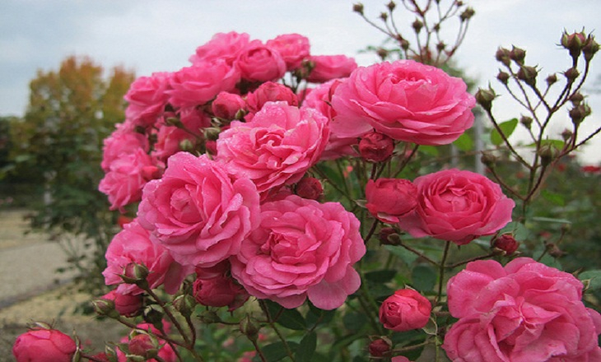
WELCOME EVERYONE

Slide 2
Presented by:
Md.Shakhawat Hossain
Assistant Teacher
Borogangni Govt.Primary School
Alamdanga,Chuadanga.

Slide 3
Lesson Identity
Subject :English
Class:five
Unit:12
How far is Saint Martin‘s?
Lesson:2-4
Page:47

Slide 4
Learning outcomes -
Listening
1.3.1 recognize which words in a sentence are stressed.
3.4.1 understand sentence made by the teacher and students.
Speaking
1.1.1Say words,phrases and sentenceS with proper sound and stress.
1.1.2say sentence with proper intonation.
6.2.1 talk about people, object and event etc.
8.1.1 take part in conversation on appropriate tropic.
Reading
1.5.1 read words,phrases and sentences in the text with proper pronunciation, stress and intonation.
1.7.1 read paragraphs, duologues,stories,letters and other texts,

Slide 5
Good morning students!
How are you?
I’m fine thank you.

Slide 6
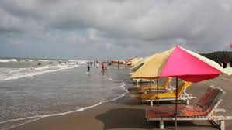
Do you know the place ?
Cox’s Bazar

Slide 7
Let’s recall what did we learn in our last English class.
1.Who went to Cox’s Bazar last month ?
Ans.Andy visited Cox’s Bazar last month.
2.What are the famous tourist sport in Bangladesh ?
Ans.Cox’s Bazar.
3.Where we can find waterfalls in Bangladesh ?
Ans.Madhabkundo.

Slide 8
Today’s lesson
How far is Saint Martin’s?

Slide 9
Let’s see some pictures

Slide 10
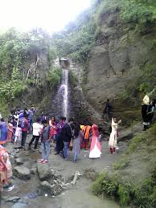
Look at the picture and think. What do you see?
Have you ever visit a place like this?
This is a waterfall

Slide 11
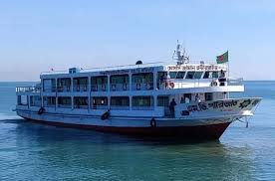
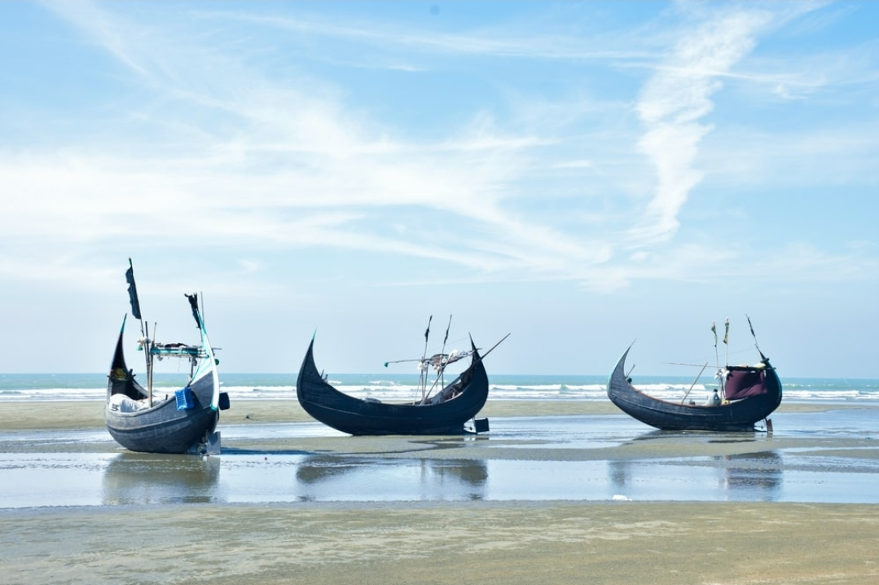
Look at the pictures again and think.Do you know them?
Yes,you are absolutly right. This two are water vehicles
Sea truck
Wooden boat

Slide 12
Open at page no 47 and just keep listening
Andy:What is special about saint Martin’s island?
Tamal:It’s a island in the Bay of Bengal, and it’s the only coral island in Bangladesh .You can see coral in different shapes and colours.And the water of Bay of Bengal is very clean and blue!
Andy:Oh,that sounds wonderful!
Tamal:Yes,it is!You can also see the turtles on the island.
The turtles make their nests on the beach and then they lay their eggs in them.You can see many fish,too!
Andy:Wow!Really?Can I go sailing?

Slide 13
Tamal:Well,you can take a day cruise.You can go on wooden boats or sea truck.The cruises are exciting and safe.They are a great way to see the Bay.
Andy:Thanks for the information, Tamal.

Slide 14
Now you read in pairs and make a summaries of the dialogue we’ve just finished reading.

Slide 15
Now the summari.
Saint Martin’s is the only coral island in Bangladesh. Different shapes and colours coral,turtles and many fish are available here.The water of the sea is very clean and blue here.Wooden boats and sea truck are available for exciting and safe cruise.

Slide 16
Say the answer shortly
1.Say the name of two water vehicle.
Ans.Water truck and wooden boat
2.Where the turtle use to lay their eggs?
Ans.On the beach.

Slide 17
Home work
Make five sentence with the colourful worlds.

Slide 18
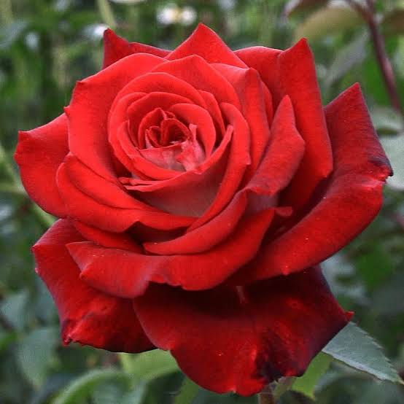
Thank you all

