Slide 1
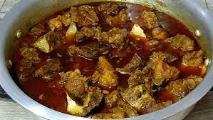
Welcome you all, dear students.

Slide 2
Identity
Md. Abdul Gafur,
Assistant teacher
Gaiar Bhanga G.P.S
Lalmai, Cumilla.
Unit: 06
Lesson: 4-5
Time: 40 minutes
Date: 9/7/2021

Slide 3
Let’s watch a video.
What do you see in the video?

Slide 4
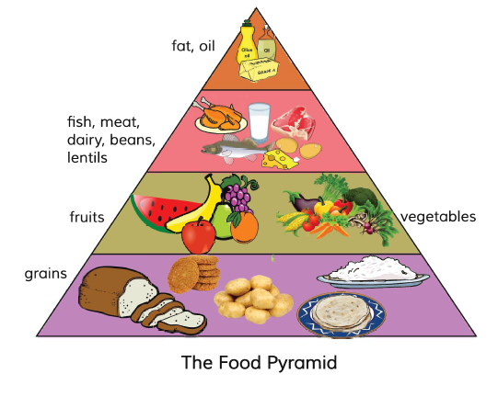
Look at the picture.
What do you see in the picture?

Slide 5
Our Today’s lesson is-
Eat healthy

Slide 6
Learning outcomes:
Students will be able to-
Listening: 4.2.1 understand and enjoy simple stories.
Speaking: 3.1.1 ask and answer wh questions.
Reading: 5.1.1 read silently with understanding paragraph.
Writing: 10.2.1 write short and simple composition on familiar objects such as people place and events.

Slide 7
New words
Different
Not the same
Bottom
Under
Similar
Same
Top
Above
Delicious
Taste
Grain
Corn

Slide 8
There are 4 levels in the Food Pyramid.
Fat
and oil.
Fish, Meat, Dairy, Beans and lentils.
Fruits and vegetables.
Grains

Slide 9
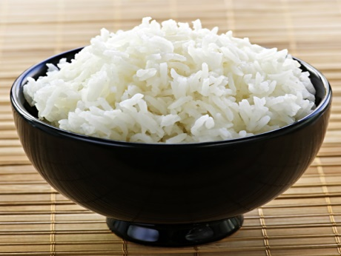
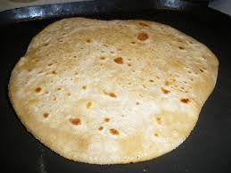
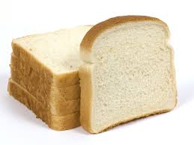
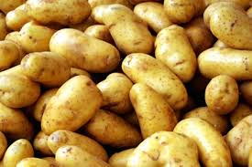
Look at the pictures.
Rice, Ruti, Bread, Potatoes.
These are grains.
Grains give us energy.

Slide 10
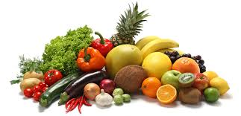
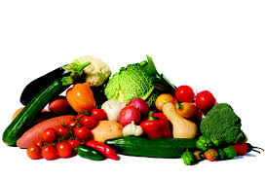
What have in these foods ?
Fruits
Vegetables
They have vitamins.

Slide 11
Individual Work
How many levels are there in the Food Pyramid?

Slide 12
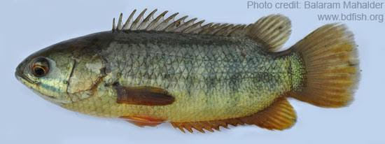
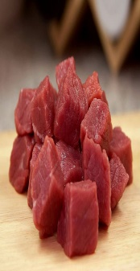
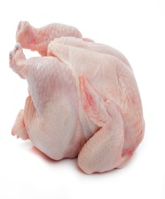
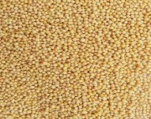
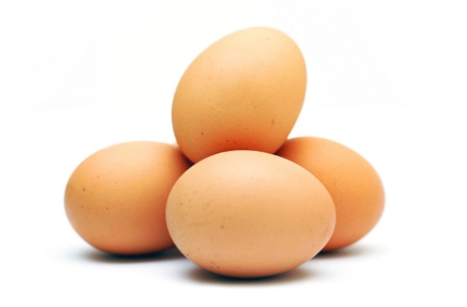
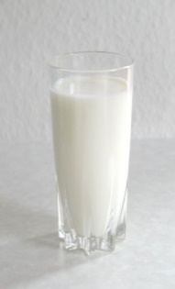
What have in these foods ?
Fish, Meat, Chicken, Lentils, Eggs, Milk
They have protein.

Slide 13
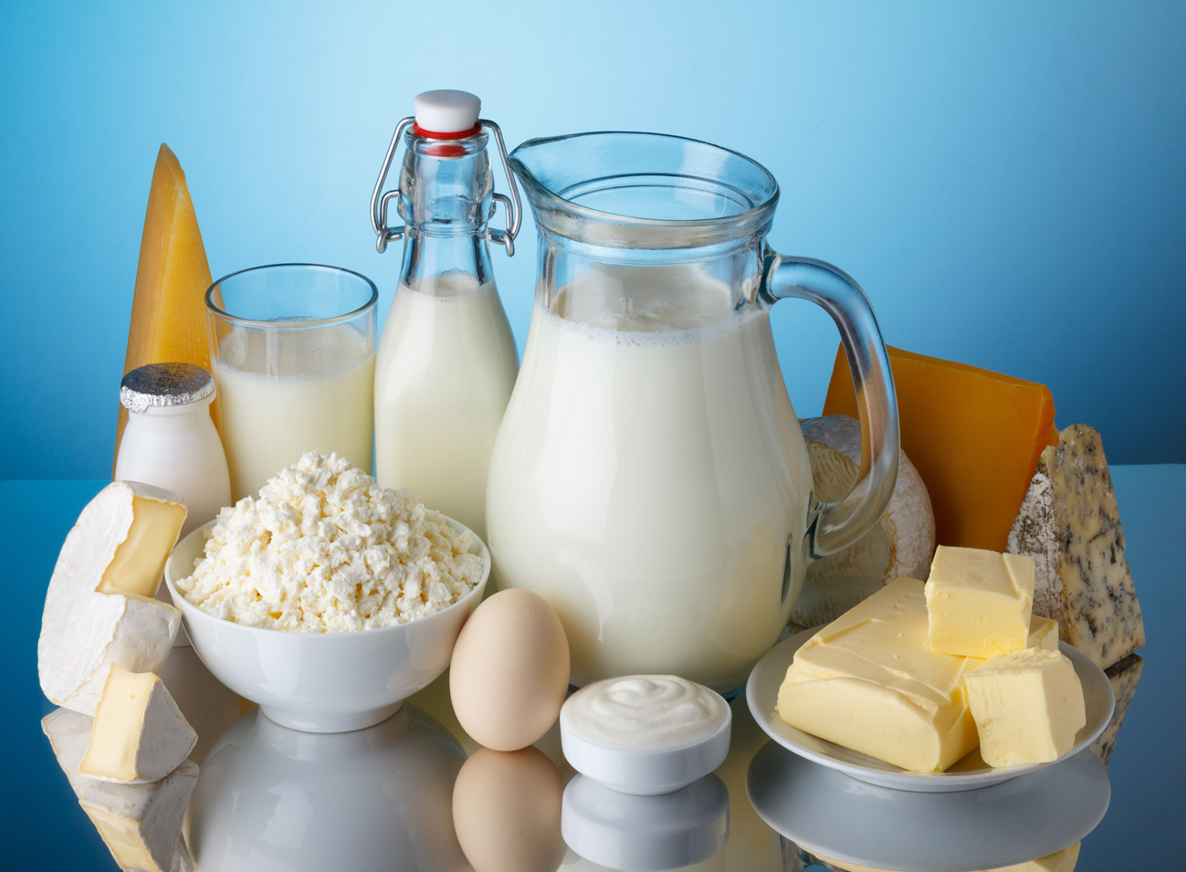
What is these?
Dairy products.
They help our teeth and bones.

Slide 14
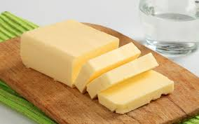
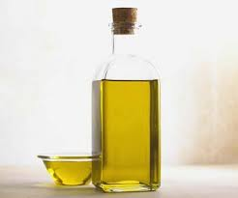
Which foods dose not need very much of our body ?
Fat
These make food delicious.
Oil

Slide 15
Food Pyramid
Fat and Oil
Dairy products
Vegetables
Bread, Patatoes
Rice, Ruti
Fruits
Fish, Meat
Lentils

Slide 16
Pair Work
What food does our body not need very much?

Slide 17
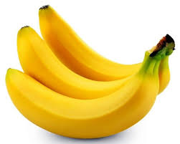
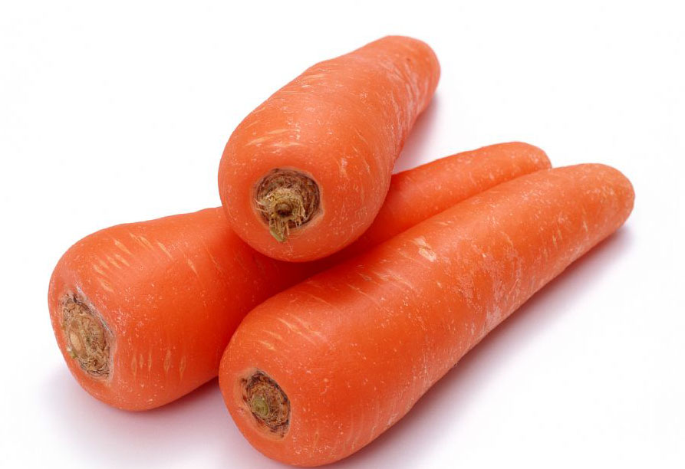
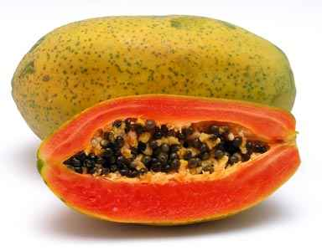
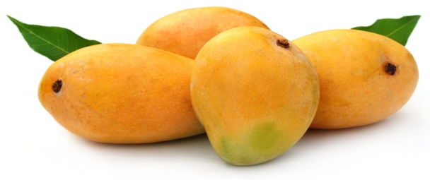
Everybody look at these pictures.
What kind of these foods ?
Healthy Foods
Banana, Egg, Carrot, Papaya, Milk, Mango

Slide 18
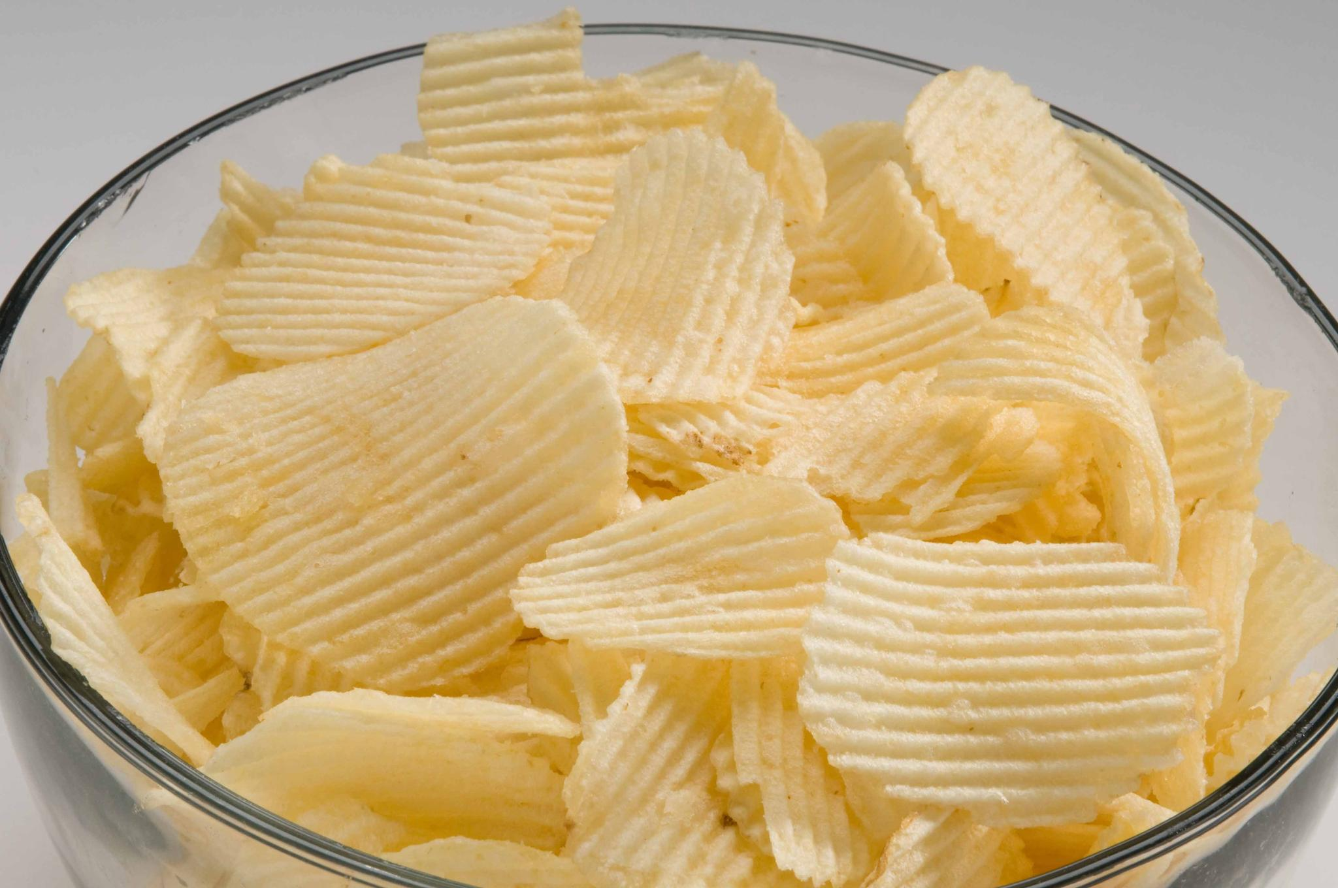
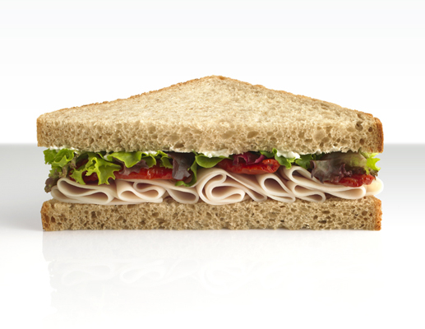
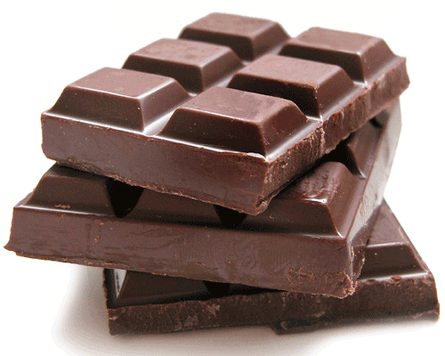
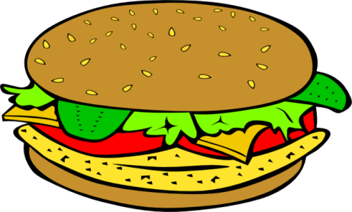
Look at these pictures
Ice-cream, Pija, Chips, Chocolate, Sandwich, Burger
Unhealthy Foods
What kind of these foods ?

Slide 19
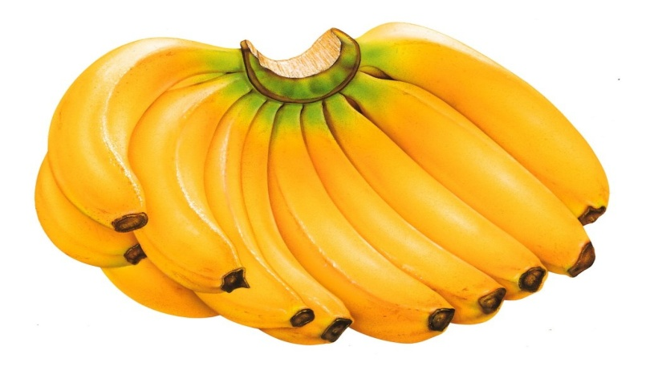
Group Work
Banana Group
Write the names of five healthy food.
Carrot Group
Write the names of five unhealthy food.

Slide 20
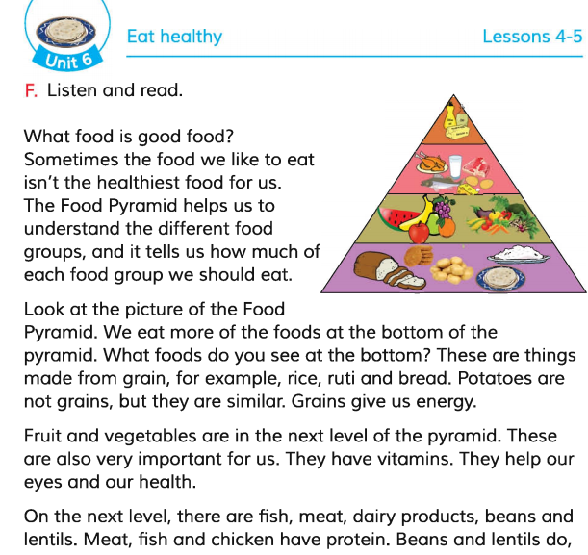
Now open your English book at page number 24. Listen to me attentively and put your finger under the line.
Read the text silently.

Slide 21
Evolation
What does the Food Pyramid tell us?
What does protein do?

Slide 22
Home Work
Write a short composition on “The Food Pyramid” in at 5 sentences.

Slide 23
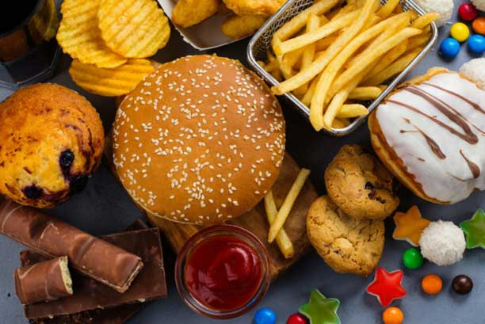
Thanks everybody, Goodbye.

