Slide 1
Welcome

Slide 2
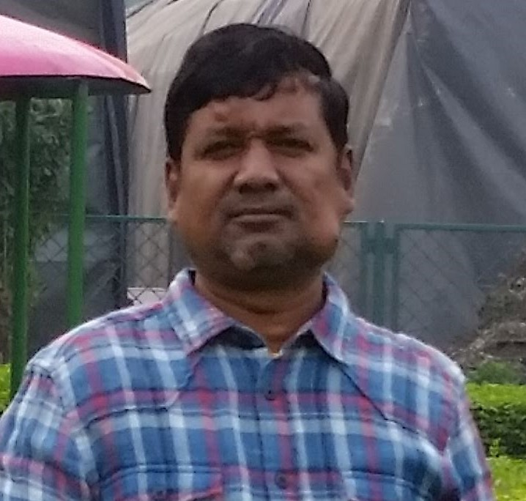
Shah Mohammad Lutful Haider Assistant Teacher
LUTFUNNESA BALIKA BIDDANIKETON
PAGLA, GAFARGAON
Class- 9-10
Unit-1,lesson-1
Time: 50 minutes

Slide 3
Let’s watch a video.....
https://www.youtube.com/watch?v=1YWLhhPytNg

Slide 4
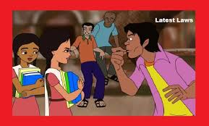

Slide 6
Learning Outcomes
From this lesson student will be learn…….
Infer meaning from context
Ask and answer question
Read and understand text through silent reading

Slide 7
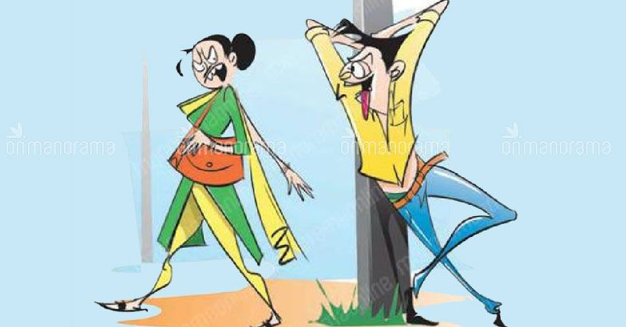
Eve Teaser
Why the girl angry to this boy?

Slide 8
Eve
Gloaming
sunset
Women

Slide 9
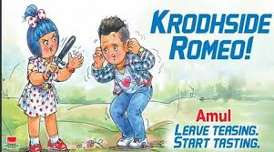
Teaser
Harasser
Torturer

Slide 10
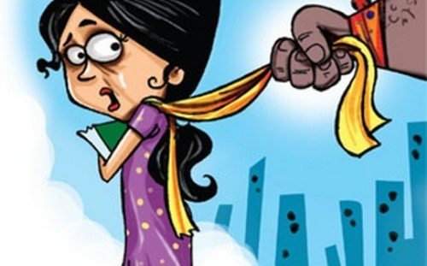
Eve teasing
What is doing?

Slide 11
Afraid
What movement of this girl?

Slide 12
Pair work---
What is the meaning of eve?
What is the mean of teaser?
Why girl afraid?

Slide 13
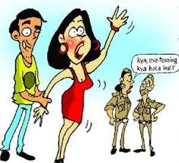
Helping
Why girl call the police?

Slide 14
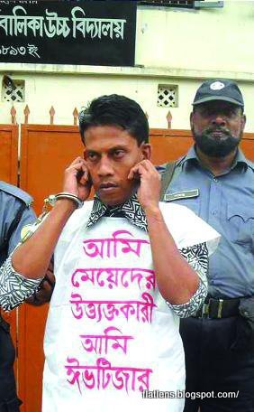
What is doing the police

Slide 15
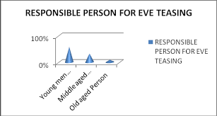
What kind of people responsible for Eve teasing?

Slide 16
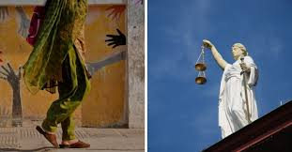
Law of justice
What kind of sculpture in front of supreme court?

Slide 17
Group work----
Who and Whose people help the women for eve teasing?
What should we against the eve teaser?
What type of court punish for Eve teaser?

Slide 18
Thank you
May Allah help you

