Slide 1
Welcome

Slide 2
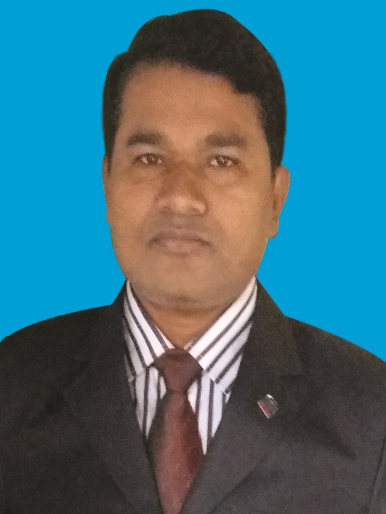
Introduction
Teacher’s Identity
Name: Md. Shahidul Islam.
Institution: Parulia High School & College.
Senior Teacher (English)
Hatibandha – Lalmonir Hat.
01716511624
Date: 08-09-2021
Class Information
Class: x Sub: English 1st Paper
Title: Mother Teresa
U-7=L-5&6tudents: 60 B

Slide 3
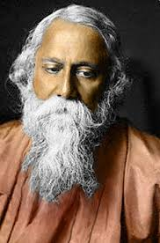
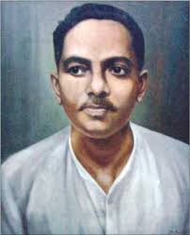
Look, Who are they? Why they famous for?
Rabindro Nath Tagor
Gibonanddo Dash

Slide 4
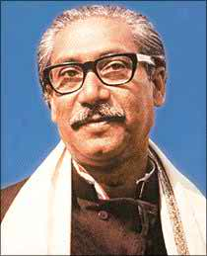
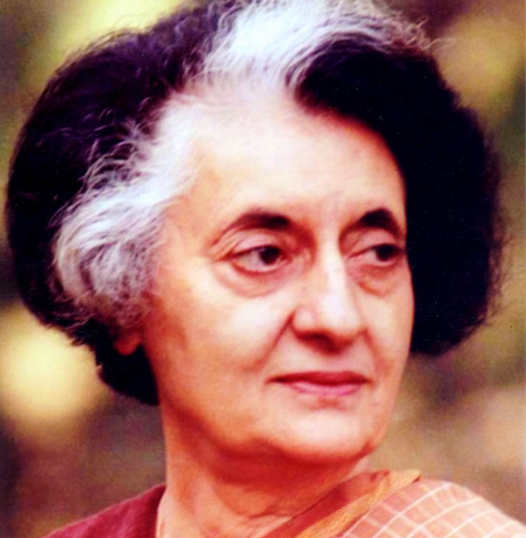
Look, Who are they? Are they famous?
Shakh Mojibur Rhaman
Indra Gandhi

Slide 5
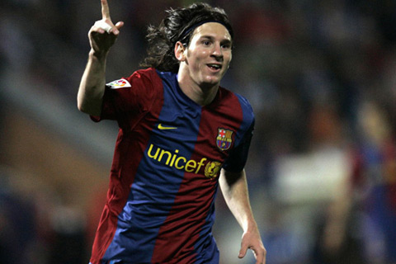
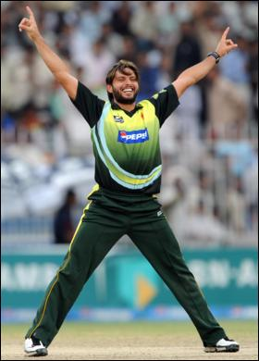
Look, Who are they?

Slide 6
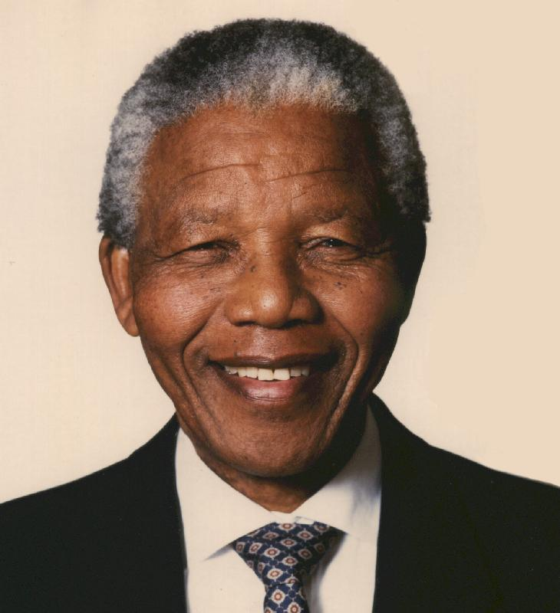
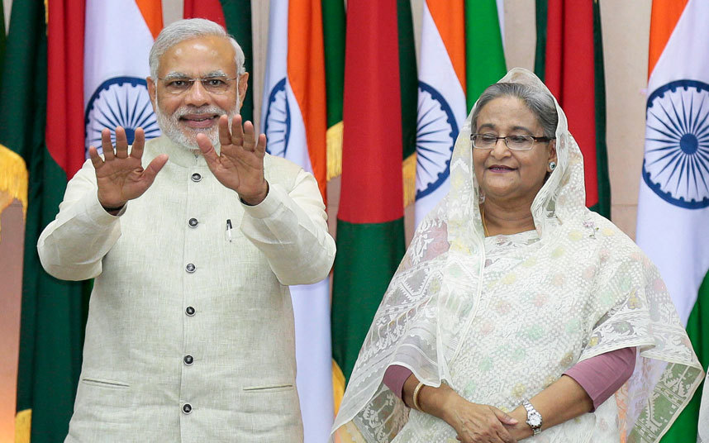
Look, Who are they?
Nelson Mendrala

Slide 7
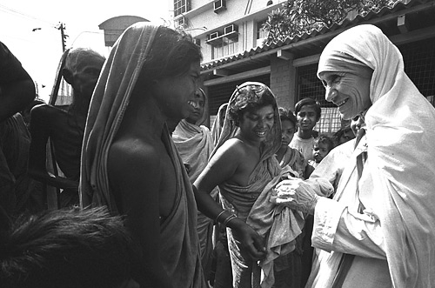
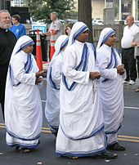
Talk about the pictures with your partner

Slide 8
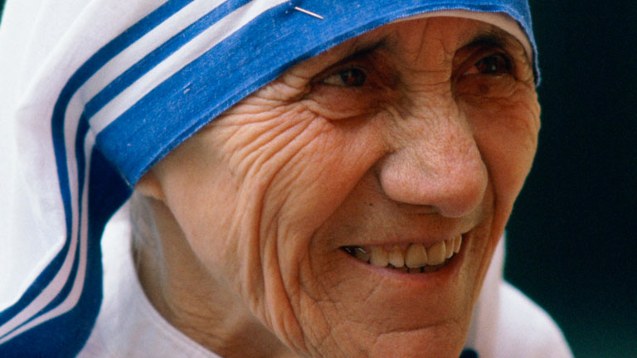
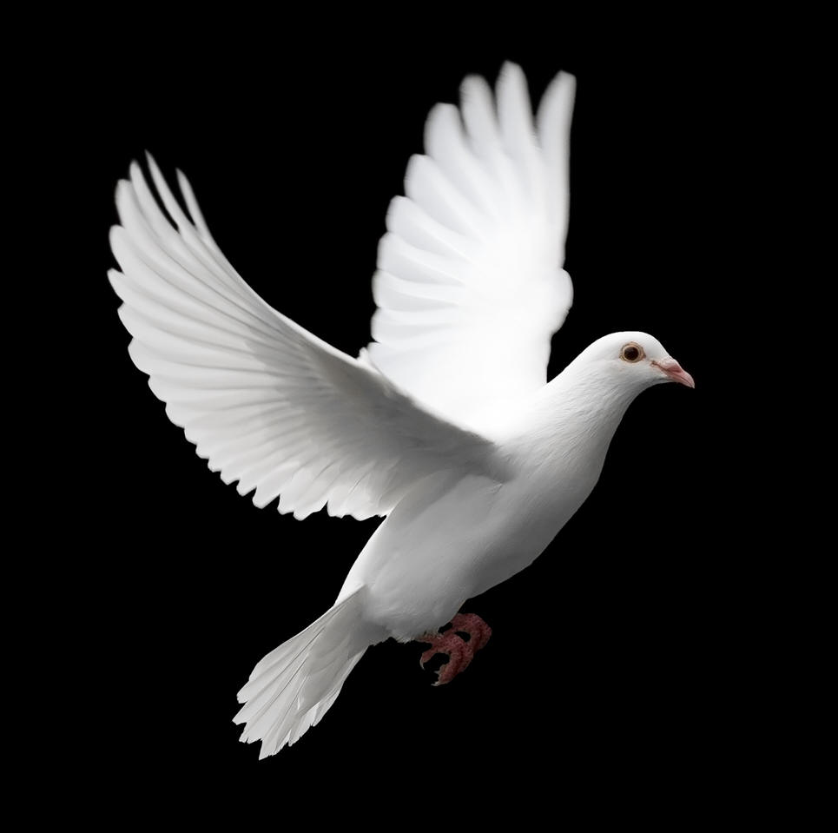
Mother Teresa

Slide 9
Unit:07
Lesson:4,5,6

Slide 10
After this lesson the students will Be able to:
Listen to the text for specific information.
to describe Mother Teresa
to answer questions.

Slide 11
born in Albanian Chatholic family
In Skopij , Macedonia
Autumn , August 26, 1910
Youngest of the three
Named Agnes Gonxha Bojaxhiu
‘Servant of humanity’
‘The mother of humanity’
‘Lover of the poorest’

Slide 12
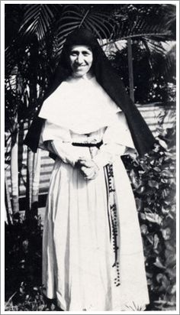
At the age of 12 She decided to be a missionary.
At 18 she left her parental home.
Joined an Irish community of Nuns called “Sisters of Loreto.”
Loreto had missions in India.

Slide 13
Took Training at the Institute of the
“Blessed Virgin Mary in Dublin.”
Came to India on May 24,1931.
Vows as a nun.
From 1931 to 1948 she taught geography and catechism at St . Mary High school in Kolkata.

Slide 14
Teresa took help from “the American Medical Missionary Sisters” in 1950.
This group is now called the ‘Missionaries Of
Charity.’
The group had four vows:
1.Poverty
2. Chasity
(purity)
3.-----------
4. Free treatment

Slide 15
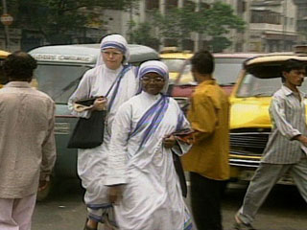
Mother Teresa and her group visited not only many parts of India but also many other countries of the world ((such as: Sri Lanka , Australia,Tanjania,Venezuela,Italy,Amman Jordan,London,New York etc)) to begin new foundation.

Slide 16
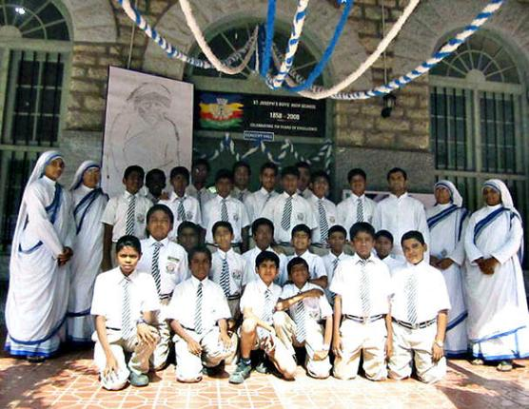
The group opened elementary schools up to nine in Kolkata.

Slide 17
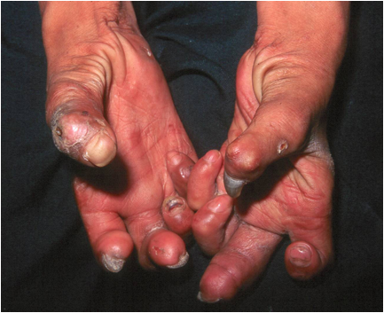
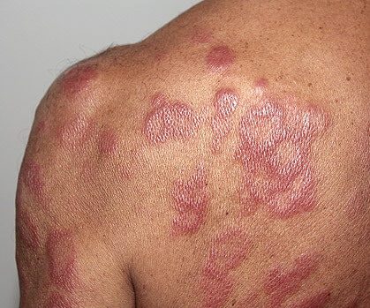
In 1957 Teresa began to work with the lepers.
Lepers (infectious disease)(kushtho)

Slide 18
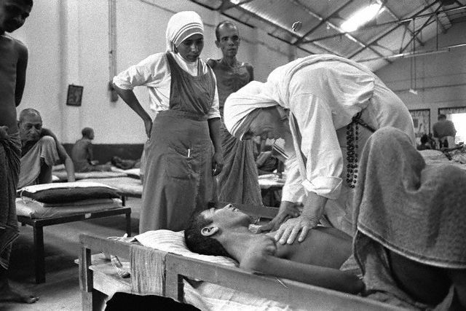
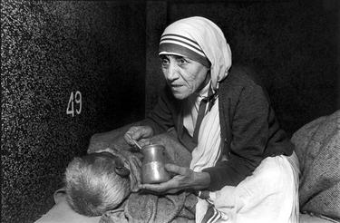
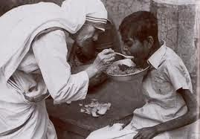
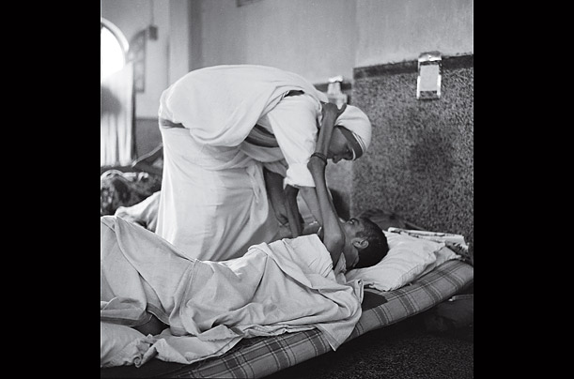
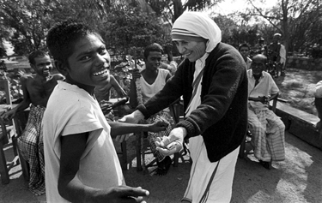
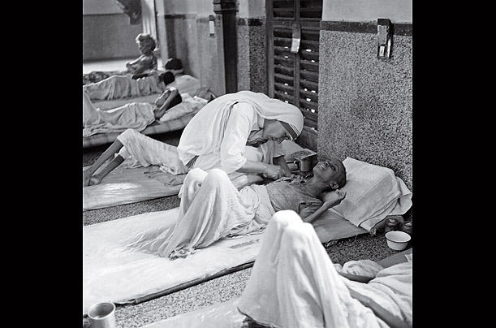
The unloved people were taken care off lovingly so that they can get scope to die in an environment of kindness and love.
Mother Teresa said that ,”Love begins at home and we must also remember that future of humanity passes through the family,”
She and her group gathered sick and dying people of the streets of kolkata and brought them to this home.
She founded “Nirmol Hridoy “ for the sick and dying people.
Those who survive , the Missionaries of Charity try to find jobs for them or send them to homes.

Slide 19
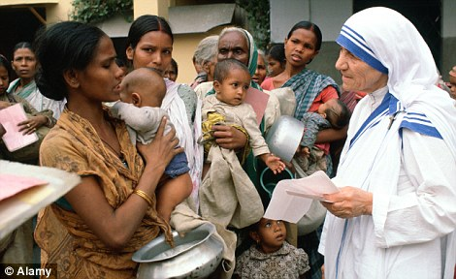
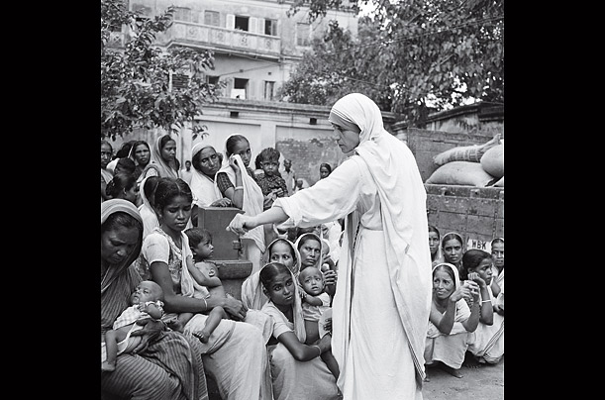
She took men, women and children to “Nirmol Hridoy.”She was stricken by the poverty of kolkata.

Slide 20
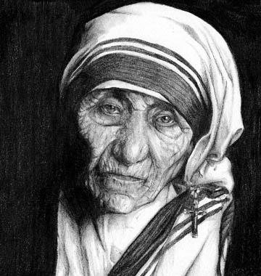
Mother Teresa’s work has been recognized throughout the world.
She has received a number of awards.

Slide 21
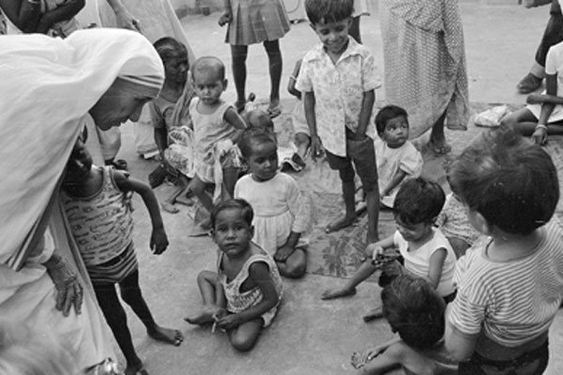
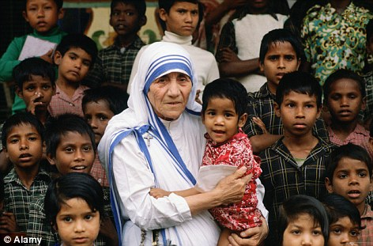
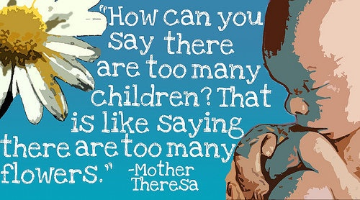
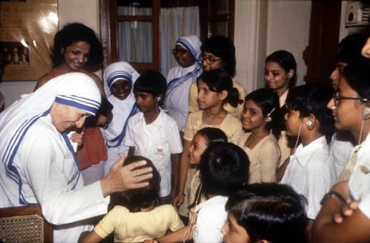
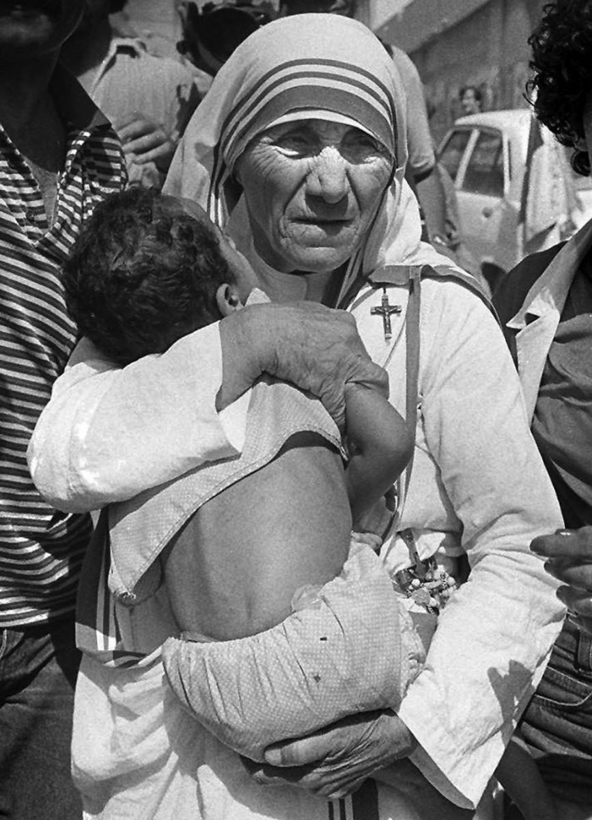
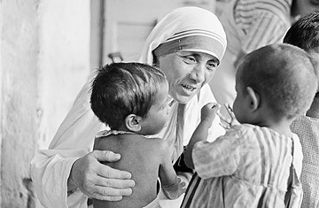
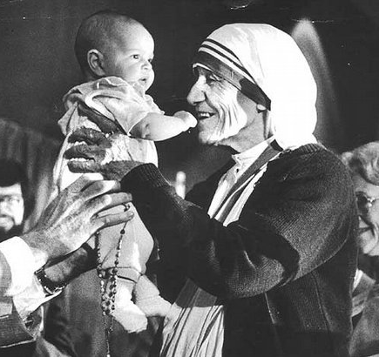
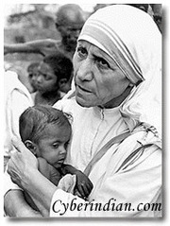
As she belonged to Catholic Missionaries, She thought that all the human are the children of God . They need caring family environment.
Abandoned and street children
She and her volunteers took all the poverty stricken , street and abandoned children.
She talked with them lovingly.
Teresa made“Shishu Vhobon” (children home) for that innocent but rejected children.

Slide 22
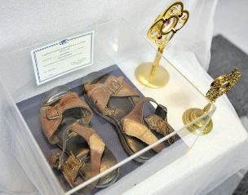
The Blazen prize (1978)
The Pope John XXIII Pace prize(197)
her shoes

Slide 23
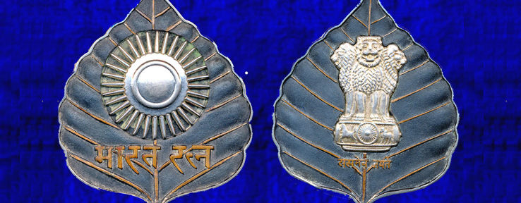
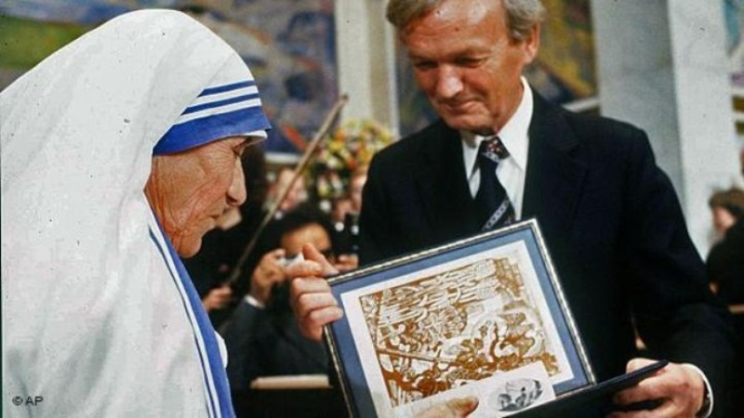
the Vharat Ratna prize (1980)
the Nobel Peace Prize(1979)

Slide 24
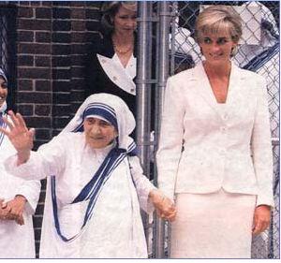
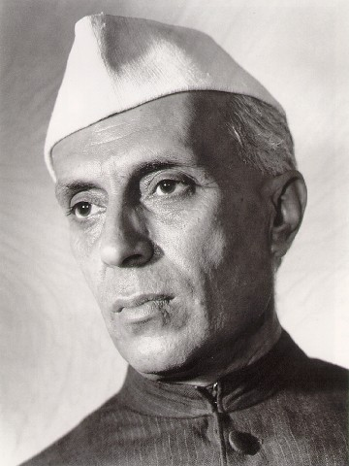
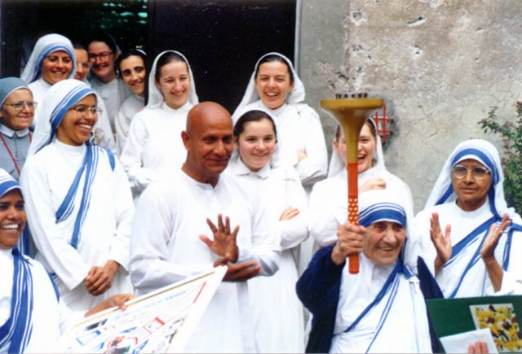
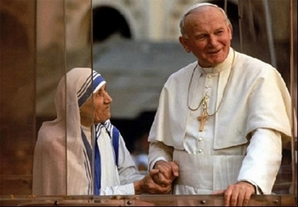
Princess Diana And Teresa
Jouhorlul Neheru (Teresa got Neheru prize also)
A minister and Teresa
The Pop John XXIII

Slide 25
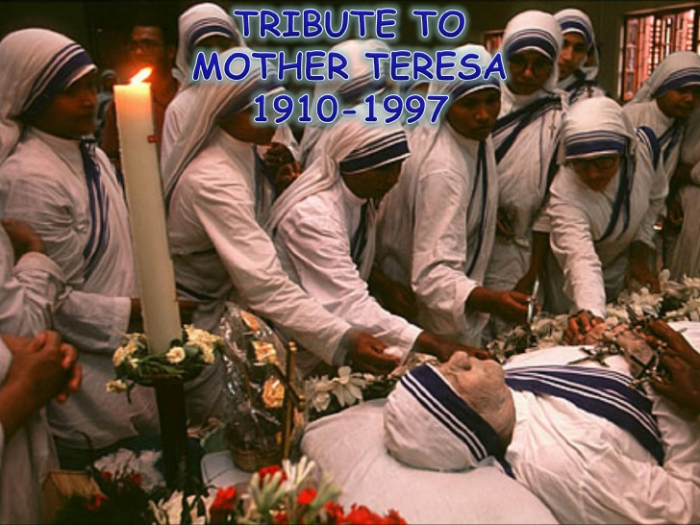
Mother Teresa died at the age of 87, on 5 September 1997.

Slide 26
Draped in a white and blue
-bordered Shari, wrinkled face, ever soft eyes and asainty smile is the picture of Mother Teresa. We salute her.
Mother Teresa taught us:
How to extend our hand towards the suffereres.
How to support in respect of creed , caste and religion.

Slide 27
Choose the best answer from the alternatives..
1. What does ‘servant of humanity 'mean in the text?
a. Becoming a slave.
b. To work in other people’s house.
c. To be oppressed by others.
d. To serve the needy.

Slide 28
2.Why did Mother Teresa want to be a missionary? Because she heard……
a. The voice of her neighbors discussing it.
b. a voice in her dream.
c. a voice within herself.
d. The voice of her parents taking about it.

Slide 29
3. Mother Teresa set out to join the missionary of the sister of Loreto in the year.
a.1927
b.1928
c.1929
d.1930
4.Mother Teresa took her first vows at the age of..
a.18
a.19
a.20
a.21

Slide 30
Chain drill.
Read the passage ‘B’ and ask and answer the following questions.

Slide 31
1. Where did Mother Teresa’s ancestors come from?
= From Albania.
2. Where was her father’s home?
= In Skopje, Macedonia.
3. Why did she want to become a missionary?
= To serve humanity.

Slide 32
4. What made her different from other girls?
= She left her home to become a missionary on the hand other girls married at her early age.
5. What did Mother Teresa do in the first 17 tears in India?
= In her first 17 years in India, Mother Teresa taught geography and theology at St. Mary’s High School in Kolkata.

Slide 33
Dual Work.
Read the passage ‘B’ and complete the table below with the information .

Slide 34
What/Who | Event | Year/Time | Place/Reason
Mother Teresa | Was born | (i)… | At Skopje in Yugoslavia.
Mother Teresa | (ii)………………… | In 1928 | To be nun.
Mother Teresa | Being awarded Noble Prize | (iii)…………… | (iv)………..
Mother Teresa | (v)--------------------- | 5-9-1997
In 1910
Came to India
In 1979
Peace
died

Slide 35
Fill in the blanks with suitable words.
Mother Teresa with a dedicated soul like Nivedetta serve the sick and the helpless all (a) her life. She was born in 1910 at Skopje in Yugoslavia. At the (b) of 18, she took (c) to become a nun and so she came to India in 1928 and thereby Mother Teresa got Indian (d) . Mother Teresa (e) at a convent school in Kolkata as a teacher.
Through
age
decision
citizenship
joined

Slide 36
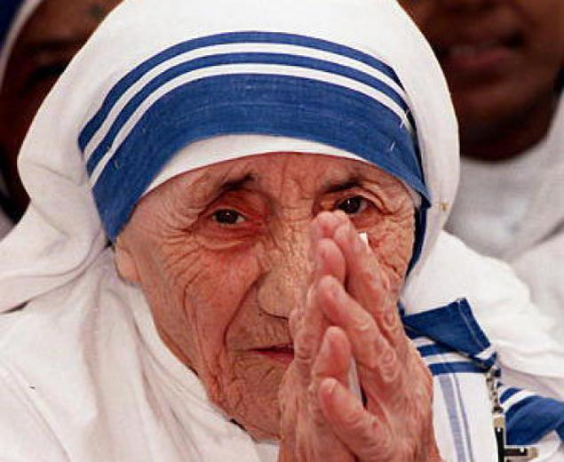
What make her different from other girl?
What are the things that we learn from her?
When did Teresa take her first vow ?
Evaluation
What is leprosy?
What was her groups vows?
Why did Mother Teresa want to become a missionary?
Why do you think Mom. Teresa won So many awards?
What does servant of humanity mean?

Slide 37
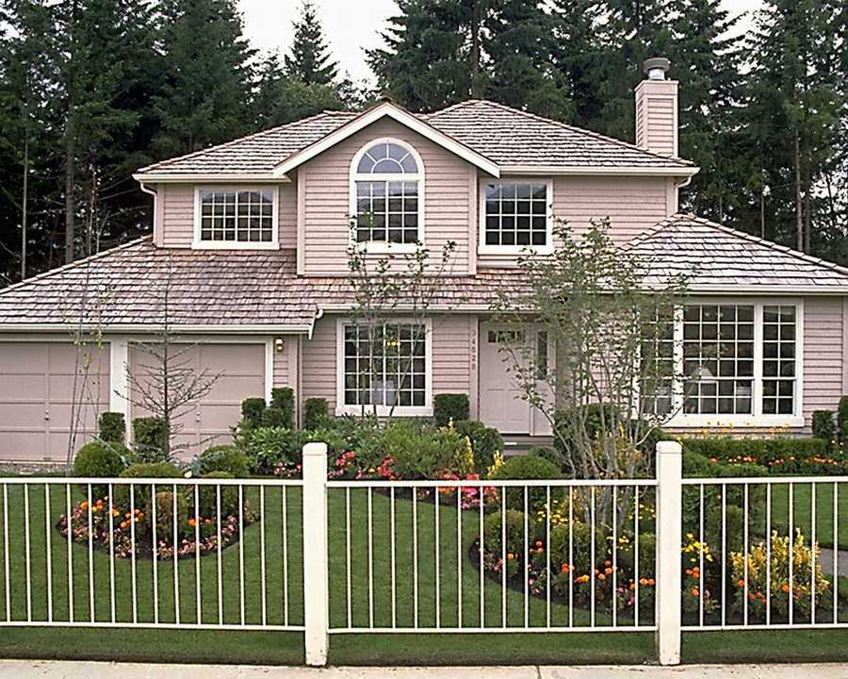
Homework
Write a short paragraph on “Mother Teresa”.

Slide 38
May Allah bless you all.

