Slide 1
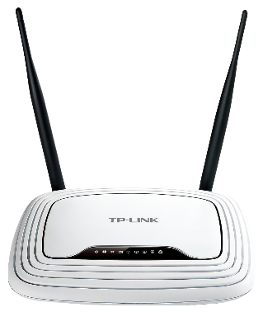
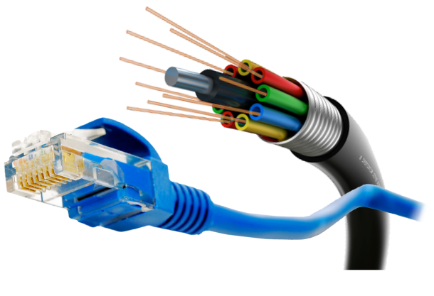
Welcome
To English class.

Slide 2
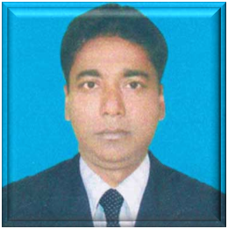
Identity
Azimnagor Com.K.
School & Coll.(voc)
English – 2nd paper
Class - Nine
Time- 45 mins
Md. Monirul Islam
Assistant Teacher
E-mail-monir19077@gmail.com
01761714820

Slide 3
Look at the pictures.
What can you see ?
Electronic mail (email or e-mail) is a method of exchanging
messages ("mail") between people using electronic devices.
E-mails

Slide 4
So, Today we will discuss about --
E- mails.
How to create e-mails account and use it.
Unit no-16

Slide 5
Learning outcomes.
After studied the lesson students will able to-
ask and answer questions ;
create and send mail .

Slide 6
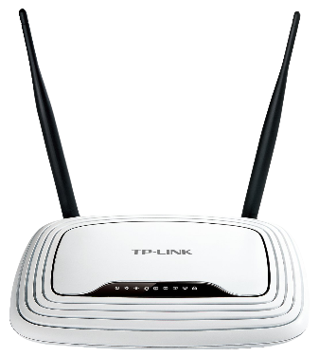
First we discuss how to create an e-mails account.
We need
Computer
Android
phone
Or
For network connectionwe need-
Modem
Broadband
Wifi

Slide 7
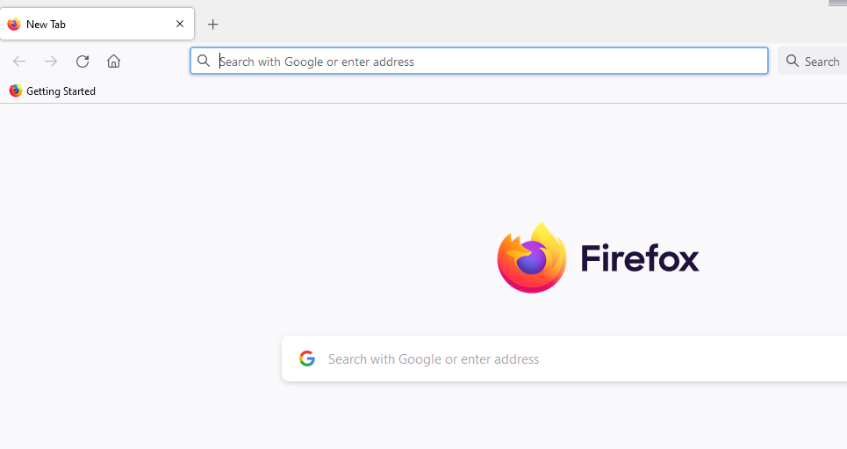
To creat an account, we start computer , add network connection, then-
Open to ..
Mozilla firefox
Internet explorer
Google chrome
Open the Gmail account creation website. Go to https://www.google.com/gmail/about/# in your computer's web browser. This will open a page with information regarding Gmail.

Slide 8
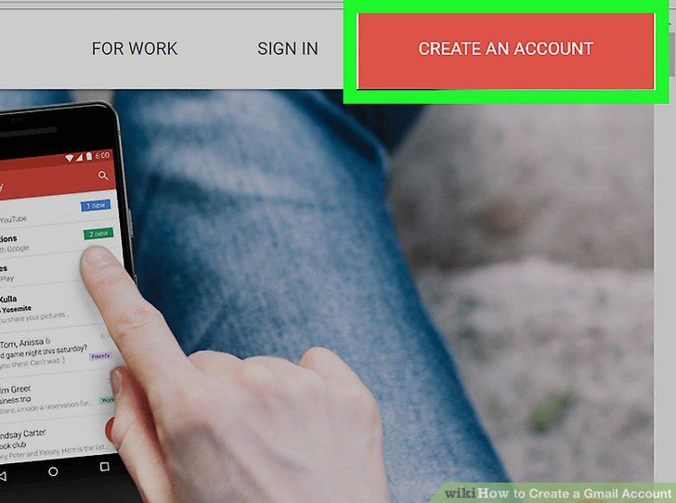
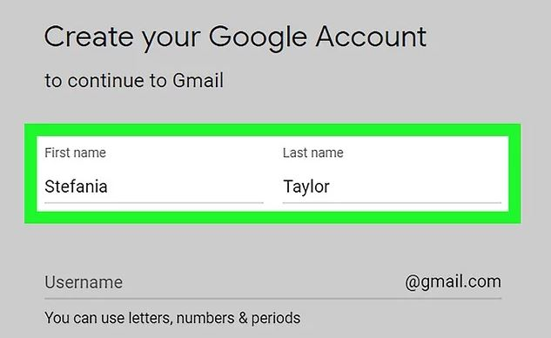
We will see this page
Enter your first and last name. Type your first name into the "First name" text box near the top of the page, then enter your last name in the "Last name" box next to it.
Create a Gmail username. In the "Username" text box, type in the username you want to use for your email address. This is the name which appears before the "@gmail.com" section of the address. If your selected username is already taken, you'll be asked to choose a different one upon clicking a different text box on the page.
Click CREATE AN ACCOUNT. It's a red button in the top-right corner of the window. Doing so takes you to the first page in the account creation section.
Monirulr
Islamr
monir1977r

Slide 9
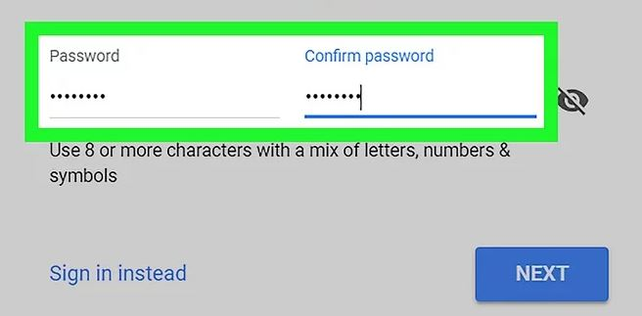
Enter a password twice. Type your preferred password into the "Password" text box near the bottom of the page, then type the same password into the "Confirm password" box to the right of the first password box. These passwords must match before you can proceed.
Click NEXT. It's a blue button at the bottom of the page.
Use 8 or more characters with a mix of letters, numbers & symbols

Slide 10
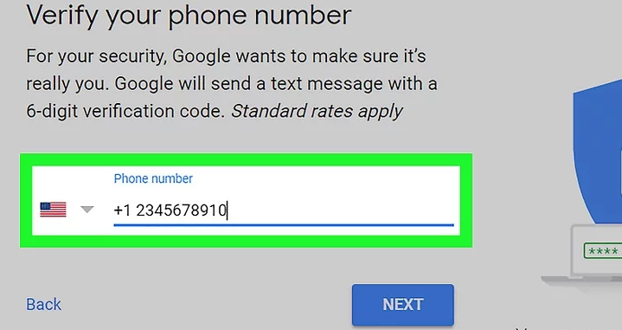
Type your phone number into the "Phone number" text box
Recovery email address — Type any other email address into the "Recovery email address" text box
mdrakib55@gmail.com

Slide 11
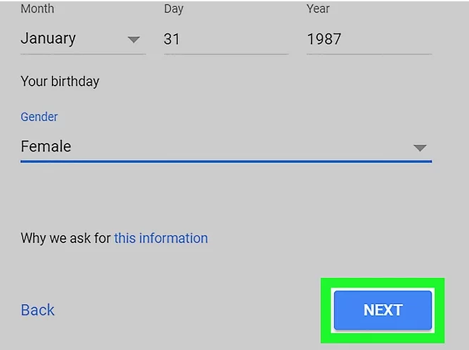
Add your date of birth. Click the "Month" drop-down box and select the month of your birthday, then type the day and year into the "Day" and "Year" text boxes, respectively.
Select a gender. Click the "Gender" drop-down box, then select one of the gender options in the resulting drop-down menu.
Click NEXT. It's a blue button at the bottom of the page.

Slide 12
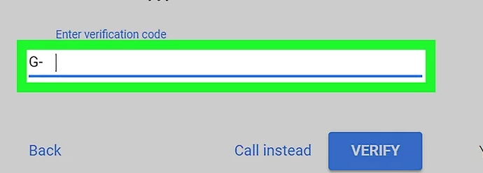
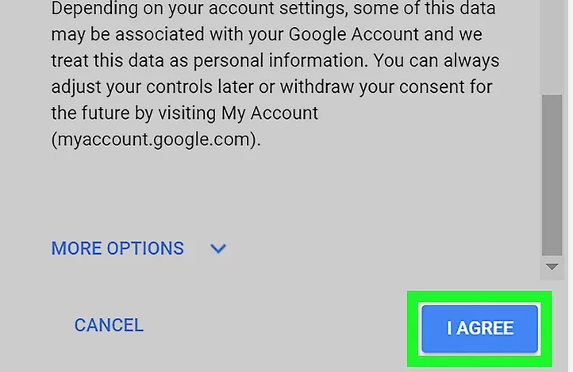
verify your phone number. If you added a phone number as an account recovery option, you can verify it now by doing the following:
Open your phone's text messages.
Enter the 6-digit number into the text box on the Gmail page.
Click VERIFY
Doing so will accept the terms of service and sign you into your Gmail account.
Scroll down and click -I AGREE

Slide 13
Now ,we share our ideas how to send mail.
Open Gmail.
Go to -https://www.gmail.com/ in your computer's web browser.

Slide 14
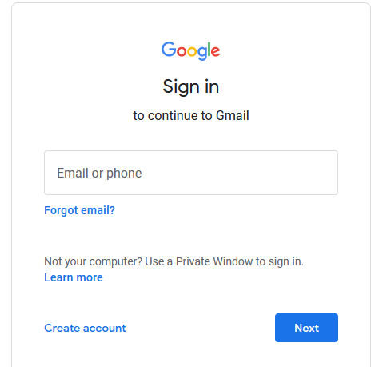
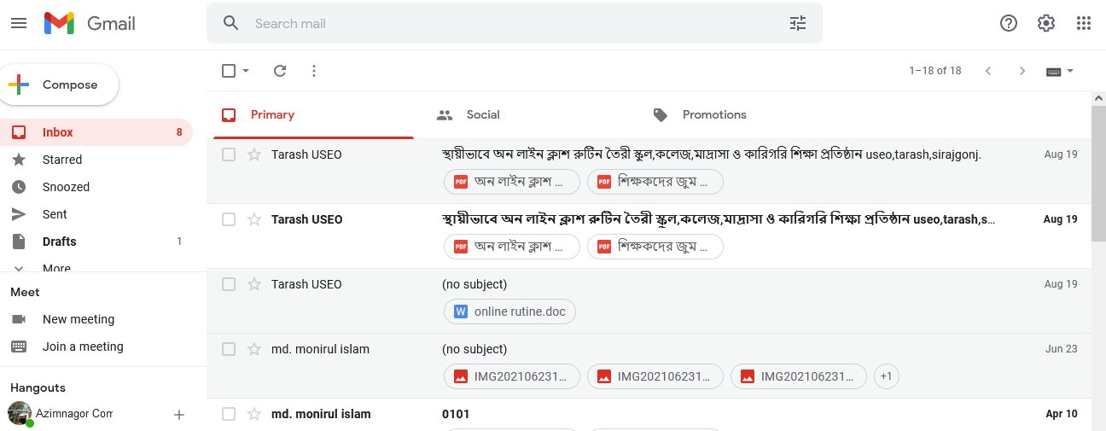
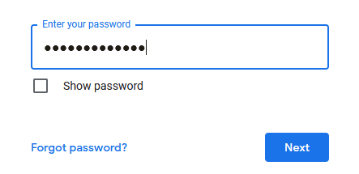
This will open your Gmail inbox.
Write your username or phone number here.
Click,
NEXT button.
Enter your password.
Click,
NEXT button.

Slide 15
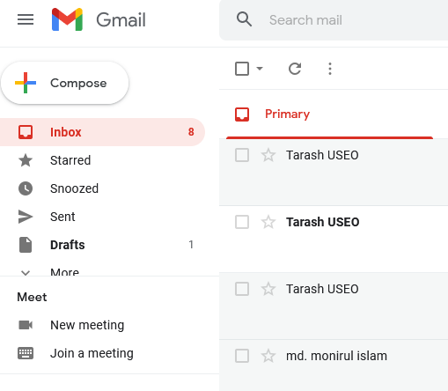
Click ＋ Compose. It's in the upper-left side of your Gmail inbox. Doing so opens a "New Message" window in the lower-right corner of the page.
If you're using the old version of Gmail, you'll click COMPOSE here instead.

Slide 16
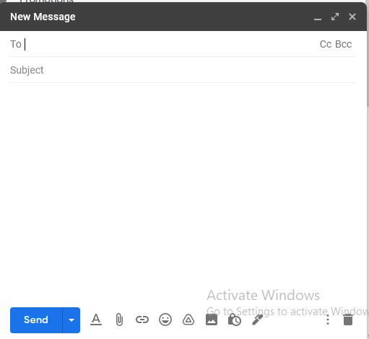
Enter the other person's email address. Click the "To" or "Recipients" text box at the top of the New Message window, then type in the email address of the person to whom you want to send your email
If you want to CC or BCC someone on the email, click either the Cc link or the Bcc link in the far-right side of the "To" text field, then type the email address you want to CC or BCC into the "Cc" or "Bcc" text field, respectively.
To add multiple email addresses, type in the first email address, press Tab ↹, and repeat with the other email addresses.

Slide 17
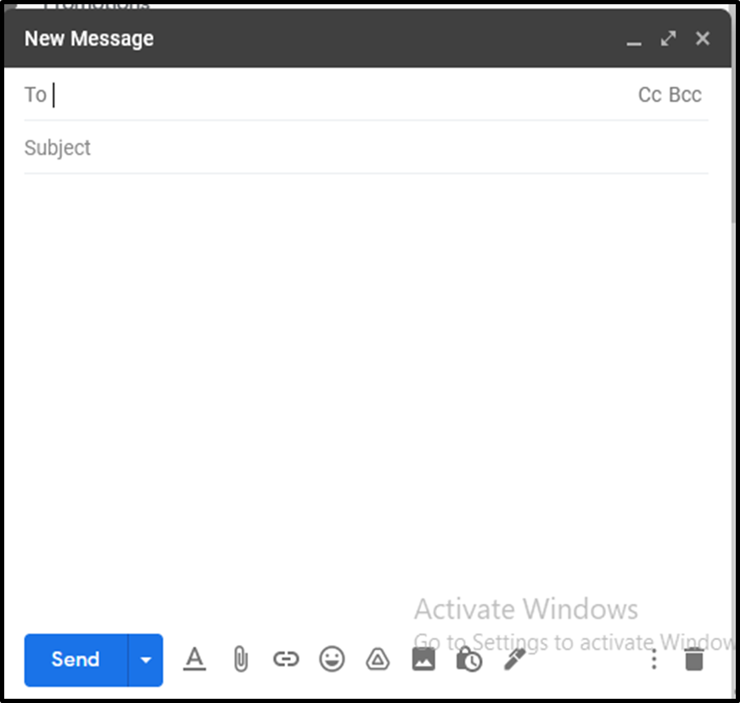
Add a subject. Click the "Subject" text field, then type in whatever you want the subject of the email to be.
Typically speaking, an email subject describes the gist of the email's message in a few words.

Slide 18
Enter your email message. In the large text box below the "Subject" text box, type in whatever you want for your email message.

Slide 19
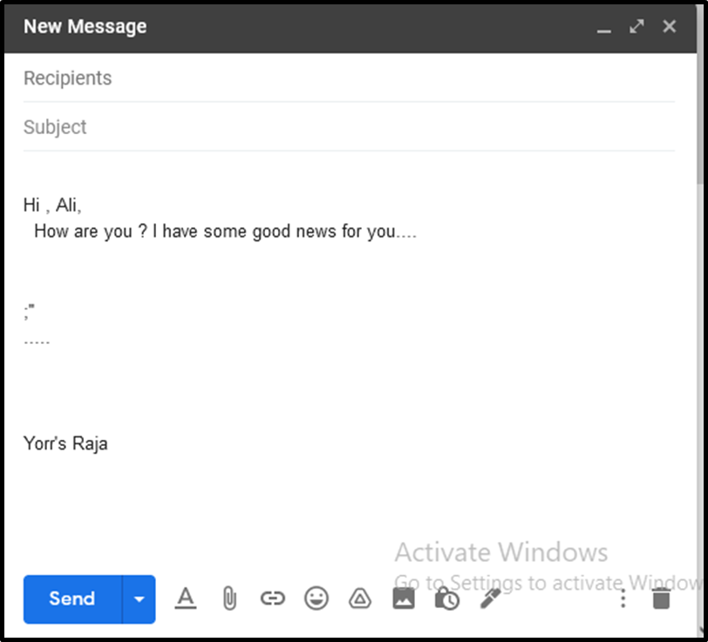
Format your email's text if needed. If you want to apply formatting to your text (e.g., bolding, italics, or bullet points), highlight the text to which you want to apply the formatting, then click one of the formatting options at the bottom of the email window.
For example, to bold a section of text, you would highlight the text and then click B at the bottom of the email.

Slide 20
Attach afile if you like. To add a file from your computer, click the"Attachments"
window, then select the file(s) you want to upload and click Open (or Choose on a Mac).
You can add photos in this way, or you can upload photos directly to the email's body by clicking the "Photos" icon at the bottom of the window, clicking Upload, clicking Choose photos to upload, and selecting photos as needed.

Slide 21
Click Send. It's a blue
button in the bottom-left corner of the email
window. Doing so will
send your email to
the specified email address(es).

Slide 22
Evaluation.
What is e-mails ?
Why e-mails need ?
Where will you write other person's e-mail address?
What will you write “Subject” text field ?

Slide 23
Home work.
Here is my e-mail address monir19077@gmail.com
create your e-mail account and send me a message about your exam preparation.

Slide 24
Thank you very much .

