Slide 1
Welcome

Slide 2
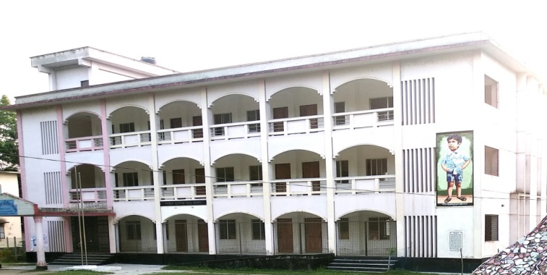
Teacher Identity
Bina karmaker
Assistant Teacher
Govt,Goila model Secodary school
Goila,Agailjhara , Barisal.
Phone--01997593089

Slide 3
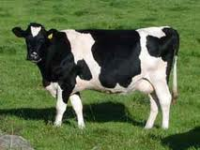
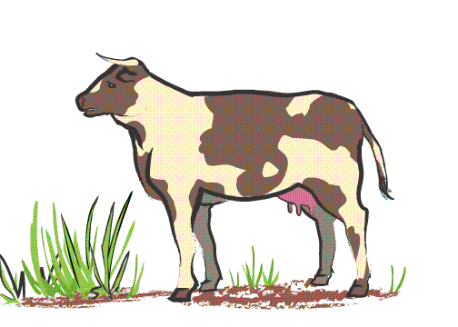
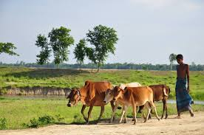
Cow

Slide 4
Class -3
Subject :English
Unseen passage
Cow

Slide 5
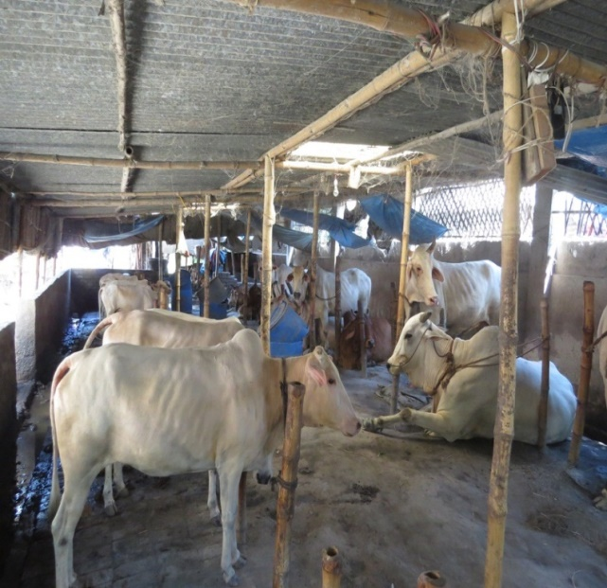
\
The cow is domestic animall.

Slide 6
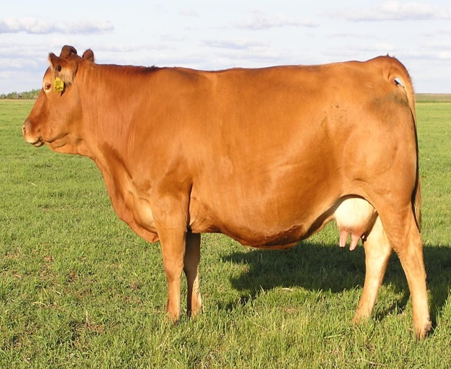
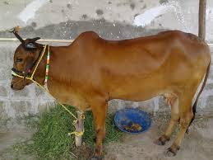
It has four legs,two ears , two eyes, a long tail and two horns.
It’s body is covered with fur.

Slide 7
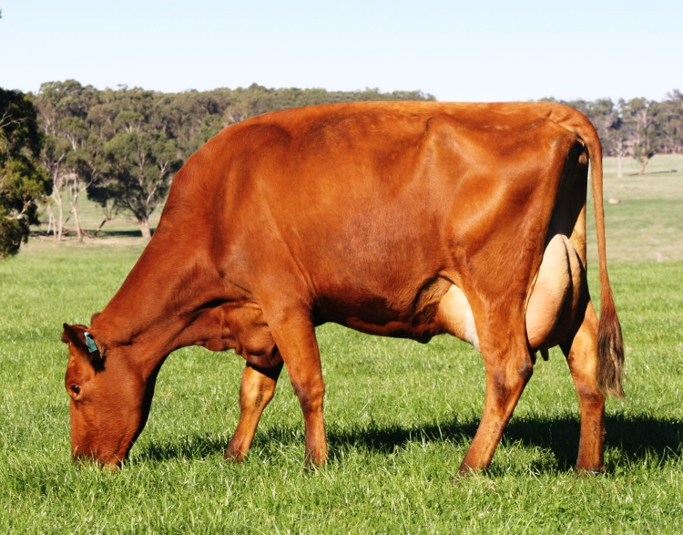
The cow lives on grass

Slide 8
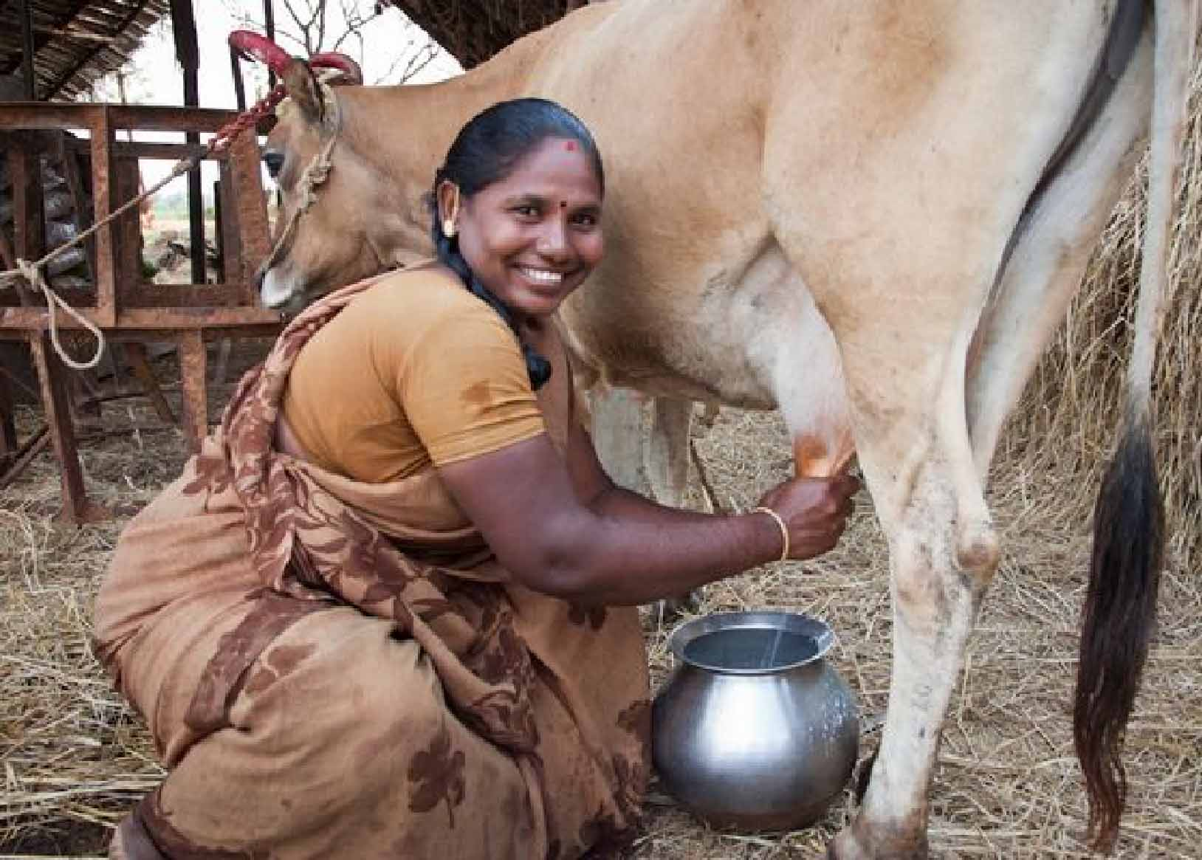
The cow gives us milk.

Slide 9
We drink milk.

Slide 10
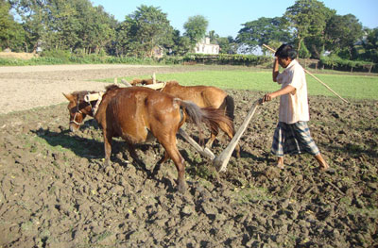
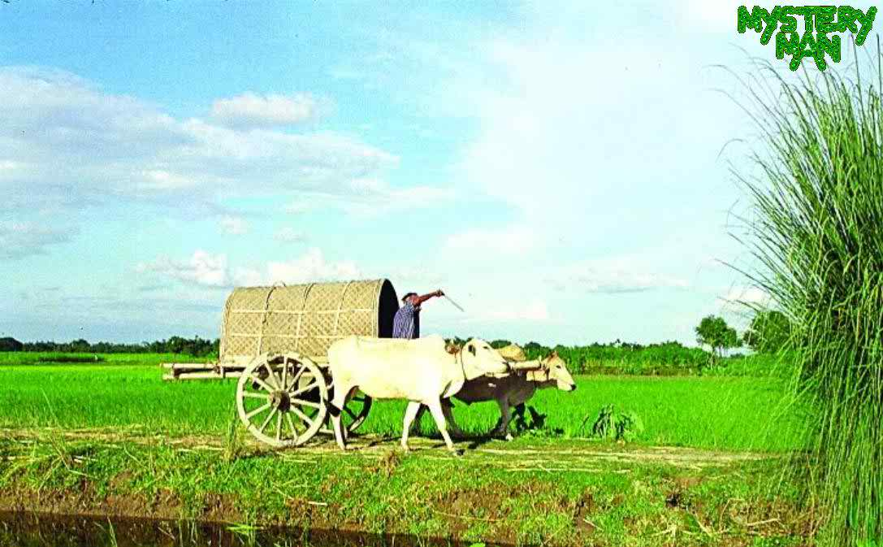
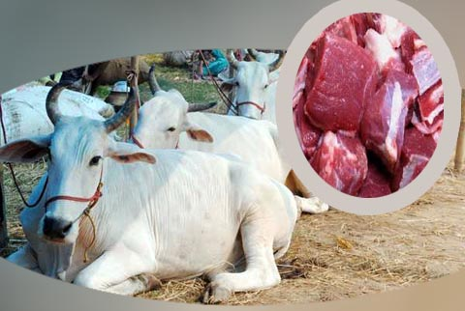
The cow is very useful to us .

Slide 11
The cow is a domestic animal. It has four legs, two ears, two eyes, a long tail and two horns. It’s body is covered with fur. The cow lives on grass. The cow gives us milk. We drink milk. The cow is very useful to us.

Slide 12
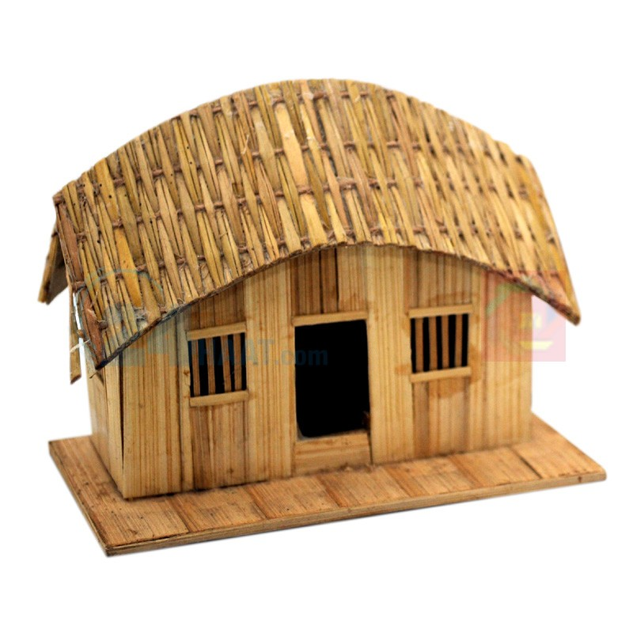
Home work
Write a letter to your friends about”Domestic animal”

Slide 13
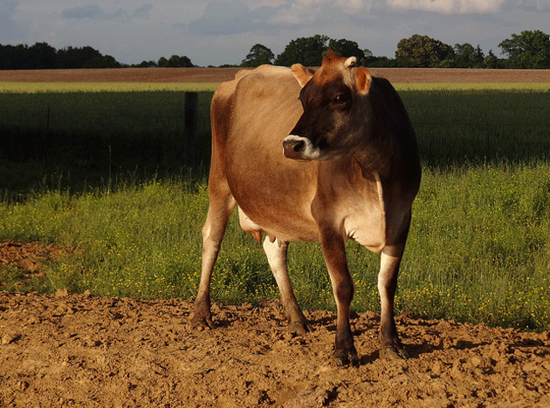
Thankyou

