Slide 2
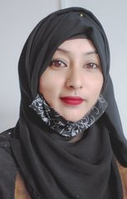
Introduction
Eva khan
Assistant teacher
Tostipur gps
Tongibari,Munshigonj

Slide 3
Introduction of the lesson
Class: five
Unit:09
Lesson:1-2
Lesson Tittle:A (Occupation).
Learning activities-A,
(A long time…..didn’t mind).

Slide 4
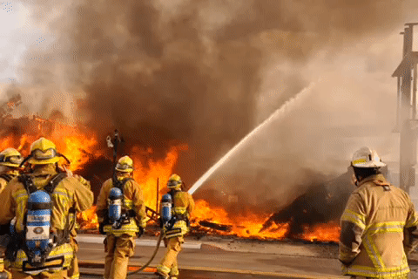
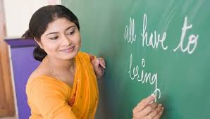
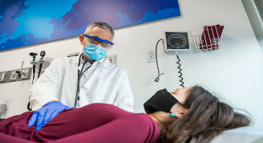
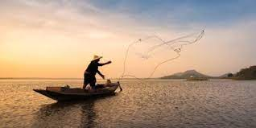
Nurse
Firefighter
Teacher
They are the people different occupations.
Can you guess what’s our today’s topic
Doctor
Fisherman

Slide 5
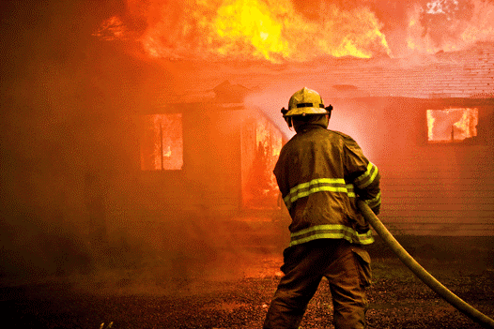
Ok, dear students our today’s lesson is
Occupations.

Slide 6
Learning Outcomes
Students will be able to-
Listening:1.3.1-recognize which words in a sentence are stressed.
Speaking:1.1.1-say words and phrases and sentences with proper sounds and stress.
Reading:1.5.1-read words , phrases and sentences with proper pronunciation , stress and intonation.

Slide 7
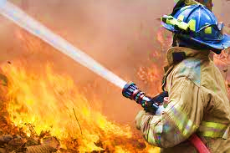
NEW WORDS
Firefighter
A person who puts out fire
Raju is a fire-fighter.

Slide 8
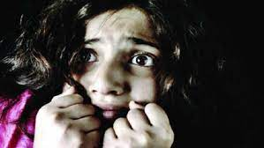
NEW WORDS
Afarid
Fear
I’m afraid of dog.

Slide 9
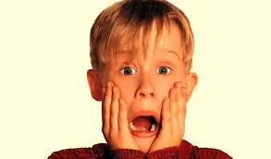
NEW WORDS
Panicked
extreme anxiety
They were panicked.

Slide 10
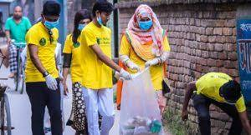
One who works without payment.
NEW WORDS
Volunteer
One who works without payment.
He is a volunteer of fire department.

Slide 11
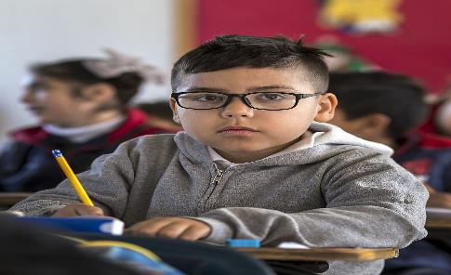
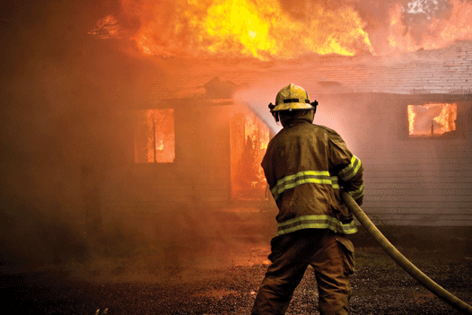
Look at the picture and read the text
A long time ago , when Raju was in class 5 , there was a fire in his school.

Slide 12
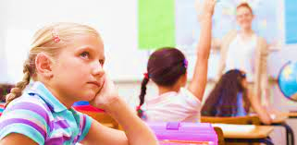
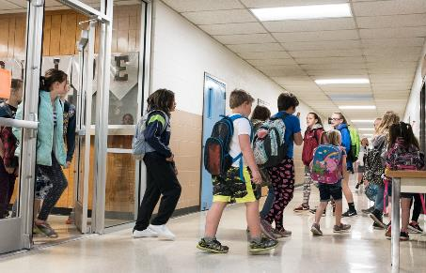
Look at the picture and read the text
Everyone was very afraid, but no one panicked.The teachers helped the students to live the building quietly and safely

Slide 13
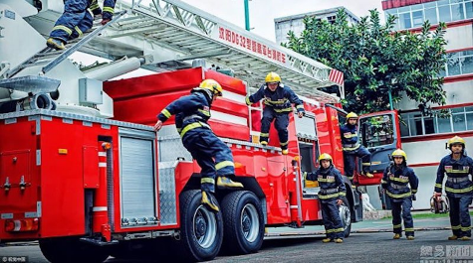
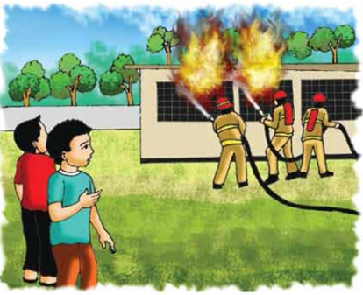
Look at the picture and read the text
Soon the firefighters came and put out the fire. Raju watched the fire fighters from the school yard. He thought about the fire and the firefighters for a long time.

Slide 14
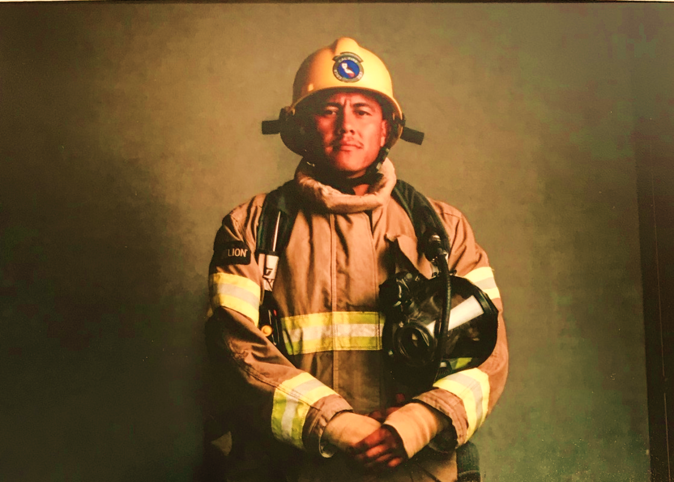
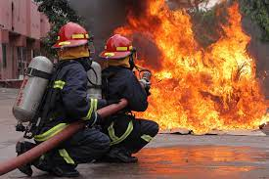
Look at the picture and read the text
After college, Raju joined a volunteer fire department . As a volunteer. He didn’t get money for his work . But Raju didn’t mind.

Slide 15
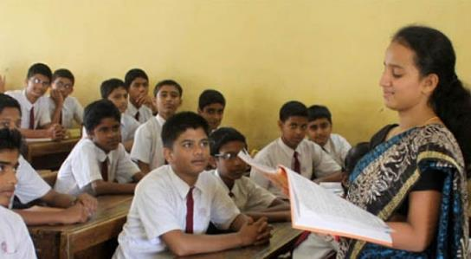
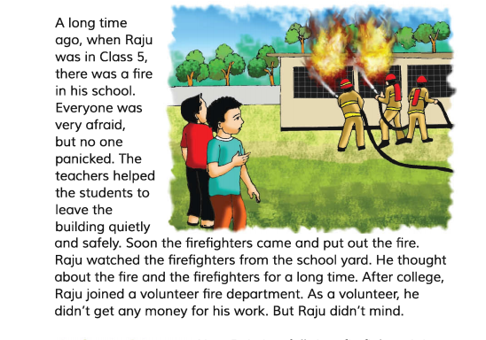
Teacher’s Reading

Slide 16
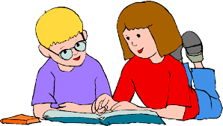
Pair work
````
Read the text in pair.one will read other will listen.

Slide 17
Silent Reading
Everyone open your textbook page at 34

Slide 18
Evaluation
Answers the following questions.
a)What is Raju?
b)Who helped students to leave the building?
c)Who put out the fire?

Slide 19
Group work
Write true/ false.
false
Everyone was panicked.
The students left the building quietly.
The students were afraid to see the firefighters.
Raju joined a volunteer fire department after school.
Now Raju earns money as a full-time firefighters.
true
false
false
true

Slide 20
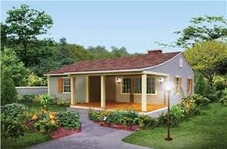
HomeTask
Write five sentences about “A Firefighter”

