Slide 1
WELCOME DEAR MY STUDENTS

Slide 2
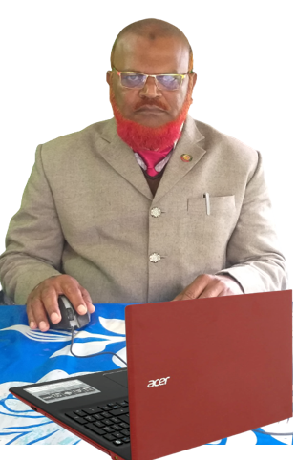
Teacher’s Information
Md. Khalilur rahman
Assistant Teacher
Atgharia High School
Haripur, Thakurgaon.
Class:-VII
English 2nd Paper
Topic:-Verbal
Time-50 minutes

Slide 3
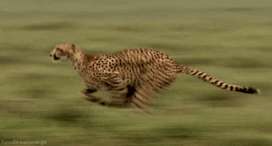
The tiger is _________very fast.
running

Slide 4
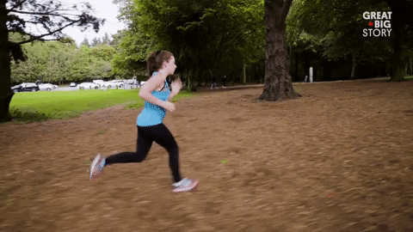
What is this?
It’s a running girl.

Slide 5
Walking in the morning
is good for health.

Slide 6
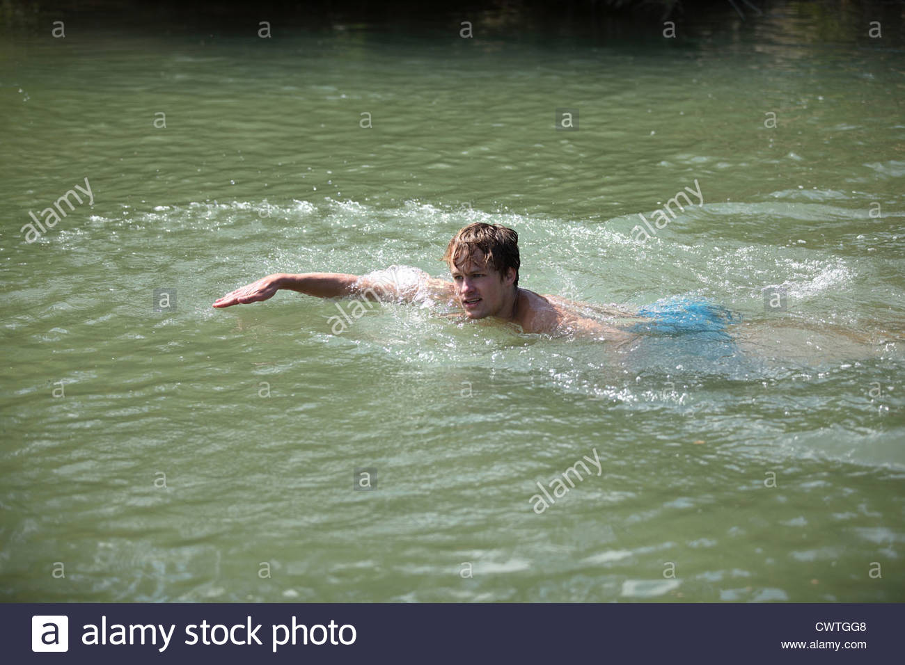
We like to swim in the river.

Slide 7
Today’s Lesson
Verbal
Gerund
Participle
Infinitive

Slide 8
Learning Outcomes:
By the end of the lesson you will be able to
a) Learn about verbal and their uses.
b) Write and speak using verbal.
c) Know the definition of gerund, participle and infinitive.
d) Know the difference between gerund and participle.

Slide 9
So, what is Verbal?
When verb is used in a sentence like noun/adjective/ adverb is called verbal.
It is a singing bird. (Sing+ing) Here Adjective
Walking is good for health. (walk+ing) Noun
The girl came to me laughing.(laugh+ing) Adverb
We like to swim in the river. (t0+swim) Noun

Slide 10
Verbal:-
Gerund
2.Participle
3. Infinitive
Walking
in the morning
is good for health.
This is a broken chair.
To walk in the morning is good for health.

Slide 11
Gerund (Verb + ing = Noun) It is used as Subject/Object/Complement
Swimming is a good exercise.
Subject
I like swimming
Object
My favourite hobby is gardening.
Complement
When verb+ing is used in a sentence like noun is called Gerund.

Slide 12
Participle
Present Participle- Verb+ing=Adjective
Past Participle- Verb+d/ed/t/en/n=Adjective
Perfect Participle-
Having + Past Participle.

Slide 13
Present Participle
This is a running car.

Slide 14
Past participle
This is a broken window.

Slide 15
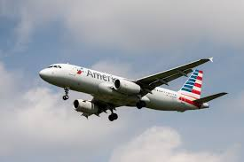
Perfect Participle
Having passed the BA Exam, he went to America.

Slide 16
Pair
work
Make a pair and discuss with your partner about the following questions:
What is gerund?
What is participle?
What is the difference between gerund and participle?

Slide 17
Infinitive
To tell a lie is a great sin.
To+Verb =Noun(Used as a Subject)
I do not like to play cricket.
(Used as object & complement of verb)

Slide 18
Bare Infinitive
The infinitive is used without to after certain verbs like bid, let, make, see, hear, need, dare etc.
I bade him go. (NOT I bade him to go)
Let him sit there. (NOT Let him to sit there.)
She made me cry. (NOT She made me to cry.)
I heard him sing a lovely song. (NOT I heard him to sing a lovely song.)

Slide 19
Evaluation
Fill in the gaps using Gerund/Participle/Infinitive
1. We saw the students-----in the field.
2. -------in the pond is good for health.
3. She is reading carefully -------- fully.

Slide 20
Answer
Playing
2. Swimming
3. To understand

Slide 21
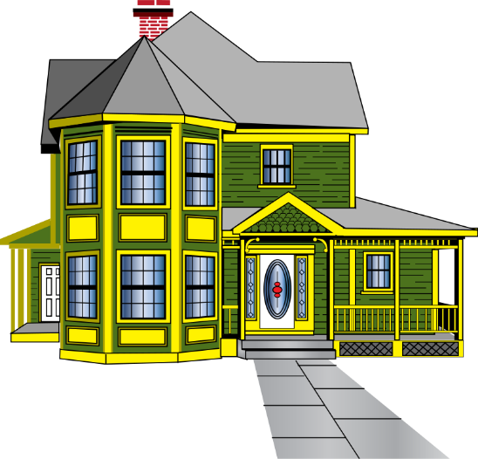
Home Work
Make ten sentences using gerund, participle and infinitive.

